Slide 1
🍳
CodeChef
Cook Smart, Eat Awesome!
AI-powered recipe finder for college hostellers — cook with whatever you've got. No grocery runs. No missing ingredients. Just instant recipes.
College Hackathon Project • Powered by Groq Llama 3.1 AI

Slide 2
Slide 1
The Problem
"Kya banau aaj?" — Every Hosteller, Every Day
Pain Point | Reality
🛒 Recipe sites work backwards | You search a dish, then find you're missing 3 ingredients
🏠 Limited equipment | No oven, sometimes no gas — just a kettle or induction
💸 Tight budgets | Can't run to grocery store for one missing item
🕐 No time | Between classes, assignments, and mess closures
🤷 Decision fatigue | "I have aloo, pyaaz, and bread... now what?"
⚡ 80% of hostel students eat the same 3-4 things on repeat because they don't know what else to make.

Slide 3
Slide 2
Our Solution — CodeChef
An AI recipe generator that works YOUR way — ingredients first, recipes second.
❌ Traditional Recipe Sites:
✅ CodeChef Approach:
1. Search "Paneer Tikka"
2. See ingredient list
3. Missing 5 items 😢
4. Go to store or give up
1. Select: Aloo, Pyaaz, Dahi
2. Set: Kettle + 15 min
3. Get 4 instant recipes! 🎉
4. Cook & eat in minutes
💡 "Type in whatever ingredients you have lying around, and AI instantly gives you recipes you can actually cook — right now, no grocery run needed."

Slide 4
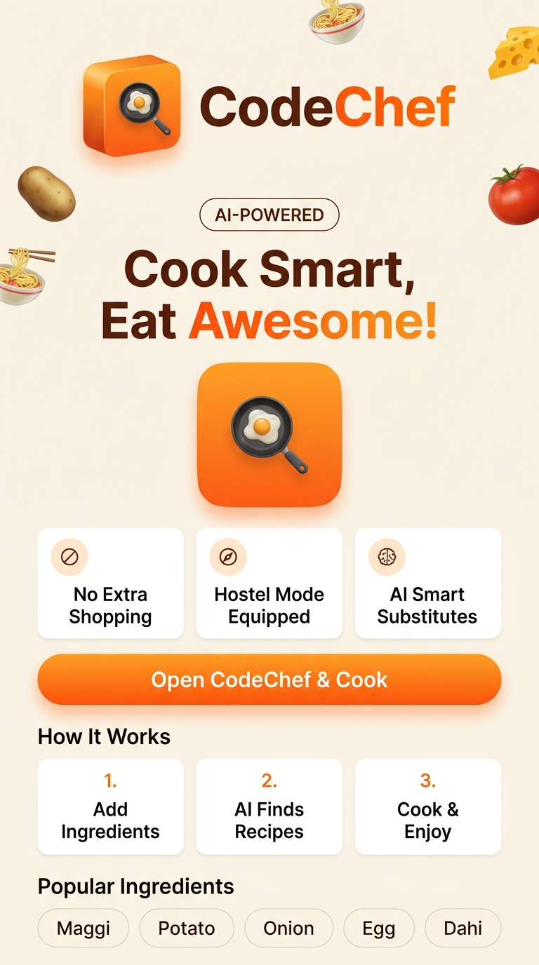
Slide 3
Landing Page — First Impression
Beautiful, mobile-first home screen with micro-animations
Key Design Elements:
🎨 Warm Orange & Cream premium color palette
🪄 Floating food emoji micro-animations
⚡ 3 feature highlight cards — instant value communication
🍳 3D Hero Graphic — strong brand identity
📖 'How It Works' — 3-step visual explainer
🌶️ Glowing CTA Button — 'Open CodeChef & Cook'
⭐ Popular Ingredients quick-select bar

Slide 5
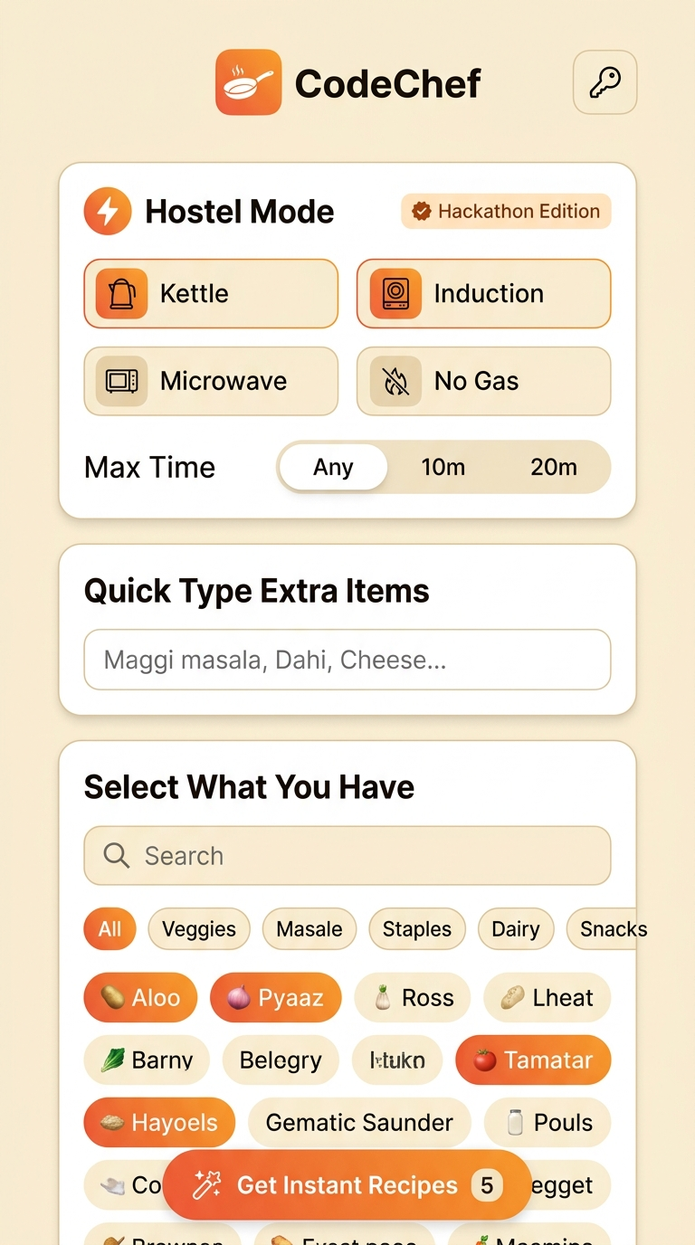
Slide 4
Feature 1 — Smart Ingredient Selection
100+ pre-loaded Indian ingredients with category filters
Feature | Description
🏷️ Category Pills | Veggies, Masale, Staples, Dairy, Hostel Snacks, Fruits
🔍 Real-time Search | Instantly filter from 100+ ingredients
👆 Tap-to-Select | Orange gradient highlight on selected items
✏️ Custom Input | Type any custom ingredient (comma-separated)
🔢 Live Counter | Shows "X selected" in real-time

Slide 6
Slide 5
Feature 2 — Hostel Mode 🏆 (Our USP!)
Equipment constraints + time filters for real hostel life
Equipment Toggles:
🏆 WHY THIS IS UNIQUE
No other recipe app filters by hostel equipment constraints.
A student with ONLY a kettle will get ONLY kettle-friendly recipes.
Time filters ensure recipes fit between classes.
This alone solves the #1 hostel cooking problem.
🫖 Kettle
🍳 Induction
📻 Microwave
⚡ No Gas
⏱️ Max Time Filter: [Any] [⚡10 min] [⏱️20 min]

Slide 7
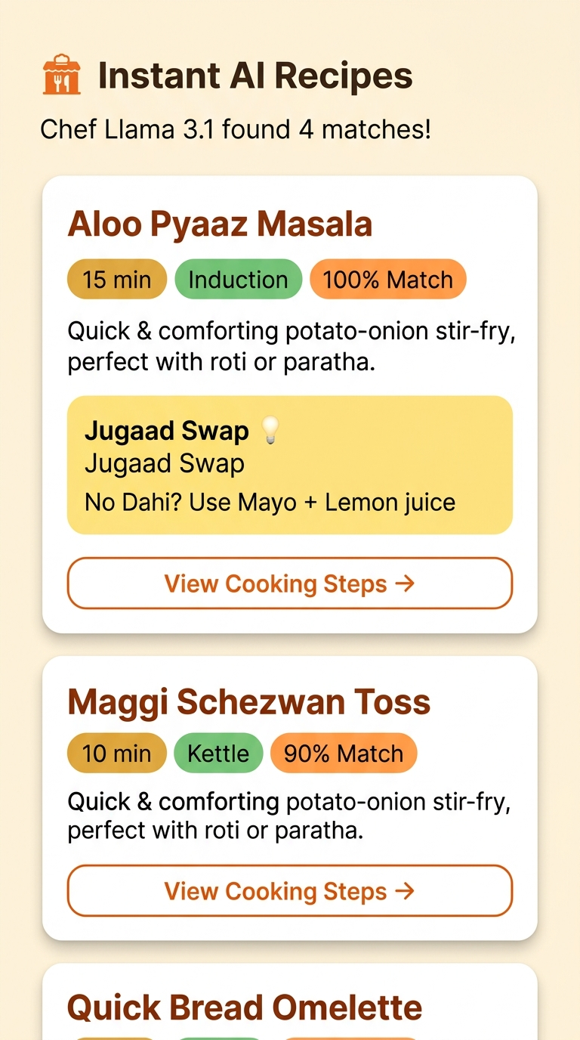
Slide 6
Feature 3 — AI-Powered Recipe Generation
Instant recipes from Groq Llama 3.1 8B in under 3 seconds
Each Recipe Card Includes:
📛 Recipe Name — bold, eye-catching typography
⏱️ Time Tag — "15 min", "10 min" etc.
🔧 Equipment Tag — "Induction", "Kettle"
📊 Match Percentage — "100% Match", "90% Match"
📝 Short Description — taste & style preview
💡 Jugaad Swap Box — desi ingredient alternatives
👉 View Steps — opens full cooking guide

Slide 8
Slide 7
Feature 4 — Jugaad Swaps (Smart Substitutes)
Missing an ingredient? AI gives instant desi jugaad alternatives!
Missing Item | Jugaad Swap | Why It Works
🥛 No Dahi? | Mayo + Lemon juice | Similar tang & creaminess
🧀 No Paneer? | Bread soaked in milk | Similar texture when cooked
🧈 No Butter? | Oil + pinch of salt | Same fat base for cooking
🍅 No Tomato? | Ketchup + water | Same acidity & color
🌿 No Coriander? | Pudina or skip | Similar garnish flavor
🥚 No Eggs? | Besan batter | Similar binding property
💡 Every recipe card has a dedicated yellow Jugaad Box with AI-suggested alternatives — even if you're missing 1-2 items, you can STILL cook!

Slide 9
Slide 8
Feature 5 — Step-by-Step Cooking Guide with Timers
Interactive bottom sheet modal with built-in countdown timers
① Wash and chop potatoes into small cubes
Timer Features:
② Heat oil on induction, add cumin seeds
▶️ Start / Pause controls per step
🔔 Audio alert when timer hits zero
📱 Hands-free — no app switching
🔢 Multiple concurrent timers
💡 Jugaad swaps shown at bottom
⏱️ 2:00 [▶ Start]
③ Add chopped onions, fry until golden brown
④ Add haldi, mirch, salt — cook well
⏱️ 5:00 [▶ Start]
⑤ Add potatoes, cover & cook on medium
⏱️ 10:00 [▶ Start]

Slide 10
Slide 9
Tech Architecture
Simple, fast, serverless architecture — zero hosting costs
📱 User (Mobile Browser)
🌐 Frontend HTML+CSS+JS
⚡ Groq API (Cloud)
🧠 Llama 3.1 8B (LLM)
🍳 Recipe Cards + Steps UI
→
→
→
→
Layer | Technology | Why?
Frontend | HTML5 + CSS3 + Vanilla JS | Zero dependencies, instant load
AI Engine | Groq Cloud API | Fastest inference (~200ms)
LLM Model | Llama 3.1 8B Instant | Optimized for speed & recipes
Styling | Custom CSS Variables | Premium design system
Fonts | Outfit + Plus Jakarta Sans | Modern premium typography
Icons | Remix Icon CDN | Lightweight icon library

Slide 11
Slide 10
AI Prompt Engineering
Carefully crafted prompts for structured, reliable recipe output
The AI prompt is engineered to:
{ "recipes": [
{
"name": "Aloo Pyaaz Masala",
"time": "15 min",
"difficulty": "Easy",
"equipment": ["Induction"],
"matchPercent": 100,
"jugaadSwap": "No dahi?
Use mayo + lemon",
"steps": [
{ "text": "Chop...",
"timerMinutes": 0 }
]
}
]
}
✅ USE ONLY the user's selected ingredients
✅ RESPECT equipment constraints (kettle/induction)
✅ STAY within time limits (10min / 20min)
✅ PROVIDE jugaad swaps for missing items
✅ OUTPUT strict JSON format for UI rendering
✅ GENERATE 3-4 unique, diverse recipes

Slide 12
Slide 11
Design Philosophy
Premium mobile-first UI with micro-animations
Design Element | Implementation
🎨 Color Palette | Orange #FF5722, Rust #3E1305, Cream #FAF5EE
✨ Glassmorphism | Backdrop blur on headers & modals
🎭 Micro-animations | Float, pulse, slide-up, scale-bounce
📱 Mobile-first | 440px max-width viewport simulation
🔤 Typography | Outfit (headings) + Plus Jakarta Sans (body)
🌊 Gradients | Orange-to-rust gradient on CTAs & selections
📐 Border radius | Rounded cards (24px), pill buttons (999px)
🎯 Touch targets | All buttons ≥ 44px for mobile accessibility

Slide 13
Slide 12
User Flow Summary
End-to-end journey from landing to eating
🏠 Landing Page
🍳 Main App
⚡ Set Hostel Mode
🧊 Select Ingredients
✨ Get AI Recipes
📋 View Recipe Cards
👨‍🍳 Cooking Steps
🍽️ Cook & Eat!
→
→
→
→
→
→
→
⏱️ Total time from open to eating: Under 20 minutes!

Slide 14
Slide 13
Competitive Advantage
Why CodeChef wins over existing solutions
Feature | Google | YouTube | Recipe Apps | CodeChef
Ingredient-first | ❌ | ❌ | ⚠️ Partial | ✅ 100%
Hostel equipment filter | ❌ | ❌ | ❌ | ✅ Unique!
Time constraint filter | ❌ | ❌ | ⚠️ | ✅
Jugaad substitutes | ❌ | ❌ | ❌ | ✅ AI-powered
Indian/Desi focused | ⚠️ | ⚠️ | ❌ | ✅ 100% Indian
Step-by-step timers | ❌ | ⚠️ | ⚠️ | ✅ Built-in
No app install | ✅ | ✅ | ❌ | ✅ Web-based

Slide 15
Slide 14
Target Audience
Who benefits most from CodeChef?
Segment | Size | Pain Level
🏫 College Hostellers | ~4 Crore students in India | 🔴 Very High
🏢 PG/Flat Students | ~2 Crore young professionals | 🟠 High
🏠 Working Professionals | Living alone, limited cooking skills | 🟡 Medium
👨‍👩‍👧 Budget Families | Want to reduce food waste | 🟡 Medium
🎯 Primary Target: 18-25 year old Indian college students
Living in hostels, PGs, or shared flats with limited kitchen equipment and tight budgets

Slide 16
Slide 15
Future Roadmap
What's next for CodeChef?
Phase | Feature | Status
v1.0 (Now) | Core ingredient → recipe AI engine | ✅ Done
v1.0 | Hostel Mode equipment filters | ✅ Done
v1.0 | Jugaad smart substitutes | ✅ Done
v1.0 | Step-by-step cooking with timers | ✅ Done
v1.1 | Voice input — 'mere paas aloo hai' | 🔜 Planned
v1.1 | Calorie tracker per recipe | 🔜 Planned
v1.2 | Community recipes — share your jugaad | 🔜 Planned
v2.0 | Photo scan — snap fridge, detect ingredients | 🔜 Planned

Slide 17
Slide 16
🎬 Live Demo Checklist
For the Judges — follow these steps!
Step 1: Open the app → See the beautiful landing page
Step 2: Tap 'Open CodeChef & Cook'
Step 3: Enable Hostel Mode → Select 'Kettle' only
Step 4: Set time to '10 min'
Step 5: Select: Maggi, Cheese, Pyaaz, Schezwan Sauce
Step 6: Tap '✨ Get Instant Recipes'
Step 7: See 3-4 AI recipes (all kettle-friendly!)
Step 8: Tap 'View Cooking Steps' on any recipe
Step 9: Start a timer in the cooking steps
Step 10: Notice the Jugaad Swap suggestions 💡

Slide 18
🏆 Key Takeaway for Judges
"CodeChef flips the recipe search model — instead of 'what dish do I want?', it answers 'what can I make with what I HAVE?' — and it does it in under 3 seconds with AI."
🏠
Hostel Mode
The ONLY recipe tool that filters by hostel equipment
💡
Jugaad Swaps
AI suggests desi alternatives for missing ingredients
⚡
Instant & Free
No backend, no install, no cost — runs in the browser
Thank you! 🙏 Questions? Let's cook something live! 🍳

