Slide 1

Bitcoin Stock investment automation

Slide 2
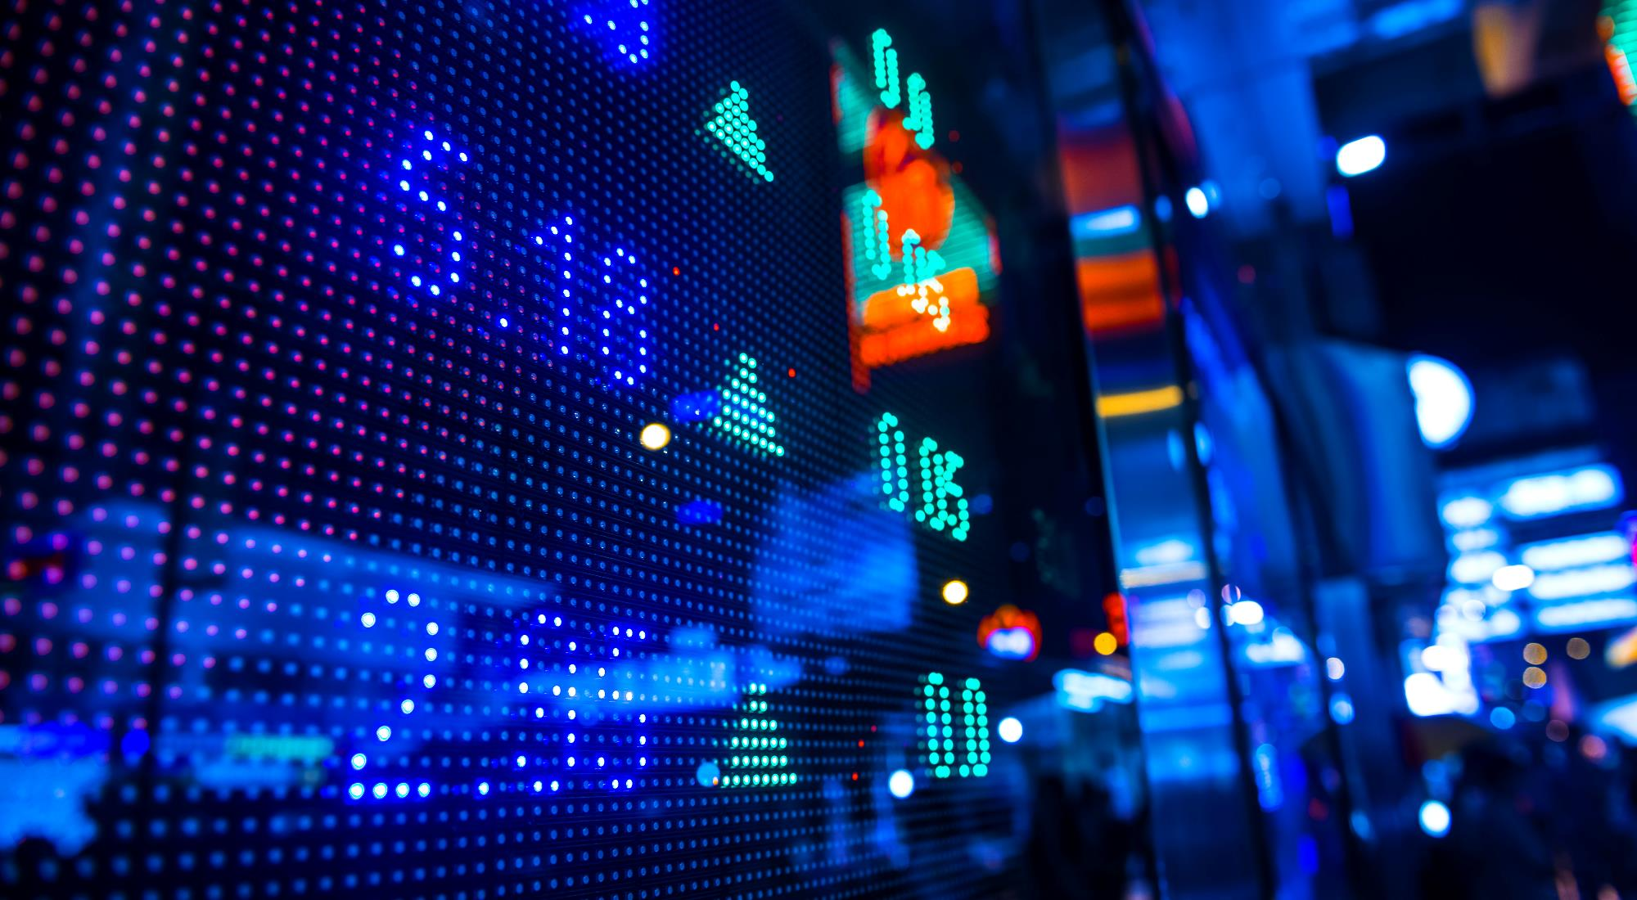
Under the guidance of
Prof. Jagannath Singh

Slide 3
Project Abstract
The project is a software based on Python-Tkinter UI framework. The user has full control to either – automate or not. If the client selects the automated process, ML algorithms take care of the rest, otherwise it is done normally on a hand-to-hand interaction basis.
For UX, the software uses Matplotlib-Live graphs to help the client visualise the flow of his liquid capital and see various economic aspects of his/her investments.
The objective was to design a software to automate the stock-investment process in a way which is most profitable to the client.

Slide 4






THE PROBLEM STATEMENT
Market Instability
Financial
Trust
Cost Control
Margins Coverage
The market is as usually unstable and any one who is new to stock investment has to has cover a lot of ground.
Be it an investment veteran or a rookie, both prioritize their financial amenities.
There was a need of a robust system which they can trust their money to.
Such a system ought to be semi-automated at its bare minimum but could be fully automated on demand.
There should be a provision of proper report generation, bookkeeping and monetary visualization.

Slide 5
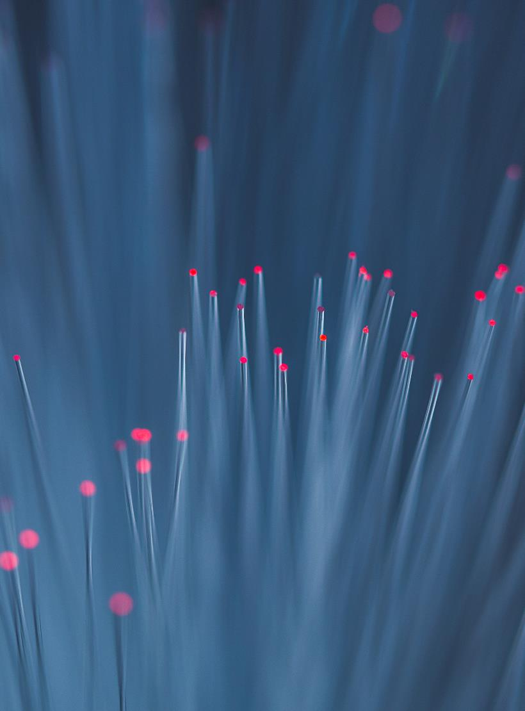


Solution = b-sia
Prioritize
Authorize
Automate
The client’s welfare was to prioritized and their bookkeeping modules was secured foremost.
The threshold investment amount was well within the client’s reach as he/she has full control of their bitcoin wallet.
The system should not only give valuable suggestion, advising on perfect time of investment and withdrawal, it should automate this process if required.

Slide 6

PROJECT PLANNING
Questionnaire For Requirement Analysis
What are the common problems faced by rookie investors as well as veterans?
How do we aim to solve the problem?
Who are the end-users?
What are the extra features to be included?
What has the admin rights?
What are the privacy and features to be provided to each type of user?
Do you need the plug-in of social media (Facebook, Google+, LinkedIn, etc.) for registration and log in?
What type of system you have and its configuration also? How to manage their account?
How to smoothen their user experience?
How to provide the abstracted information needed as per the situation?
How many backups do you need to keep for future reference, if any?

Slide 7
SYSTEM REQUIREMENTS
To run this application we need different types of software and tools such as:
Python >=3.7.1
Tensorflow, Keras, Theano
Tkinter
Centralized Database accessible to Admin

Slide 8
FUNCTIONAL REQUIREMENTS
R1: Registration
R1.1: Registration as an Admin
  Description: A person registers himself into the system as an Admin in order to access the background details of the software and make necessary modifications and updates to it.
  Input: Personal details such as Name, Email address, Admin ID and Password.
  Output: Admin Registration Successful

Slide 9
FUNCTIONAL REQUIREMENTS
R1.2: Registration as a Investor
R1.2.1: Registration as Experienced Stock Investor
Description: A person register into the system as a Investor and submits his personal details and account information.
Input: Personal details such as Name, Contact no, Email address, Investor ID, Bitcoin Account Information and Password.
Output: Investor Registration + SIA Wallet Information + Report Generation Key

Slide 10
FUNCTIONAL REQUIREMENTS
R1.2: Registration as a Investor
R1.2.1: Registration as Inexperienced Stock Investor
Description: A person register into the system as a Investor and submits his personal details and account information.
Input: Personal details such as Name, Contact no, Email address, Investor ID, Bitcoin Account Information and Password.
Output: Investor Registration + SIA Wallet Information + Report Generation Key

Slide 11
FUNCTIONAL REQUIREMENTS
R2: Login
R2.1: Login as Admin
  Description: An Admin can validate the transactions, update the UI, change priority and access privileges or review feedback.
  Input: Admin ID and Password.
  Output: Admin Control Panel
R2.1.1 Transaction Validation
Description : An Admin can validate any fraudulent transactions detected by FRAUD DETECTION SYSTEM (FDS)
Input : Detected transaction
Output : Transaction is reverted.

Slide 12
FUNCTIONAL REQUIREMENTS
R2.1.2 Updating of UIs
Description : An Admin can change interactivity of UI.
Input : Additional Tk-code
Output : UIs are changed.
R2.1.3 Priority Amendment
Description : An Admin can change the priority of any fraudulent account reported by FDS.
Input : Detected account ID.
Output : Net transactions could be reverted, account can be de-prioritized, wallet can be removed and account can be reprimanded back to the user, depending on the veracity of the user.
R2.1.3 Feedback Reviewing
Description : An Admin can review feedback form the users.

Slide 13
FUNCTIONAL REQUIREMENTS
R2.2: Login as a Investor
R2.2.1: Login as Experienced/Inexperienced Stock Investor
Description: A person logs into the system and uses software capabilities.
Input: Investor ID and Password.
Output: Investor Login + User Panel
R2.2.1.1 Wallet Login
Description : An investor can log in his wallet and view his previous and ongoing transactions.
Input : Wallet Login Code
Output : Wallet StartUI

Slide 14
FUNCTIONAL REQUIREMENTS
R2.2.1.2 Plot Viewing
Description : He can view the ongoing up/downs in his selected stocks
Input : Stock Ticker.
Output : Stock graphs in Matplotlib.
R2.2.1.3 Report Generation
Description : He/she can report of his/her transactions.
Input : Selected dates on the calendar.
Output : Appropriate Report.
R2.2.1.4 Threshold Choice
Description : He/she can choose his/her transaction threshold (₿).
Input : Select the value ₿.
Output : The value ₿ is sent for transaction in transit.

Slide 15
NON - FUNCTIONAL REQUIREMENTS
Safety Requirements:
System has to check :
If Python- frameworks and libraries are fully updated
If the Login and Registration is properly working.
If Constraints are there during registraition.
Mandatory Fields do not remain empty.
Security Requirements:
For security of the system the technique known as database replication should be used so that all important data is kept safe. In case of crash, the system should be able to back up and recover data.
Also Fraud Detection System is to be incorporated.
Software Quality Attributes:
The system will have a simple and user-friendly graphical interface. Users will be able to understand and use all the features of the website easily. Any action will be performed with just a few click.

Slide 16

Thank You
Akanksha , Aditya
1605006, 1605004

