Slide 1
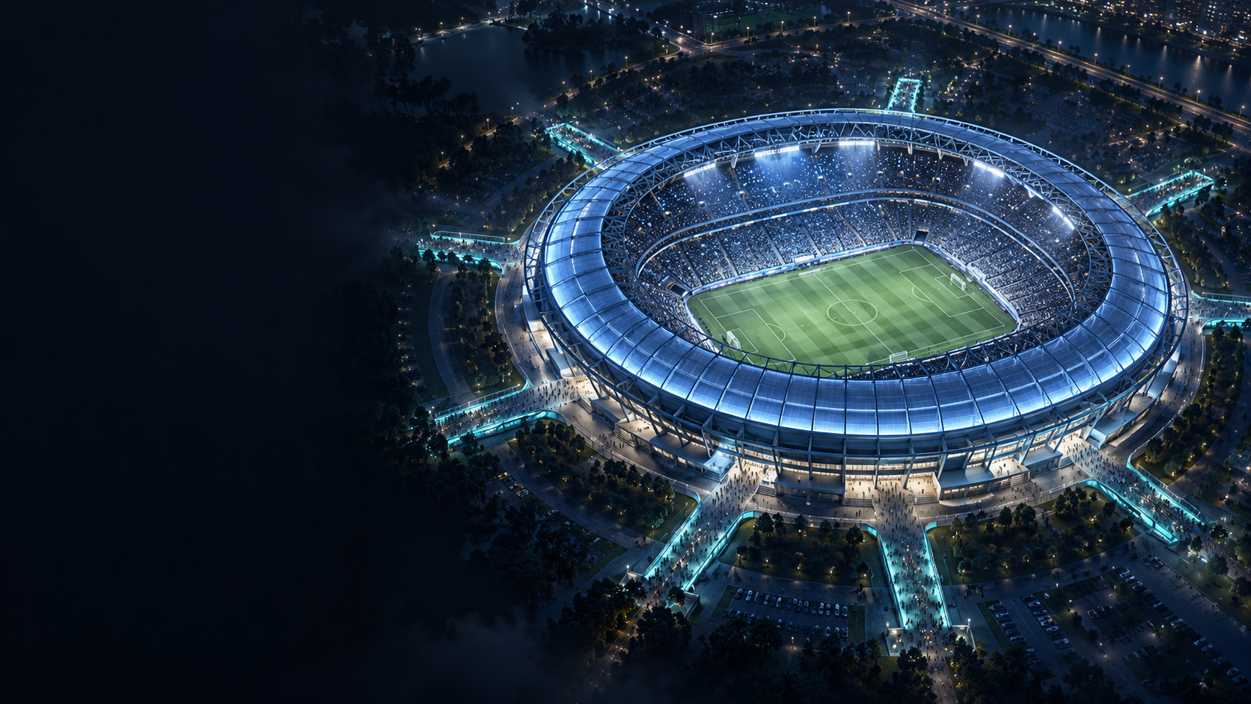
NorthStar
Real-time evacuation intelligence
for crowds and critical facilities
TEAM NORTHSTAR
01
Notes:
Opening, about 25 seconds. NorthStar is our venture brand. CrowdGuardian is the name still visible in the running prototype. When thousands of people leave at once, the shortest route can become the slowest. We help operators understand pressure and available capacity so they can make a better evacuation decision. The deck presents the completed-system vision, with actual current-prototype captures on slide 6. Stadium cover: AI-generated fictional architectural concept, not an actual venue. No commercial traction or validated safety claim is asserted.
Background provenance: built-in image generation, fictional stadium. Prompt: premium cinematic 16:9 aerial fictional oval stadium at dusk, right-side composition, navy and ice-blue lighting, subtle teal exit paths, dark left negative space, no words or UI. Saved as tmp/pitch-build/assets/stadium-concept.png and embedded into the presentation.

Slide 2
WHY NORTHSTAR
A blocked exit changes everything
4,000
Civilian safety
Stadium dispersal, public events
and transport interchanges
people. Eight exits.
Uneven information.
Defense & security readiness
Facility evacuation, assembly points
and continuity during disruption
Operators need to see rising pressure
and adapt when a route fails.
02
Notes:
Why we built it, about 35 seconds. Crowds often concentrate at familiar exits. A closure changes capacity immediately, while operators still need time to understand the consequence. Crisis mitigation means identifying growing pressure, practicing disruptions, and adapting available routes. Dual use here means civilian and defense/security applications. Defense use is protective: evacuation, assembly, and continuity at installations or restricted campuses. The same capacity-and-routing problem appears in both domains. The 4,000 population and eight exits come from shared/stadium-config.json.
Context source: UNDRR, What is the Sendai Framework for Disaster Risk Reduction? Its priorities include understanding disaster risk and preparedness for effective response. https://www.undrr.org/implementing-sendai-framework/what-sendai-framework . Reviewed 17 October 2026. NorthStar's dual-use positioning is the team's proposed product strategy.

Slide 3
SCENARIOS AND FAILURE POINTS
One stadium. Two operating conditions
01 Post-event departure
02 Earthquake response drill
G
G
H
H
F
F
4,000
A
4,000
A
E
PEOPLE
E
PEOPLE
B
B
D
D
C
C
Demand clusters at familiar gates
Blocked exits shift queues elsewhere
25%
less nominal exit capacity when 2 of 8 equal-capacity gates close
03
Notes:
Scenario diagrams, about 40 seconds. The first scenario is ordinary dispersal after an event. All exits exist but people can cluster unevenly. The second scenario represents selected gates becoming unavailable after an earthquake. We simulate route availability, not structural damage or seismic physics. The diagram closes B and D as an illustrative two-gate case. The actual demonstration later closes B, C, and D. Capacity calculation: each shared model gate is 90 people per simulated minute; eight gates total 720 and six total 540. Loss = (720-540)/720 = 25%. This is nominal model capacity, not a measured real-world evacuation performance estimate. Sources: shared/stadium-config.json and PROJECT_CONTEXT.md.

Slide 4
PROPOSED SOLUTION
A shared view. An explainable next action
Completed-system vision
1
2
3
4
5
Observe
Detect
Forecast
Evaluate
Reassign
People and
available routes
Persistent
gate pressure
Near-term
queue growth
Compare feasible
interventions
Execute approved
route changes
Commercial entry
Paid venue pilot, then annual site software and calibration services
04
Notes:
Solution and business model, about 35 seconds. In the completed architecture, NorthStar continuously updates the venue state, detects pressure, predicts demand and compares feasible interventions. Operators retain control of gate availability and intervention policy. Routing changes have reasons and feedback. Our proposed commercial entry is a paid venue validation pilot, followed by an annual site subscription and layout/calibration onboarding. This is a proposed model, not existing revenue. Current implementation already supports physical-path movement, live Python detection and deterministic routing in the browser. Forecast-to-live integration and actual counterfactual rollouts remain planned. Sources: README.md, PROJECT_CONTEXT.md, backend/app/forecasting/baseline.py.

Slide 5
ARCHITECTURE AND STACK
The technical decision loop
Target architecture: Python owns decisions. React executes and visualizes them.
Stadium twin
Python engine
Operator
React + TypeScript
Typed operator controls
Person telemetry + gate state
Three.js + R3F
Validate, detect, forecast, score
Interactive spatial twin
Risk + recommended action
FastAPI + WebSockets
Continuous data exchange
Approve intervention / policy
Deterministic algorithms
Changed person-to-gate assignments
Inspectable decisions
Shared venue geometry
Consistent routing and detection
Movement updates the next telemetry snapshot
05
Notes:
Technical solution, about 50 seconds. Read the sequence from top to bottom. The stadium twin reports active/exited identities and movement; a complete target contract also includes gate state. Python validates the batch, detects persistent pressure, forecasts and evaluates alternatives. The operator reviews intervention choices or sets an authorized routing policy. The backend returns changed assignments and the frontend moves and displays people. React and TypeScript support the existing operator UI. Three.js and React Three Fiber render the 3D stadium. FastAPI and WebSockets already carry the person stream and detector responses. Deterministic route scoring does not require ML. Shared geometry prevents divergent gate definitions. Target boundary: routing is still browser-owned today, and live forecasting/rollouts are planned. Sources: frontend/package.json; backend/pyproject.toml; README.md; shared/stadium-config.json. Animation: diagram messages appear in chronological order.

Slide 6
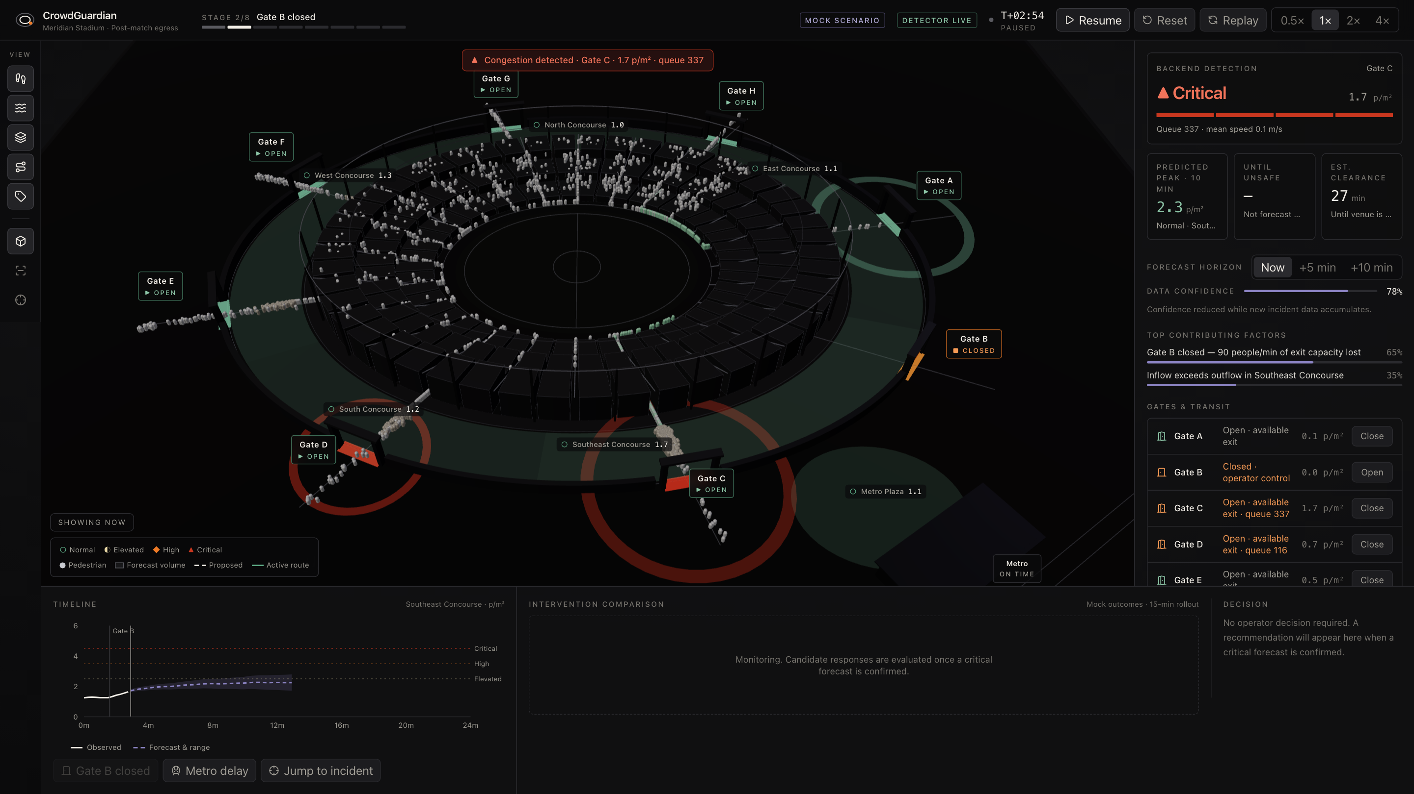
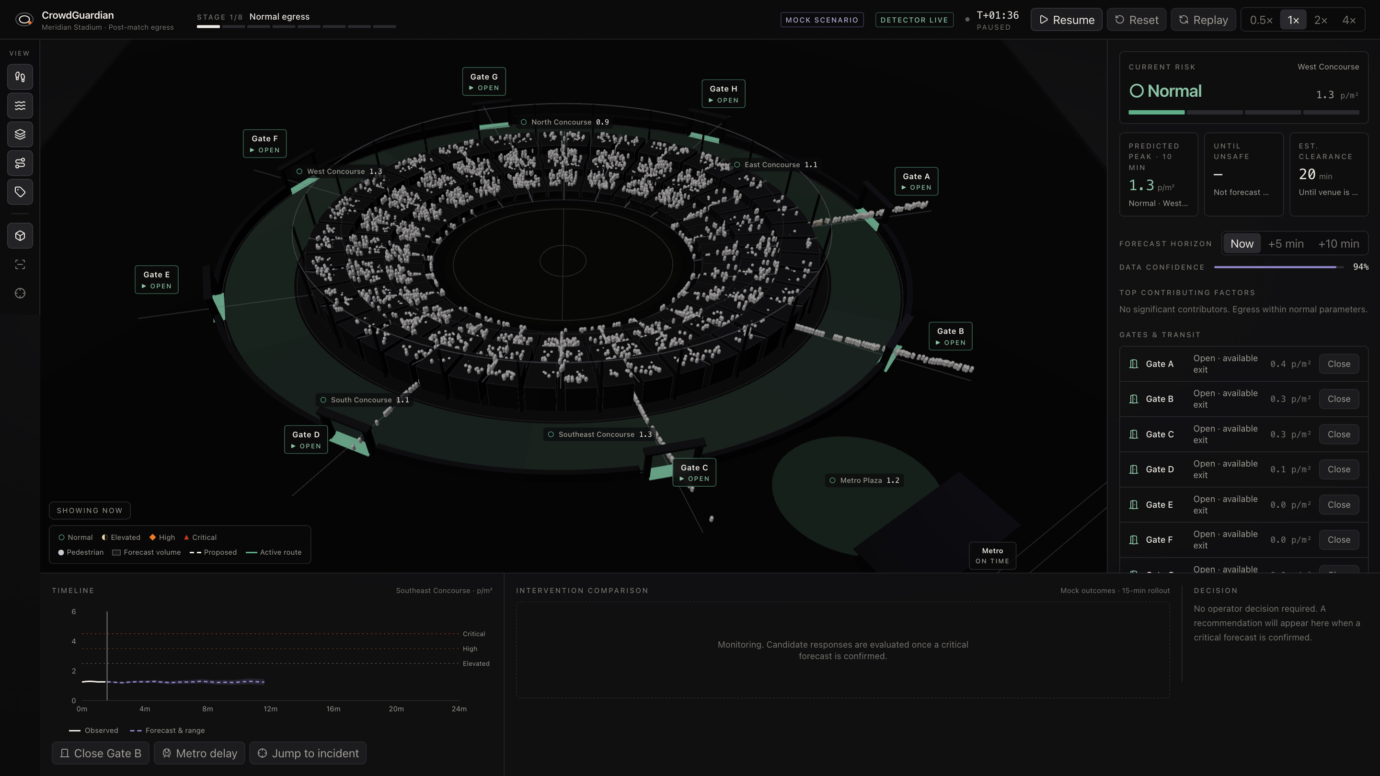
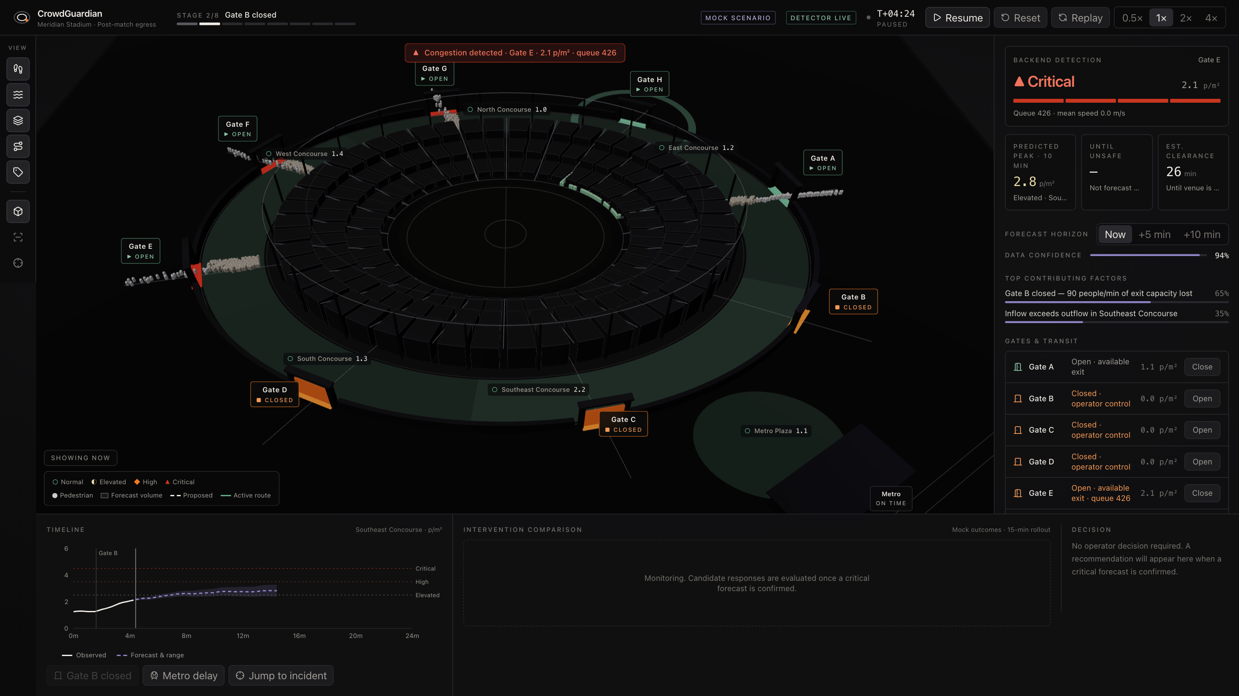
REAL PROTOTYPE DEMO
The stadium responds to a changing layout
Click the stadium to play the recorded demo
01 Normal departure
4,000 people use eight exits.
01 ALL OPEN
03 B / C / D CLOSED
02 Gate B closes
Python flags Gate C:
337 queued, 0.10 m/s.
03 B, C and D close
Demand shifts to other gates.
06
Actual app captures. Forecast and recommendation panels still use demonstration data.
Notes:
Demo, about 60 seconds plus optional playback. These images are unaltered captures of the app running against the actual Python backend on 17 October 2026. No fake WebSocket responses were injected. Screenshot 02 is all-open at 96 simulated seconds, with 59 exited. Screenshot 03 shows Gate B closed and a backend Gate C queue of 337, density about 1.73 people/m² and mean speed about 0.10m/s at 174 simulated seconds. Screenshot 05 closes B, C and D, with queues E/F/G = 426/215/207 at 266.9 simulated seconds, and 1,854 exited. Actual capture received 27 Python replies with zero browser page errors. Movement rerouting currently runs in the frontend. Forecast curves and recommendation comparisons remain demonstration values and are not performance evidence. Raw capture provenance: tmp/pitch-build/assets/demo-provenance.json. If the embedded clip is present, click the large screenshot to play the recorded live run.

Slide 7
HACKATHON TWISTS
A government pathway. A global product
01 Funding pathway
02 Global deployment
NSF America’s Seed Fund
California stadium
Shanghai campus
Indian event venue
Up to $305k for Phase I feasibility R&D.
Project Pitch before full proposal.
AFWERX SBIR/STTR
Same engine. Local map, signage,
language, rules and field validation.
Topic-aligned prototype contracts
for defense installation resilience.
Proposed U.S. pathways, subject to eligibility and matching topics. No awards or partnerships secured.
07
Notes:
Government pathway and globalization, about 45 seconds. NSF America’s Seed Fund is the proposed early R&D route: Phase I up to $305,000, subject to a successful Project Pitch invitation and competitive full proposal. U.S. small-business size, ownership, PI employment and work-location rules apply; this team’s eligibility has not been established. AFWERX SBIR/STTR is the proposed defense route: identify an installation-resilience customer and a suitable announced topic, then compete for a prototype contract. No specific open evacuation topic has been verified. NSF funds R&D rather than purchasing the product. AFWERX Phase III adoption uses non-SBIR government or private funding. Internationally, reuse the engine while configuring local site maps, signage, languages, access rules, data handling and approved operating procedures. California, Shanghai and India are proposed applications, not current customers.
Official sources, reviewed 17 October 2026: NSF 26-510, Small Business Innovation Research / Small Business Technology Transfer: https://www.nsf.gov/funding/opportunities/small-business-innovation-research-small-business-technology . This page lists Phase I grants up to $305,000 and Phase II fixed-amount cooperative agreements up to $1,250,000. Project Pitch and eligibility: https://seedfund.nsf.gov/solicitation-eligibility/ . AFWERX Get Funded: https://afwerx.com/get-funded/ . AFWERX describes U.S. for-profit small-business eligibility, majority qualifying U.S. ownership/control, and topic-based DAF feasibility/prototype contracts. No evacuation-specific open topic or NorthStar eligibility has been established. No award or agency partnership is claimed. Global adaptation examples are proposed, not deployed.

Slide 8
FUTURE SENSING AND PILOT GOALS
From simulated people to measured movement
Cameras, LiDAR
and turnstiles
Anonymous counts
and calibrated tracks
Live venue
state
OpenCV for calibration and image processing
Detection + tracking for visible people. Density estimation for occluded crowds.
PILOT TARGET
PILOT TARGET
15%
20%
less clearance time
lower peak queue
Unmeasured pilot targets against a fixed nearest-open-gate baseline across repeated runs.
08
Notes:
Future scope, about 40 seconds. OpenCV supports calibration and image processing; trained detectors or density estimators supply crowd measurements. A deployed pipeline needs detection and tracking when individuals are visible, or density estimation under heavy occlusion. LiDAR and turnstile counts could supplement vision. Convert observations to calibrated ground-plane measurements without requiring identity recognition. Validate accuracy at each site under lighting changes, occlusion and camera overlap. The displayed 15% reduction in full clearance time and 20% reduction in peak queue are proposed pilot hypotheses, not measured or promised outcomes. Evaluate repeated runs against the same fixed nearest-open-gate baseline and report additional walking and failures. A hypothetical 20-minute baseline with 15% improvement saves 3 minutes, but no measured baseline exists yet.
Official technical sources, reviewed 17 October 2026: OpenCV YOLO DNN inference tutorial, https://docs.opencv.org/4.13.0/da/d9d/tutorial_dnn_yolo.html ; OpenCV camera calibration and 3D reconstruction documentation, https://docs.opencv.org/4.13.0/d9/d0c/group__calib3d.html . Density-estimation example: Li, Zhang and Chen, CSRNet, CVPR 2018, https://openaccess.thecvf.com/content_cvpr_2018/html/Li_CSRNet_Dilated_Convolutional_CVPR_2018_paper.html . The camera/LiDAR/turnstile architecture is a proposed system design. Pilot targets are author-selected hypotheses, not values claimed by these sources or achieved by NorthStar.

Slide 9
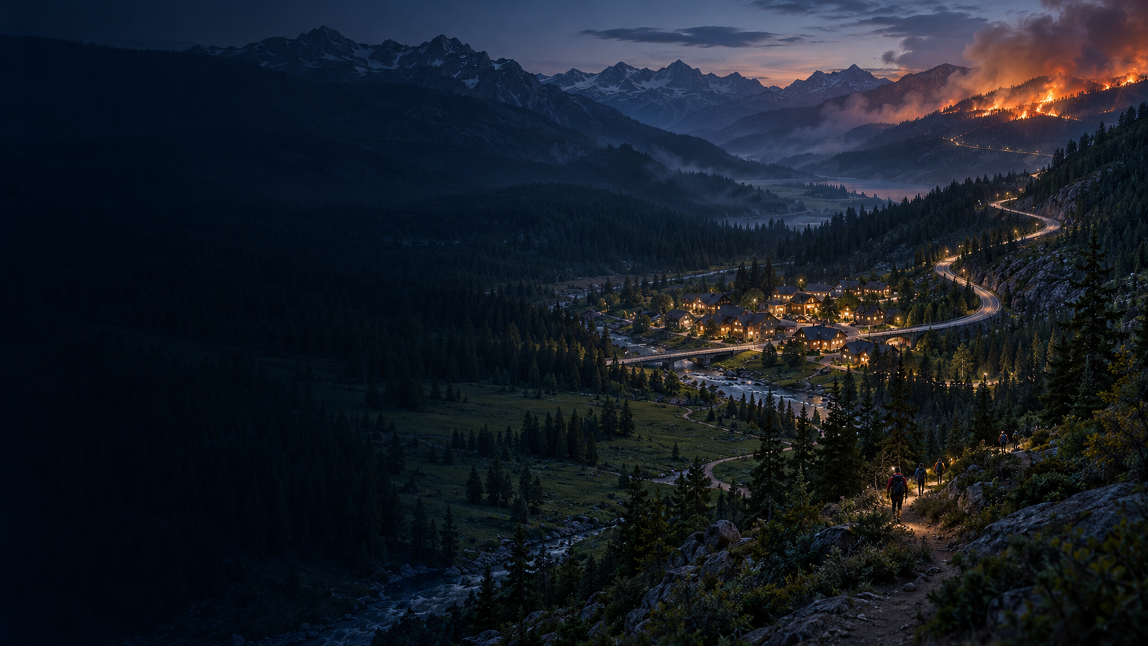
DUAL USE AND EXPANSION
The route network changes.
The decision loop carries over
Civilian wildfire evacuation
Road closures, mountain trails
and authority-provided hazard zones
Defense & security facilities
Restricted routes, assembly points
and evacuation under disruption
Future applications require domain-specific models and field validation.
09
Notes:
Dual use and future domains, about 35 seconds. For wildfire, the model would combine authoritative hazard feeds with road availability, vehicle capacities and mountain-trail constraints. It supports exposure reduction and evacuation. It does not prevent ignition or independently certify a route safe. Road and pedestrian movement need different capacity and travel models. For defense and security facilities, the same decision loop can use restricted access, protected assembly areas, damaged exits and local command policy. This is a protective, non-weapon application. Every new domain requires calibration and validation. Wildfire background is AI-generated fictional concept art, not a real fire or a screenshot of an implemented wildfire simulator.
Background provenance: built-in image generation, fictional mountain evacuation concept. Prompt: wide 16:9 mountain forest valley at blue hour, winding road and foot trail toward clear valley, distant wildfire glow on upper-right ridge, dark left negative space, no text, logos or UI. Saved as tmp/pitch-build/assets/wildfire-concept.png and embedded into the presentation. This image illustrates future scope, not an implemented wildfire simulation.

Slide 10
Thank you
NorthStar
Seeking one venue partner
for a six-week validation pilot
A calibrated model and controlled drills.
Measured outcomes.
Khushi Patel Ujjwal Puri
Mansi Surywanshi Aditya Lanjewar
10
Notes:
Closing, about 25 seconds. We are seeking one venue partner for a proposed six-week paid validation pilot. We would calibrate the venue, run controlled incident drills and compare clearance time, queue pressure and walking-distance tradeoffs. The goal is evidence an operator can inspect. Thank you from Team NorthStar: Khushi Patel, Ujjwal Puri, Mansi Surywanshi and Aditya Lanjewar. Six weeks is a proposed pilot scope, not an existing agreement or contracted commitment. Optional Q&A: why deterministic routing, how to handle all gates closed, what changes for wildfire, how to validate a camera pipeline.

