Slide 1

Graphic Era Hill University
Mini Project Topic – Online Quiz
Submitted By- Submitted To-
Aditya Arora Ms. Manisha Aeri
Sem IV Asst. Professor
E1 04 Class Coordinator E1

Slide 2

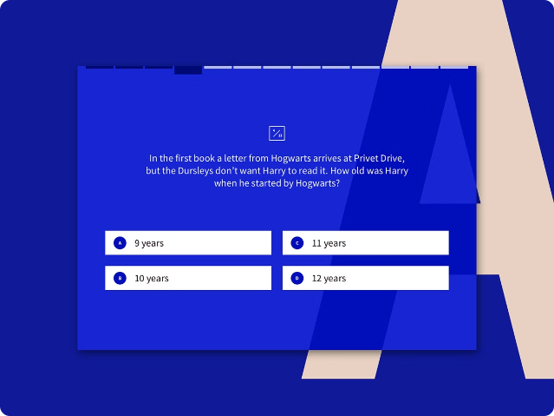

Online Quiz Project
This project focuses on creating an interactive online quiz application. Users can take quizzes on a variety of topics, with questions dynamically loaded from an external API.
by Aditya Arora

Slide 3


Project Overview
1
Requirements Gathering
First, I defined the project goals and user requirements, including features like question fetching, display, and scoring.
2
Design & Development
Next, I designed the user interface using HTML and CSS, and implemented the core functionality using JavaScript.
3
API Integration
I integrated the project with a third-party API to dynamically fetch quiz questions and answers.
4
Testing & Deployment
Finally, I thoroughly tested the application, ensuring it met all requirements and deployed it to a web server for accessibility.

Slide 4
Technologies Used
HTML
CSS
JavaScript
HTML was used to structure the quiz interface, including elements like question containers, answer buttons, and score displays.
CSS provided styling and visual enhancements, ensuring a visually appealing and user-friendly experience.
JavaScript handled the core functionality, from fetching data from the API to managing user interactions and updating the display.

Slide 5


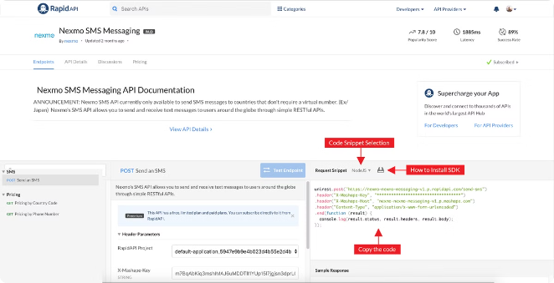



Question Fetching from API
API Endpoint
The project interacts with an external API to retrieve quiz questions and answers.
API Call
Using JavaScript, the application sends a request to the API, specifying the desired topic or category.
Data Retrieval
The API responds with a JSON object containing a set of questions and their corresponding answers.
Data Parsing
The application parses the received JSON data to extract the relevant information for displaying questions and answers.

Slide 6

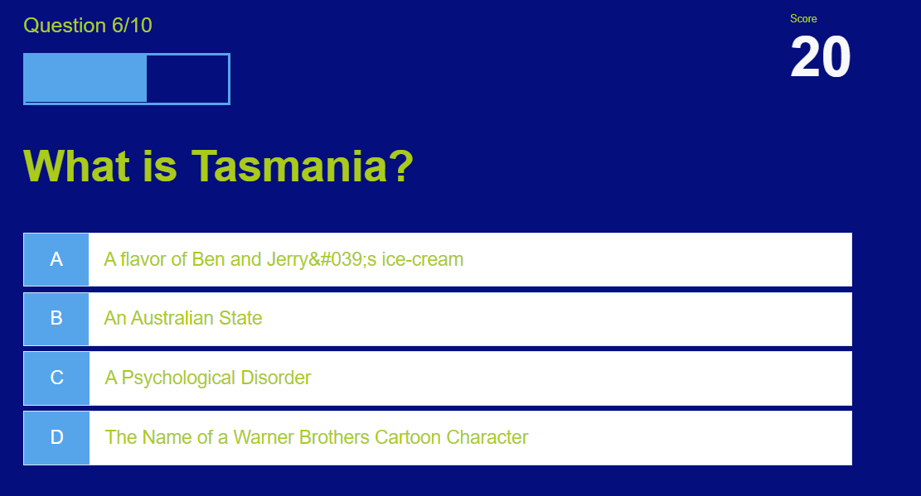
Question Display on Screen
Question Display
Answer Options
Each question is displayed prominently on the screen, with clear formatting and visual cues.
Multiple answer options are presented to the user, allowing them to select the best response.
User Interaction
Dynamic Updates
The user interacts with the quiz by clicking on the answer options, triggering the scoring system.
The display updates dynamically as the user progresses through the quiz, showcasing the next question and updating the score.

Slide 7


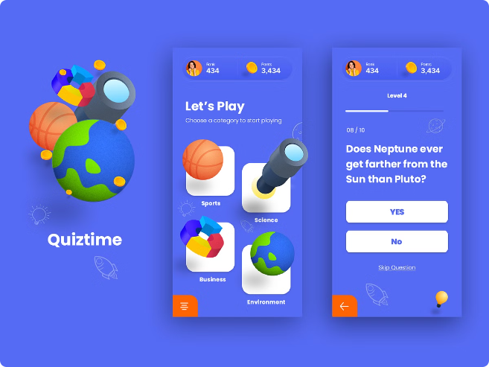


Scoring System
Correct Answers
For every correct answer, the user earns 20 points, accumulating their score as they progress.
Incorrect Answers
Incorrect answers do not result in points deduction, but the user is informed of their incorrect choice.
Final Score
At the end of the quiz, the user's final score is displayed, providing a measure of their performance.

Slide 8

Conclusion
This project demonstrates the power of combining HTML, CSS, JavaScript, and external APIs to create engaging and interactive online experiences.

