Slide 1
e
GO
eGO is a web application which is used to facilitate and make things handy for the EV users like finding EV charging stations and connecting with other plug-in vehicle owners. It’s the completely public EV charging map over India, with every major distributor of charging stations. It also solves the range anxiety problems for the users, interoperability of data and build the ecosystem for this growing revolution in automobiles.
VMware Software India Pvt.Ltd.
ORGANISATION NAME:
Electrical Vehicle(EV) Ecosystem
PROBLEM STATEMENT:
BUG SLAYERS
TEAM NAME:
Vishesh Maheshwari
TEAM LEADER:
DOMAIN BUCKET:
Software-Web Application Development
COLLEGE:
Institute of Engineering and Technology, DAVV, Indore

Slide 2
Problem Statement Details
Description | Electric Vehicle (EV) will be the vehicle of choice soon. However, EV demand on the grid is unknown and EV users have range anxiety. To address these challenges, can we build an EV eco system and connect all players of the eco system? Can we create predictive models for EV demand? How do we provide inter-operability of data and end user applications? For more details please refer to attachment.
Organisation | VMware Software India Pvt.Ltd.
Category | Software
Domain Bucket | Software - Web App development

Slide 3
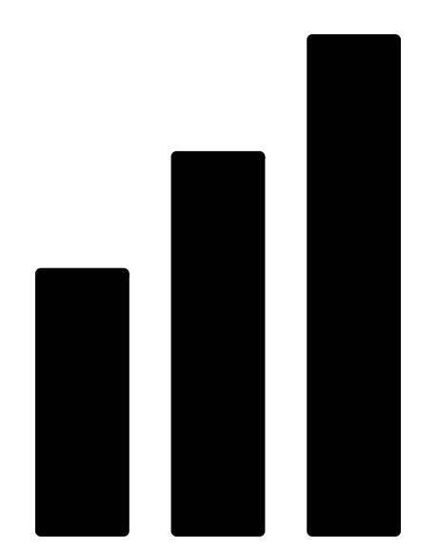

Challenges
Solution
The future of the automobile industry is pinned on electric vehicles but India lacks the infrastructure which can support the ecosystem. The challenges are in following ways:
Range anxiety among consumers.
Inadequate charging infrastructure.
Inadequate electricity supply in parts of India.
Lack of Interoperability between multiple charging networks i.e. drivers need to multiple cards and app to access different stations.
We will develop a web application which will create an unique account for every electronic vehicle after the verification of vehicle.
This account will connect all users as well as the different charging station operator to the ecosystem and bring interoperability at a single platform.
This application will also take regular surveys and analytics of user data which can be used by station operators to build their infrastructure in a beneficial way.

Slide 4




Key Features and Technology Stack
Location of Station
Easy Navigation
We can locate nearby charging stations and sort them according to their distances and reviews.
We will provide easy navigable map inside our application.
JS
JavaScript
Interoperability
Compatibility
CSS
CSS
</>
Our application will provide interoperability among different charging station operators at single platform.
It’s an additional feature will tell whether the car is compatible or not with station charging plugs.
HTML
MySQL
Geocoding
Security
Pricing Details
The plus point of our application is that no burglar can charge the stolen vehicle without its unique ID and password
The application will regular update the current charging prices as decided by the government.
jQuery
JSP
Data Mining
Transaction Record
Through regular surveys and analytics our application maintain a reliable data for end user as well as operator.
The application will maintain the time, date and payment detail of the user on the regular basis.

Slide 5
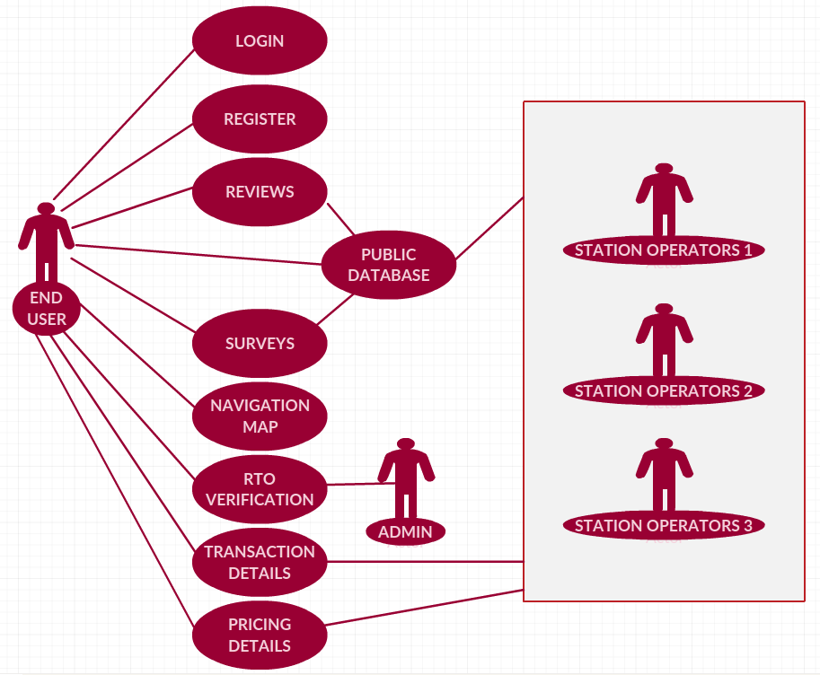
Use Case and Dependencies
USE CASE DESCRIPTION
After registration and login, the user will be asked to verify his vehicle for RTO registration number. After the validation the user is opened to use the any of the given features.
The main point of our application is user can give review and surveys which can be used by other users as well as all station operators.
The transaction detail will be maintained for user and transaction detail will be updated by station operator.
DEPENDENCIES
Society: User (for reviews)
Station Operator(Transaction Details)
Device: Mobile/Computer
Technology: Internet, GPS

