Slide 1
IPL Data Analytics Dashboard
Insights on Players, Teams & Venues (2008–2023)
Aditya Anilkumar| Data Analyst

Slide 2
Objective
• To analyze IPL data (matches, players, venues)
• To uncover patterns in batting, bowling, toss decisions, and stadiums
• To create interactive dashboards for decision-making

Slide 3
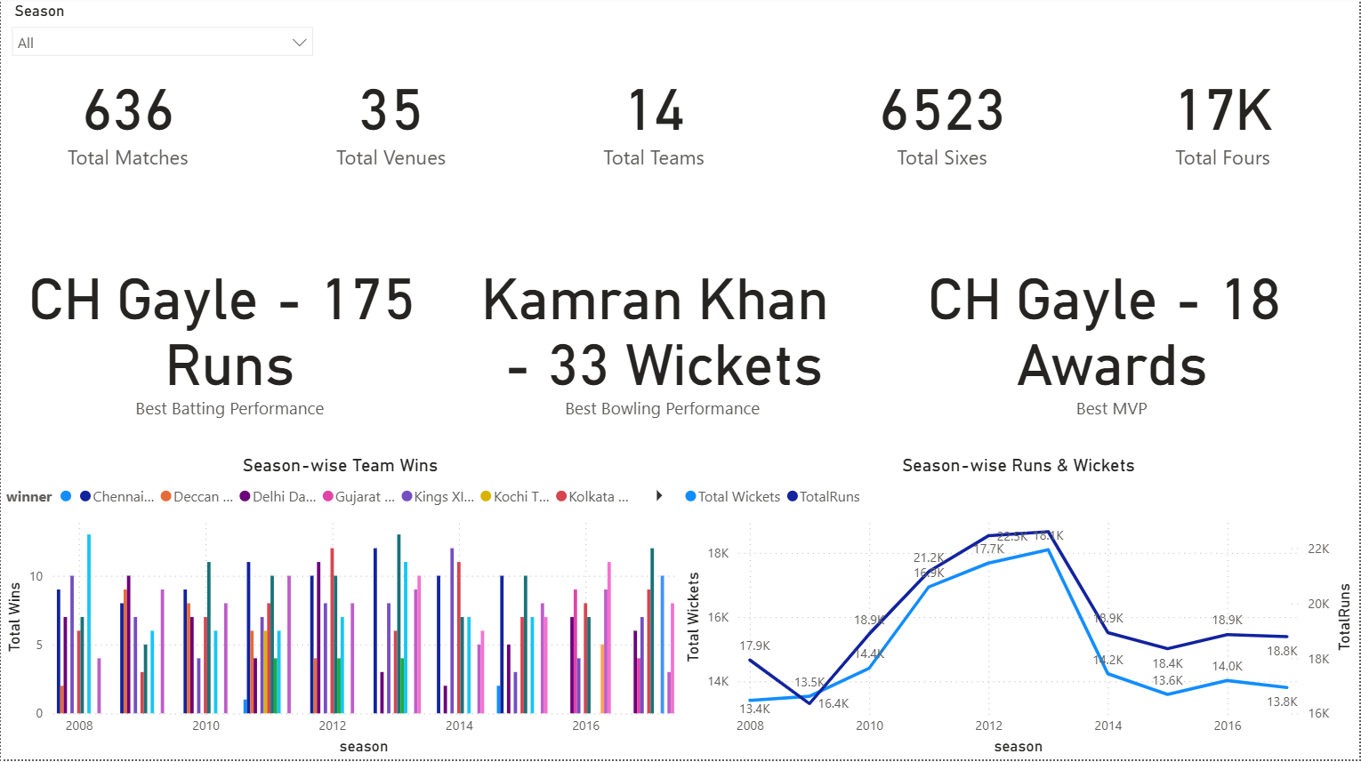
Overall IPL Stats (2008–2023)
636 matches, 35 venues, 14 teams → shows the massive scale of IPL.
6,523 sixes and 17K fours highlight the batting-heavy nature of the tournament.
Best batting → Chris Gayle’s 175 runs (single innings).
Best bowling → Kamran Khan, 33 wickets in a season.
Most MVP awards → Gayle again (18 awards) → clearly a game-changer.
Trend: Runs & wickets peaked around 2012–2013, then slightly dipped, showing changes in pitch/playing styles.

Slide 4
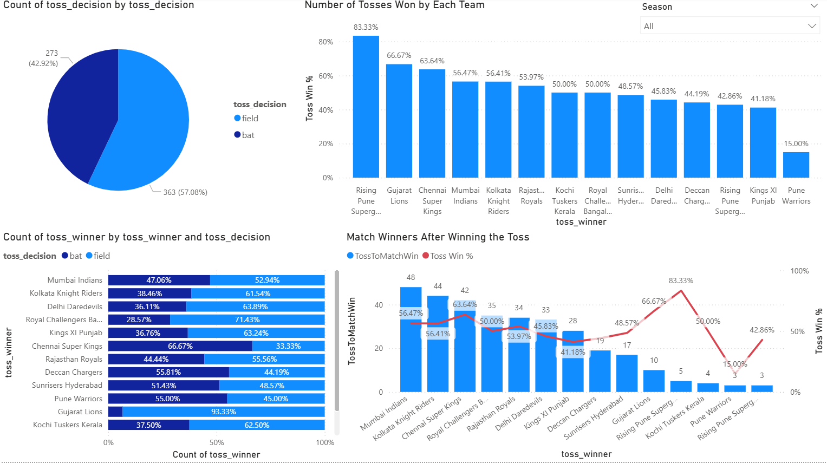
Toss Analysis
Teams prefer to field after winning the toss, about 57% of the time. This is a common strategy in T20 matches.
Winning the toss does not ensure victory. Mumbai Indians and Chennai Super Kings use their toss advantage more effectively than other teams, but overall, match wins are fairly even across all toss decisions.
Rising Pune Supergiants had the highest toss win percentage at 83%, but this did not consistently lead to victories.
Gujarat Lions also had strong toss statistics, but, once again, winning the toss does not equal winning the match.
Takeaway: The toss offers a slight advantage, but winning requires execution.

Slide 5
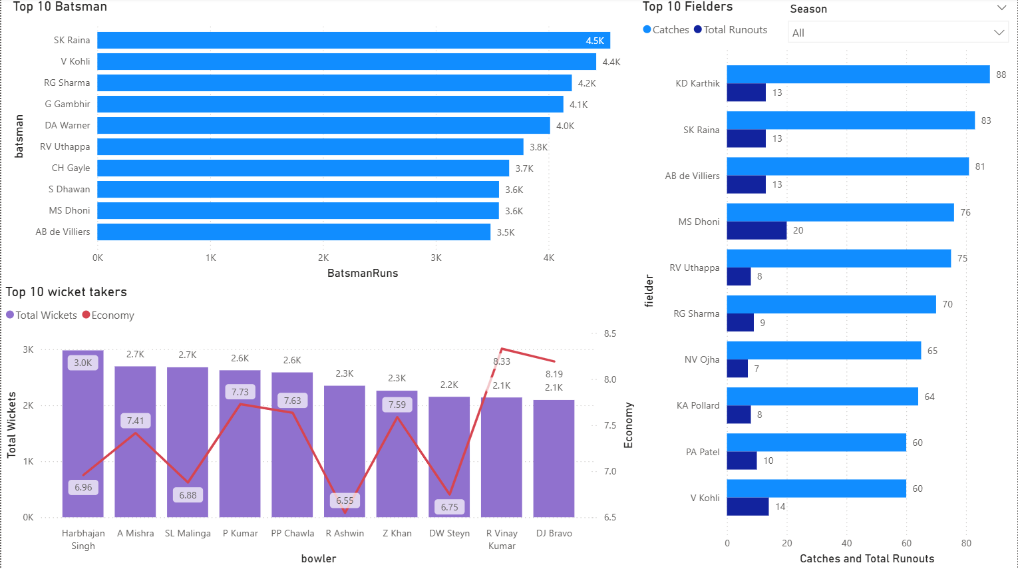
Player Analysis
Top Run Scorers:
Suresh Raina (4.5K), Virat Kohli (4.4K), Rohit Sharma (4.2K). These players show consistency across seasons.
Top Wicket Takers: Harbhajan Singh (3K wickets), Malinga, Ashwin highlight bowlers who did well in IPL conditions.
Fielding Impact: Dhoni stands out with 20 runouts. ABD, Raina, Karthik are among the top catchers. This proves fielding is equally important.
Boundary Hitters:
Sixes: Chris Gayle, Raina, Warner lead the way.
Fours: Gautam Gambhir is in the lead with 484, followed by Raina, Warner, and Kohli.
Insight: Balanced teams need consistent scorers, attacking bowlers, and sharp fielders.

Slide 6
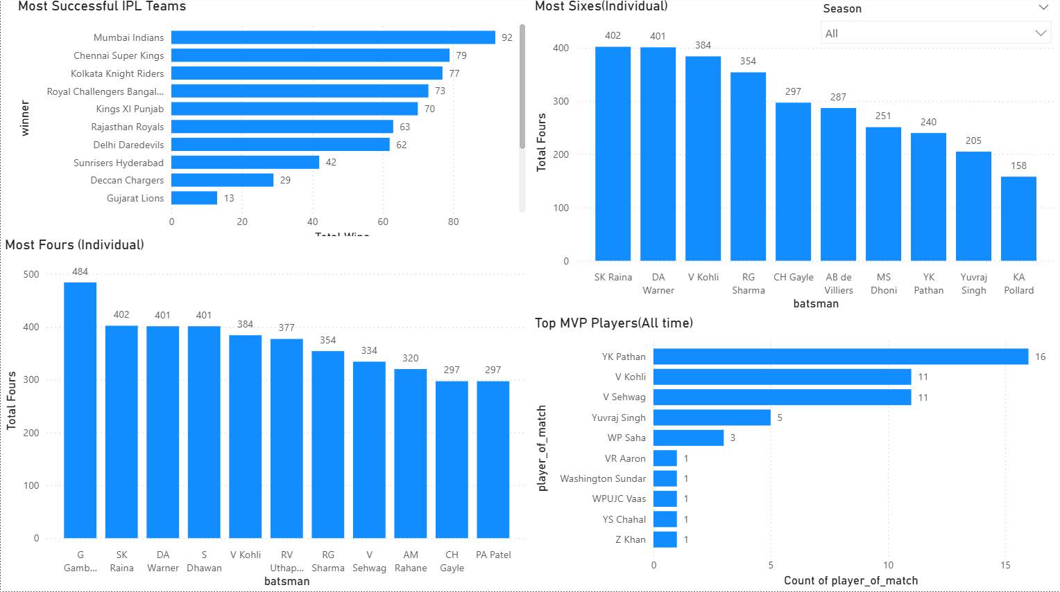
Team Success
Mumbai Indians, with 92 wins, are the most successful team.
Chennai Super Kings, with 79 wins, come in a close second.
RCB, Punjab, and Rajasthan have been consistent but hold fewer titles.
Deccan Chargers and Gujarat Lions faded because of their shorter existence.
Insight: MI and CSK dominate due to stable squads, good balance, and strong captains, like Dhoni and Rohit.

Slide 7
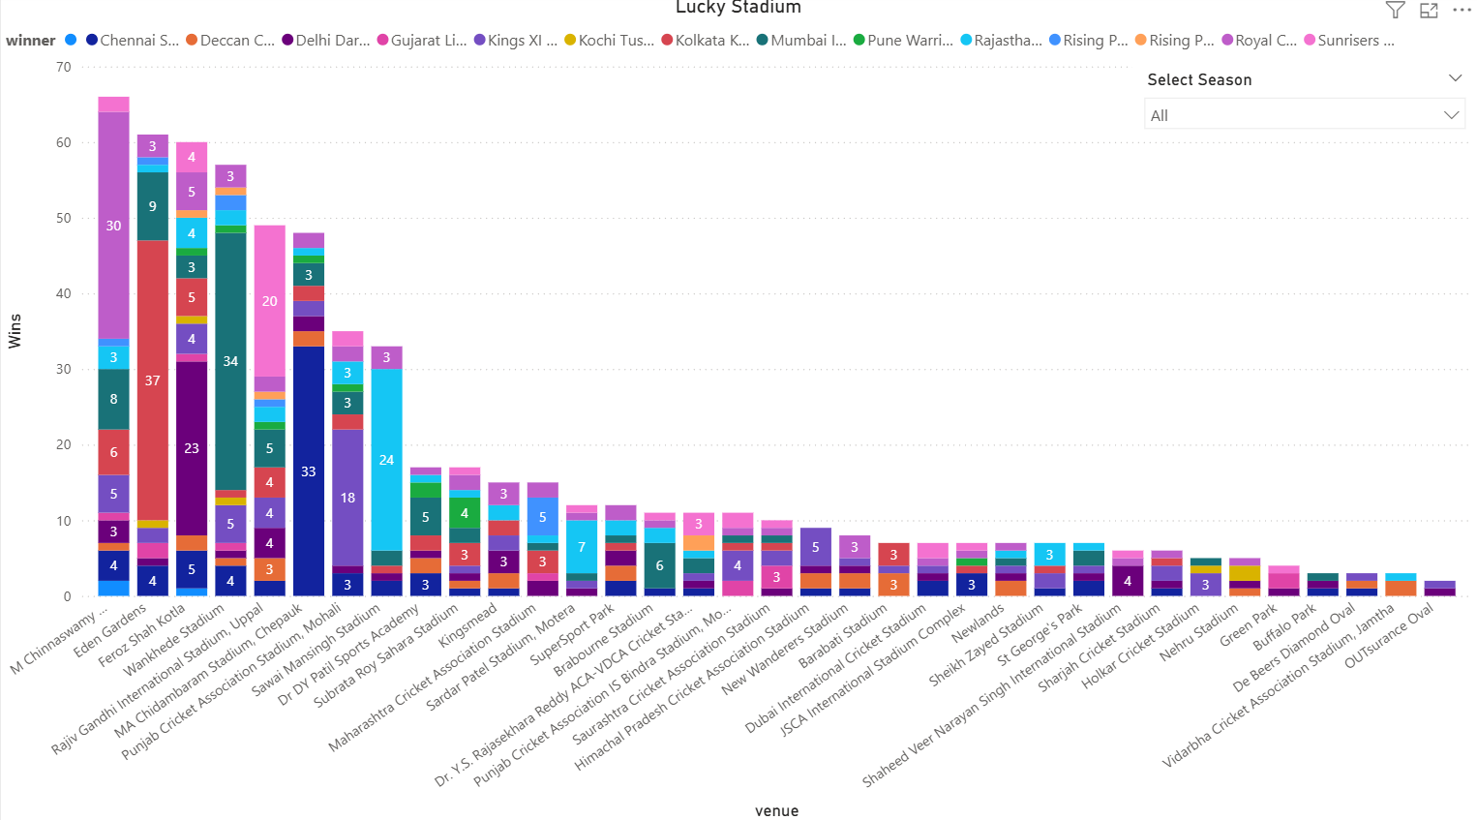
Venues & “Lucky Stadiums”

Slide 8
MVP & Lucky Stadiums
YK Pathan (16 awards), underrated clutch player.
Kohli & Sehwag (11 each), consistent match-winners.
Gayle, explosive, top six-hitter and MVP machine.
MVPs show that impact players, not just top scorers, define outcomes. (Dhoni, Rohit).
Eden Gardens, Wankhede, and Chepauk are the most successful venues.
MI excels at Wankhede while CSK excels at Chepauk. This shows a clear home advantage.
Teams win much more often at their home stadiums. Fan support and familiarity with the pitch are big factors. MVPs demonstrate that impact players, not just top scorers, shape the results, like Dhoni and Rohit.

Slide 9
Key Insights (Summary)
Toss: Fielding first is preferred, but it does not guarantee a win.
Players: Legends like Kohli, Raina, and Gayle consistently shine. The balance of batting, bowling, and fielding is crucial.
Teams: MI and CSK dominate IPL history. Stability and leadership are important.
Venues: Home ground advantage is significant, especially for MI and CSK.
Trend: IPL peaked around 2012 and 2013 in runs and wickets, showing tactical shifts over time.

Slide 10
Conclusion & Next Steps
IPL data shows that strategy is more important than luck; the toss alone does not determine outcomes.
Data helps teams select the best players, arrange batting order, and create strategies based on the venue.
Future analysis could focus on:
Player form by season (Kohli's strong performance in 2016, Gayle's peak in 2012).
The impact of foreign players compared to Indian players.
Predictive models for match results that use AI to estimate win probability.

