Slide 1







DATA SCIENCE
BOT

Slide 2




STUDIO SHODWE
OBJECTIVE
An AI-powered Streamlit app where users upload a CSV and interact with a smart assistant to:
Clean data automatically
Perform exploratory data analysis (EDA)
Train models based on user input (classification/regression)
Compare model performances
Download the updated data

Slide 3
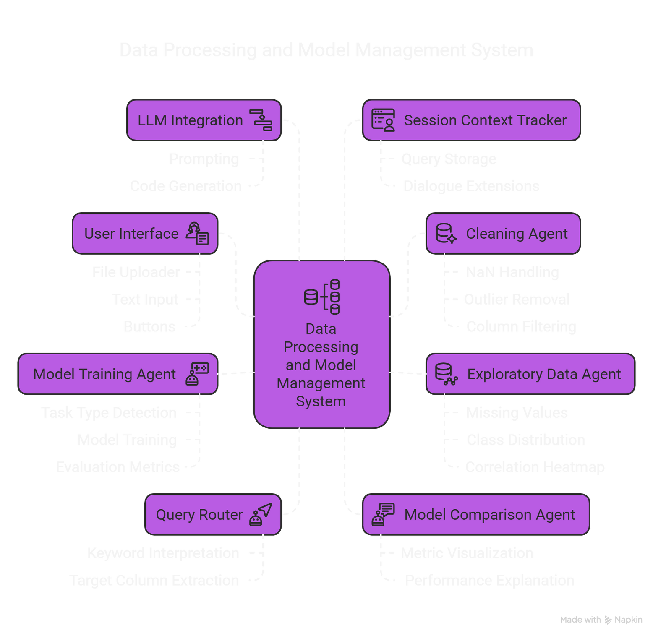


Slide 4

CORE COMPONENTS BREAK DOWN
1
app.py ( Main User Interface)
Displays the Streamlit interface: file uploader, query box, buttons.
Accepts a query like “clean the data” or “train model on age”.
Passes your CSV and query to the handle_query() function.
Stores session data in memory (st.session_state), such as:
Raw and cleaned DataFrame
Model results
Task type (regression/classification)
Memory of recent queries
Key triggers:
handle_query(query, df) → routes query to the correct agent
update_memory(query) → tracks recent query history

Slide 5
CORE COMPONENTS BREAK DOWN
2
query_manager.py
Parses your natural language query to detect:
"clean" → runs clean_data() from cleaning.py
"eda", "explore" → runs generate_auto_eda() from eda.py
"predict", "train" → runs train_model() from train.py
Uses regex to extract the target column from phrases like:
“predict age”, “train model on income”

Slide 6
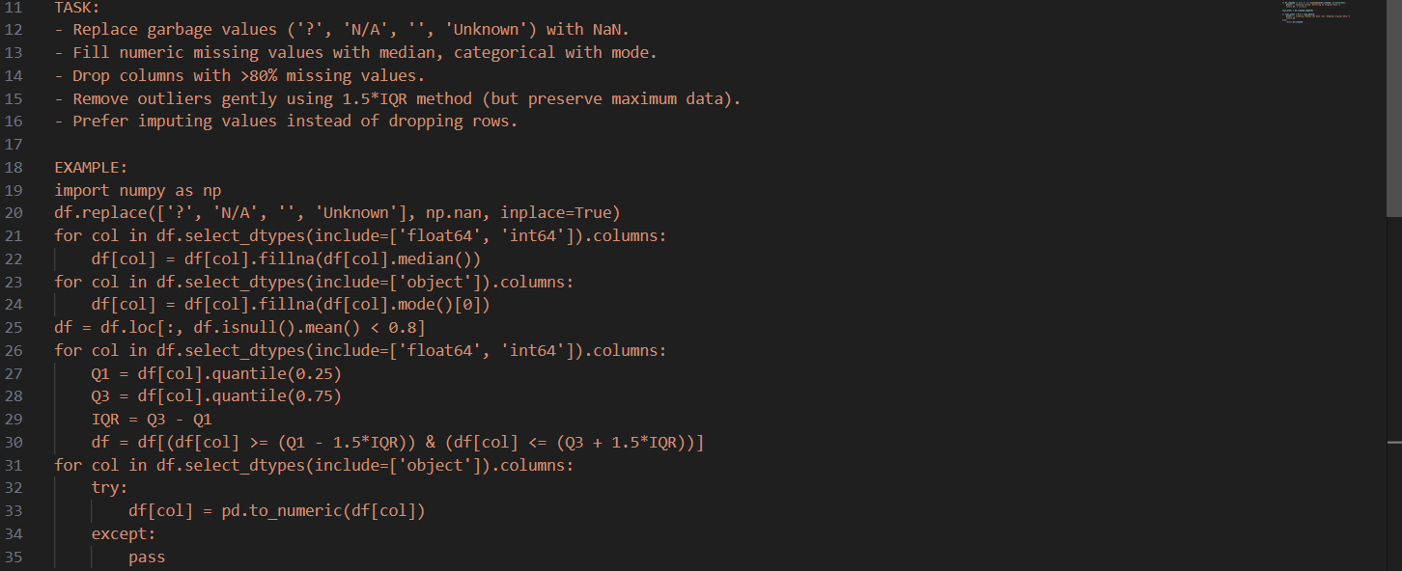
CORE COMPONENTS BREAK DOWN
3
cleaning.py
Summarizes the uploaded CSV (column types, missing values).
Crafts a smart prompt and sends it to the LLM (via llm_manager.py).
The LLM replies with Python code for:
Replacing junk values with NaN
Filling missing values (median/mode)
Dropping high-missing columns
Gently removing outliers (IQR)
Executes that Python code safely on the DataFrame.
If code is invalid or data gets wiped out → reverts to original.

Slide 7

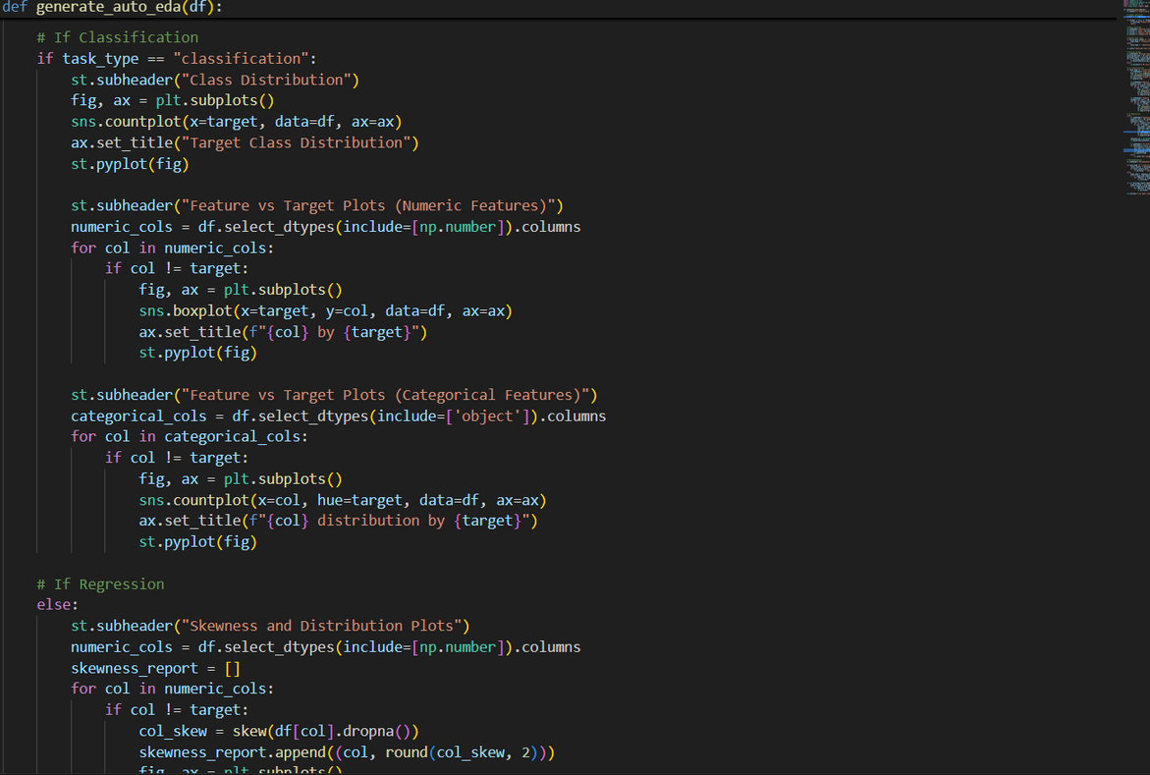
CORE COMPONENTS BREAK DOWN
4
eda.py
What it does:
Starts interactive EDA via Streamlit.
User picks a target column from a dropdown.
Automatically detects if the task is classification or regression.
Based on task type, it generates:
Class distribution
Skewness histograms
Boxplots, countplots
Correlation heatmaps
Auto-adapts visualizations based on the task type, And provide recomendations used to enhance your model for training

Slide 8
CORE COMPONENTS BREAK DOWN
5
6
train.py
Detects task type (classification vs. regression).
Cleans the data again (via clean_data() from clean.py)
Splits into train/test sets (80/20).
Trains two models depending on task:
Classification: Logistic Regression, Random Forest Classifier
Regression: Linear Regression, Random Forest Regressor
Then Evaluates models with appropriate metrics
compare_models.py
Takes in the results_df and task_type from train.py.
For each metric (Accuracy, RMSE, etc.):
Plots bar chart
Highlights best model
Writes human-readable explanation

Slide 9
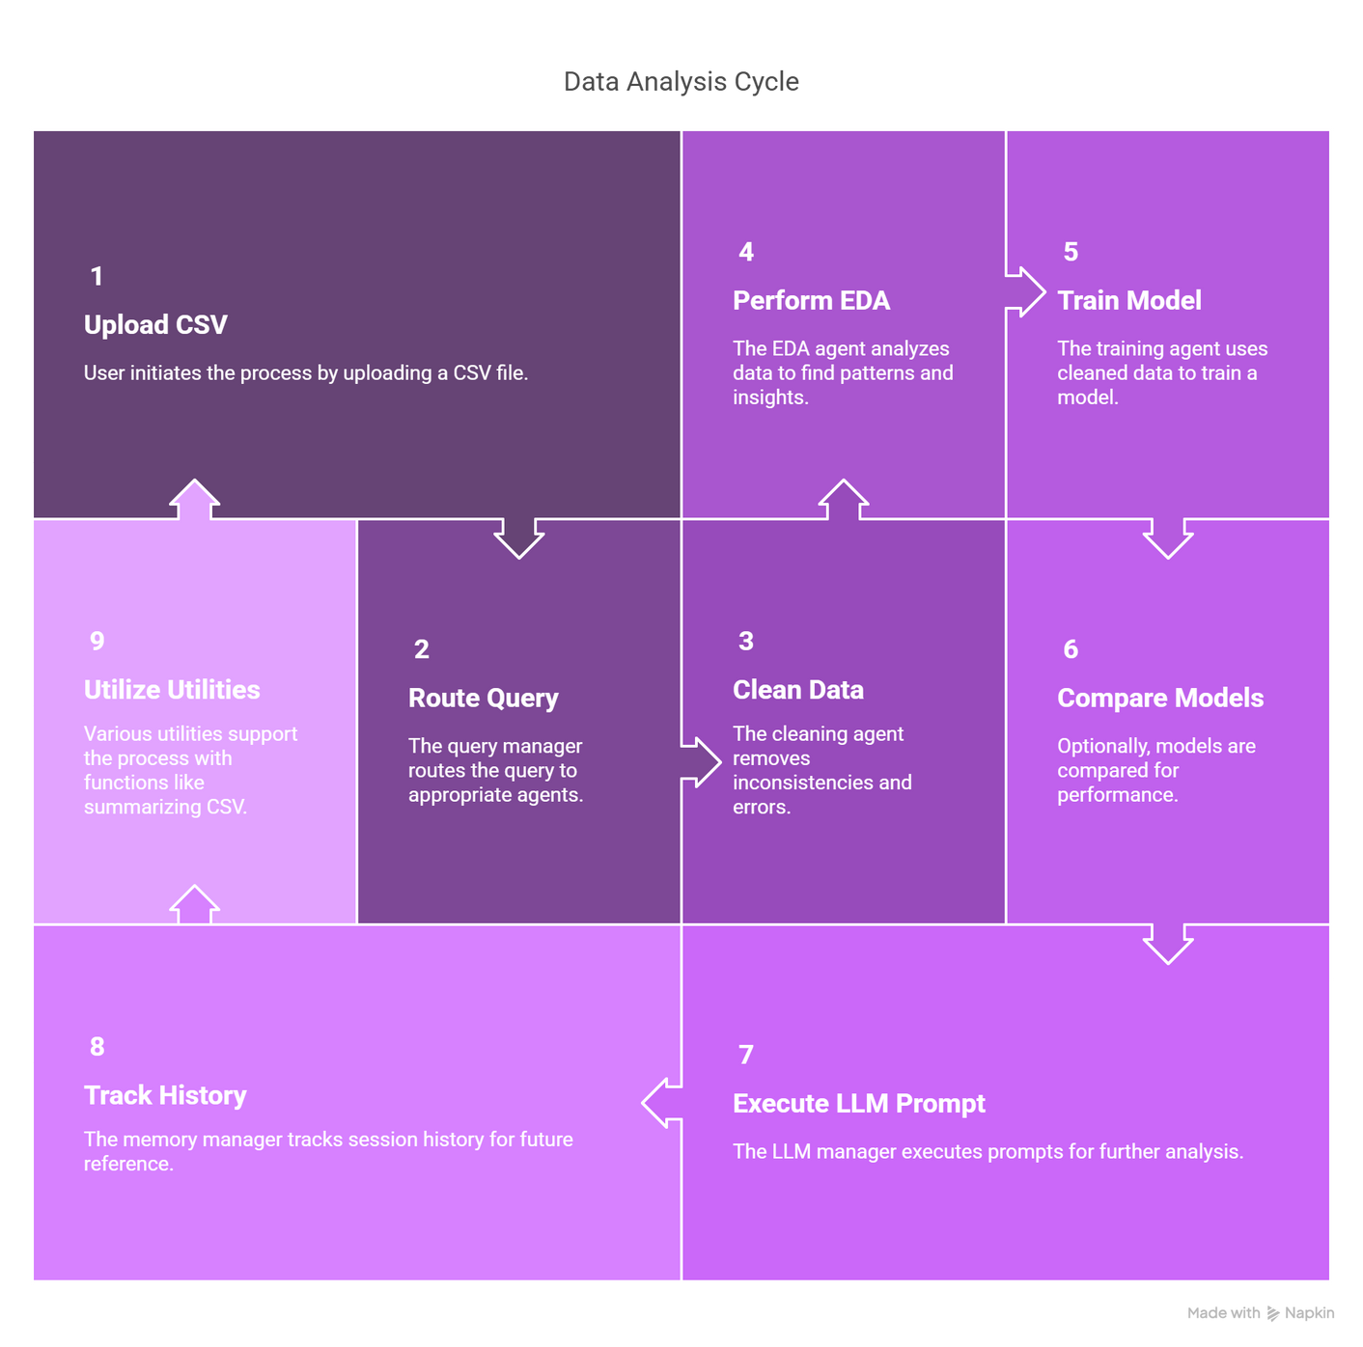

SYSTEM STRUCTURE

Slide 10
CONCLUSION:
The Data Science bot offers a seamless and interactive experience for automating key data science workflows, data cleaning, EDA, model training, and evaluation through natural language queries. With modular agents powered by Streamlit and LLM-driven logic, it simplifies complex analysis and empowers non-technical users to gain deep insights from their data in real time.
Areas for Improvement (Concise)
Multi-turn reasoning: Add memory/context awareness to follow up intelligently on past queries.
User-driven model selection: Let users choose algorithms and tune hyperparameters.
Robust error handling: Improve LLM failure recovery and code validation.

Slide 11


THANK YOU!

