Slide 1
Stock Price Prediction Model for time-series data
Kandula Aditya Sri Krishna Raghav Chowdary
NITK Surathkal

Slide 2
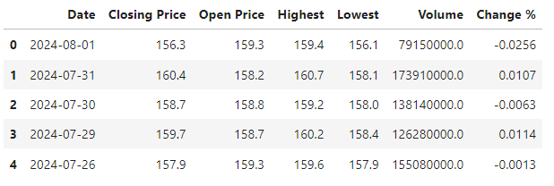
Data Understanding and EDA:
The dataset contains 7 columns Date, Closing price, Opening price, Lowest, Highest and Change% on that day.
We will be taking Closing Price as the target column for prediction.

Slide 3
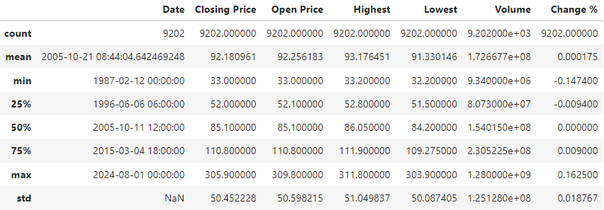
Data Understanding and EDA Cont…
The range of values and mean and standard deviation of the dataset can be seen below.
The standard deviation of the closing price is high (around $50), indicating substantial price fluctuations over the years.
The volume shows a wide range, from as low as ~9 million shares to as high as 1.28 billion, suggesting periods of both low and high trading activity.

Slide 4
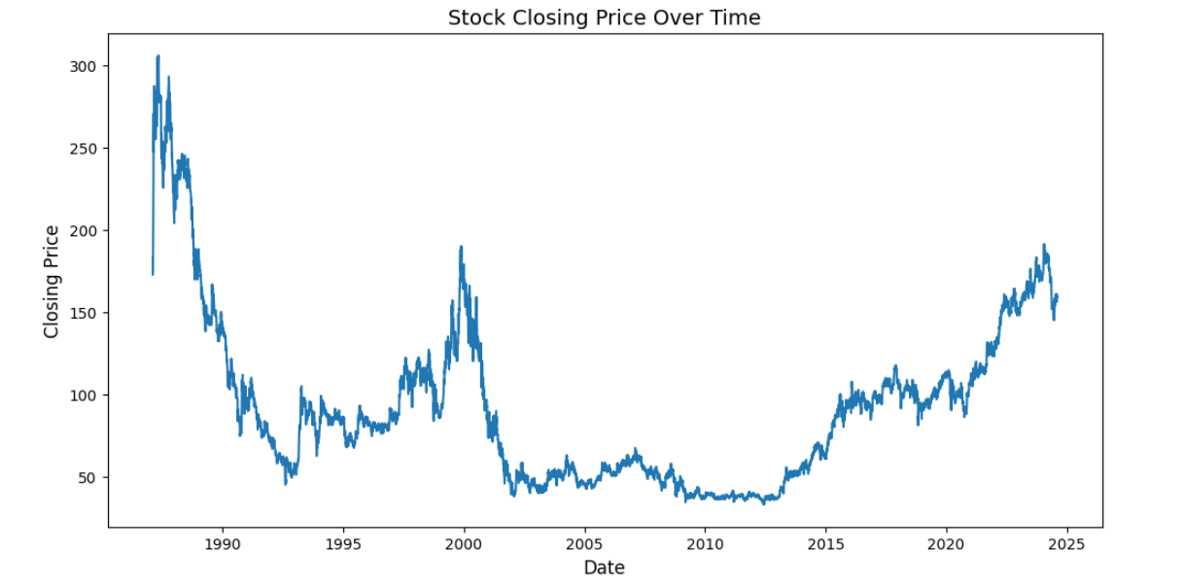
Data Understanding and EDA Cont…

Slide 5
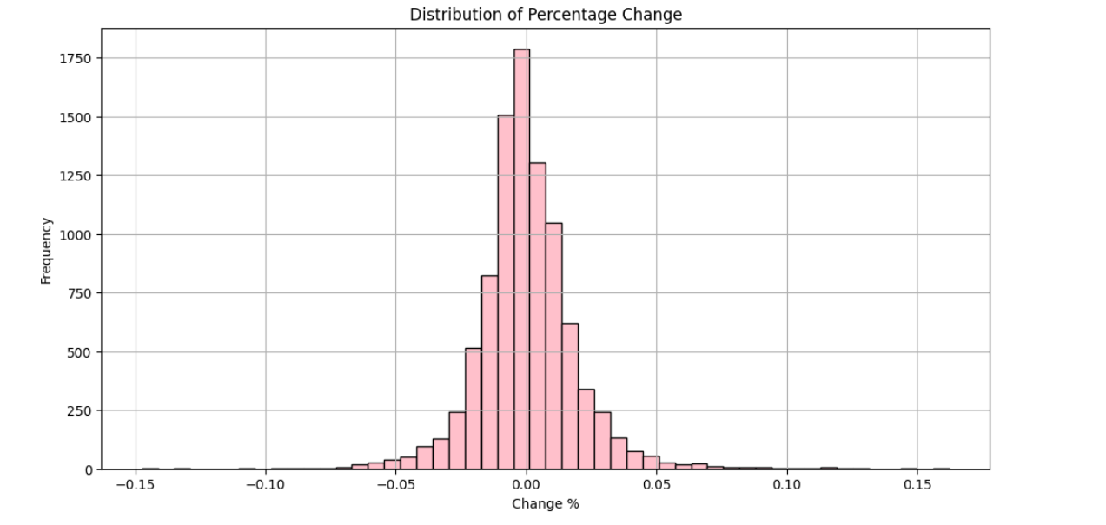
Data Understanding and EDA Cont…
Most price changes are small and follows normal distribution as shown, indicating stability. Large fluctuations are rare. A normal distribution suggests the stock’s short-term price movements are more predictable, as extreme changes are uncommon.

Slide 6
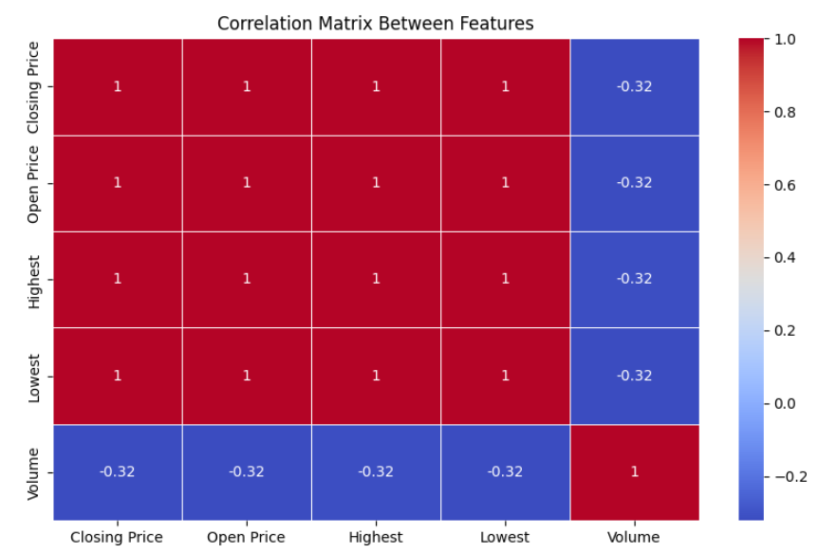
Data Understanding and EDA Cont…
Correlation of 1 between Opening, Closing, Highest, and Lowest prices suggests that these price metrics are nearly identical in their movement—when one increases or decreases, the others follow in the same manner. This is typical for stock price data, where these values are closely related as they represent different points within the same trading day.
The negative correlation of -0.32 between these prices and Volume indicates a weak inverse relationship. This suggests that when trading volume increases, prices tend to slightly decrease, or when volume decreases, prices rise slightly. However, since the correlation is not strong, volume is not a major driver of price changes in this case. Selection deleted

Slide 7
Feature Engineering.
Why we add moving average and volatility to our data?
The 20-day moving average smooths short-term price fluctuations, making it easier to identify long-term trends in the stock's price behavior.
The 20-day volatility (rolling standard deviation) shows periods of increased or decreased risk, highlighting when the stock price is more volatile.
If the 20-day Moving Average closely follows the Closing Price, it indicates that the stock price doesn’t fluctuate much in the short term, suggesting stability and a consistent price trend without large deviations.
The abnormal and distant 20-day Volatility suggests that the stock experiences sudden spikes or drops in volatility during certain periods, even if the overall price trend is stable. This can indicate occasional market shocks or events causing short-term unpredictability, despite general price stability. Selection deleted

Slide 8
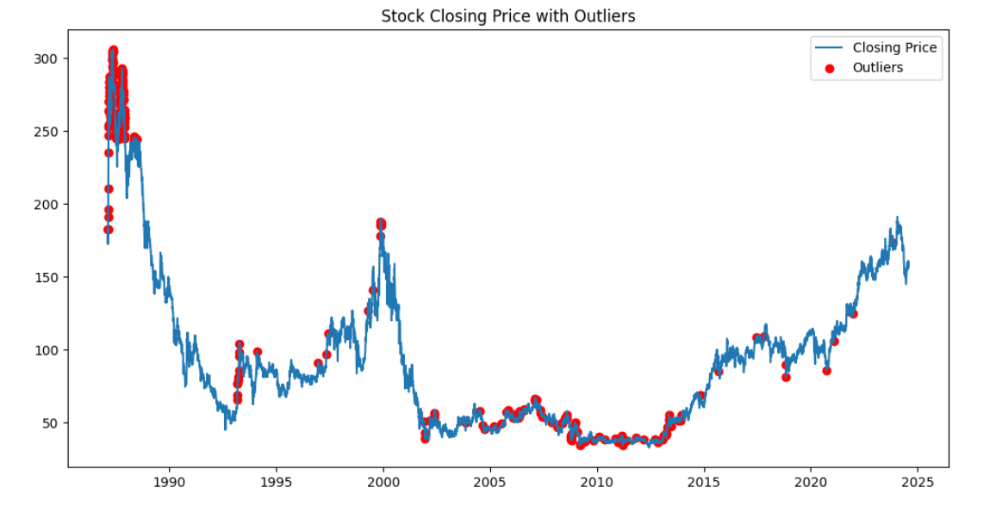
Outliers
Since there are only 305 outliers from 9200 rows of data, this indicates that extreme price or volume fluctuations are relatively rare. Most of the stock's price and volume movements fall within normal ranges, suggesting a generally stable and predictable stock with occasional spikes or drops. Please refer code for clear understanding.

Slide 9
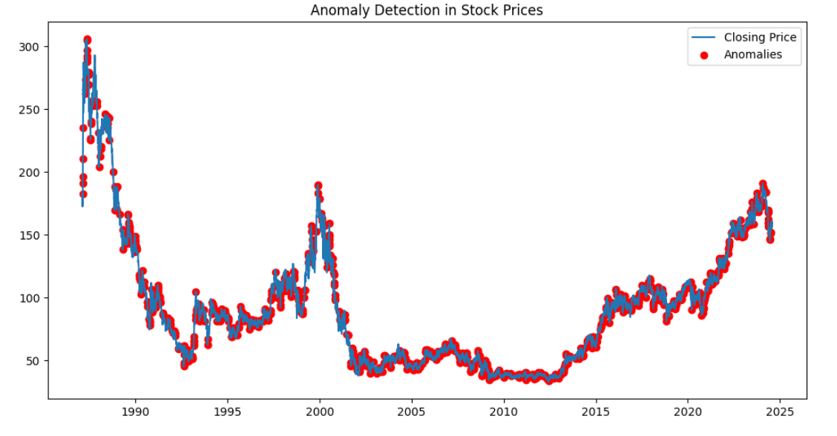
Anomalies in data:
The 20-day rolling mean and standard deviation are used to detect anomalies in the closing price, defined as deviations beyond 2 standard deviations. These anomalies highlight significant price movements, potentially signaling important market events like news or earnings reports.

Slide 10
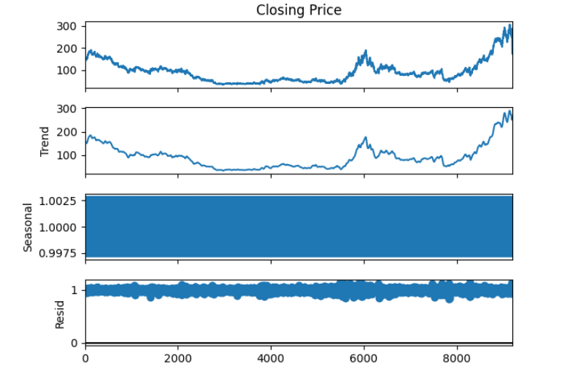

Slide 11
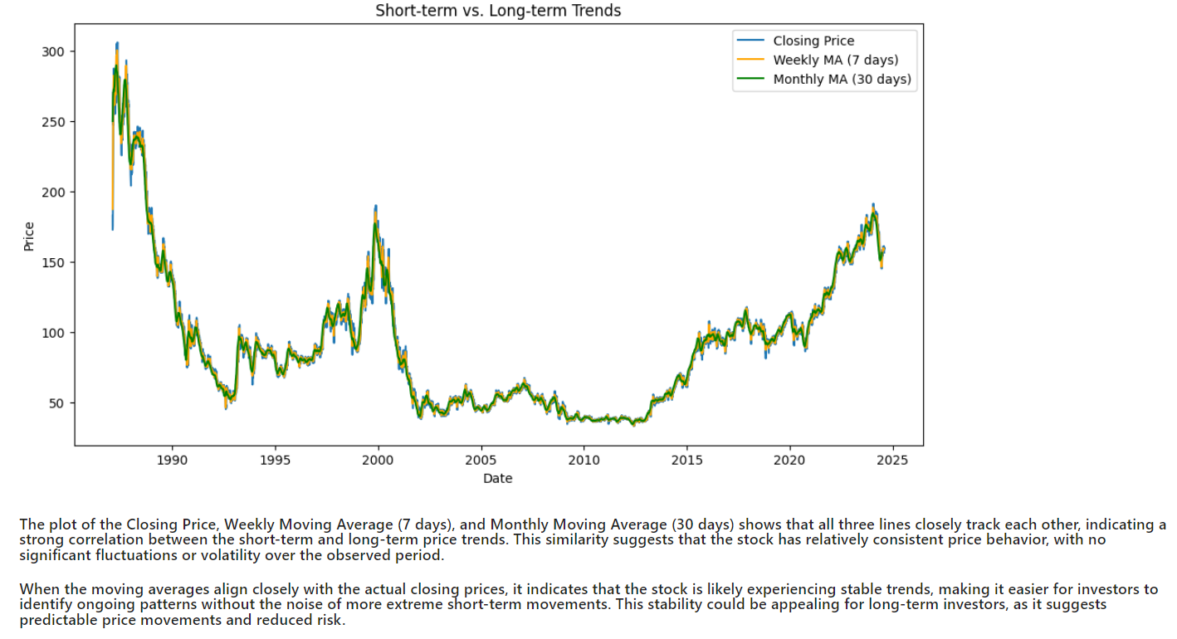

Slide 12
Modeling:
We are using 4 models in this project for prediction
Support Vector Machine
XGBoost
LSTM ( Long Short term Memory )
ARIMA ( AutoRegressive Integrated Moving Average )
Note: In upcoming slides we are following given below abbrevasions. These are used in Model evaluation after prediction.
MSE: Mean Sqaured Error
MAE: Mean Absolute Error
MAPE: Mean Absolute percentage Error
R-Squared: R2 error score

Slide 13
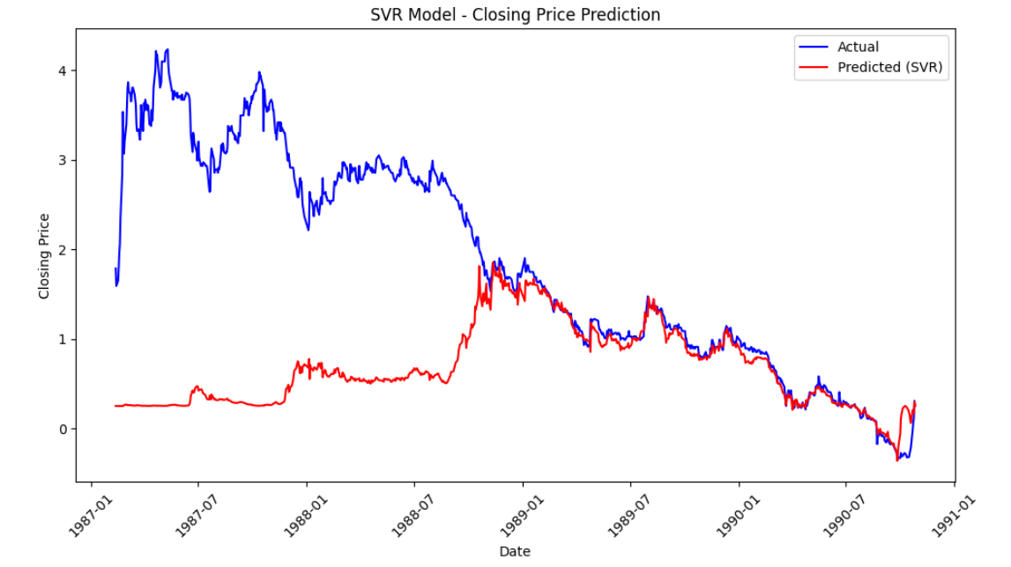
Model-1 : Support Vector Machine
MSE: 3.23937, MAE: 1.21469, MAPE: 46.28642%, R-Squared: -1.20986

Slide 14
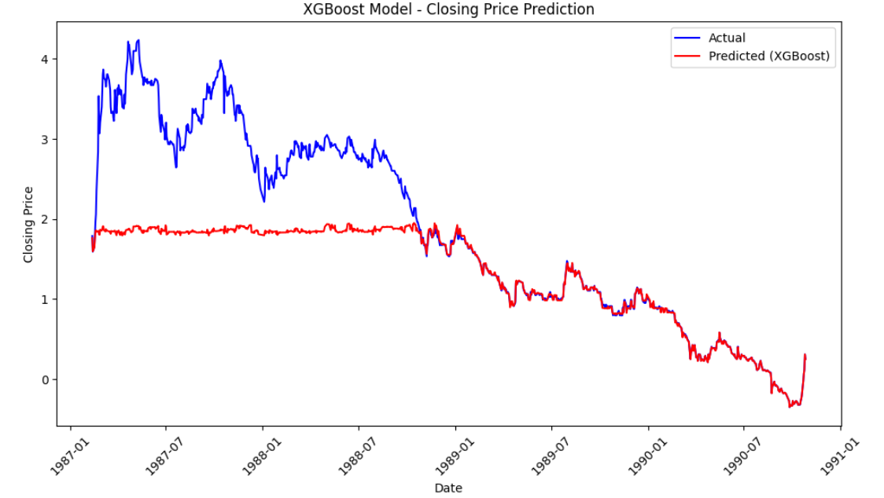
Model-2 : XGBoost
MSE: 0.75738, MAE: 0.54951, MAPE: 17.81508%, R-Squared: 0.48333

Slide 15
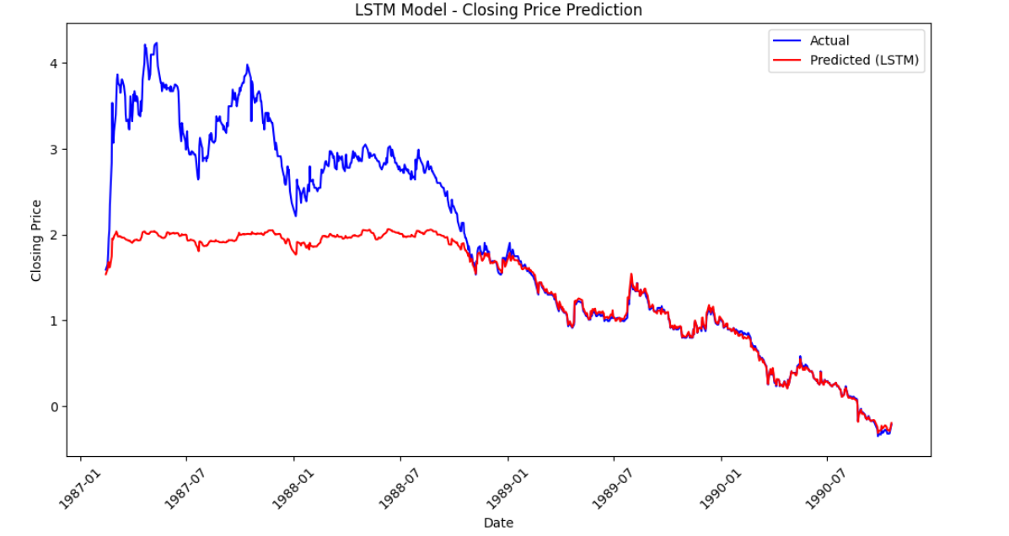
Model-3 : LSTM
MSE: 0.64128, MAE: 0.51056

Slide 16
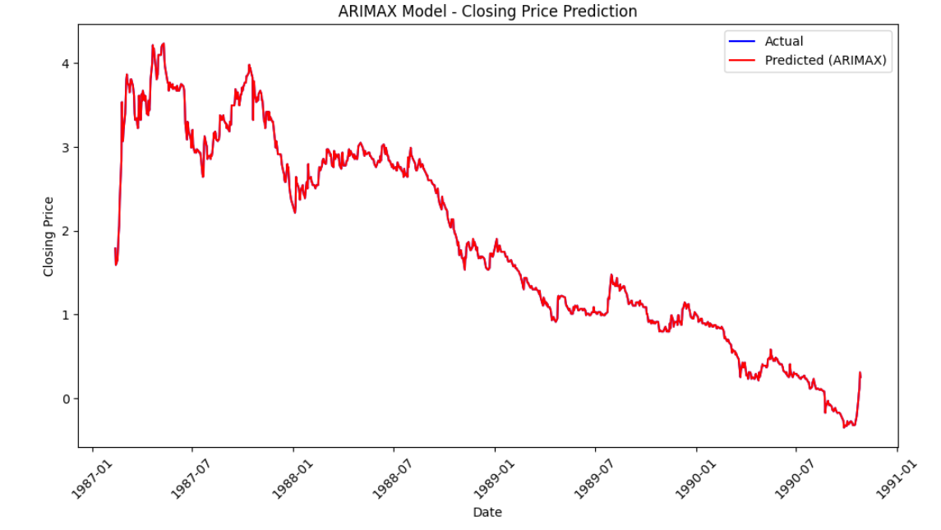
Model-4 : ARIMA
MSE: 0.00000, MAE: 0.00001, MAPE: 21.93465%

Slide 17
Conclusion
ARIMA has achieved very high accuracy on the specific dataset being evaluated, with minimal error in predictions.
All other models such as SVM, XGBoost, LSTM worked good on low closing price data but werent able to capture the data of closing price with low values.
Rolling means, standard deviations, and volatility help capture short-term and long-term trends, which can add valuable features for better predictive modeling.
Adding technical indicators like RSI and MACD captures momentum and trend information, improving the model's ability to predict price movements.
Recommendations
Use techniques like Grid Search or Random Search to optimize the hyperparameters of your models (e.g., kernel type, C-value in SVM). This can significantly improve performance by finding the best configuration for your dataset.
Apply methods like Recursive Feature Elimination (RFE) or Principal Component Analysis (PCA) to reduce irrelevant or redundant features. This can reduce noise and improve model generalization and accuracy. We can apply PCA because correlation is more between features.

Slide 18
THANK YOU

