Slide 1

Application of machine learning in online recruitment
Aditya Srivastava
A8979220002
Faculty guide name – Dr. Shailja Pandey
Industry guide name – Mr. Abhyuday Mishra
NTCC
Amity School Of Applied Sciences
Amity University

Slide 2
INTRODUCTION

Slide 3
Hiring a candidate is a legal process for which it has to be satisfy all the requirements given by the company which is done through recruitment process.
Nowadays, a fast and efficient recruitment is also important which reduces costs, company’s reputation etc. which is done through online recruitment system rather than traditional system.
With the help of machine learning using classification algorithm online recruitment is done.
Our data is taken from HR department of Escaleratechnologies.com

Slide 4

RECRUITMENT
Recruitment is the method to determine requirements the number of vacancies, analyze the job, reviewing the participants, screening them and then select for the post.

Slide 5

According to EDWIN B FLIPPO
“Recruitment is the process of searching the candidates for employment and stimulating them to apply for jobs in an organization.”

Slide 6

Online recruitment system
An online recruitment system is a service that automates a company’s recruiting needs by getting volumes of employment applications over the internet.
It allows a company to easily streamline the different processes involved.

Slide 7
MERITS OF ONLINE RECRUITMENT SYSTEM
Cost-effective process.
It’s immediate and easy.
We can reach to a bigger audience.
company make jobs advertisement more attractive.
It is flexible, durable and accessible.
It expedites the hiring process.
It allows confidentiality.

Slide 8
DEMERITS OF ONLINE RECRUITMENT SYSTEM
Costs can spiral.
It can be difficult to measure their effectiveness.
It’s informal.
It attracts bad candidates.
There’s a lot of competition.
It could lead to lost labor hours.
You may miss out great employees.

Slide 9
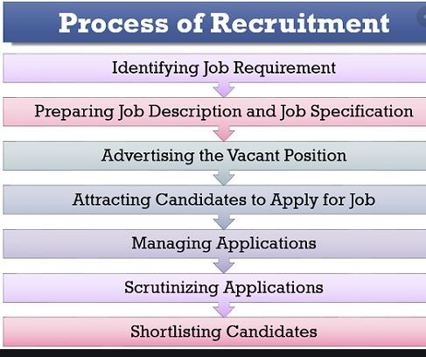
Process of online recruitment system
These are steps taken by any company through which online recruitment is done.

Slide 10

Machine learning
Machine learning is a method of data analysis is that automates analytical model building.
It is a branch of artificial intelligence based on the idea that the systems can learn from data, identify patterns and make decisions with minimal human intervention.

Slide 11
Arthur Samuel stated that
“It gives computers the ability to learn without being explicitly programmed”
Tom M. Mitchell said that
“A computer program is said to learn from experience E concerning some class of tasks T and performance measure p if its performance at tasks int, as measured by P improves with experience E.”

Slide 12
Application of Machine Learning
Self-driven cars
Amazon’s ALEXA
Google translate
Facebook- auto tagging feature
Netflix and amazon’s Prime
Dynamic pricing
Transportation and commuting
Google maps
Spam and non-spam email
Facial recognition system

Slide 13
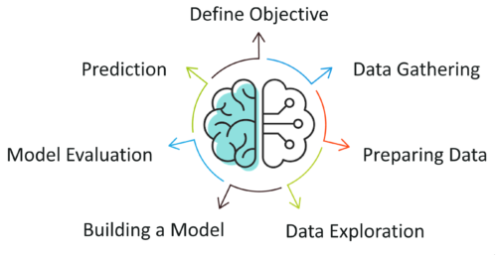
Process of machine learning

Slide 14
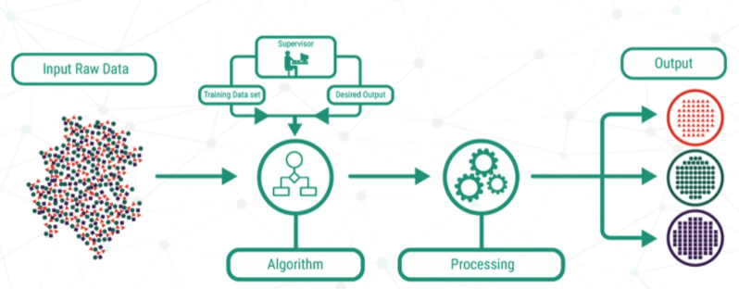
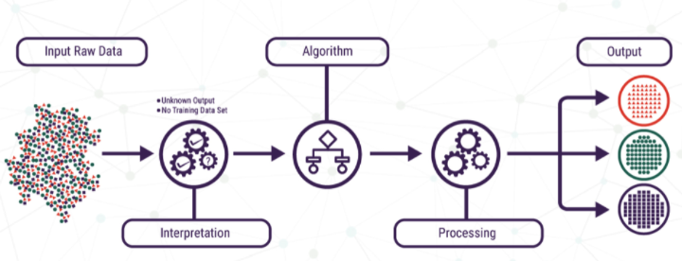
Types of Machine Learning
Supervised machine learning
Unsupervised machine learning

Slide 15
Machine Learning in Recruitment
Talent sourcing
CV screening
Job advertising
Candidate assessment and preselection
Candidate engagement
Predicting hiring needs

Slide 16
How machine learning is revolutinizing recruitment
Machine learning helps to get applicants information.
Compressing the hiring gap
Job vacancy
Reviewing resumes and social behavior
Balance’s recruiters’ risk
Conducts intuitive search
Risk extensive process

Slide 17
Regression Analysis
Regression analysis first named by FRANCIS GALTON in 1807 and LEGENDRE used regression analysis and named as ordinary least squares. In 1809 GAUSS comes and then LEGENDRE and GAUSS found GAUSS-MARKOV theorem.
Regression analysis is a statistical method in which we check a relationship between dependent variable and independent variable.
Regression analysis helps in predicting the future outcomes through the past experiences.
It helps us to analyze the wide variety of relationships
It helps us to control the independent variables.
Some real-world examples are weather forecasting, risk assessment and score prediction etc.

Slide 18
Classification algorithm
Classification algorithm is a part of supervised machine learning algorithm.
It is a process through which categorizing a given set of data into classes.
It is a process in which predictive modelling to approximate the mapping function from input variables to discrete output variables.

Slide 19
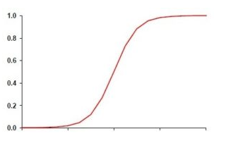
Logistic regression
Logistic regression used for predicting the dependent variables under the given set of independent variables.
It is used to classification problems where target variable is categorical variable.
it gives the probabilistic values which lies between 0 and 1.

Slide 20
Application of logistic regression
Determining a heart attack.
Understanding the possibility of getting admission into a university.
Gmail and other inboxes find spam emails

Slide 21
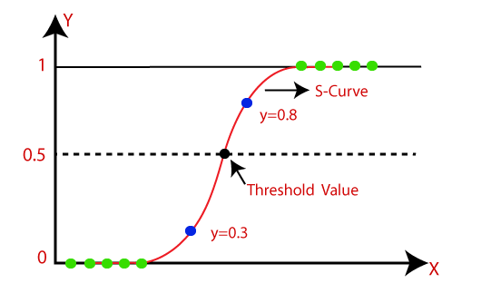
Sigmoid curve
It is also known as logistic function.
It is function used to map from predictive values to probabilities.
It can do map any value between 0 to 1.
It forms the s- shaped curve as the values cannot go beyond 0 to 1.
We use threshold value which also lies between 0 to 1. Mainly we take threshold value to be 0.5.

Slide 22
Types of logistic regression
Binary – there can be only possible outcomes such as ‘yes’ or ‘no’, ’true’ or ‘false’ etc.
Multinomial – there can be three or more than three unordered types of dependent variables.
Ordinal – there can be three or more than three ordered types of dependent variables.

Slide 23
Assumption of Logistic Regression
The dependent variable is categorical in nature.
The independent variables should not have multi-collinearity which means that the independent variables must be independent of each other.
All the variables in the model be meaningful .
Sample size should be large.

Slide 24
Dataset
Dataset is gathered from the HR department of the company.
Data is collected during the online recruitment for assistant manager post.
Data has 300 candidates which has all the details such as gender, high school or intermediate details, graduation details and post graduation details.

Slide 25
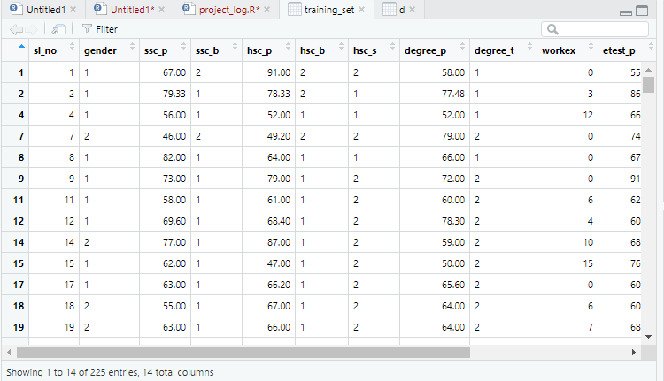
Training Dataset
This is the training set in which the model is trained.
The data is created from the main dataset.
It has 14 columns and 225 rows of entries.

Slide 26
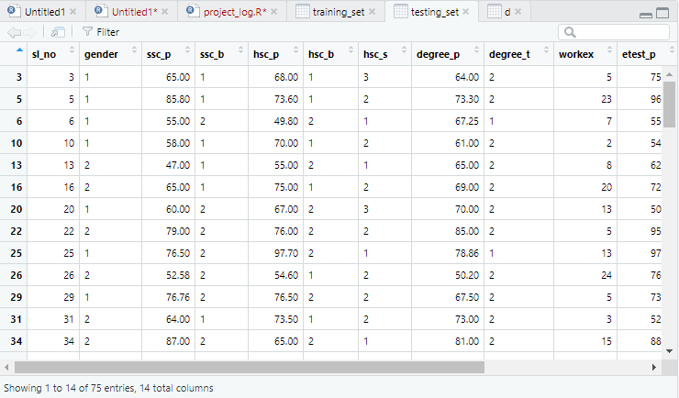
Testing Dataset
This is the testing set in which the model is tested.
The data is created from the main dataset.
It has 14 columns and 75 rows of entries.

Slide 27
ANALYSIS

Slide 28
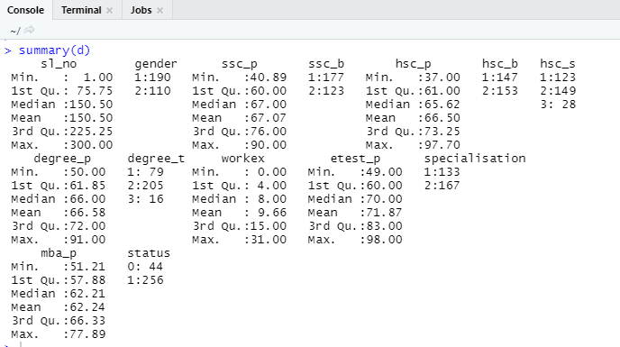
This tells us about the summary of each and every variable.
Categorical variable tells us about the ratio of their variable.
Numerical variable tells us all about the data.

Slide 29
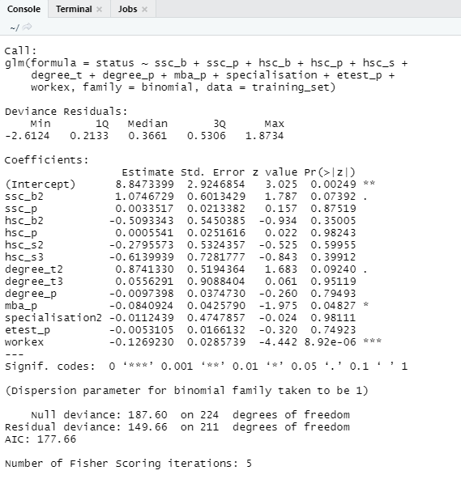
MODEL
This model tells us about the data that there are 13 variables and workex is the highest significant variable which means that workex will effect during the recruitment and some less significant variables such as mba_p, ssc and degree.

Slide 30
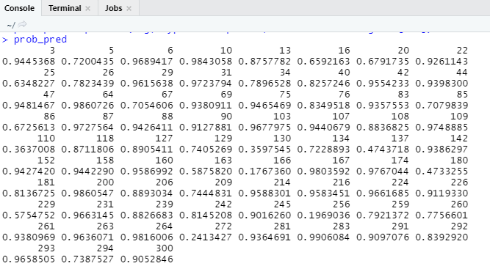
Prediction part 1
This is the prediction done on the testing set which gives probabilistic values of every term.

Slide 31
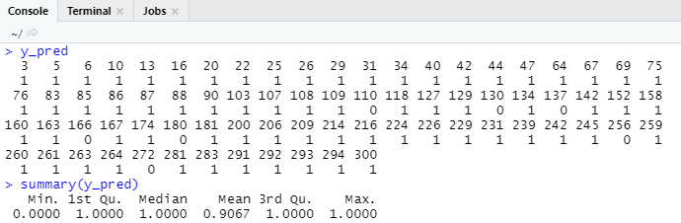
Prediction part 2
When the probabilistic values is converted into whole number by taking a threshold number which was taken as 0.5.

Slide 32
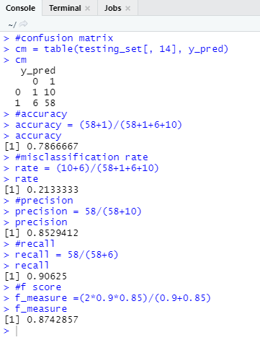
Confusion Matrix
It tells about the model that how accurate it is.

Slide 33
Table 1
 | Hired | Not Hired
Minimum | 0 | 0
First quartile | 8.5 | 4
Median | 16.5 | 7
Mean | 15.77 | 8.609
Third quartile | 22 | 12
Maximum | 31 | 27
In this table it shows the summary of the hired and not hired candidates according to workex (work experience).

Slide 34
Table 2
 | Hired | Not Hired
Minimum | 51.29 | 51.21
First quartile | 59.26 | 57.69
Median | 65.24 | 61.95
Mean | 64.80 | 61.80
Third quartile | 70.87 | 65.61
Maximum | 77.89 | 77.89
In this table it shows the summary of the hired and not hired candidates according to mba_p (percentage in MBA).

Slide 35
Table 3
 | Hired | Not Hired
Minimum | 50 | 50
First quartile | 64.38 | 61.37
Median | 69 | 66
Mean | 68.95 | 66.17
Third quartile | 75.55 | 71.72
Maximum | 85 | 91
In this table it shows the summary of the hired and not hired candidates according to degree_p (percentage in degree or graduation).

Slide 36
Table 4
 | Hired | Not Hired
Minimum | 41 | 40.89
First quartile | 63.75 | 59.45
Median | 69.30 | 66.50
Mean | 69.76 | 66.61
Third quartile | 79.50 | 75.25
Maximum | 88 | 90
In this table it shows the summary of the hired and not hired candidates according to ssc_p (percentage in high school).

Slide 37
Results
online recruitment system has revolutionized the offline recruitment system. Slowly by slowly in some ways there is a change in the recruitment process which highly affects the traditional method. From the data we have collected we have clearly seen that a company is hiring a fresher by its qualifications specially by their work experience and their MBA marks for their assistant manager post. As we have seen that for acquiring any job, we have to make our educational qualifications looks good. A student is getting hired or not is mostly depends on the academics for the first time. But apart from these qualifications students who is getting graduation marks was also important for some candidates from the process of recruitment. Therefore, we can see that recruitment system is somehow changing and using machine learning makes easy way for the recruiters and the candidates so that it will makes us life easier.

Slide 38
Conclusion
We conclude that machine learning helps the recruitment process in many ways to ease the work of a recruiter or the candidate who is filling the post in a company or finding a job in the company. As it will also tell us work experience is most important for the post of assistant manager. Experience and marks in graduation and MBA play a crucial part in getting posted by any company. Therefore, a good work experience will get too easy for a candidate to get a job in a reputed company. We also see that hired candidates have an average in marks or inexperience. They neither are too good nor too bad. Hiring can be difficult to make our process fast we have to use machine learning. Our traditional system of hiring candidates is outdated and needs to be replaced as it will waste a huge amount of time, money, and mainly services that will use somewhere where it is also needed.

Slide 39


