Slide 1

Disease Prediction Using Machine Learning
Aditya Srivastava
A8979220002
Faculty Guide’s Name- Dr. Gunjan Singh
Industry Guide’s Name - Mr. Jaison Leon
NTCC
Amity School of Applied Sciences
Amity University

Slide 2
Introduction
prediction of disease is sometimes a difficult process
using machine learning algorithm disease prediction is much more easy .
decision tree algorithm is used to predict the disease based on their symptons.
today, using these algorithm disease prediction is fast and efficient way to acknowledge about the diseases otherwise it could be fatal to death.

Slide 3
Disease Prediction
it is the way to recognize the diseases based on their symptons.
prediction can be done on an early stage for any diseases otherwise it would fatal for that person to death.
based on their symptoms disease could be predicted accurately otherwise person’s life could be at risk.

Slide 4

Machine Learning
Machine learning is a method of data analysis is that automates analytical model building.
It is a branch of artificial intelligence based on the idea that the systems can learn from data, identify patterns and make decisions with minimal human intervention.

Slide 5
Arthur Samuel stated that
“It gives computers the ability to learn without being explicitly programmed”
Tom M. Mitchell said that
“A computer program is said to learn from experience E concerning some class of tasks T and performance measure p if its performance at tasks int, as measured by P improves with experience E.”

Slide 6
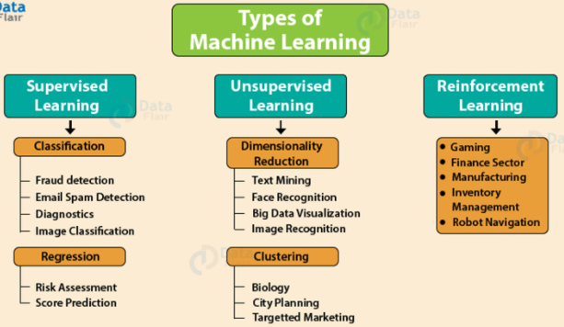
Types of Machine Learning

Slide 7
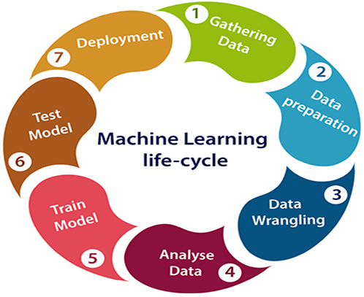
Process of Machine Learning

Slide 8
Disease Prediction Using Machine Learning
through machine learning disease prediction is a way to recongnize the diseases based on their symptons in a fast and efficient way.
decision tree is an supervised learning algorithm is used in case of flow-chart structure.
using machine learning, the process is easy, helpful and understandable easily and doctors can predict the diseases in an early stage and cured properly.

Slide 9
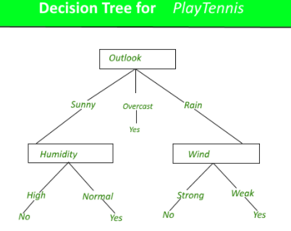
Decision Tree Algorithm
a decision tree algorithm is a classification algorithm.
it typically starts with a single node, which branches into possible outcomes.
each of these outcomes leads to additional nodes, which branch off into their possibilities.
it is loike a flow-chart structure, which each internal node represents a “test” on an attribute.

Slide 10
Dataset
the dataset is based on some diseases with their symptons.
data is of 500 people for the disease prediction.
some symtons of predicting the disease are nodal skin eruptions, cold, itching, stomach pain, joint pain etc.

Slide 11
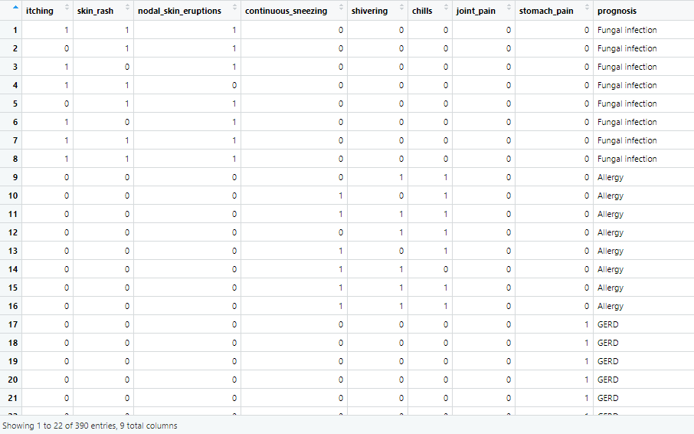
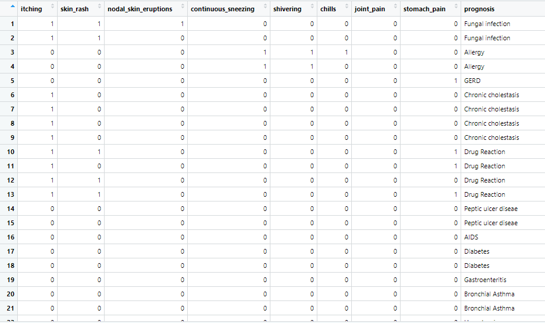
Training And Testing Dataset

Slide 12
ANALYSIS

Slide 13
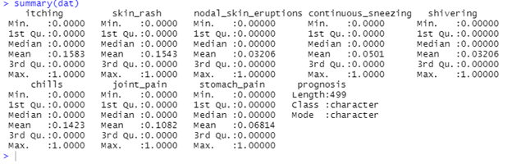
Table 1
this table shows the summary of all the symptoms through disease can be predicted.

Slide 14
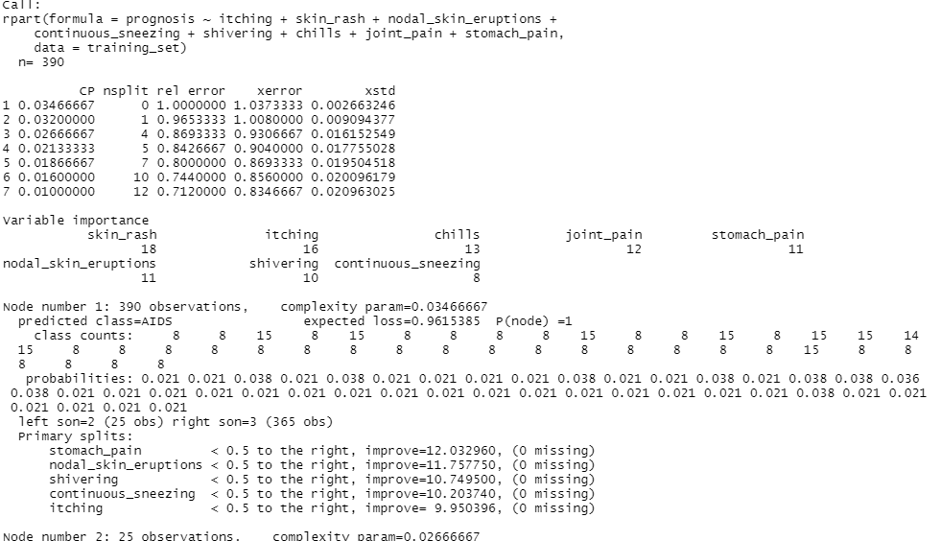
Table2
this analysis shows the summary of the model in this every node will work.each nodes outcomes will leads to additional nodes.
the pictorial representation is shown in the next slide.

Slide 15
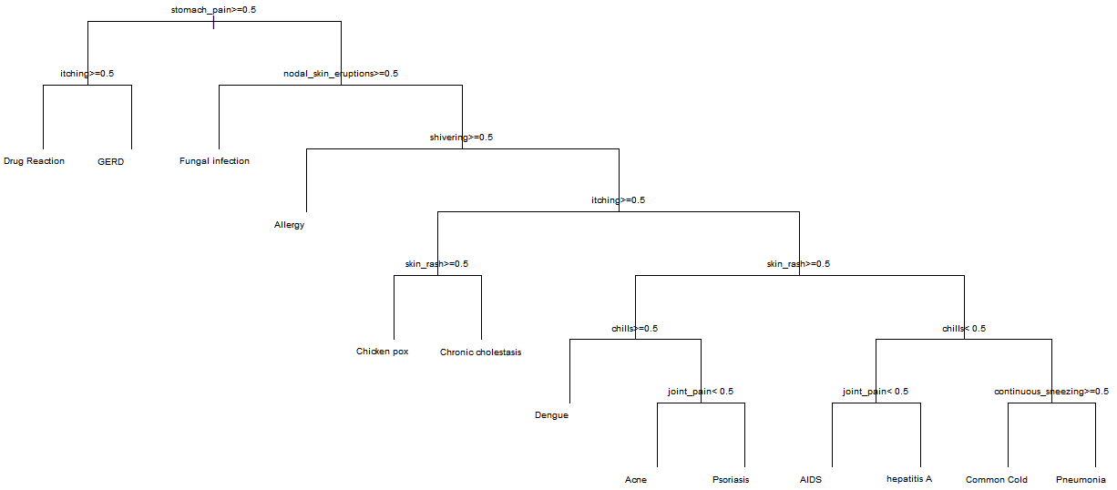

Slide 16
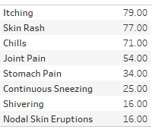
Table3
this table shows the how much the symptoms affect on diseases.
itching has highest symptoms shown by any diseases whereas nodal skin eruptions and shivering is the lowest symptoms on the human body.

Slide 17
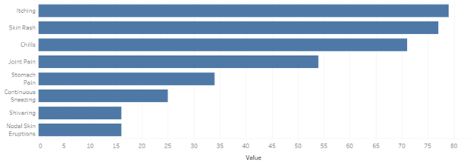
Graph1
this bar chart shows the level of symptons which can be visible on the human body.

Slide 18
THE END

