Slide 1
Advanced Programming CSE 201 Instructor: Sambuddho
(Semester: Monsoon 2024)
Week 3 – Inheritance

Slide 2
Basics of Inheritance (in Java)
- Closely connected to polymorphism.
- Def_1: Referencing many related objects as one generic type.
- Def_2: Reference of ‘parent’ class utilizing attributes and methods of a ‘child’ class, depending on which one it is referencing.

Slide 3
Slide Acknowledgement
CS15, Brown University

Slide 4
Basics of Inheritance (in Java)
- Closely connected to polymorphism.
- Def_1: Referencing many related objects as one generic type.
- Def_2: Reference of ‘parent’ class utilizing attributes and methods of a ‘child’ class, depending on which one it is referencing.

Slide 5


Spot the Similarities
What are the similarities between a convertible and a sedan?
What are the differences?

Slide 6
Convertibles vs. Sedans
Convertible
Sedan
Top Down Roof (Retractable Roof)
Drive
Brake
Play radio
Lock/unlock doors
Turn off/on turn engine
Fixed Roof

Slide 7
Can we model this in code?
In some cases, objects can be very closely related to each other
Convertibles and sedans drive the same way
Flip phones and smartphones call the same way
Imagine we have an Convertible and a
Sedan class
Can we enumerate their similarities in one place?
How do we portray their relationship through code?
Convertible
putTopDown()
turnOnEngine()
turnOffEngine()
drive()
Sedan
parkInCompactSpace ()
turnOnEngine()
turnOffEngine()
drive()

Slide 8
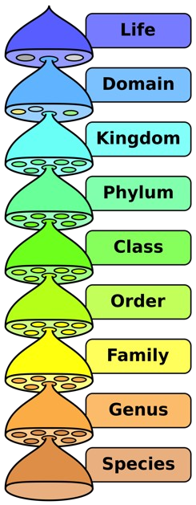

Inheritance
In OOP, inheritance is a way of modeling very similar classes
Inheritance models an “is-a” relationship
A sedan “is a” car
A dog “is a” mammal
Animalia
Chordata
Mammalia
Remember: Interfaces model an “acts-as”
relationship
You’ve probably seen inheritance before!
Taxonomy from biology class
…
Canis

Slide 9
Modeling Inheritance (1/2)
This is an inheritance diagram
Each box represents a class
Mammal
A Poodle “is-a” Dog, a Dog “is-a” Mammal
Transitively, a Poodle is a Mammal
“Inherits from” = “is-a”
Poodle inherits from Dog
Dog inherits from Mammal
This relationship is not bidirectional
A Poodle is a Dog, but not every Dog is a Poodle (could be a Labrador, a German Shepard, etc)
Dog
Poodle
Labrador

Slide 10
Modeling Inheritance (2/2)
●Superclass/parent/base: A class that is inherited from
Mammal
●Subclass/child/derived: A class that inherits from another
●“A Poodle is a Dog”
Poodle is the subclass
Dog is the superclass
●A class can be both a superclass and a subclass
Ex. Dog
●In Java you can only inherit from one superclass (no multiple inheritance)
Other languages, like C++, allow for multiple
Dog
Poodle
Labrador
inheritance, but too easy to mess up
Andries van Dam © 2016 9/27/16

Slide 11
Motivations for Inheritance
A subclass inherits all of its parent’s public and protected capabilities
If Car defines drive(), Convertible inherits drive() from Car and drives the same way. This holds true for all of Convertible’s subclasses as well
Inheritance and Interfaces both legislate class’s behavior, although in very different ways
Interfaces allow the compiler to enforce method implementation
An implementing class will have all capabilities outlined in an interface
Inheritance assures the compiler that all subclasses of a superclass will have the superclass’s public capabilities without having to respecify code – methods are inherited
A Convertible knows how to drive and drives the same way as Car because of inherited code
Benefit of inheritance
Code reuse
▪
▪
If drive() is defined in Car, Convertible doesn’t need to redefine it! Code is inherited Only need to implement what is different, i.e. what makes Convertible special

Slide 12
Superclasses vs Subclasses
A superclass factors out commonalities among its subclasses
o describes everything that all subclasses have in common.
NOTE: Java classes can have only one parent (super) class, unlike CPP.
A subclass differentiates/specializes its superclass by:
o adding new methods:
o Overriding inherited methods:

Slide 13
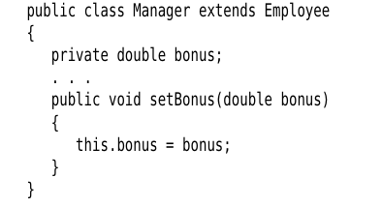
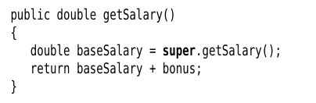
Method Overriding
Override parent class ‘public’ methods (not private).
Child can access ‘public’ methods and attributes of parent class.
Using parent class attributes – super.<Attib_name>
Using parent class methods – super.f()
Calling parent class constructor
<subclass constructor>{
super(<arguments>)
}

Slide 14
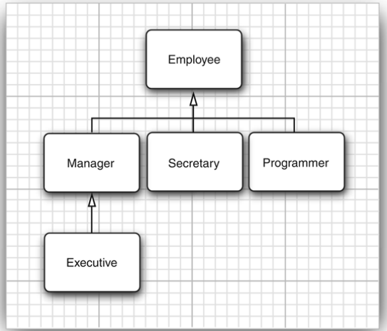
Inheritance and Polymorphism
Polymorphism is an incredibly powerful tool.
Allows for generic programming.
Treat multiple classes as their generic type while still allowing specific method implementations to be executed.
Polymorphism+Inheritance is strong generic coding

Slide 15
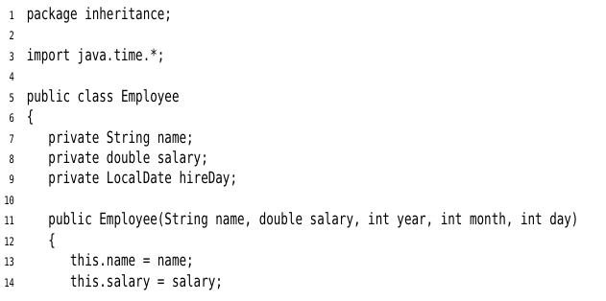
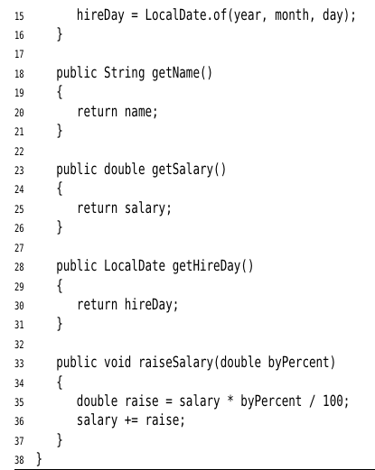
Inheritance and Polymorphism

Slide 16
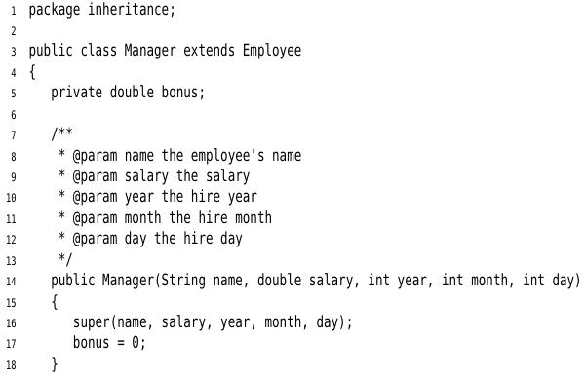
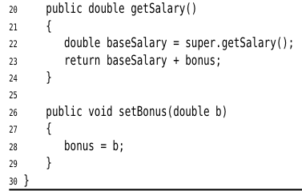
Inheritance and Polymorphism

Slide 17
Inheritance and Polymorphism

Slide 18



Inheritance and Polymorphism
Why ?

Slide 19
Rules for Method Calls
1. Compiler looks at types of objects and method names, determines the appropaite method based on the return type. The compiler also resolves.
2. Argument types.
3. Method types – ‘private’ , ‘static’ , ‘final’.
4. Polymorphic associations – dynamic binding at runtime.

Slide 20
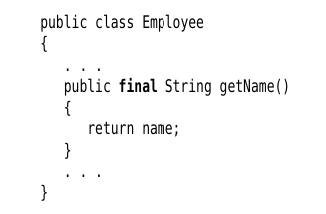

Preventing Inheritance
1. What all a child class inherits:
Public objects and methods.
Private of parent is never inhreited.
Parent constructors (by default public, like everything else in Java).
Preventing inheritance:
You could also prevent specific methods
from being inherited without making them private.

Slide 21
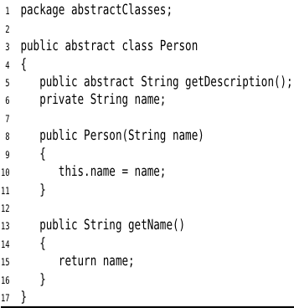
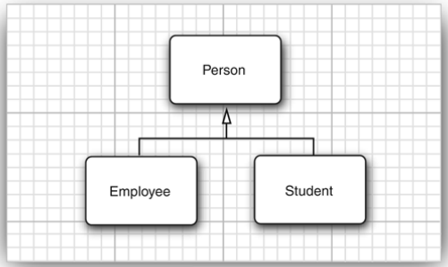
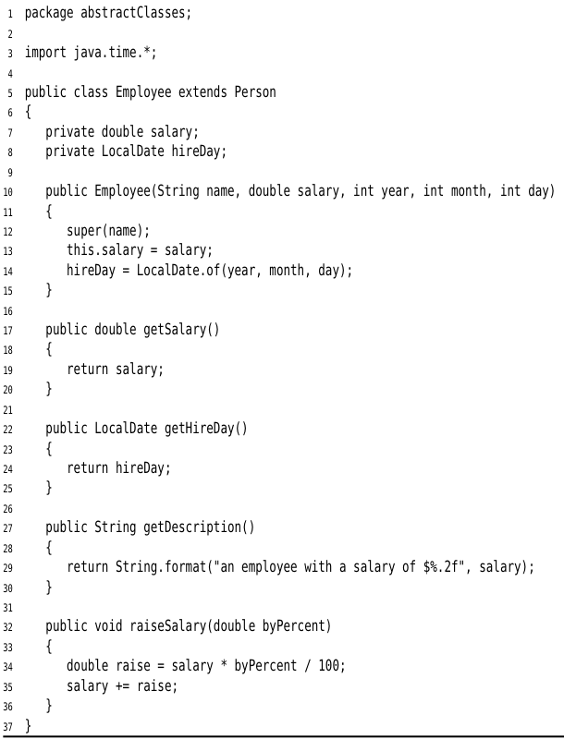
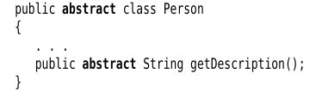
Abstract Classes

Slide 22
Protected Access
‘Protected’ methods and objects cannot be accessed by objects of the class much like ‘private’.
‘Protected’ methods and objects/variable can be accessed by child classes.

Slide 23


Object – the Cosmic Super Class
Object – parent of all classes (implicit); not of primitive types – int, char, byte etc.
Can be assigned to object of any class.
Arrays – regardless they are of primitive types or of classes, are of type Object.

Slide 24
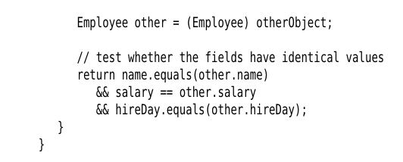
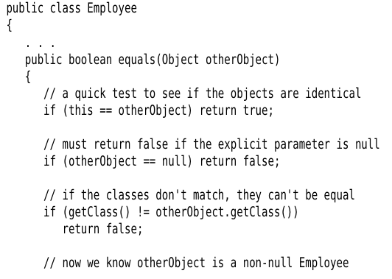
Object – equals() method
Test if two objects ‘equal’ or same. Could mean many things – reference to same object (default), same value etc.
Object class defines equal(). Other classes, can extend it with their own definition.

Slide 25
Object – toString() method
Used to for printing a string equivalent information of the class. E.g. System.out.println(s); the return type is String and the name is toString()
class MyClass{
...
public String toString(){
return “XYZ”;
}
}

Slide 26
Object Wrappers and Autoboxing
Object corresponding to a primitive type [Integer, Long, Flot, Double,Short, Byte and Boolean].
Their objects are immutable – once a wrapper object has been created their values cannot be changed.
They are ‘final’ and cannot be inherited.
Integer[] list;
list = new Integer[500];
list[0] = 1;
list[1] = 1;
list[i]++;
But list[i] == list[j] fails.

Slide 27
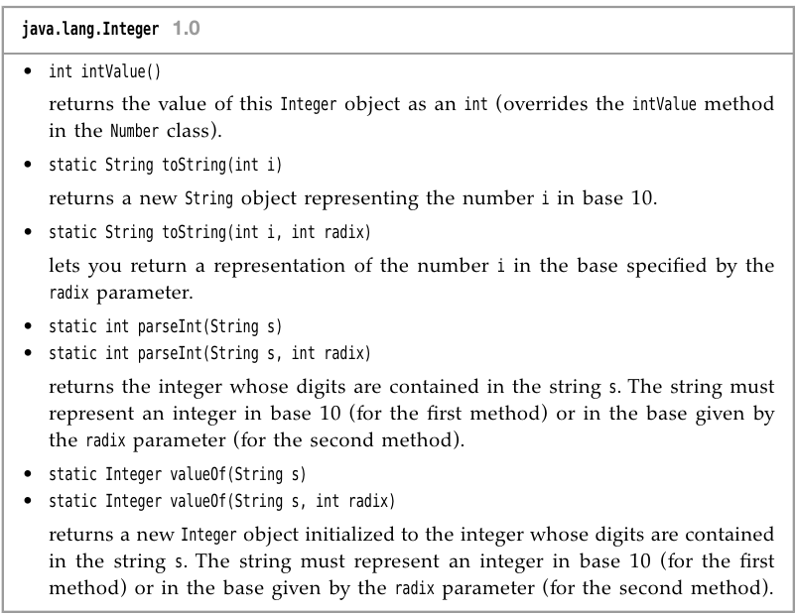
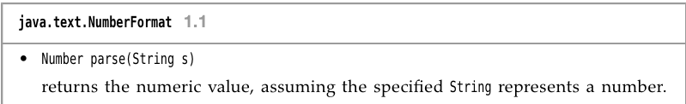
Object Wrappers and Autoboxing
list[i].intValue() == list[j].intValue();

Slide 28

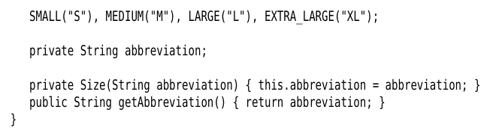

Enum classes
Enumerated types – alternatives to constants.
public enum Size { SMALL, MEDIUM, LARGE, EXTRA_LARGE }

Slide 29
Generic ArrayLists
ArrayList is a generic class with a type parameter.
An example of polymorphism.
Provides a dynamically growing (or shrinking) array of objects.
ArrayList<Integer> mylist = new ArrayList<Integer>();
or
ArrayList<Integer> mylist = new ArrayList<>();

Slide 30
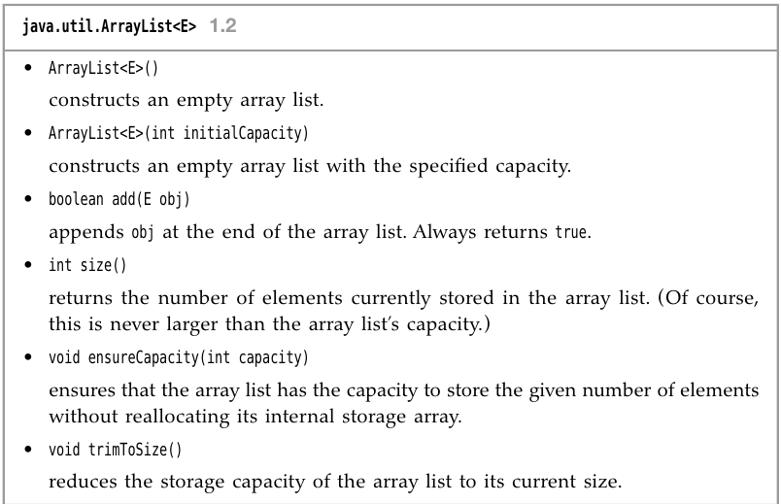
Generic ArrayLists
Accessing ArrayList elements
mylist.get(index);
mylist.set(index,val);
ArrayList.toString() already defined. Prints comma separated array element values.

Slide 31
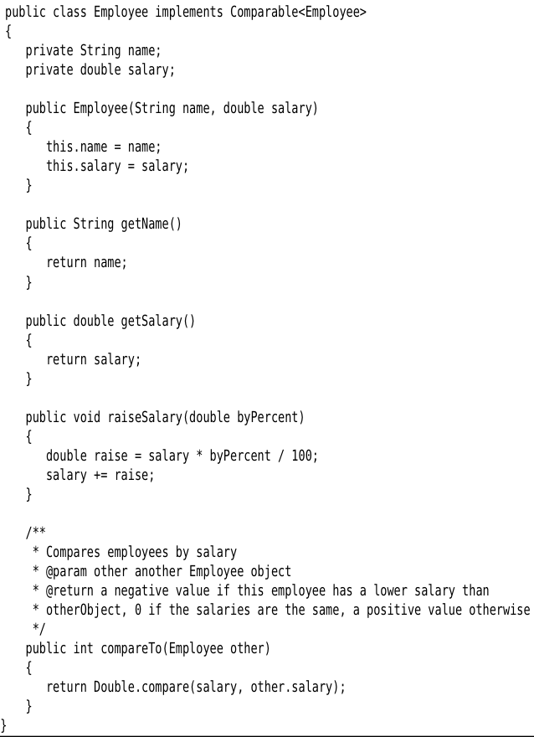
Interfaces

Slide 32

Interfaces

Slide 33
Interfaces – Single Inheritance with Multiple Interface Implementations.
public interface Comparable{
public int compareTo(Object otherobject);
}
class Manager extends Employee implements Comparable {
....
}
Can be as many as the programmer
feels like.

Slide 34
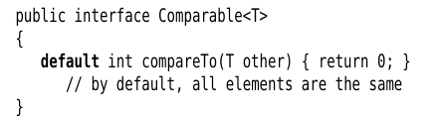
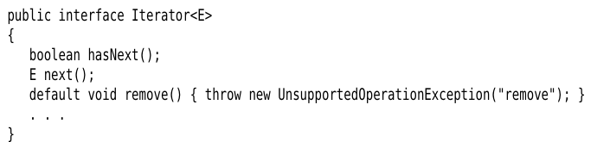
Interfaces –Default Methods
Somewhat like a default constructor, but you cannot instantiate objects of interfaces!

Slide 35
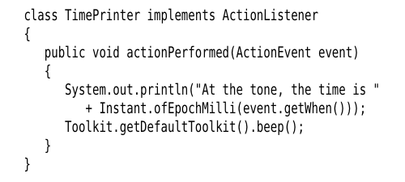
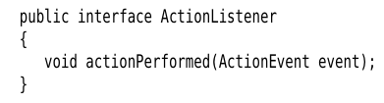
Popular Use Case – Callbacks.
Callback function frameworks use interfaces.
Event listeners – need to implement these interfaces and interface functions.
Timer t = new Timer(1000,new TimePrinter());

Slide 36
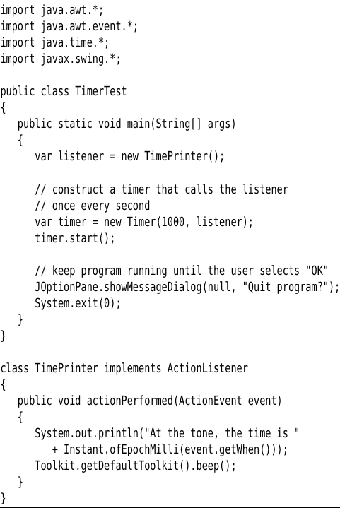
Popular Use Case – Callbacks.

Slide 37
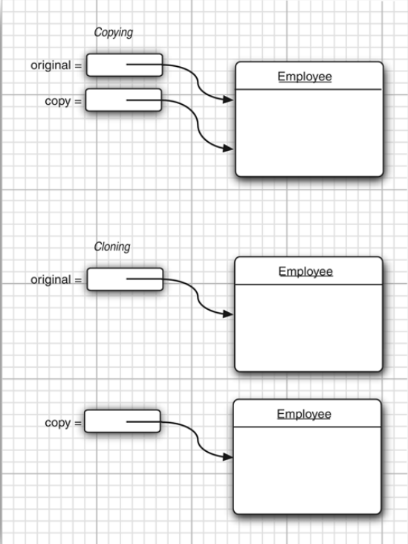


Object Cloning

Slide 38
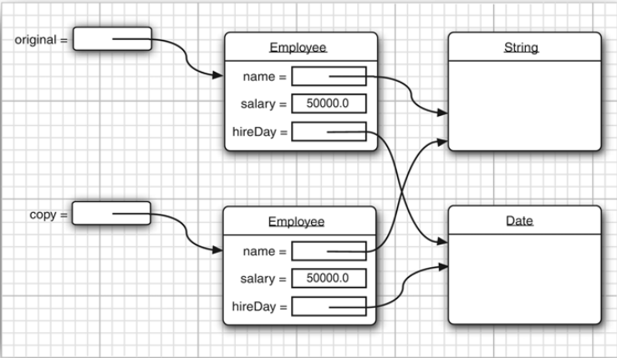
Object Cloning – Default:Shallow Copy

Slide 39
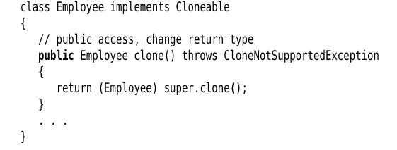
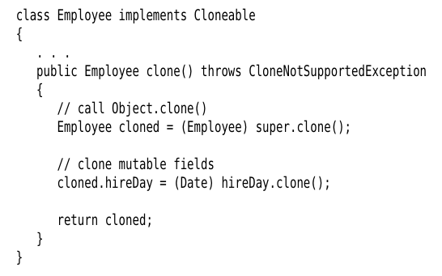
Object Cloning – Deep Copy: Implement Clonable

