Slide 1
Advanced Programming CSE 201 Instructor: Sambuddho
(Semester: Monsoon 2024)
Week 4 – Inner Classes
and Exceptions/Exception
Handling

Slide 2
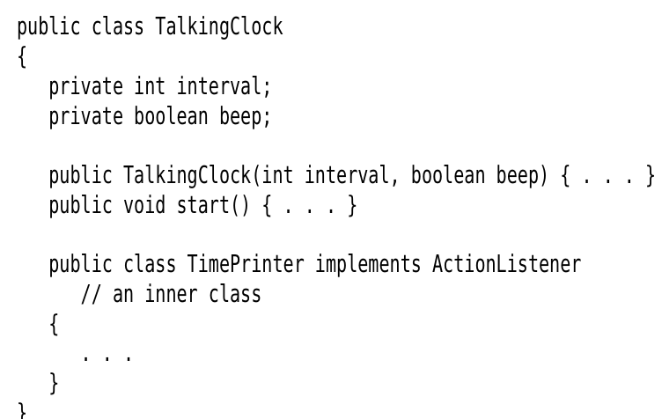
Inner Classes

Slide 3
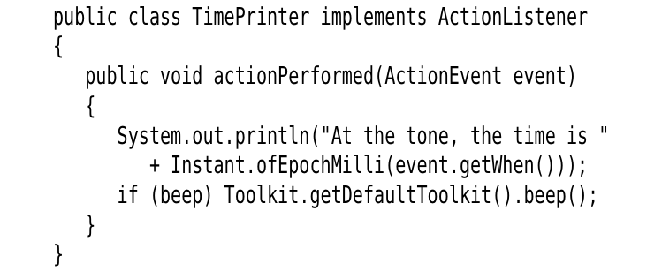
Inner Classes
Implicit reference to object of outer class. However the correct way to use is to refer with object of the outer class.

Slide 4
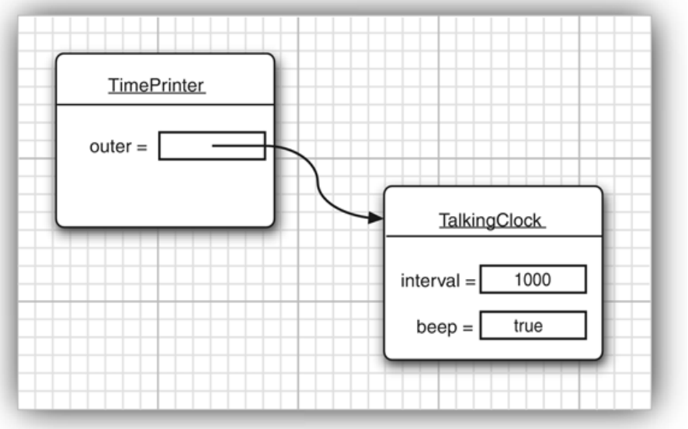
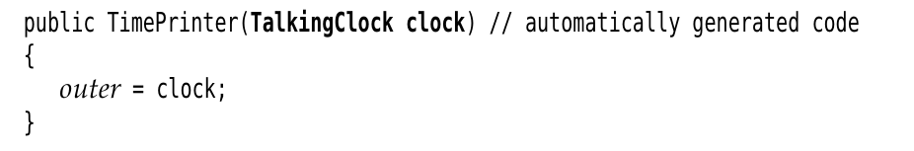
Inner Classes
Accessible with an object of the outer class in the inner.

Slide 5
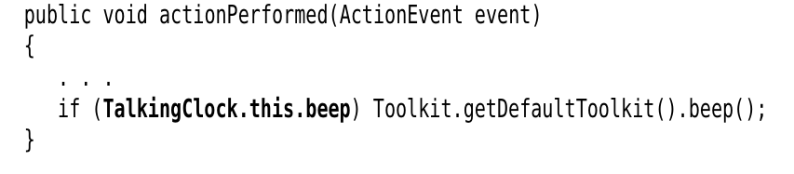
Inner Classes
Accessible without requiring in object. Outer class encapsulates the inner class as well.

Slide 6
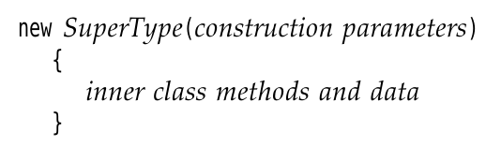
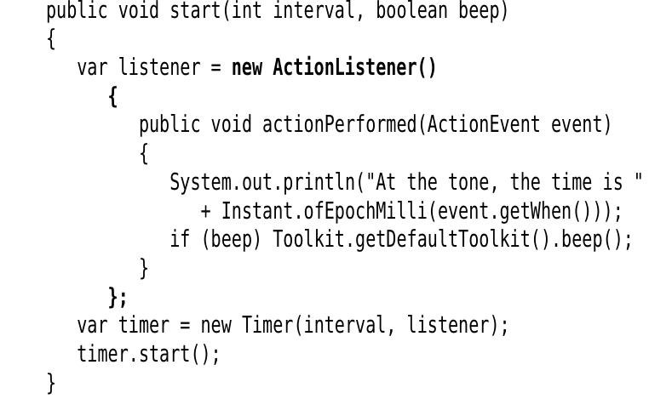
Anonymous Class

Slide 7
Exceptions and Exception Handling
OOP avatar of errors and error handling.
- Array out of bounds.
- IOException – e.g. File not found error.
- Mathematical exception – divide by zero error, NAN error, floating point exception etc.

Slide 8

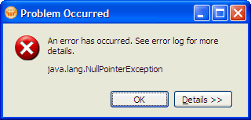

Being Defensive is Important
© Vivek Kumar

Slide 9
Exception Handling Syntax
Process for handling exceptions
o o
try some code, catch exception thrown by tried code, finally, “clean up” if necessary
try, catch, and finally are reserved words
try denotes code that may throw an exception
o o o
place questionable code within a try block
a try block must be immediately followed by a catch block unlike an if w/o else thus, try-catch blocks always occurs as pairs
catch exception thrown in try block and write special code to handle it
o o o
catch blocks distinguished by type of exception
can have several catch blocks, each specifying a particular type of exception Once an exception is handled, execution continues after the catch block
finally (optional)
special block of code that is executed whether or not an exception is thrown
o
follows catch block
Andries van Dam © 2016 9/22/16

Slide 10
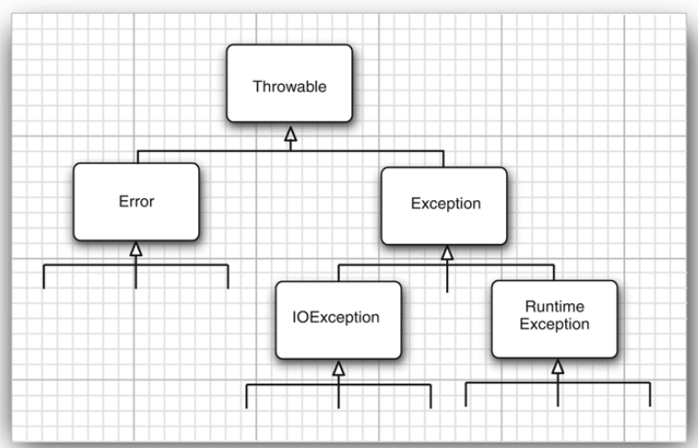
Exceptions and Exception Handling
Exceptions are also classes

Slide 11
Exceptions Handling by JVM
Any method invocdation is represented as a “stack frame” on the Java “stack”
Callee-Caller relationship: If method A calls method B then A is caller and B is callee
Each frame stores local variables, input parameters, return values and intermediate calculations
In addition, each frame also stores an “exception table”
This exception table stores information on each try/catch/finally block, i.e. the instruction offset where the catch/finally blocks are defined.
How JVM handles exceptons:
1. Look for exception handler in current stack frame (method)
2. If not found, then terminate the execution of current method and go to the callee method and repeat step 1 by looking into callee’s exception table
3. If no matching handler is found in any stack frame, then JVM finally terminates by throwing the stack trace (printStackTrace method)

Slide 12
Exception Handling Syntax
Process for handling exceptions
o o
try some code, catch exception thrown by tried code, finally, “clean up” if necessary
try, catch, and finally are reserved words
try denotes code that may throw an exception
o o o
place questionable code within a try block
a try block must be immediately followed by a catch block unlike an if w/o else thus, try-catch blocks always occurs as pairs
catch exception thrown in try block and write special code to handle it
o o o
catch blocks distinguished by type of exception
can have several catch blocks, each specifying a particular type of exception Once an exception is handled, execution continues after the catch block
finally (optional)
special block of code that is executed whether or not an exception is thrown
o
follows catch block
Andries van Dam © 2016 9/22/16

Slide 13
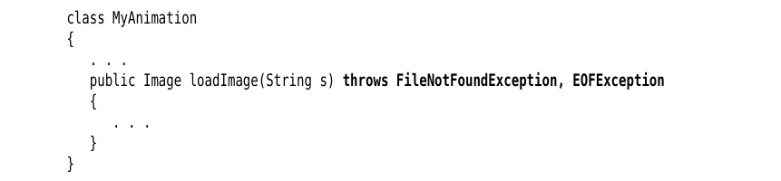
Exceptions and Exception Handling
Methods tells Java compiler that what kind of errors it can throw.

Slide 14
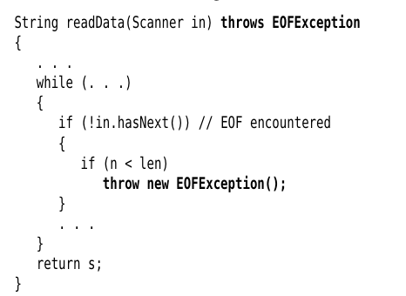
Throwing an Exception

Slide 15
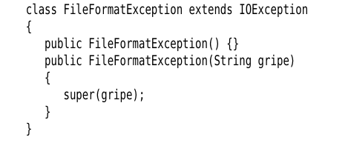
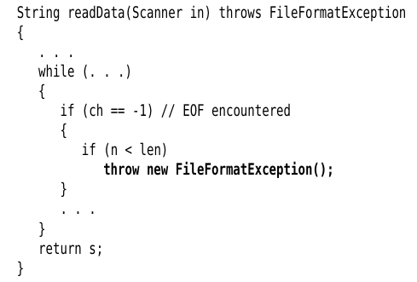
Creating and Throwing Exception Class

Slide 16
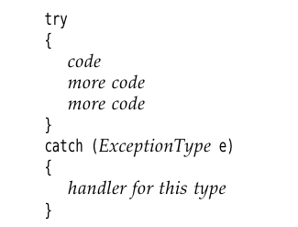
Catching What Was Thrown
In try {} code after the throw is skipped.
The program jumps to the catch() handler.
If no appropriate handler, then JRE handles it and show it on stdout

Slide 17
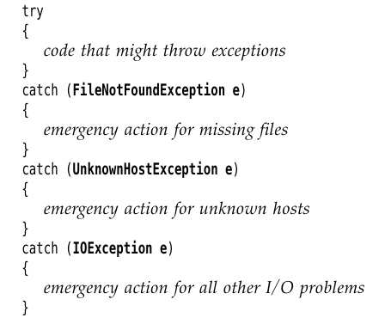
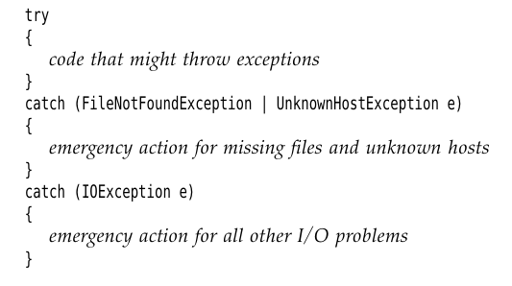
Catching What Was Thrown
Combining exceptions

Slide 18
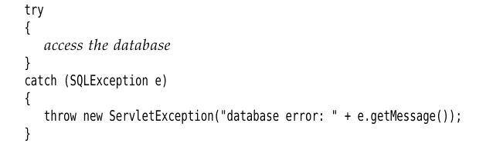
Rethrowing Exceptions

Slide 19
Finally Clause
- Executed at the end of all try{} catch{} blocks.
- Last set of instructions to be called before the program terminates. Usually used for resource release and clearup operations.

Slide 20
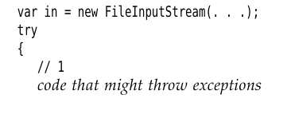
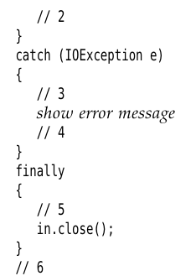
Finally Clause

Slide 21
Using Assertions
- Idiomatic tools for defensive programming.
- Faster execution than throwing exceptions.
- Not to be used for everyday programs.
- Irrecoverable.
- Usually program terminates.
assert <condition>;
assert <condition> : <expression> ;
[ Check condition. If false then create an object with argument <experession> of type AssertionError – JVM catches it and prints the details presented in the <expression> ]

Slide 22
Using Assertions
if (x > 0){
....
}
Else {
...
}
if (x > 0){
throw new exception(“myexception”) ;
}
catch(Exception ep){
...
}
assert x>0 : new String(“x>0”);

Slide 23

Logging
- System.out.println() cannot be always used – makes things slow.
- Adding and removing them at all places can be cumbersome.
- Usually not used in production code.
- Logging can be collectively enabled or supressed.

Slide 24

Log Levels
Top -> Bottom levels of logging.
If you log a bottom level,
then you log all levels above it.
SEVERE, WARNING and INFO
are always enable for every
Java program by default.
logger.warning(msg);
logger.fine(msg);
logger.log(Level.<Levelname>, msg);

Slide 25

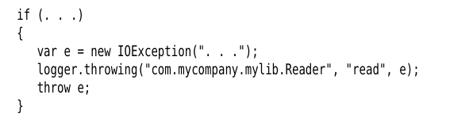

Logging Unexpected Exceptions
Two methods commonly used:

