Slide 1
Advanced Programming CSE 201 Instructor: Sambuddho
(Semester: Monsoon 2024)
Week 5 – Generic Classes

Slide 2
Generic Container to Hold Different Types ?
By using any of the concepts taught till now in this course, how can you store different types of objects in a same datastructure
o
E.g., String, Integer, Float, etc. ?
4

Slide 3
Approach 1
public class MyGenericList { private ArrayList myList; public MyGenericList() {
myList = new ArrayList();
}
public void add(Object o) { myList.add(o);
}
public Object get(int i) { return myList.get(i);
}
Using inheritance we know Object class can hold any type of objects
We can create ArrayList of objects
Problems we face:
Mandatory type casting while getting the object from list
No error checking while adding objects as we are allowed to add any type of objects
public static void main(String[] args) { MyGenericList generic = new
MyGenericList();
generic.add(“hello”); generic.add(10); generic.add(10.23f);
......
String str = (String) generic.get(0); // OK String str = (String) generic.get(1); //
NOT OK
▪
Wrong type casting can land
you with runtime errors
}
5
© Vivek Kumar

Slide 4
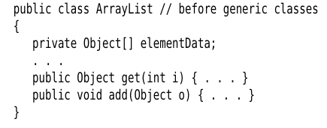


Generic Programming
- Code that can be reused. Need not be rewritten for individual types.
- Same class and methods can be used for multiple types (non primitive).
- Avoid generic casting errors.

Slide 5




Solution: Generic Programming
Our generic cup can hold different types of liquid
In the notation Cup<T>:
o o o o o
T = Coffee T = Tea
T = Milk T T = Soup
……
Cup == Generic Container

Slide 6
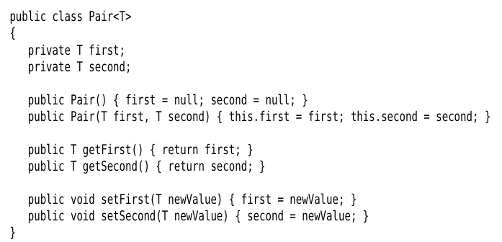

Generic Programming
var files = new ArrayList<String>();
Or
ArrayList<String> files = new ArrayList();

Slide 7
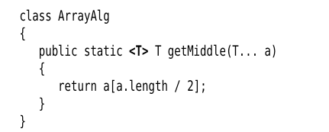
Generic Methods

Slide 8
Solution to our Problem
public class MyGenericList <T> { private ArrayList <T> myList; public MyGenericList() {
myList = new ArrayList
<T>();
}
public void add(T o) { myList.add(o);
}
public T get(int i) { return myList.get(i);
}
}
Using generic programming we don’t have to implement different classes for different object types.
Programmer friendly code!
We just have to create different instances of MyGenericList for
different objects.
public class Main {
public static void main(Sting args[]) {
MyGenericList<String> strList = new
MyGenericList<String>();
MyGenericList<Integer> intList = new
MyGenericList<Integer>();
strList.add(“hello”); intList.add(1);
...
10
}
© Vivek Kumar

Slide 9
Generic Class with Two Fields (1/3)
public class Pair <T1, T2> { private T1 key;
private T2 value;
public Pair(T1 _k, T2 _v) { key = _k; value = _v;
}
public T1 getKey() { return key; } public T2 getValue() { return value; }
}
Why this code isn’t correct?
MyGenericList class instantiated without specifying the type of its two fields
public class Main {
public static void main(Sting args[]) {
MyGenericList<Pair> db =
new MyGenericList<Pair>();
db.add(new Pair<String, Integer>(“John”, 2343)); db.add(new Pair<String, Integer>(“Susane”, 8908));
...
}
}

Slide 10
Generic Class with Two Fields (2/3)
public class Pair <T1, T2> { private T1 key;
private T2 value;
public Pair(T1 _k, T2 _v) { key = _k; value = _v;
}
public T1 getKey() { return key; } public T2 getValue() { return value; }
}
Why this code isn’t correct
During instantiation we have to declare the type of fields in MyGenericList class on both RHS and LHS of statement
public class Main {
public static void main(Sting args[]) {
MyGenericList<Pair<String, Integer>> db = new MyGenericList<Pair>();
db.add(new Pair<String, Integer>(“John”, 2343)); db.add(new Pair<String, Integer>(“Susane”, 8908));
...
}
}

Slide 11
Generic Class with Two Fields (3/3)
public class Pair <T1, T2> { private T1 key;
private T2 value;
public Pair(T1 _k, T2 _v) { key = _k; value = _v;
}
public T1 getKey() { return key; } public T2 getValue() { return value; }
}
This is the correct implementation and usage of a generic class with multiple fields
public class Main {
public static void main(Sting args[]) {
MyGenericList<Pair<String, Integer>> db =
new MyGenericList<Pair<String, Integer>>(); db.add(new Pair<String, Integer>(“John”, 2343)); db.add(new Pair<String, Integer>(“Susane”, 8908));
...
}
}
14

Slide 12
Why Generic Array Creation not Allowed ?
// Legal statement (arrays are covariant) Object array[] = new Integer[10];
// Compilation error below (generics are invariant)
Arrays are covariant
Subclass array type can be assigned to superclass array reference
List<Object> myList = new ArrayList<Integer>();
// Below line incorrect but let’s assume its correct
List<Integer> intList[] = new ArrayList<Integer>[5]; List<String> stringList = new ArrayList<String>();
stringList.add(“John”);
Object objArray[] = intList; objArray[0] = stringList;
Generics are invariant
Subclass type generic type cannot be assigned to superclass generic reference.
If generic array creation was allowed then compile time strict type checking cannot be enforced.
Runtime ClassCastException will be generated in the example here.
// This will generate ClassCastException
int my_int_number = objArray[0].get(0) ;

Slide 13
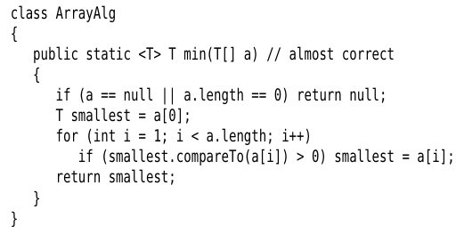

Bounds for Type Variables
Issues?
Does an object of arbitrary type have a method compareTo()?
Adding multiple bounds

Slide 14
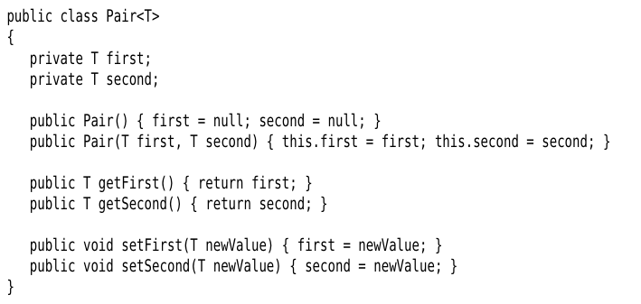
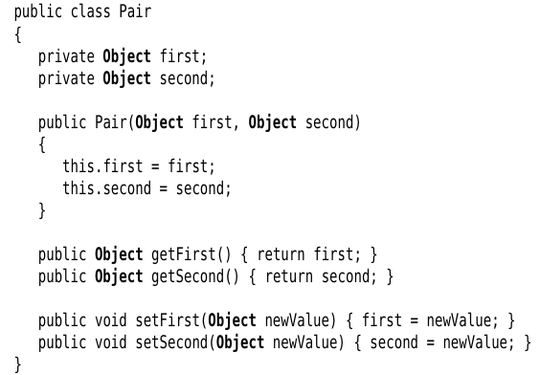
Type Erasures – Basis of Generic Programming
Rule: Erase and replace generic type with a raw type (for bounded types) and Object for unbounded.

Slide 15
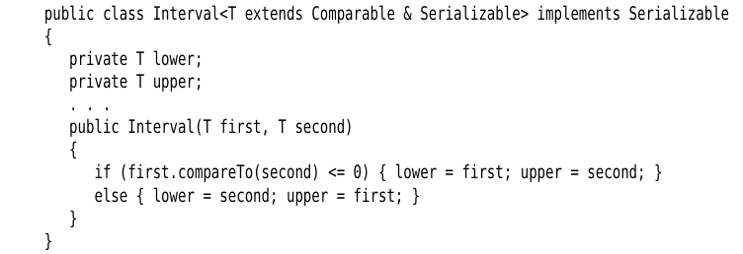
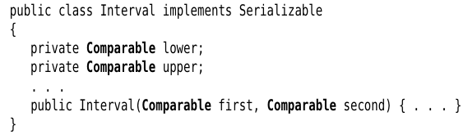
Type Erasures – Basis of Generic Programming
Rule: Erase and replace generic type with a raw type (for bounded types) and Object for unbounded.

Slide 16
Type Erasures – Implicit Casting
Step 1: Call to raw method Pair.getFirst();
Step 2: Cast returned object to type Object.
Pair<Employee> epairs = new Pair<>;
Employee epair = epairs.getFirst();

Slide 17
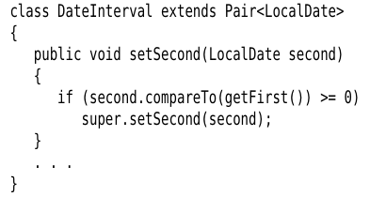
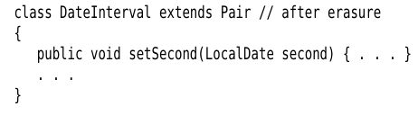
Type Erasures – Translating Generic Methods
But Pair also has setSecond(Object second);!!
Erasure interferes with polymorphism!!

Slide 18
Type Erasures – Translating Generic Methods – Bridge Methods
The compiler generates a bridge method in the DateInterval class.
(of Pair)

