Slide 1

SMART INDIA HACKATHON 2026
TITLE PAGE
Problem Statement ID : SIH26261
Problem Statement Title: AI-Powered Application Validation, Document Authentication and Regulatory Compliance Verification
Theme : Smart Automation
PS Category : Software
Team ID : 199635
Team Name : Code Blooded

Slide 2
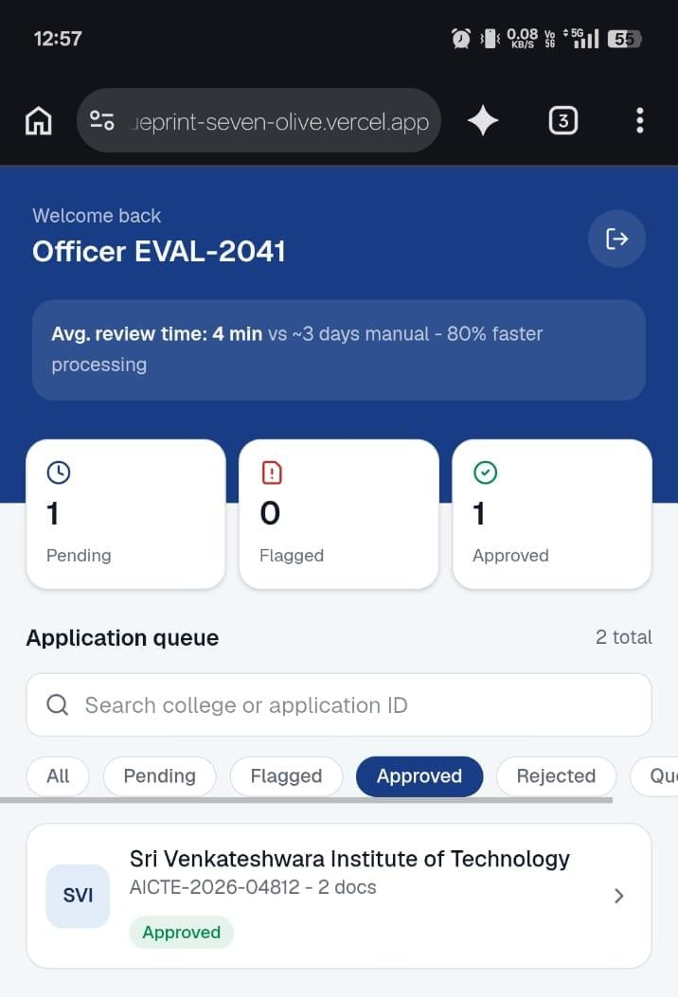
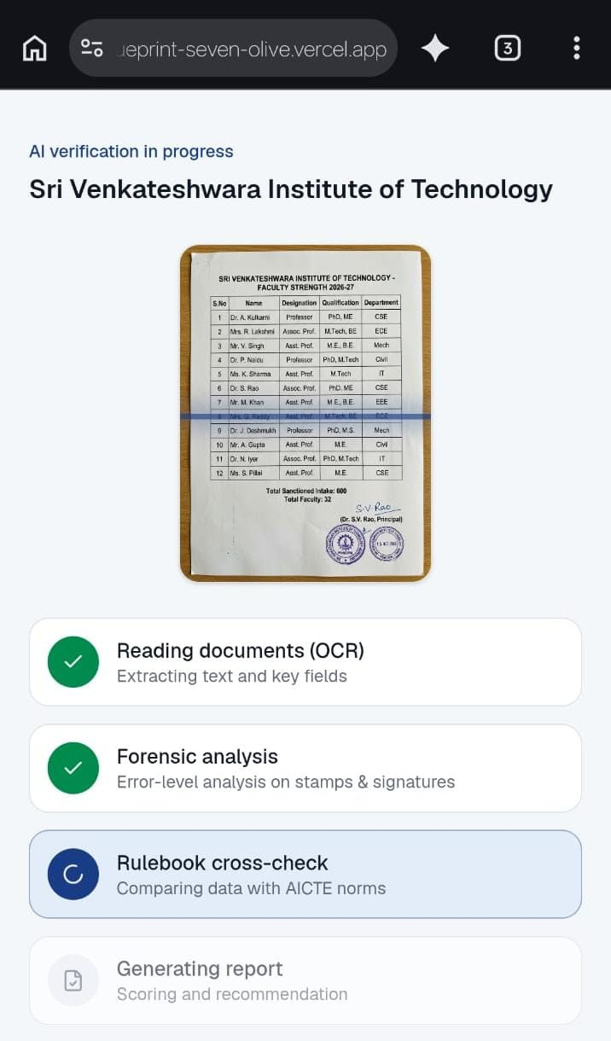
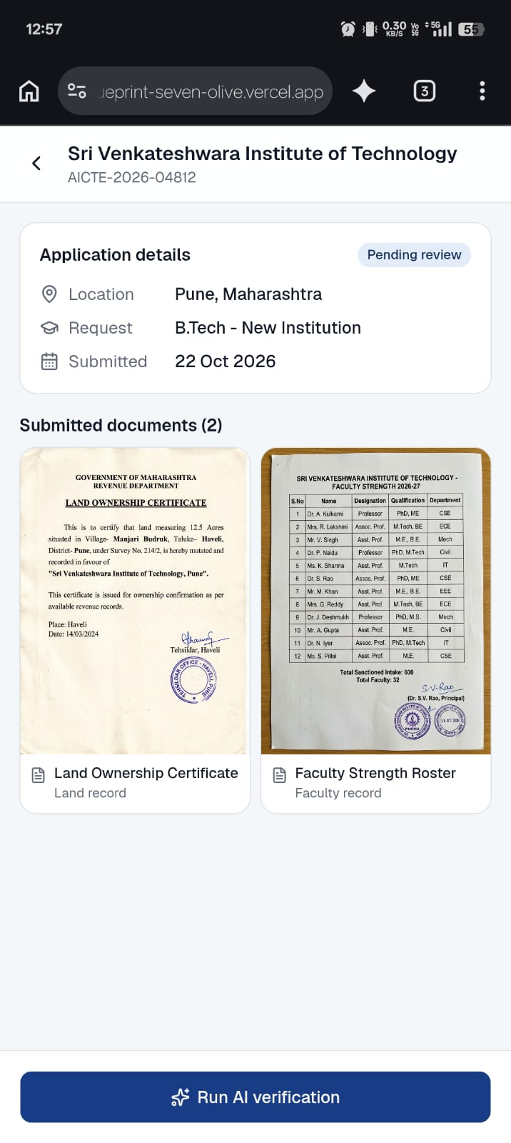
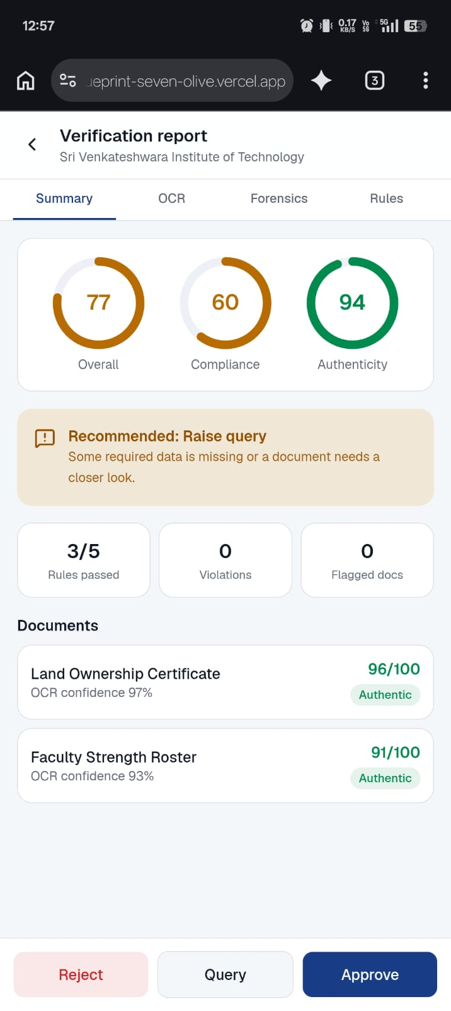
ValidAI Compliance Engine
CODE BLOODED
Proposed Solution
Secure portal ingests applications; OCR extracts text and tables; forensic AI checks signatures, stamps, and pixel metadata; RAG cross-checks extracted data against AICTE handbooks for an instant compliance report
Eliminates manual review bottlenecks, reduces human error, and flags fraudulent documents or missing compliance metrics instantly.
Combines visual forensics for stamp and signature authentication with context-aware AI for complex regulatory rule checking.

Slide 3
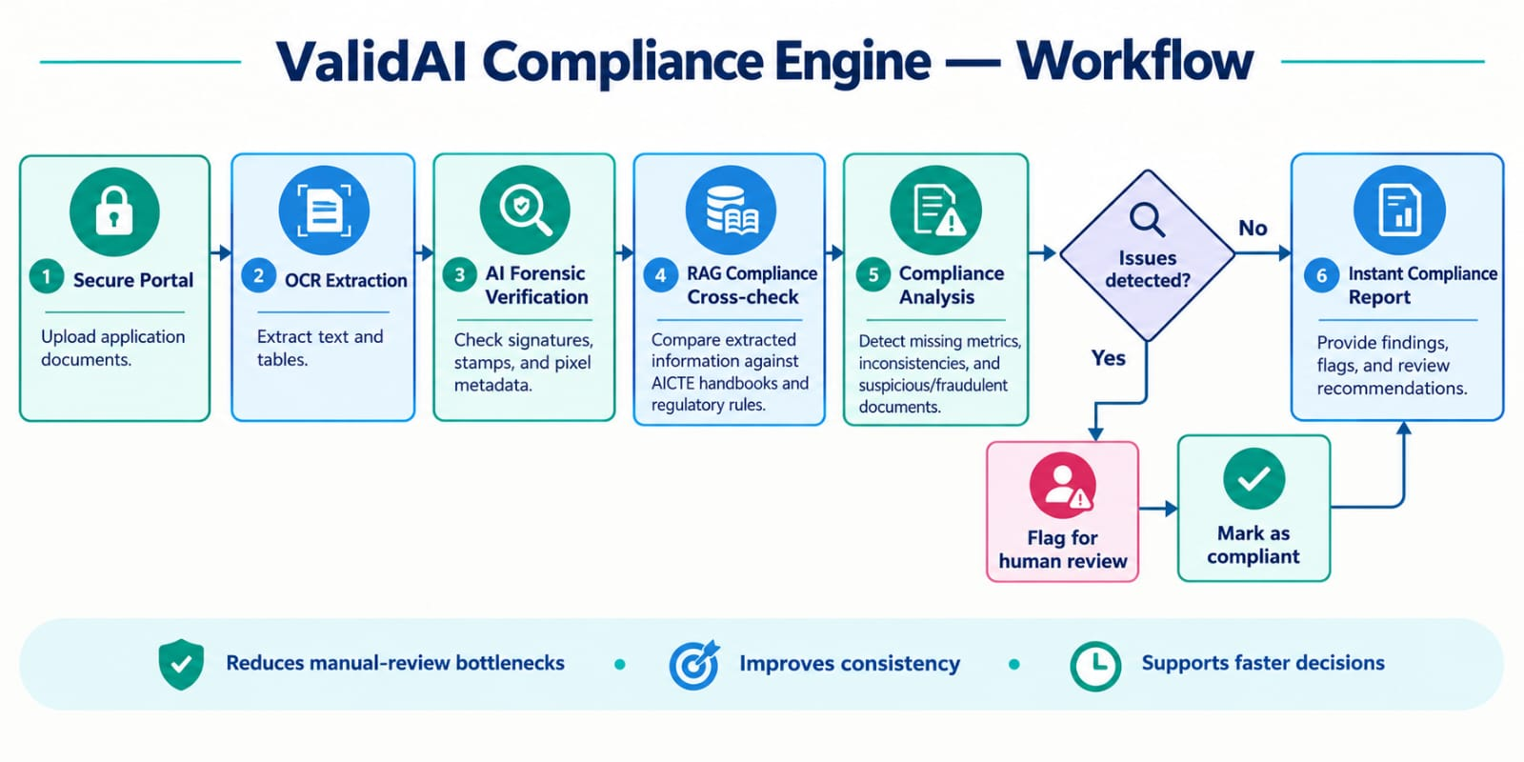
TECHNICAL APPROACH
CODE BLOODED
Technologies: Backend Python, FastAPI, Node.js; Frontend React.js, Tailwind CSS; AI/ML Tesseract OCR, OpenCV forensics, PyTorch, LangChain, Llama-3/OpenAI API; Database PostgreSQL, ChromaDB vector store.
Implementation flow: Secure institutional upload portal → pre-processing (deskewing, noise reduction, image enhancement) → data extraction (layout analysis and OCR mapping) → authenticity check (forgery detection and signature/stamp verification) → regulatory validation (LLM checks extracted data against AICTE norms) → dashboard output (final audit report; Approve or Flag status).

Slide 4
FEASIBILITY AND VIABILITY
CODE BLOODED
Feasibility: Highly feasible with existing open-source computer vision models (Paddle) and scalable AWS/Azure cloud infrastructure.
Challenges: Low-quality scans, highly variable institutional certificates, and handwritten inputs.
Mitigation: Contrast enhancement and noise removal; OCR training on diverse Indian institutional documents; human-in-the-loop routing for low-confidence results.

Slide 5
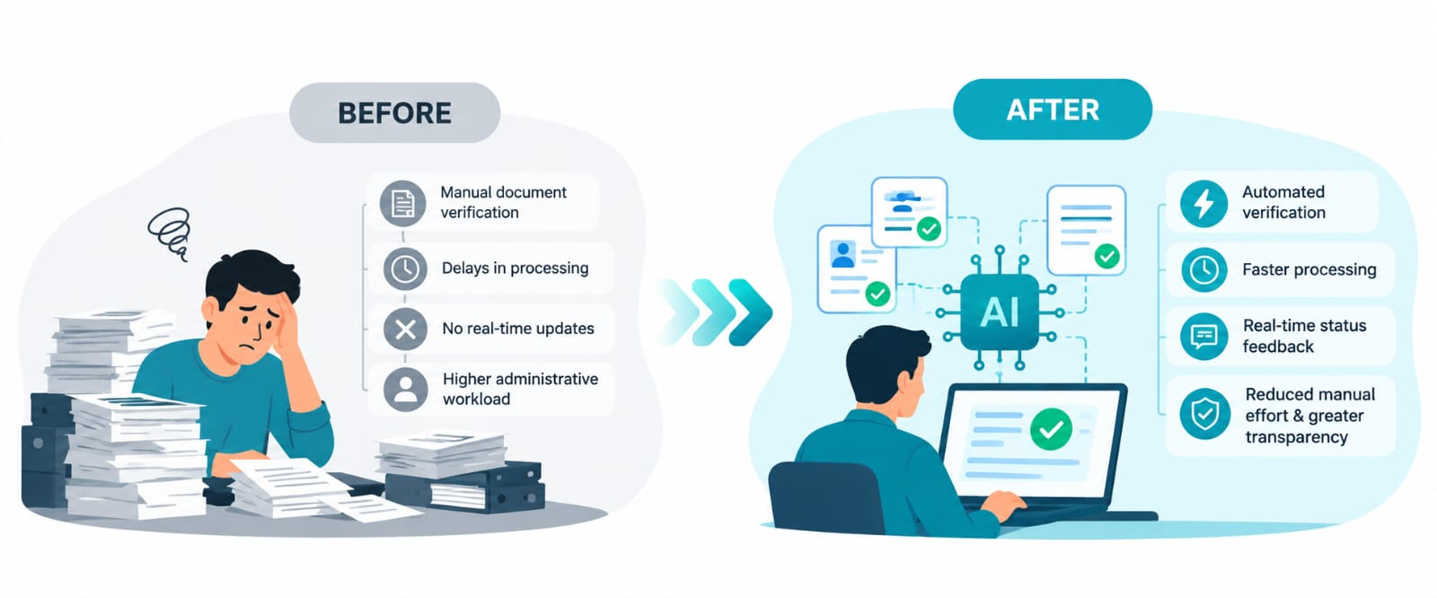
IMPACT AND BENEFITS
CODE BLOODED
Impact: AICTE evaluators and institutional applicants see an estimated 80% faster processing time with real-time application status feedback.
Benefits: Economic - lower administrative costs and manual verification hours. Governance - greater

Slide 6
RESEARCH AND REFERENCES
CODE BLOODED
AICTE Approval Process Handbook (APH) guidelines, research on document tampering detection using convolutional neural networks(Source code and dataset - GitHub), official Tesseract OCR documentation, open-source RAG framework documentation.
Prototype : Demo Video, Git Hub Repository.

