Slide 1
Automatic Number Plate Recogization System

Slide 2
Agenda
01. Introduction
02. Elements
03. Working Modules
04. Applications
05. Advantages
06. Disadvantages
07. Conclusion

Slide 3
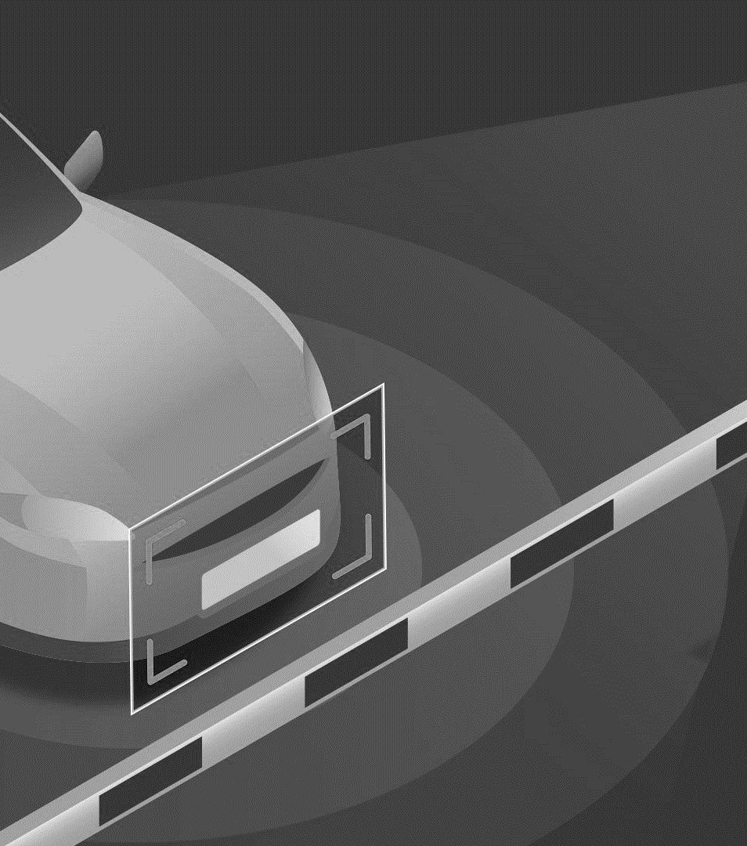
Introduction
The license plates are placed on the front and back of the vehicle.
A vehicle registration plate is a metal or a plastic plate attached to a motor vehicle for identification purposes.
Automatic Number Plate Recognition (ANPR) is an image-processing technology which is used to identify vehicles by their number plates using Optical Character Recognition.
This technology is used in various security and traffic applications such as access-control system

Slide 4
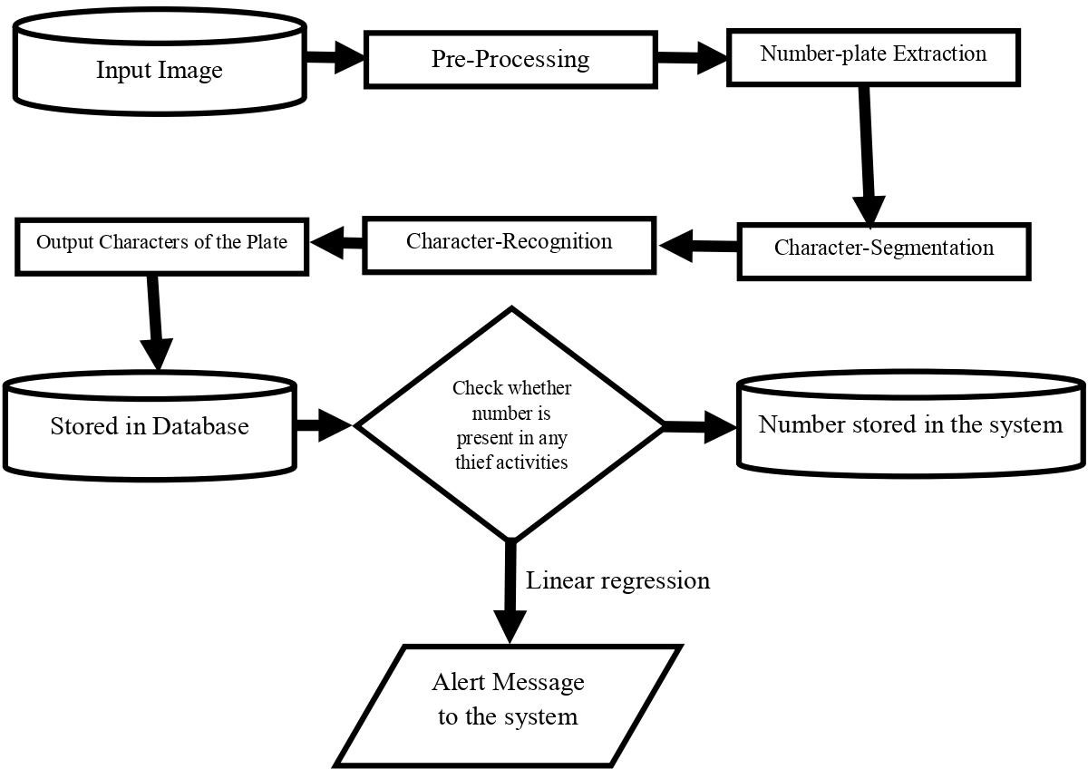

Slide 5
Elements
Open CV
Database
Software
Computer
Libraries
CV2
Matplotlib
Pytesseract
Imutils
Tkinter
Os
Numpy
Pandas

Slide 6
Modules
License Plate Detection
Character Segmentation
Masking Numberplate
Optical Character Recognition
Comparing number with crime records
Send alert if number matches

Slide 7
Applications
Parking
Access-control
Tolling
Stolen cars
Traffic control

Slide 8
Advantages
Improving road safety.
Reduces crime.
Giving a greater police presence.
Increasing the percentage of stop/searches that lead to an arrest.
pre-paid parking members can be easily differentiated from non-members.

Slide 9
Disadvantage
The images of the number plate or of any object which is taken by using the optical character reader technology, Image may get blurred mainly due to the reason of motion blurring for which the picture seems to be hazy when uploaded in the database.
The technology often uses low-resolution images for which the images are not actually visible properly in every case.

Slide 10
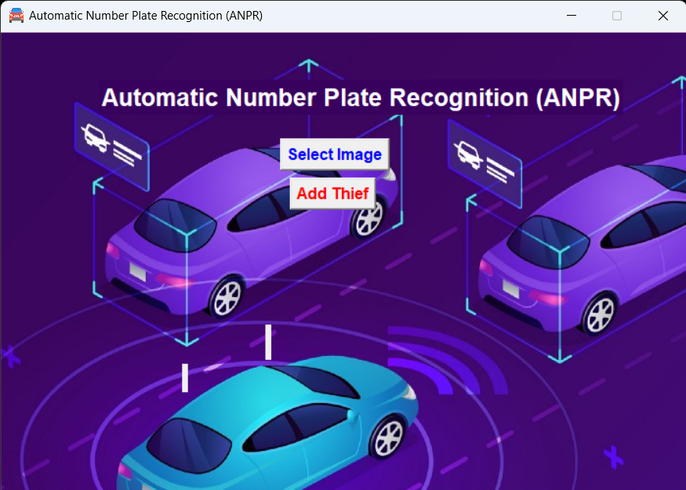
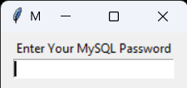
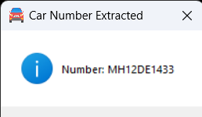

Slide 11
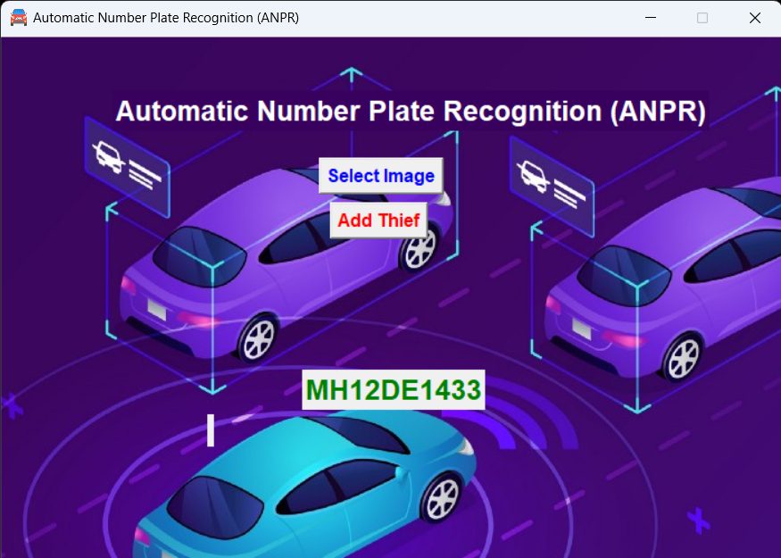
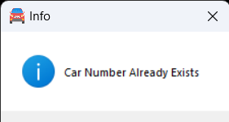
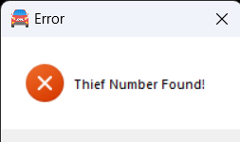

Slide 12
Conclusion
There is an immediate need of such kind of Automatic Number Plate Recognition system in India as there are problems of traffic, stealing cars etc. Government should take some interest in developing this system as this system is very economical and eco-friendly, if applied effectively This change will help in the progress of the nation.

Slide 13
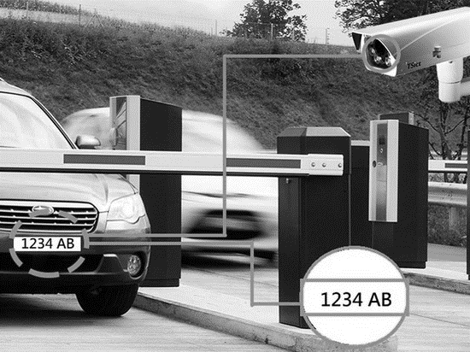
Thank you

