Slide 1
ViterbiNet: A Deep Learning Based Viterbi Algorithm for Symbol Detection (2020)
Nir Shlezinger, Nariman Farsad, Yonina C. Eldar, and Andrea J. Goldsmith
EE4140 Mini Project
Aditya Mallick

Slide 2
Background
Task of receiver - symbol detection.
Conventional detection algorithms rely on the the instantaneous CSI (channel state information) for detection.
This needs to be accurately estimated, otherwise leading to poor detection performance.
Channel estimation overhead also decreases the data transmission rate – need a solution for effective channel estimation
Notes:
The task of the receiver is to reliably recover the transmitted symbols from the observed channel output, or in other words, symbol detection.

Slide 3
Motivation for ML Based Approach
ML doesn’t rely on known stochastic models, becomes effective when the model is unknown or hard to estimate.
ML often captures information hidden in complex data better than traditional methods.
ML techniques often converge faster than iterative model-based approaches, even when the model is known.

Slide 4
Related Work
DNN for decoding structured codes (Gruber et al., 2017)
Neural Belief Propagation - decoding linear codes (Nachmani et al., 2018)
VAE for equalizing linear multipath channels (Caciularu et al. 2018)
Sliding Bidirectional RNN for sequence detection (Farsad et al., 2018)
RNN decoders for sequential codes (Kim et al. 2018)
These approaches yield good performance when sufficient training is available.
Notes:
There has been emerging interest in using AIML for receiver design.
- 2nd^{st} one used deep learning for decoding linear codes
3rd used variational autoencoders for equalizing linear multipath channels
4th proposed sequence detection using bi-directional recurrent neural networks (RNNs)
Last one considers RNN structures for decoding sequential codes like conv codes.

Slide 5
Scope for Improvement
Previous approaches treated the network as a black box
Depended on exhaustive training and relied on methods that were developed to treat secondary tasks such as image processing.
Q. Can we achieve gains in performance, complexity, or training size, by combining channel-model-based methods, such as the Viterbi algorithm, with ML-based techniques?

Slide 6
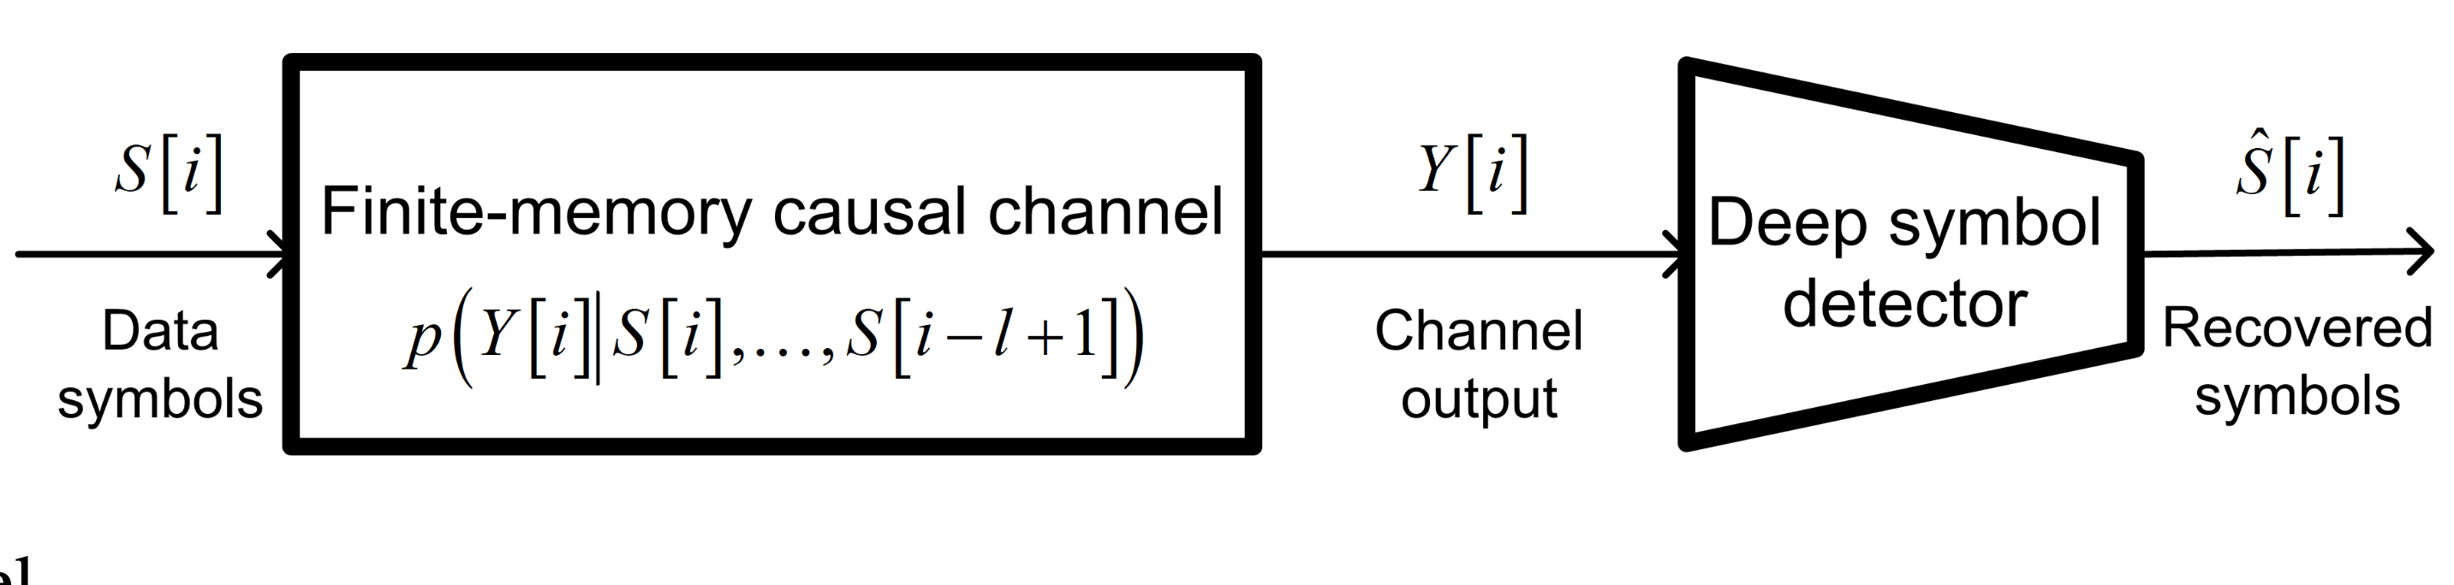
Mathematical Formulation
The channel can be modelled as a conditional PDF between input and output.
Courtesy of: Shlezinger et Al., “ViterbiNet: A deep learning based Viterbi algorithm for symbol detection,” IEEE Trans. Wireless Commun., vol. 19, no. 5, pp. 3319–3331, 2020.
Notes:
Receiver does not know the conditional PDF p –y(i)

Slide 7
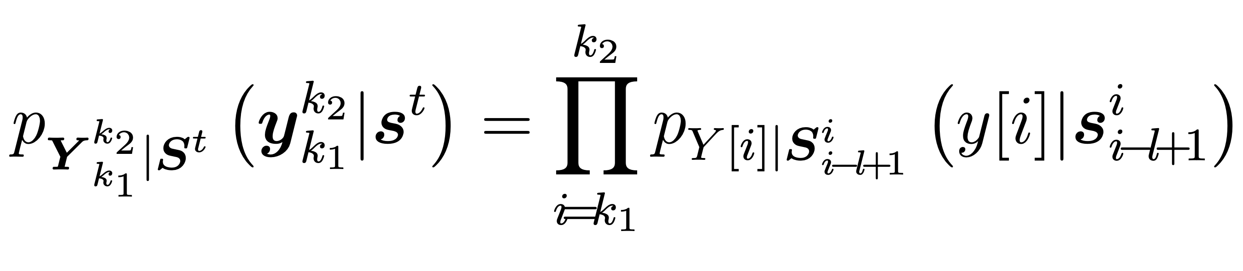
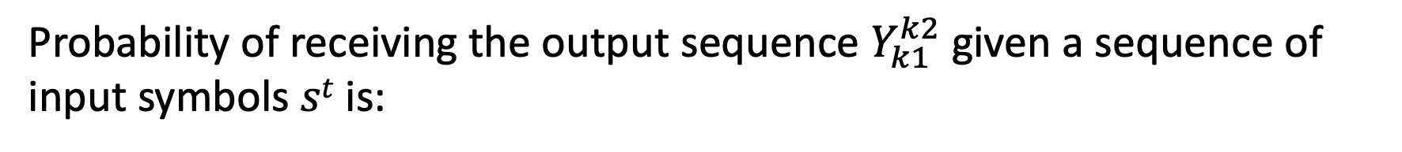
Mathematical Formulation
Probability of receiving the output sequence $Y_{k1}^{k2}$given a sequence of input symbols $st$ is:
Courtesy of: Shlezinger et Al., “ViterbiNet: A deep learning based Viterbi algorithm for symbol detection,” IEEE Trans. Wireless Commun., vol. 19, no. 5, pp. 3319–3331, 2020.
Notes:
Assume channel is stationary, so the conditional PDF does not depend on the index$i$.

Slide 8
Review of the Viterbi Algorithm
One of the most common symbol detection algorithms
Minimum error probability symbol detector for channels obeying a Markovian input-output stochastic relationship, which is encountered in many practical channels.
Requires the receiver to know the exact statistical relationship relating the channel input and output, i.e full instantaneous CSI.

Slide 9
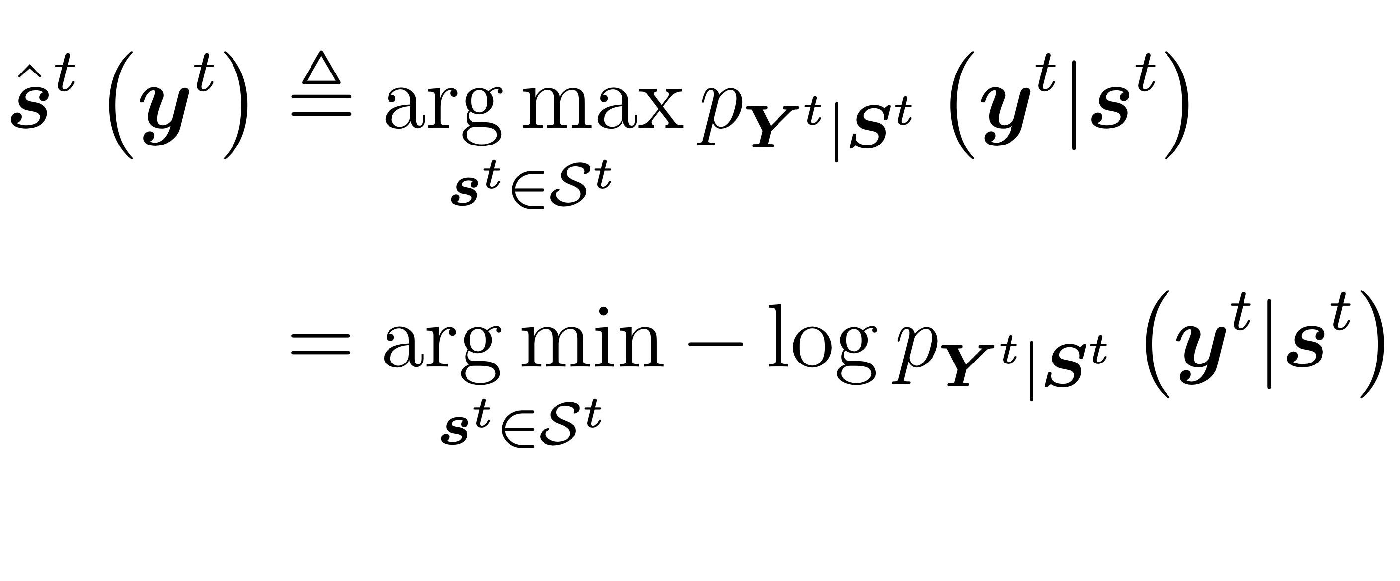
Mathematical Formulation of VA
Since VA gives minimum probability of error, we know that for an equiprobable constellation this corresponds to a maximum likelihood decision rule:
Courtesy of: Shlezinger et Al., “ViterbiNet: A deep learning based Viterbi algorithm for symbol detection,” IEEE Trans. Wireless Commun., vol. 19, no. 5, pp. 3319–3331, 2020.

Slide 10
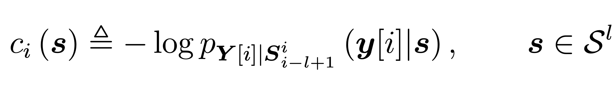
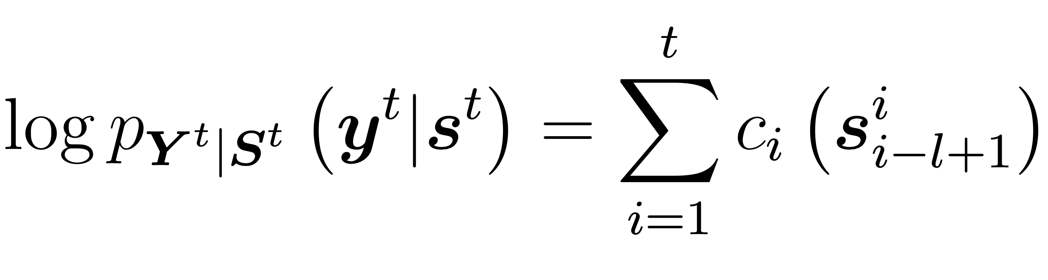
Mathematical Formulation of VA
We will define the log-likelihood function below
Then, using the channel model, we can write the following:
Courtesy of: Shlezinger et Al., “ViterbiNet: A deep learning based Viterbi algorithm for symbol detection,” IEEE Trans. Wireless Commun., vol. 19, no. 5, pp. 3319–3331, 2020.

Slide 11
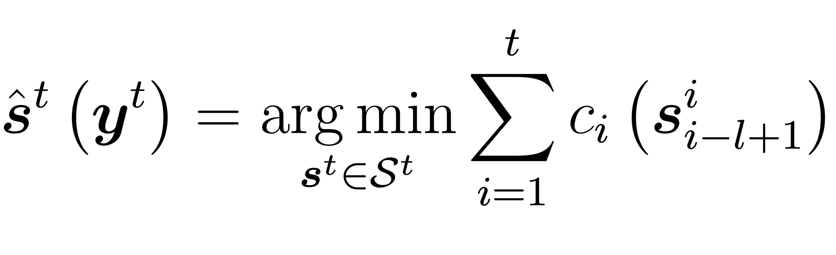
Mathematical Formulation of VA
Finally, the problem reduces to:
Can be solved recursively by treating the possible combinations of transmitted symbols at each time instance as states and iteratively updating a path cost value for each state.
Courtesy of: Shlezinger et Al., “ViterbiNet: A deep learning based Viterbi algorithm for symbol detection,” IEEE Trans. Wireless Commun., vol. 19, no. 5, pp. 3319–3331, 2020.

Slide 12
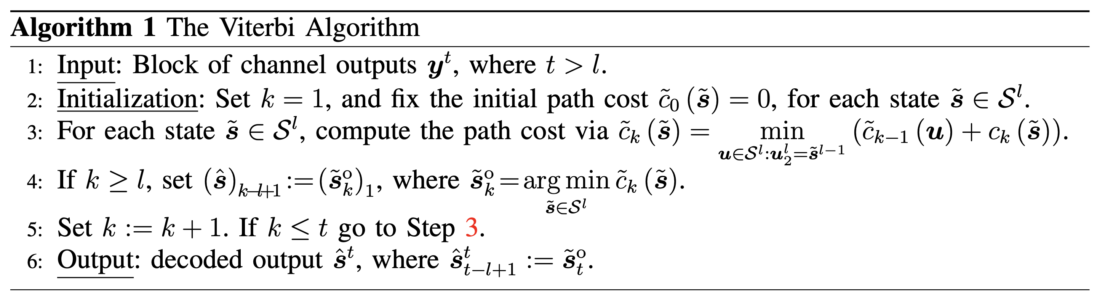
Pseudocode for VA
Courtesy of: Shlezinger et Al., “ViterbiNet: A deep learning based Viterbi algorithm for symbol detection,” IEEE Trans. Wireless Commun., vol. 19, no. 5, pp. 3319–3331, 2020.
Notes:
In the following section we propose ViterbiNet, an ML-based symbol decoder based on the Viterbi algorithm, that does not require CSI.

Slide 13
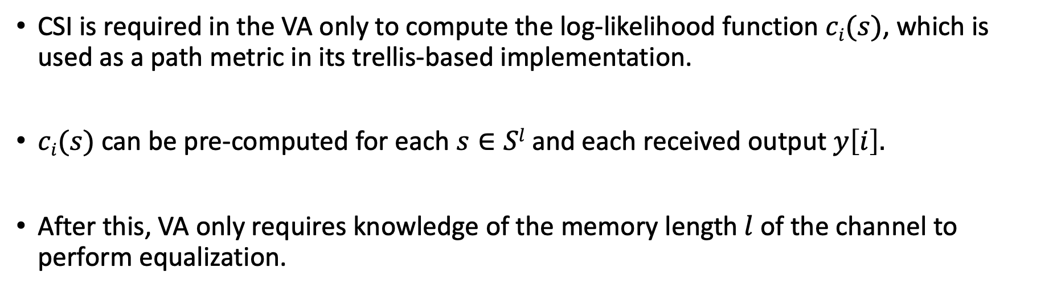
VA Analysis
CSI is required in the VA only to compute the log-likelihood function $ci(s)$, which is used as a path metric in its trellis-based implementation.
$ci(s)$can be pre-computed for each $s∈Sl$ and each received output $y\left[i\right].$
After this, VA only requires knowledge of the memory length$l$of the channel to perform equalization.
Notes:
In the following section we propose ViterbiNet, an ML-based symbol decoder based on the Viterbi algorithm, that does not require CSI.

Slide 14
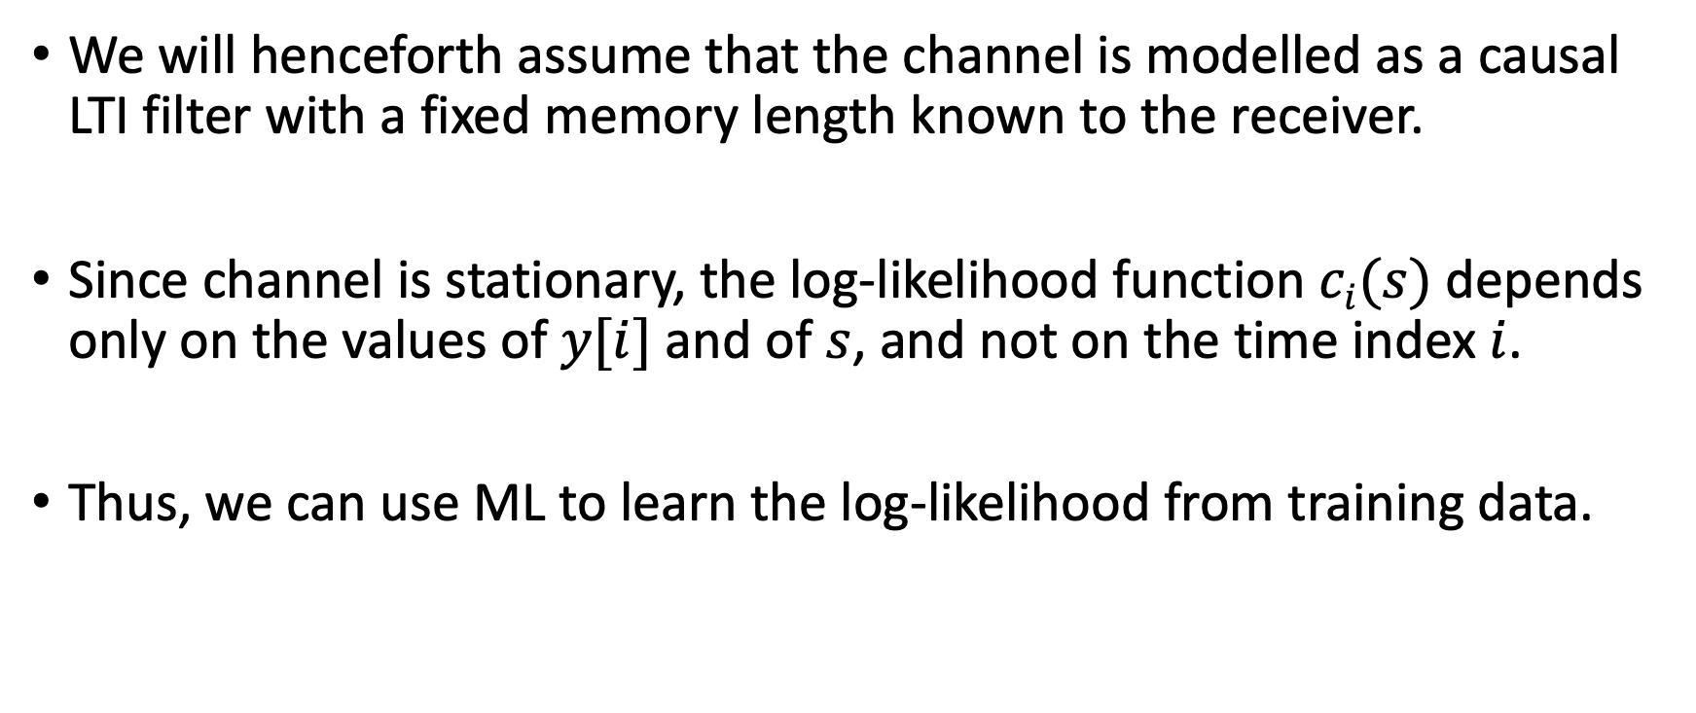
Integrating ML into the Viterbi Algorithm
We will henceforth assume that the channel is modelled as a causal LTI filter with a fixed memory length known to the receiver.
Since channel is stationary, the log-likelihood function $ci(s)$ depends only on the values of $y[i]$ and of $s$, and not on the time index$i$.
Thus, we can use ML to learn the log-likelihood from training data.

Slide 15
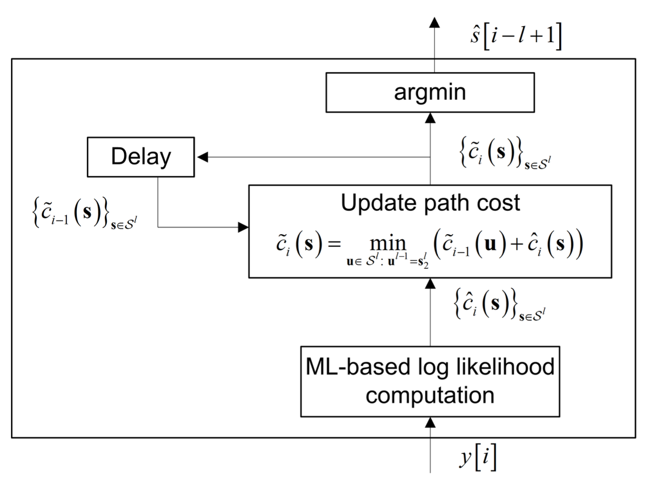
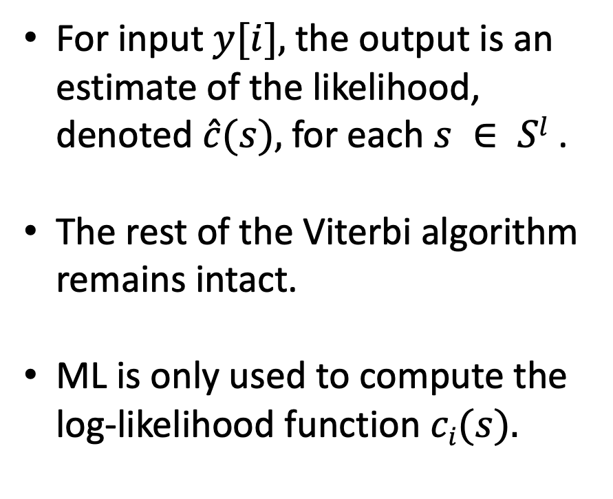
Integrating ML into the Viterbi Algorithm
For input $y[i],$the output is an estimate of the likelihood, denoted $\hat{c}(s),$for each $s ∈ Sl$ .
The rest of the Viterbi algorithm remains intact.
ML is only used to compute the log-likelihood function $ci(s).$
Courtesy of: Shlezinger et Al., “ViterbiNet: A deep learning based Viterbi algorithm for symbol detection,” IEEE Trans. Wireless Commun., vol. 19, no. 5, pp. 3319–3331, 2020.

Slide 16
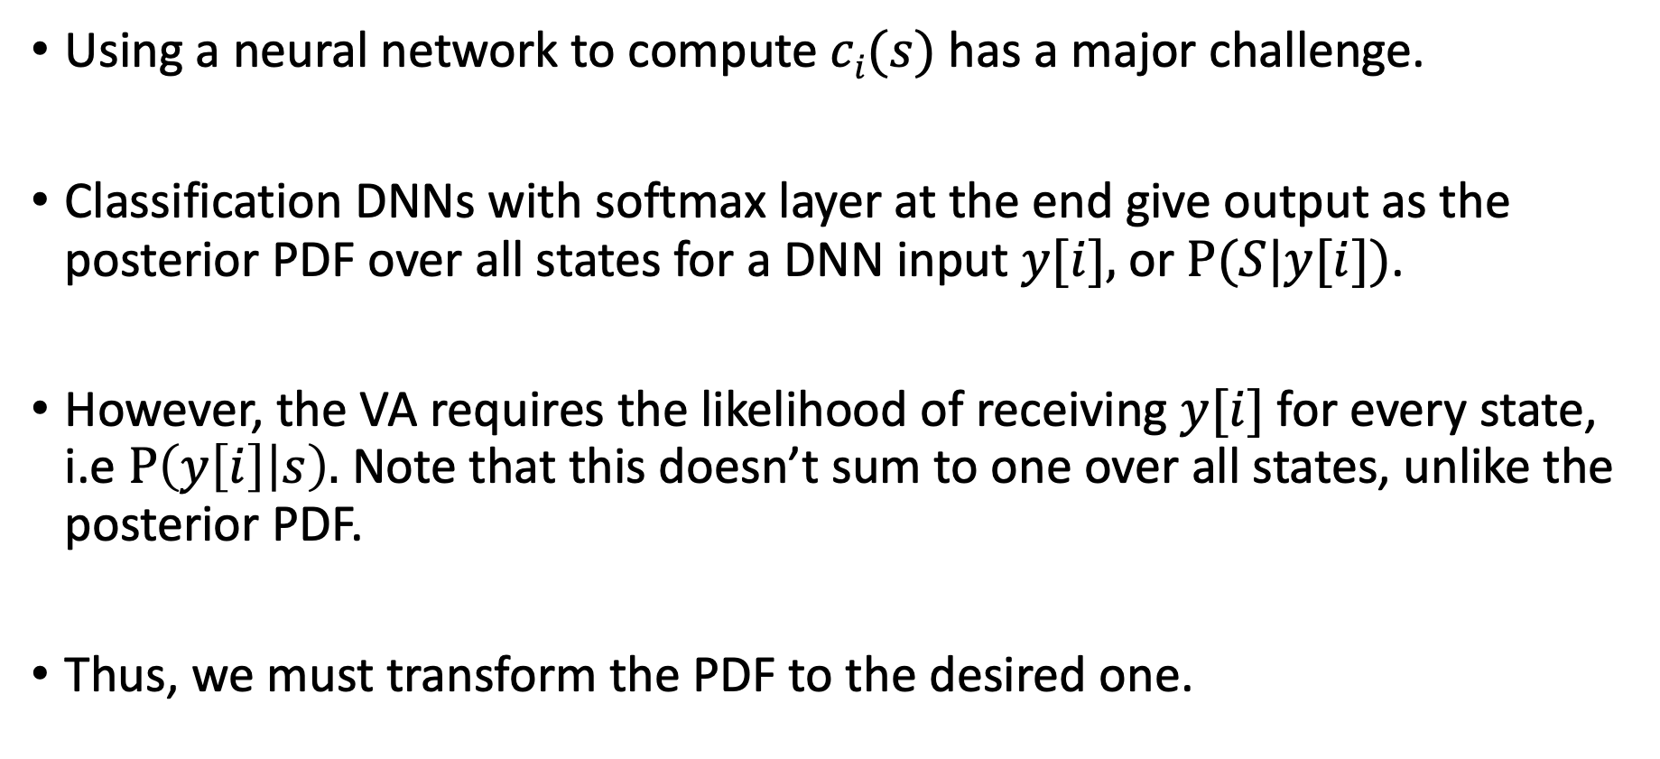
Integrating ML into the Viterbi Algorithm
Using a neural network to compute $ci(s)$ has a major challenge.
Classification DNNs with softmax layer at the end give output as the posterior PDF over all states for a DNN input $y[i],$or $P(S|y[i])$.
However, the VA requires the likelihood of receiving $y[i]$for every state, i.e $P\left(y\left[i\right] | s\right).$ Note that this doesn’t sum to one over all states, unlike the posterior PDF.
Thus, we must transform the PDF to the desired one.
Notes:
For this reason, the previous work involving SBRNN used a DNN to approximate the MAP
detector by considering p of s[i] given y[i-l+1] to y[i].

Slide 17
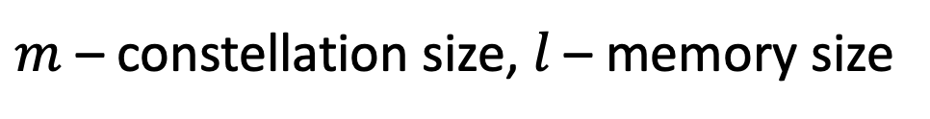
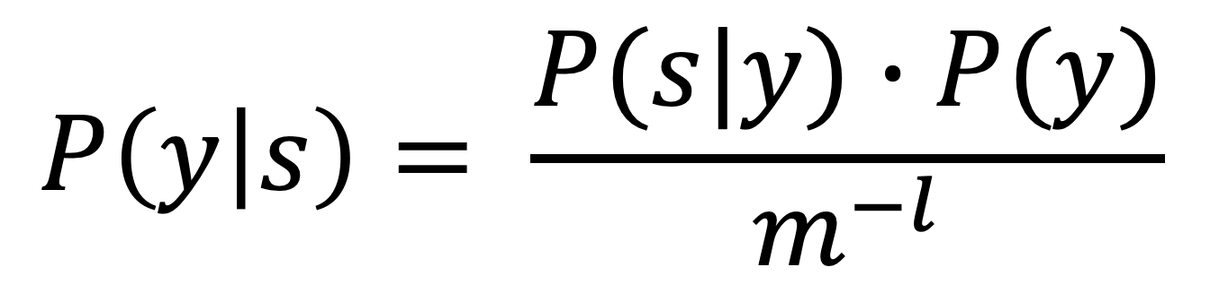
Integrating ML into the Viterbi Algorithm
Due to the equiprobable nature of transmitted symbols, we can express the desired PDF in terms of marginal and posterior PDFs by Baye’s rule:
$$P\left(y | s\right)= \frac{P(s|y)∙P(y)}{m^{−l}}$$
$m$ – constellation size, $l$ – memory size
Notes:
For this reason, the previous work involving SBRNN used a DNN to approximate the MAP
detector by considering p of s[i] given y[i-l+1] to y[i].

Slide 18
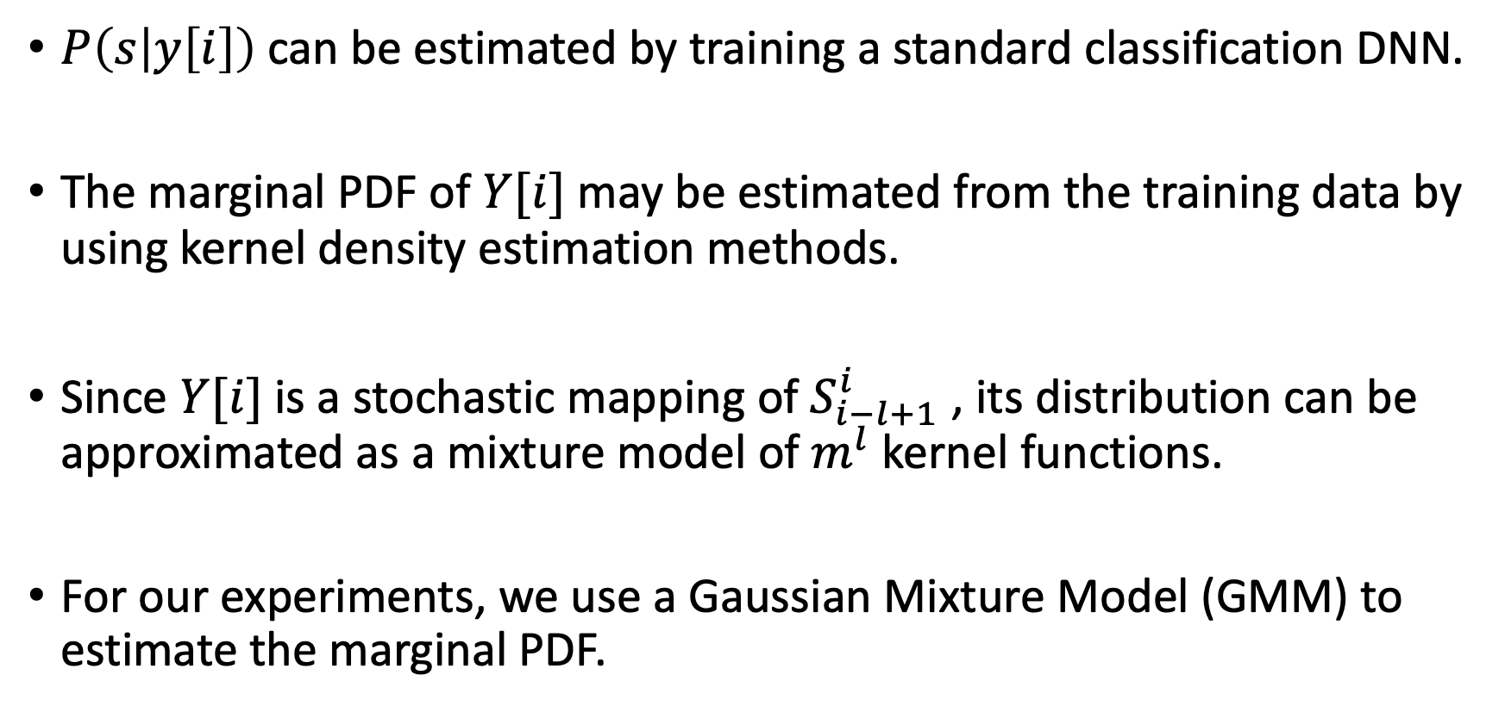
Integrating ML into the Viterbi Algorithm
$P\left(s | y\left[i\right]\right)$can be estimated by training a standard classification DNN.
The marginal PDF of $Y[i]$may be estimated from the training data by using kernel density estimation methods.
Since $Y[i]$is a stochastic mapping of $S_{i−l+1}^{i}$ , its distribution can be approximated as a mixture model of $m^{l}$ kernel functions.
For our experiments, we use a Gaussian Mixture Model (GMM) to estimate the marginal PDF.
Notes:
A Gaussian mixture model is a probabilistic model that assumes all the data points are generated from a mixture of a finite number of Gaussian distributions with unknown parameters.
GMM finds the mean, variance and weight of the different distributions used by implementing the expectation-maximization (EM) algorithm.
One can think of mixture models as generalizing k-means clustering to incorporate information about the covariance structure of the data as well as the centers of the latent Gaussians.

Slide 19
Gaussian Mixture Model
Assumes all data points are generated from mixture of a finite number of Gaussian distributions with unknown parameters.
Iteratively finds mean, variance and weight of each distribution in the mixture by using the expectation-maximization (EM) algorithm.
Similar to k-means clustering but in addition to the mean, also incorporates information about the shape of the distribution (covariance).

Slide 20
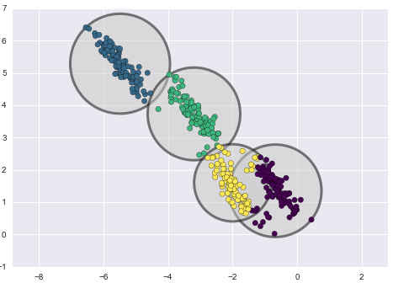
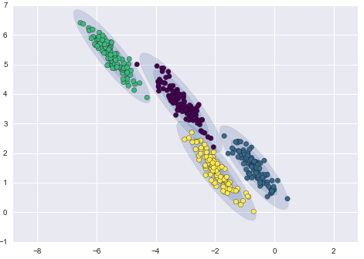
K-Means Clustering vs GMM
Kmeans - hard classification
GMM - soft classification
Courtesy of: https://www.kaggle.com/code/vipulgandhi/gaussian-mixture-models-clustering-explained

Slide 21
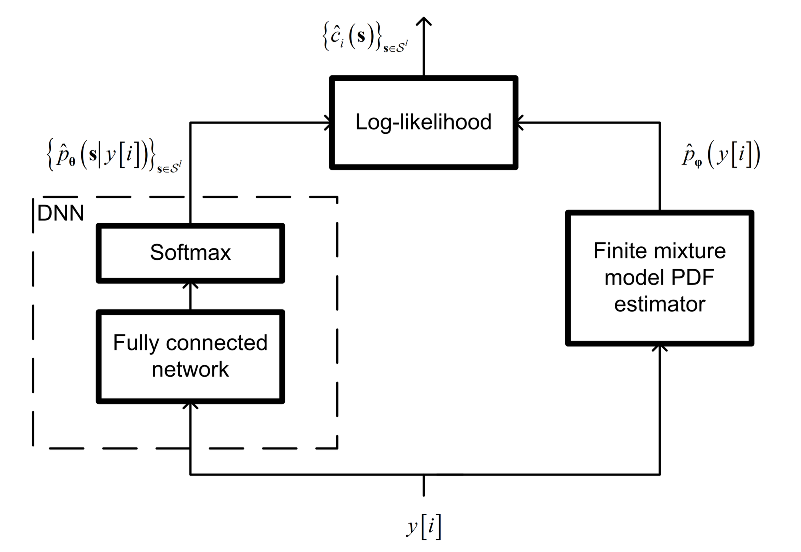
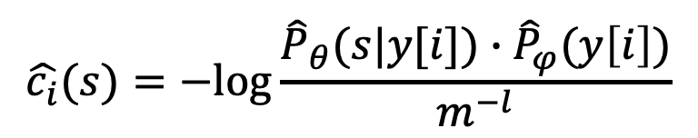
Final Workflow
$$\hat{c_{i}}(s)=−log⁡\frac{{\hat{P}}_{θ}(s|y[i])∙{\hat{P}}_{φ}(y\left[i\right])}{m^{−l}}$$
Courtesy of: Shlezinger et Al., “ViterbiNet: A deep learning based Viterbi algorithm for symbol detection,” IEEE Trans. Wireless Commun., vol. 19, no. 5, pp. 3319–3331, 2020.
Notes:
Final workflow

Slide 22
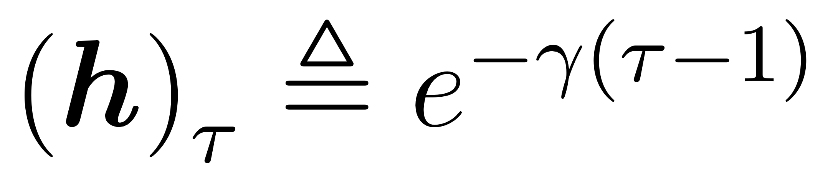
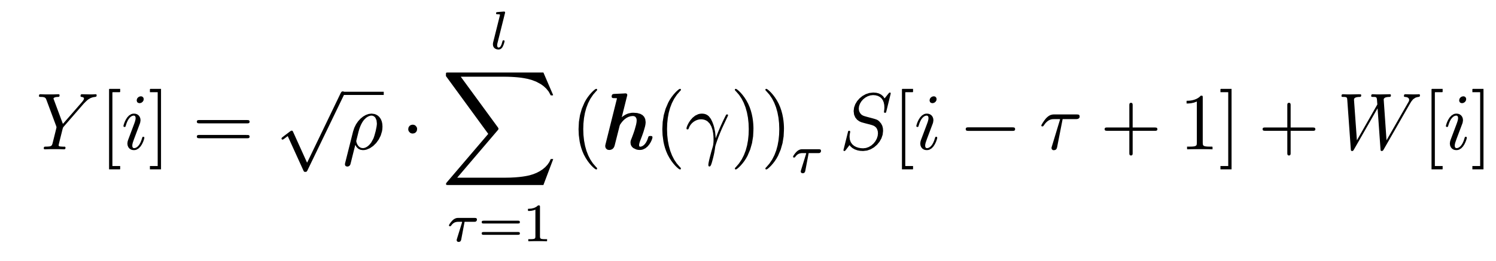
Experiments
We have considered an ISI Channel with exponential decay profile to model real-world fading phenomena:
AWGN is also present, giving us the following output expression:
Courtesy of: Shlezinger et Al., “ViterbiNet: A deep learning based Viterbi algorithm for symbol detection,” IEEE Trans. Wireless Commun., vol. 19, no. 5, pp. 3319–3331, 2020.

Slide 23
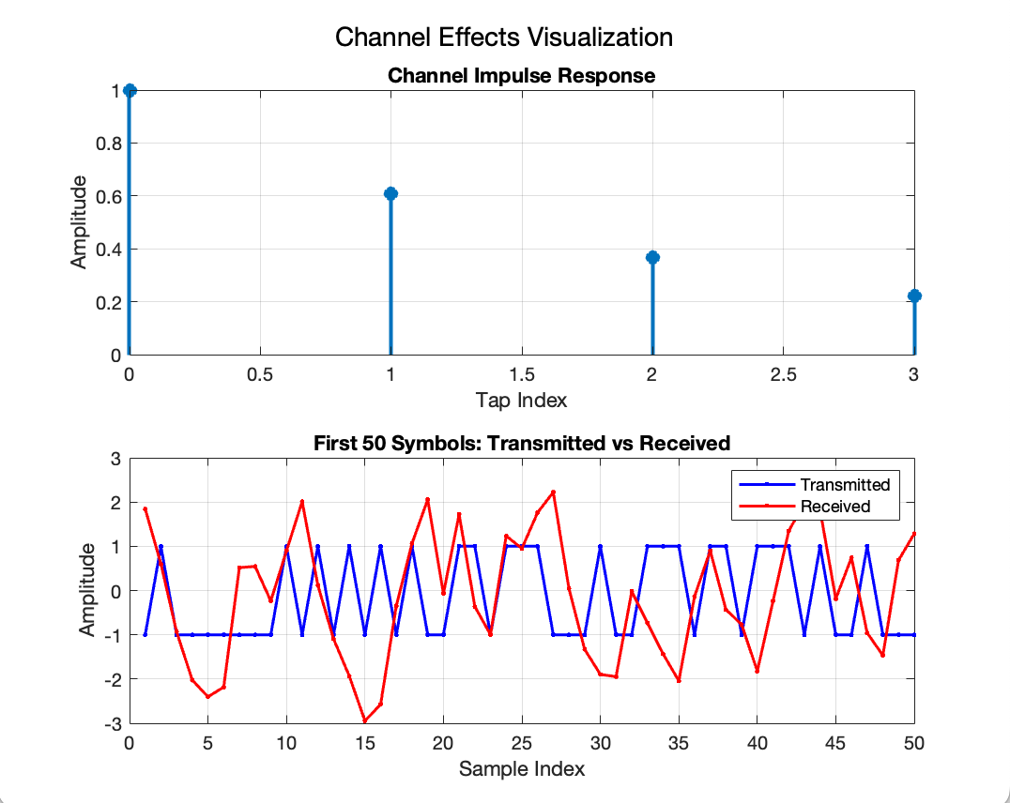
Experiments
We will transmit BPSK modulated symbols and use real-valued channel coefficients.
This is done for simplicity, since using complex numbers would require complex DNN weights.
3 – layer DNN (1x100 sigmoid, 100x50 Relu and 50x16 softmax).

Slide 24
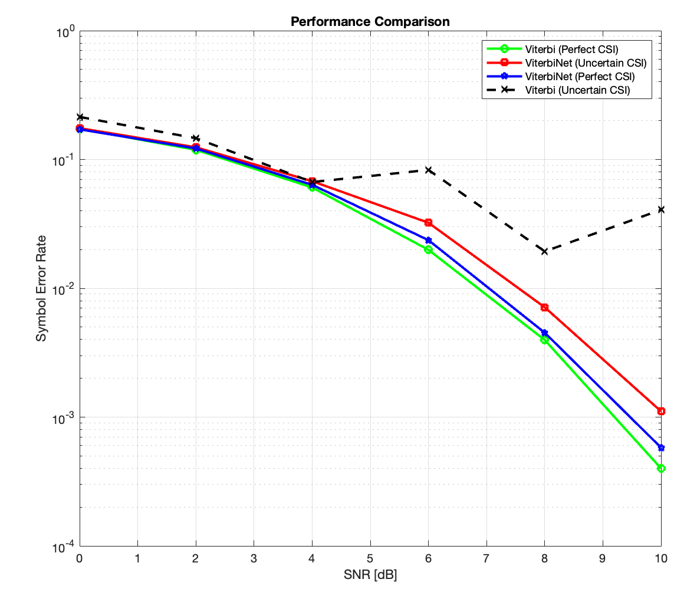
Experiments
Comparison of ViterbiNet and Viterbi Algorithm in 2 settings:
Perfect CSI
Uncertain CSI – noisy channel estimate for VA, VN trained using multiple noisy channel estimates.
VN almost matches VA performance in full CSI setting.
VN performs much better than VA in uncertain CSI scenario, only slightly worse than Perfect CSI.

Slide 25
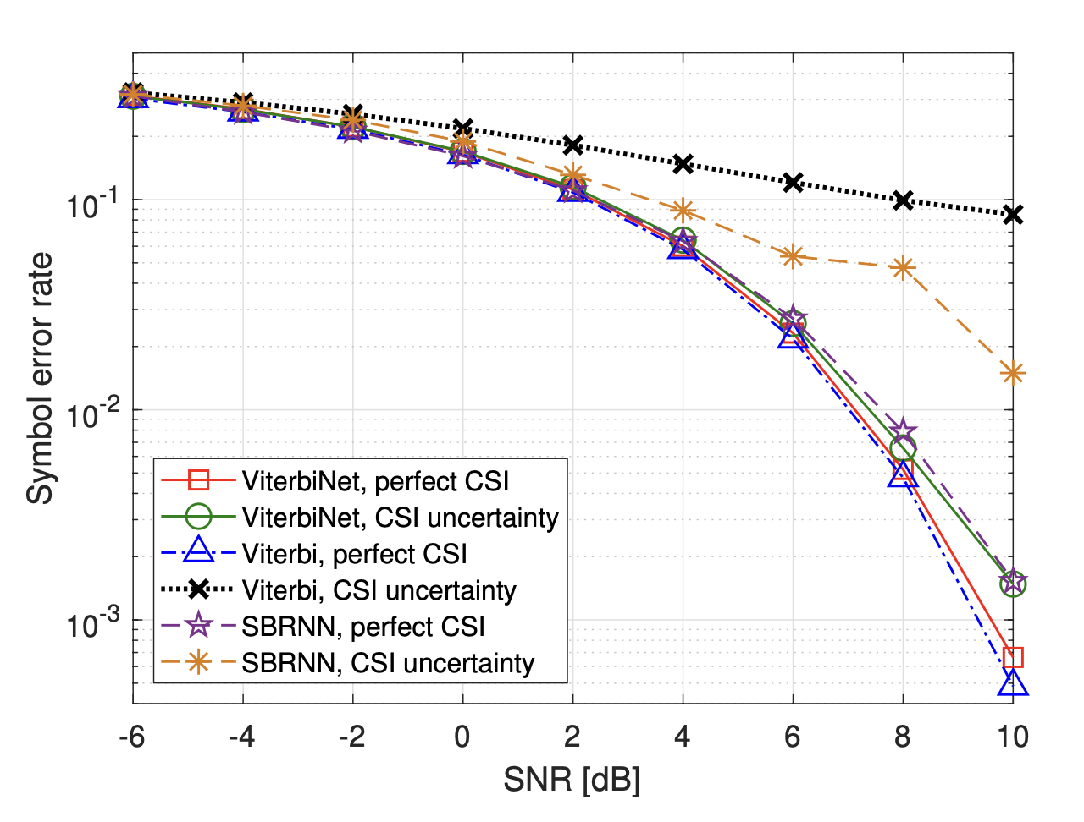
Comparison with Paper

Slide 26
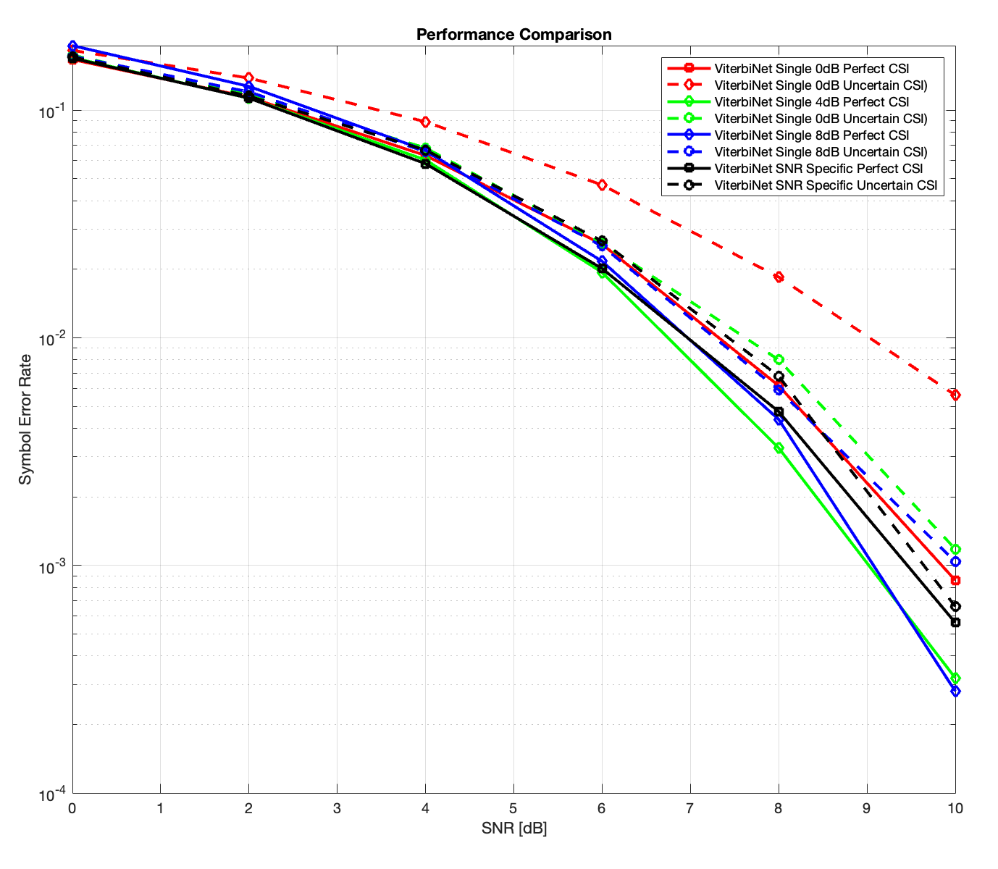
Experiments
Comparison of ViterbiNet using general SNR training and specific SNR training:
ViterbiNet generalizes well to multiple SNR levels even when trained with single SNR data, sometimes even better than SNR specific training!
Lesser training cost for same performance

Slide 27
Online Training in Block-Fading Channels
Block faded communications refers to channel changing with every block of data received.
Performing channel coding can allow ViterbiNet to train and track channel variations online.
The receiver will use the a-priori knowledge of a header sequence to re-train in real-time with estimated outputs of decoded header.
A FEC code combined with error detection code like checksum, CRC will give best results.

Slide 28
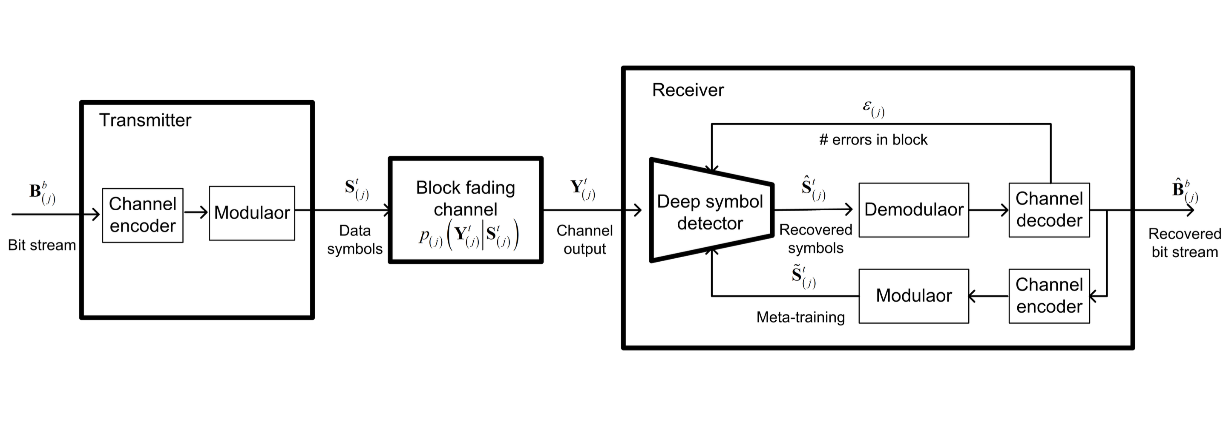
Online Training in Block-Fading Channels
Courtesy of: Shlezinger et Al., “ViterbiNet: A deep learning based Viterbi algorithm for symbol detection,” IEEE Trans. Wireless Commun., vol. 19, no. 5, pp. 3319–3331, 2020.

Slide 29
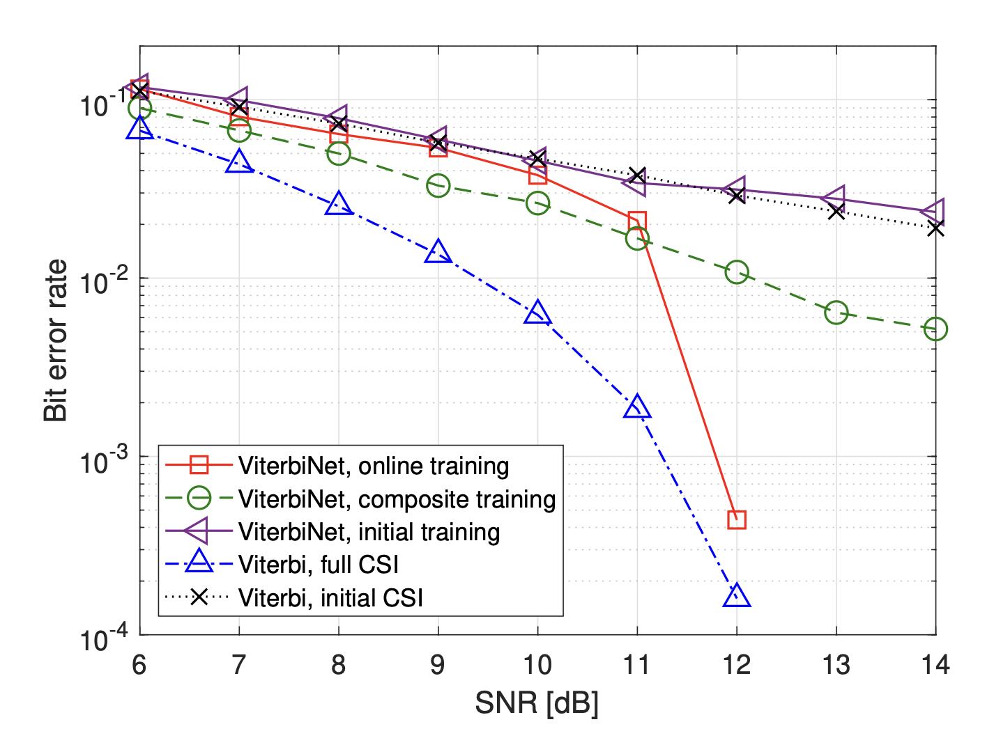
Paper result: Coded BER versus SNR, block-fading ISI channel with AWGN.

Slide 30
Main Takeaways
ViterbiNet approaches the optimal VA and outperforms previous ML-based symbol detectors using a small amount of training data.
VN can operate in the presence of CSI uncertainty, where the VA fails.
VN can adapt via online learning in block-fading channel conditions.

Slide 31
Drawbacks and Future Directions
ViterbiNet still suffers from inherent drawbacks of VA.
Large constellation size and channel memory increases complexity of ViterbiNet, since the state space of the DNN output grows exponentially.
We assumed that the receiver has either accurate knowledge or a reliable upper bound on channel memory l.
The extension of the decoder to account for unknown memory length is left for future exploration.

