Slide 1
Big Data Analytics
for Business
IS 843 - Spring ‘22
Lecture 02
Professor: Mohammad Soltanieh-ha

Slide 2
Apache Hadoop

Slide 3

What is Hadoop?
An open source software platform for distributed storage and distributed processing of very large datasets on computer clusters built from commodity hardware.

Slide 4
What is Hadoop?
In 2003 Google File System paper and a year later Google MapReduce paper were published.
Doug Cutting and Mike Cafarella founded the Hadoop project, but many companies including Google, Yahoo!, Facebook, LinkedIn, eBay and IBM contributed to this open source project.
The base Apache Hadoop framework is composed of the following modules:
Hadoop Common – contains libraries and utilities needed by other Hadoop modules.
Hadoop Distributed File System (HDFS) – a distributed file-system that stores data on commodity machines across the cluster.
Hadoop YARN – responsible for managing computing resources in clusters.
Hadoop MapReduce – a programming model for processing and generating big data sets with a parallel, distributed algorithm on a cluster.

Slide 5
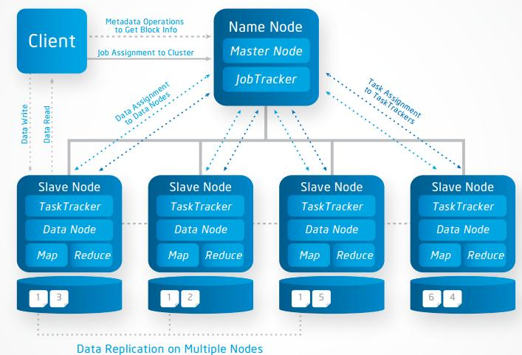
Hadoop Cluster - Architecture

Slide 6
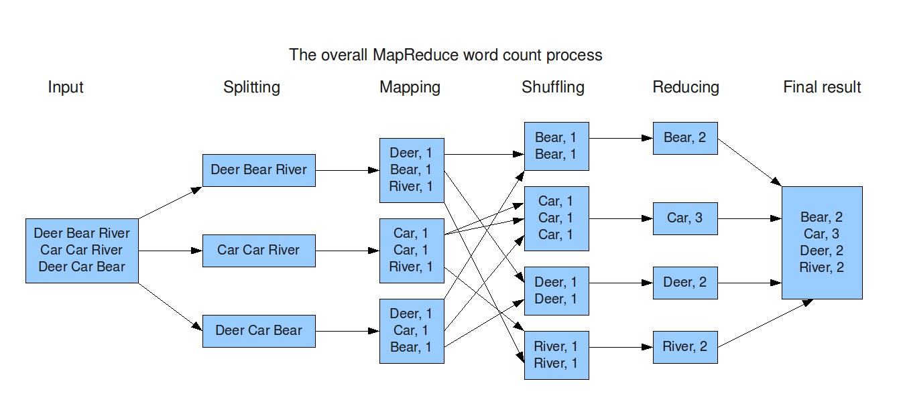
MapReduce

Slide 7
Why Hadoop?
Scalable - horizontal scaling is virtually limitless as vertical scaling is bound with hardware.
Flexible - can manage structured and unstructured data
Cost Effective - massively parallel computing on commodity servers
Robust Ecosystem
Hadoop is cloud friendly!

Slide 8
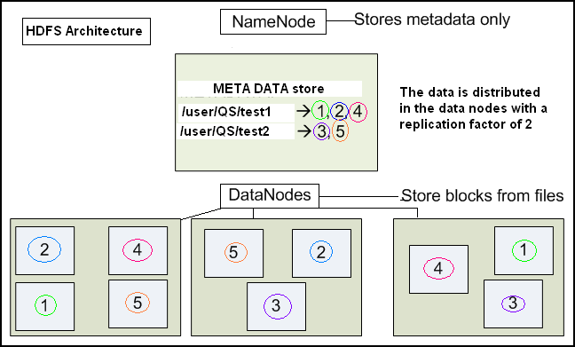
Hadoop File System - HDFS

Slide 9
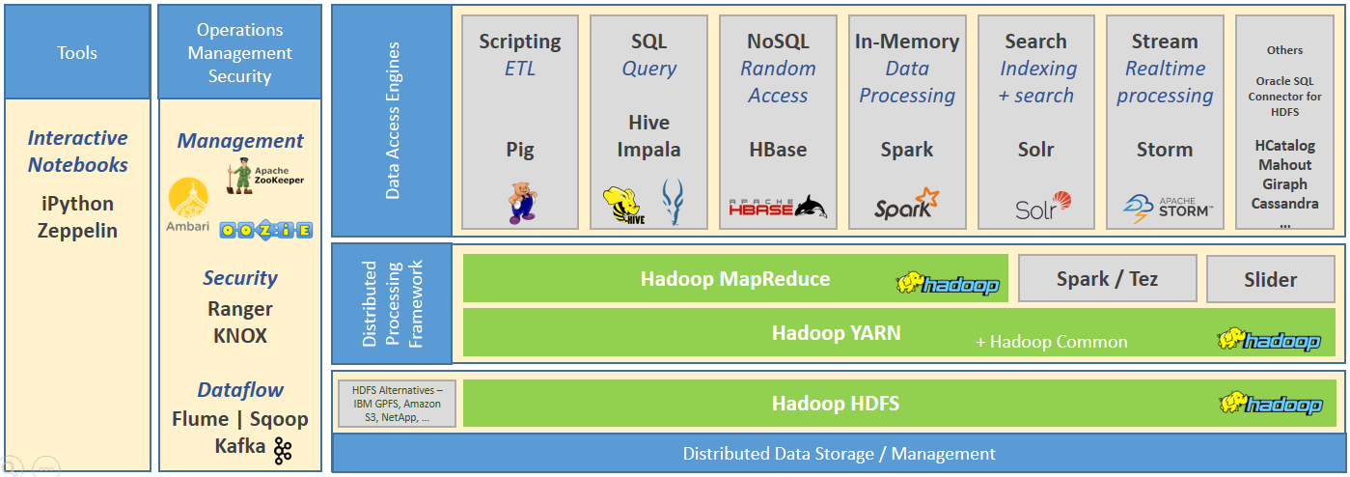
Hadoop Ecosystem
(Resource Manager)

Slide 10
Hadoop Distributors
These companies provide production ready Hadoop platforms:
Cloudera
Hortonworks
MapR
Cloudera and Hortonworks merged in 2018.

Slide 11
Command Line Basics
cd – Change Directory: this command changes your current directory
ls – List: this lists the files within the directory we’re currently in
cp – Copy: for copying a file
rm – Remove: for removing a file
mv – Move: for moving files from one location to another
wget – This retrieves a file that’s hosted on a web server.
vi – This is a very basic text editor included with Linux. When you’re in vi, you need to hit the “i” key to enter “insert mode”, which lets you actually edit things. When you’re done editing, press ESC to leave insert mode. Then, you can type commands such as “:wq” to write your changes and quit vi.

Slide 12
In-Class Activity
Hortonworks on Google Cloud
Complete instructions on how to deploy a Hortonworks sandbox environment on Google Cloud can be found on the document at: https://github.com/soltaniehha/Big-Data-Analytics-for-Business/blob/master/01-Introduction/Deploy-Hortonworks-Sandbox-on-Google-Cloud.pdf
Make sure to stop or shutdown the instance when you are not using it. The allocated cost for this section should not exceed $5.

Slide 13
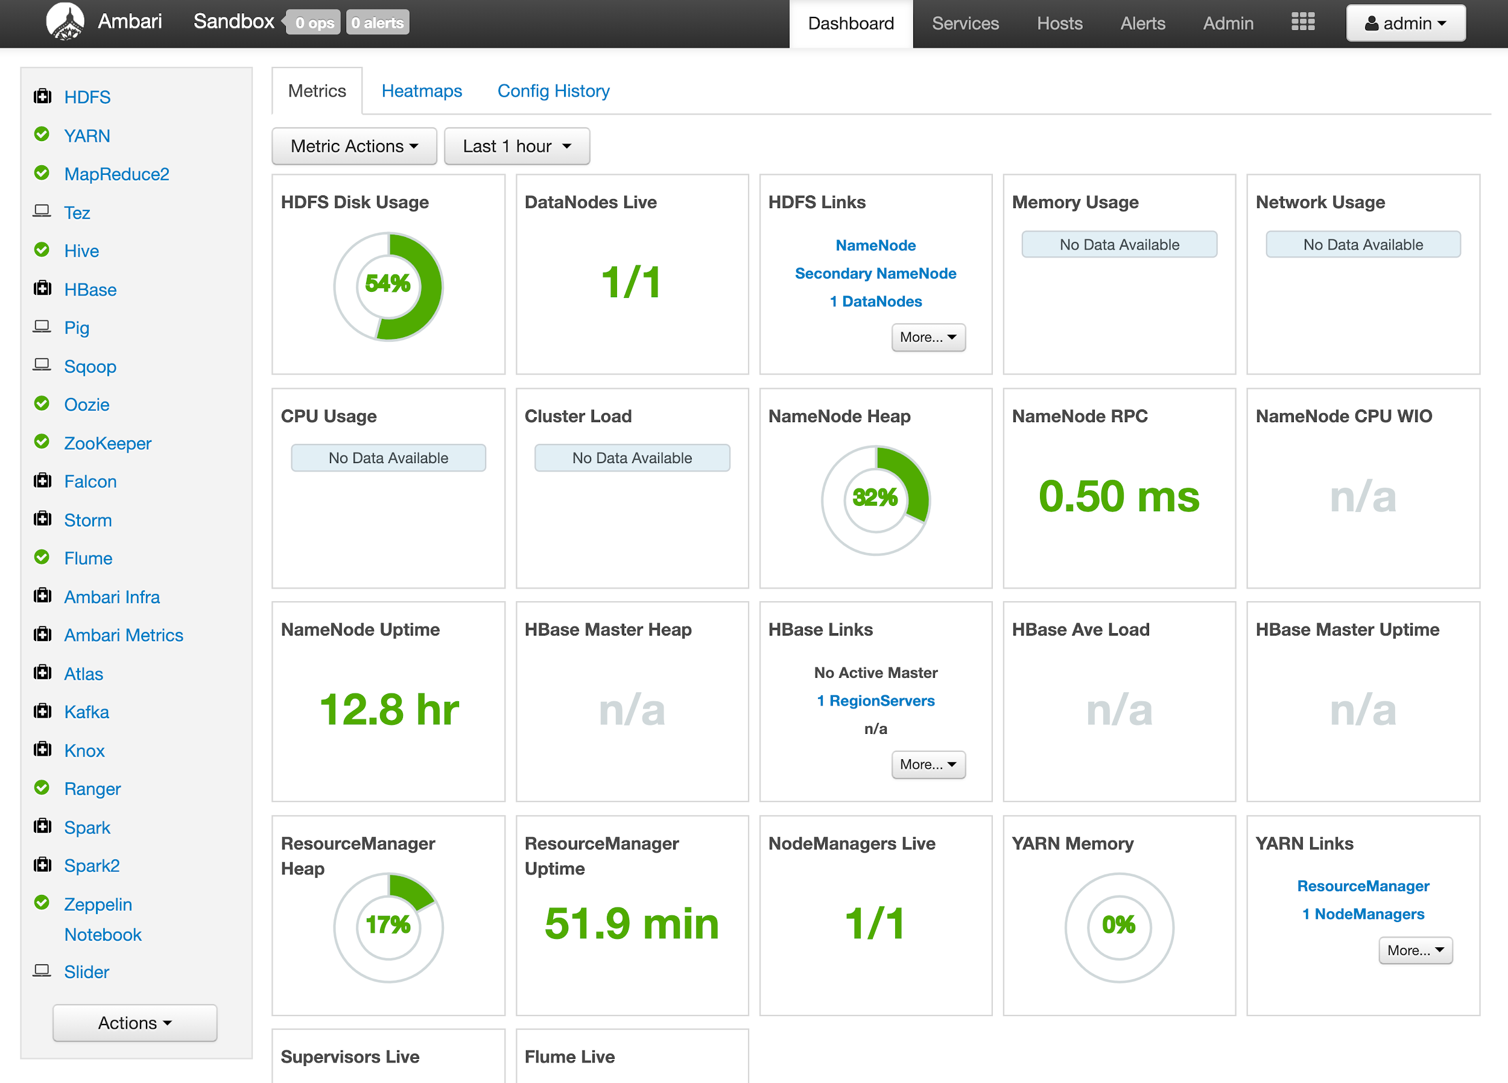
Apache Ambari UI

Slide 14
Exercise - Uploading a File into HDFS
Download the code and data from github (case sensitive): bit.ly/IS843
From the top menu of Ambari go to File View
Select User > maria_dev, then create a new folder called NBA
Upload Players.csv & Seasons_Stats.csv from 02-Querying-Big-Data/data/nba-players-stats into this newly created folder
You can click on your file and open it to view what it looks like. We need the file structure for uploading it into Hive, e.g., comma separated.
Congratulations! Your files now live on Hadoop File System.

Slide 15
Exercise - Accessing HDFS via Command Line
Google Cloud:
SSH into the ambari instance
SSH into sandbox docker container: ssh -p 2222 maria_dev@localhost
Get a list of files on Hadoop File System:
hadoop fs -ls /
hadoop fs -ls /user/maria_dev/

Slide 16
Exercise - Copying to HDFS via Command Line
After SSH into the ambari instance, log in as maria_dev: ssh -p 2222 maria_dev@localhost
Create a text file with vi: vi test.txt
Press “i” to edit. Write a few words and quit by pressing ESC, then “:wq!” then press return.
Copy the file from local (sandbox env.) disk to HDFS: hadoop fs -put test.txt /user/maria_dev/
Verify if it’s there: hadoop fs -ls /user/maria_dev/
You can also verify through the Ambari console!

Slide 17
Exercise - Uploading Tables in Hive
From Ambari go to Hive View and select Upload Tables
Select CSV and choose the correct information regarding delimiters, end of line, header, etc.
Select file from your local machine, or alternatively, give the HDFS path: /user/maria_dev/NBA/Players.csv & /user/maria_dev/NBA/Seasons_Stats.csv
Make sure the column names and types are accurate and then press upload.
Now check in the Hive view to see if you can see your newly created table. Make sure to refresh the schema.
Dataset source (with some modifications): https://www.kaggle.com/drgilermo/nba-players-stats
It has been scraped from www.basketball-reference.com.

Slide 18
players Table - Sample Query
Let’s see which university has had the highest number of NBA players over the years
SELECT college, count(*) AS count_nba_players
FROM players
where college <> "" -- excluding players with no college data
GROUP BY college
ORDER BY count_nba_players DESC;
Note: If you are receiving errors by running this query it’s because your Tez optimizer is not set properly (Tez is the default optimizer). You can change it to MapReduce for the purpose of this exercise:
From Hive view go to Settings (on the right menu) > +add > hive.execution.engine > mr

Slide 19
seasons_stats Table - Sample Query
Identify top 10 most scored players

Slide 20
seasons_stats Table - Sample Query
Identify top 10 most scored players
SELECT player, sum(points) AS total_points
FROM seasons_stats
GROUP BY player
ORDER BY total_points DESC
LIMIT 10;

Slide 21
Exercise - NBA Dataset
Find top 10 most scored NBA players that came from University of North Carolina

Slide 22
Exercise - NBA Dataset
Find top 10 most scored NBA players that came from University of North Carolina
SELECT p.player, s.total_points
FROM players p
LEFT JOIN
(SELECT player, sum(points) total_points FROM seasons_stats GROUP BY player) s
ON p.player = s.player
WHERE p.college = 'University of North Carolina'
ORDER BY s.total_points DESC
LIMIT 10;

Slide 23
Clean Up
Let’s clean up the default database and put our newly created tables into a new database called nba:
CREATE DATABASE nba;
CREATE TABLE nba.players AS SELECT * FROM default.players;
CREATE TABLE nba.seasons_stats AS SELECT * FROM default.seasons_stats;
DROP TABLE default.players;
DROP TABLE default.seasons_stats;

Slide 24
Movie Lens - Movie Rating
Dataset source: https://grouplens.org/datasets/movielens/
100,000 ratings from 1000 users on 1700 movies. Released 1998.
Data can be found in 02-Querying-Big-Data/data/movieLens-movie-rating
First, we will upload the files to HDFS in a new folder called “movies”. This time, let’s use a script to load the data. Use the following scripts to load the data into Hive tables. You will need to execute the content in Hive:
02-Querying-Big-Data/scripts/create_movies_table.sql
02-Querying-Big-Data/scripts/create_ratings_table.sql

Slide 25
Create ratings Table
CREATE DATABASE IF NOT EXISTS movie_rating;
USE movie_rating; -- switching to movie_rating DB
DROP TABLE IF EXISTS ratings;
CREATE TABLE ratings (
user_id INT,
movie_id INT,
rating INT,
rating_timestamp INT)
ROW FORMAT DELIMITED -- contains one row per line
FIELDS TERMINATED by '\t'
TBLPROPERTIES ("skip.header.line.count"="1"); -- skip the first line which is the header
LOAD DATA INPATH '/user/maria_dev/movies/ratings.csv' OVERWRITE INTO TABLE ratings;

Slide 26
Exercise - Find the Top Rated Movies
What are the top 10 most favorite movies?

Slide 27
Exercise - Find the Top Rated Movies
What are the top 10 most favorite movies?
Execute the script 02-Querying-Big-Data/scripts/top_movies.sql
We are using a new syntax, VIEW
You can save the result of any query as a view
Views act like virtual tables
A view is a predefined SQL query that is stored in the database with an associated name
View can be dropped by DROP VIEW <view_name> syntax

Slide 28
Create/Drop Databases
CREATE DATABASE nba;
DROP DATABASE nba;

Slide 29
HiveQL
HiveQL is very similar to standard SQL but with limited functionality.
The major difference is that SQL is a querying language for relational databases, but Hive makes unstructured or semi-structured data seem like structured.
Internally, a compiler translates HiveQL statements into a directed acyclic graph of MapReduce, Tez, or Spark jobs, which are submitted to Hadoop for execution.
Hive documentation: https://cwiki.apache.org/confluence/display/Hive/LanguageManual

Slide 30

Activity
DataCamp assignments according to the syllabus
Kaggle
Create an account at www.kaggle.com
Go to the Datasets section and filter on small (<10MB) datasets. Pick 2 of your favorite CSV files, upload them to your HDFS and then Hive.
Use your SQL knowledge to explore the dataset.
Prepare a few questions and try answering them by querying the dataset. They don’t need to be sophisticated questions. E.g., “Which movie got the highest rating in the past 20 years?”
Quiz 1 next week

Slide 31
Remember to Stop Your VM!

