Slide 1
Big Data Analytics
for Business
IS 843 - Spring ‘22
Lecture 03
Professor: Mohammad Soltanieh-ha

Slide 2
Delete the Instance from Last Week
We won’t need this instance. Feel free to delete.

Slide 3

Databases
What kind of databases are out there?
Relational (tabular) databases
Non-relational databases
When to use a relational database?

Slide 4
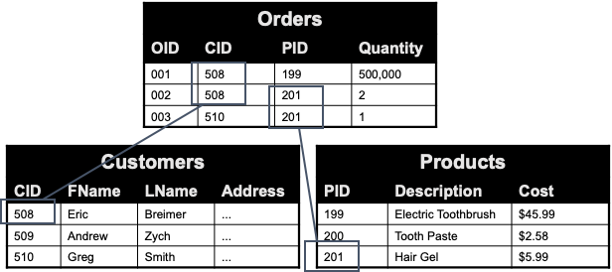


Relational Databases
These databases model data as rows and columns in a series of tables, and use SQL for writing and querying data.

Slide 5

BigQuery
Google’s Big Data Database
BigQuery is a serverless analytics database and data warehousing service that enables interactive analysis of massively large datasets
It’s fast, highly scalable, cost-effective, NoOps, and fully managed
BigQuery is foundation for modern BIs
It’s been GA since November 2011
Datasets can be queried using standard SQL
More info here!

Slide 6
BigQuery Public Datasets
Go to console.cloud.google.com/bigquery
If it’s your first time, you will need to sign up and accept terms and conditions.
Please make sure you are within your BU account and IS843 project.
Now, go to this link to access BigQuery’s public dataset
Under Resources you should see a project called bigquery-public-data.
Click on it and then on the right hand side click on PIN PROJECT.
You can now browse all of the public data sources.

Slide 7
An Introduction to SQL

Slide 8
SQL Language
Structured Query Language, SQL, is designed for a specific purpose: to query data contained in a relational database.
There are many different variations of SQL. BigQuery supports two versions:
Standard SQL (preferred)
Legacy SQL (previously known as BigQuery SQL)
We will get an overview of basic functionalities of standard SQL.
Note 1: Most SQL engines are cAse-iNseNsItivE by default
Note 2: Use UPPERCASE for the reserved keywords like SELECT and WHERE

Slide 9
Query
Query is the command that gets executed in order to communicate with the database.
Consider the following query:
SELECT word FROM `bigquery-public-data.samples.shakespeare`
Command Column Command Project Dataset Table
shakespeare table: contains a word index of the works of Shakespeare, giving the number of times each word appears in each corpus.
Note: `project.dataset.table` is surrounded by backticks ``

Slide 10
Table Properties
Consider shakespeare table of samples dataset from bigquery-public-data project.
Locate this table in BigQuery and check out the following properties:
Schema: provides the field names within the table with their data types, mode, and optional description
Details: gives details about the table, such as its size, number of rows, location, and more
Preview: gives you a glimpse of the first rows. Looking at the preview doesn’t count against your 1TB/mo free query, and is always the best way to get a sense of the data.
Note: no matter how small the table is, the minimum amount of charges billed for each query is 10MB

Slide 11
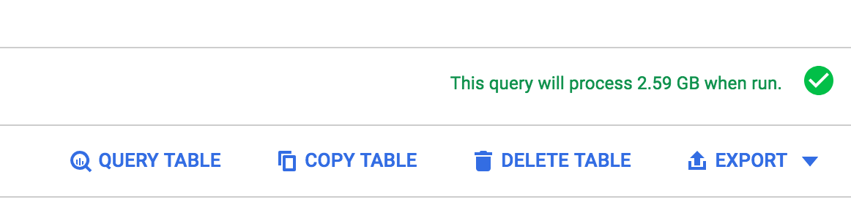
BigQuery Best Practices
BigQuery allows you to query 1TB/Mo for free
The volume is calculated based on the amount of data processed.
Here are a few tips
Avoid SELECT *
Select only the columns that are needed.
Don't run queries to explore or preview table data.
On the Table Details page, click Preview to sample the data.
Do not use a LIMIT clause as a method of cost control, doesn’t work!
Use the default table expiration time to remove the data when it's no longer needed.
Before running queries, preview them to estimate cost:

Slide 12
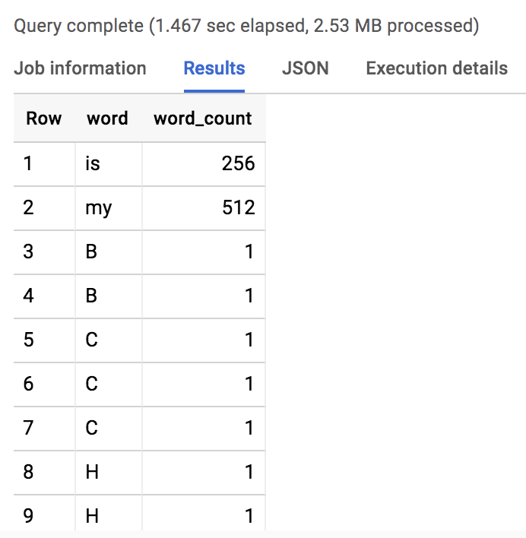
SELECT list
SELECT word, word_count FROM `bigquery-public-data.samples.shakespeare`
With SELECT we can select one or more columns
This query will print out word & word_count columns.
Number of rows printed are limited to the UI settings, but in fact all the rows are processed.

Slide 13
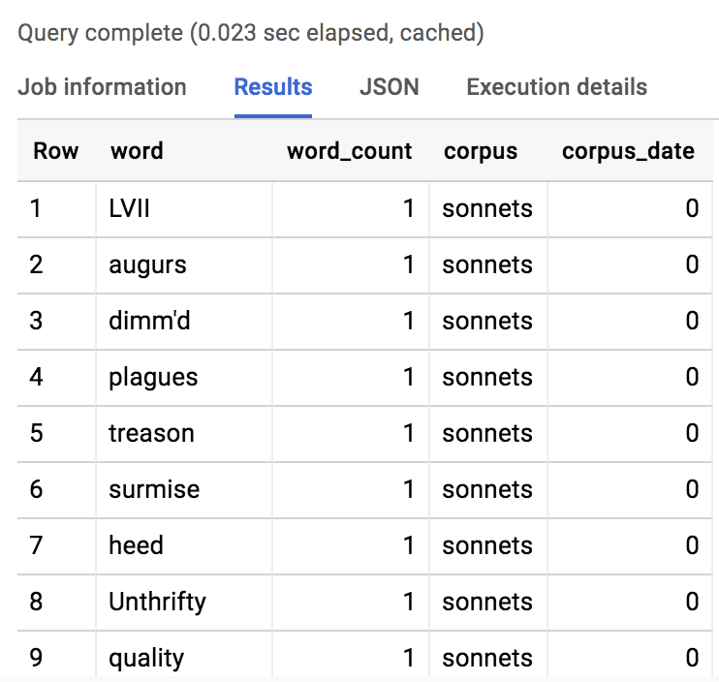
SELECT *
SELECT * FROM `bigquery-public-data.samples.shakespeare`
This query will print out all of the columns (fields).
Notice that we are not being billed for this query since it was cached.

Slide 14
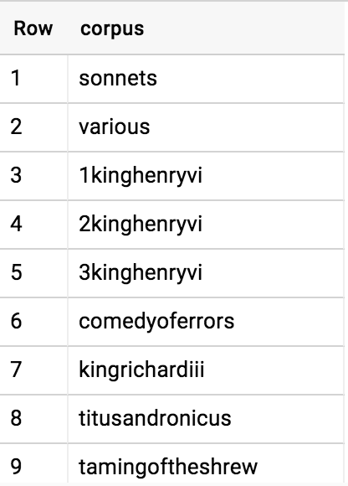
SELECT DISTINCT
SELECT DISTINCT corpus FROM `bigquery-public-data.samples.shakespeare`
SELECT DISTINCT discards duplicate rows and returns only the distinct ones.

Slide 15
COUNT
SELECT COUNT(*) FROM `bigquery-public-data.samples.shakespeare`
Returns total number of rows
SELECT COUNT(DISTINCT corpus) FROM `bigquery-public-data.samples.shakespeare`
Returns number of distinct corpus

Slide 16
Filtering with WHERE
SELECT word FROM `bigquery-public-data.samples.shakespeare` WHERE word_count >= 100
Returns all the words that have at least 100 word_count in one single corpus.
SELECT word, word_count FROM `bigquery-public-data.samples.shakespeare`
WHERE corpus = "hamlet" AND LENGTH(word) > 1
Returns all the words with at least two characters in Hamlet and the number of times each has appeared.

Slide 17
ORDER BY
SELECT word, word_count FROM `bigquery-public-data.samples.shakespeare`
WHERE corpus = "hamlet"
ORDER BY word_count DESC
This query ranks the most popular words in Hamlet.
DESC has to be used in order to give us a descending order. If we don’t specify DESC the default ranking gives us an ascending order. One could use ASC for more clarity, but it’s not necessary.

Slide 18
BETWEEN
SELECT DISTINCT corpus, corpus_date FROM `bigquery-public-data.samples.shakespeare`
WHERE corpus_date BETWEEN 1600 AND 1603
Lists all the corpora and their published year from 1600 to 1603 (inclusive)
This is a useful shorthand for filtering values within a specified range. It is equivalent to:
SELECT DISTINCT corpus, corpus_date FROM `bigquery-public-data.samples.shakespeare`
WHERE corpus_date >= 1600 AND corpus_date <= 1603

Slide 19
LIKE and NOT LIKE
SELECT word, word_count FROM `bigquery-public-data.samples.shakespeare`
WHERE corpus = "hamlet" AND word LIKE "%love%"
SQL engine is looking for any character value that contains “love” and may or may not start with those character, and may or may not end with them. If we use “love%” instead, we wouldn’t get “beloved” in the outcome.
SELECT word, word_count FROM `bigquery-public-data.samples.shakespeare`
WHERE corpus = "hamlet" AND word LIKE "%love%" AND word NOT LIKE "%loved%"
Selects words from Hamlet that contain “love”, but excludes the ones that contain “loved”.
Note: As we’ve seen SQL commands are case-insensitive but character values are case-sensitive.

Slide 20
SUM
SELECT SUM(word_count) FROM `bigquery-public-data.samples.shakespeare`
WHERE corpus = "hamlet"
The query returns 32,446, which is the number of words Shakespeare used to write Hamlet.

Slide 21
MAX & MIN
SELECT MAX(corpus_date) FROM `bigquery-public-data.samples.shakespeare`
According to the database the last corpus written by Shakespeare goes back to 1612
SELECT MIN(corpus_date) FROM `bigquery-public-data.samples.shakespeare`
WHERE corpus_date <> 0
And the first ones is dated 1590. Notice that we have used unequal sign <> to exclude the year 0 which represents an unknown year

Slide 22
ORDER BY multiple criteria
SELECT DISTINCT corpus, corpus_date FROM `bigquery-public-data.samples.shakespeare`
ORDER BY corpus_date DESC, corpus
This will give us a unique list of all the corpora and their year, ranked by year (most recent first), and breaks the ties by corpus, which will be based on alphabetical order.

Slide 23
GROUP BY
SELECT
corpus,
corpus_date AS year,
SUM(word_count) AS word_count,
COUNT(DISTINCT LOWER(word)) AS distinct_word_count
FROM `bigquery-public-data.samples.shakespeare`
GROUP BY corpus, year
ORDER BY word_count DESC
Aggregates by groups (here corpus and corpus_date)
Note that we are using operator AS to rename some of columns

Slide 24
HAVING
SELECT corpus FROM `bigquery-public-data.samples.shakespeare`
GROUP BY corpus
HAVING SUM(word_count) > 30000
We use HAVING clause to filter the outcome of a GROUP BY.
This query will return any corpus that contains more than 30,000 words
Exercise: Recreate the query above without using HAVING.

Slide 25
CASTing
Consider the following query:
SELECT * FROM `bigquery-public-data.noaa_gsod.gsod2020`
WHERE CAST(year AS INT64) = 2020
AND CAST(mo AS INT64) = 2
AND CAST(da AS INT64) = 2
AND stn="994971" -- Boston
CAST() function is used to convert the type of a column.
Note: we can use “--” to leave comments inside our query. Any character after that will be ignored.

Slide 26
CONCAT() Function
We can concatenate strings with the CONCAT() function. E.g.:
SELECT CONCAT(year,"-",mo,"-",da) AS date, *
FROM `bigquery-public-data.noaa_gsod.gsod2020`
WHERE CAST(year AS INT64) = 2020
AND CAST(mo AS INT64) = 2
AND CAST(da AS INT64) = 2
AND stn="994971" -- Boston
Note: This only works with characters. If you need to concatenate integers or other types you can first convert their type with a CAST and then concatenate them.

Slide 27
EXTRACT() & TIMESTAMP() Functions
In the following query we are using a subquery to extract the day component of the timestamp:
SELECT EXTRACT(day FROM timestamp) AS day FROM
(
SELECT TIMESTAMP(CONCAT(year,"-",mo,"-",da)) AS timestamp, *
FROM `bigquery-public-data.noaa_gsod.gsod2020`
WHERE CAST(year AS INT64) = 2020
AND CAST(mo AS INT64) = 2
AND CAST(da AS INT64) = 2
AND stn="994971" -- Boston
)

Slide 28
IF(cond, true_result, else_result)
If cond is true, returns true_result, else returns else_result. E.g.:
SELECT
TIMESTAMP(CONCAT(year,"-",mo,"-",da)) AS timestamp,
IF(dewp = 9999.9, NULL, dewp) AS dewp
FROM `bigquery-public-data.noaa_gsod.gsod2020`
WHERE CAST(year AS INT64) = 2020
AND CAST(mo AS INT64) = 2
AND CAST(da AS INT64) = 2
AND stn="994971" -- Boston

Slide 29
IS NULL & IS NOT NULL
NULL represents a missing or unknown value. IS NULL operator can be used for filtering the NULL values. It is contrary to IS NOT NULL, where filters the records with a definite value.
SELECT * FROM `bigquery-public-data.cms_medicare.hospital_general_info`
WHERE hospital_overall_rating_footnote IS NOT NULL
Returns 1,267 records where hospital_overall_rating_footnote is available.

Slide 30
Activity - Public Datasets on BigQuery
https://cloud.google.com/public-datasets/
Some of not too large, and possibly interesting datasets:
london_bicycles: Bicycle rentals data in London
cms_medicare: The Centers for Medicare & Medicaid Services
fda_food: FDA
ccaa_basketball: Contains data about NCAA Basketball games, teams, and players.
openaq: OpenAQ is an open-source project to surface live, real-time air quality data from around the world.
world_bank_intl_education: Education data from World Bank
Pick a dataset and explore.

Slide 31
Creating a Table in BigQuery
You can create a table in BigQuery:
Manually using the GCP Console, the classic BigQuery web UI, or the command-line tool's bq mk command
Programmatically by calling the tables.insert API method
From query results
By defining a table that references an external data source
When you create a table in BigQuery, the table name must be unique per dataset. The table name can:
Contain up to 1,024 characters
Contain letters (upper or lower case), numbers, and underscores
More info here.

Slide 32
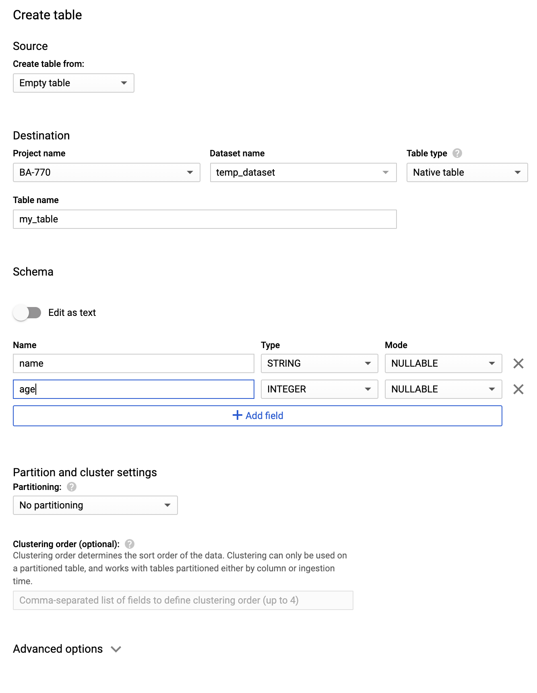
Creating an Empty Table Manually
Click on your project name under resources
Create a new dataset
On the right hand side click on CREATE DATASET
Give a Dataset ID such as temp_dataset
Optionally provide an expiration date for this dataset
Number of days after table creation: 3
Click create
Select the temp_dataset dataset and click on CREATE TABLE
For Dataset name, choose the appropriate dataset (temp_dataset)
In the Table name field, enter the name of the table you're creating in BigQuery (my_table)
Verify that Table type is set to Native table
In the Schema section, enter the schema definition. Enter schema information manually by adding one field at a time. You will need to specify the name, type and mode of each column
In the Advanced options section, leave the default values
Click Create table

Slide 33
Update the Dataset Description
Click on the temp_dataset dataset and modify the description to something like:
Tables in this temporary dataset have an expiration of 3 days and are used for practice.

Slide 34
INSERT Statement
Use the INSERT statement when you want to add new rows to a table.
CREATE OR REPLACE TABLE temp_dataset.sales
(SKU STRING,
total_ordered INT64)
INSERT INTO temp_dataset.sales
(SKU, total_ordered)
VALUES('GGOEGHPA002910', 101)

Slide 35
CREATE TABLE Statement
Simple CREATE TABLE statement:
Using more options:
NOTE: my_table2 already exists, so the query above won’t do anything. Relace CREATE TABLE IF NOT EXISTS with CREATE OR REPLACE TABLE.
CREATE TABLE temp_dataset.my_table2
(
name STRING,
age INT64
)
CREATE TABLE IF NOT EXISTS temp_dataset.my_table2
(
name STRING NOT NULL OPTIONS(description="A required STRING field"),
age INT64 OPTIONS(description="An optional INT64 field")
)
OPTIONS(description="Created by a SQL command")

Slide 36
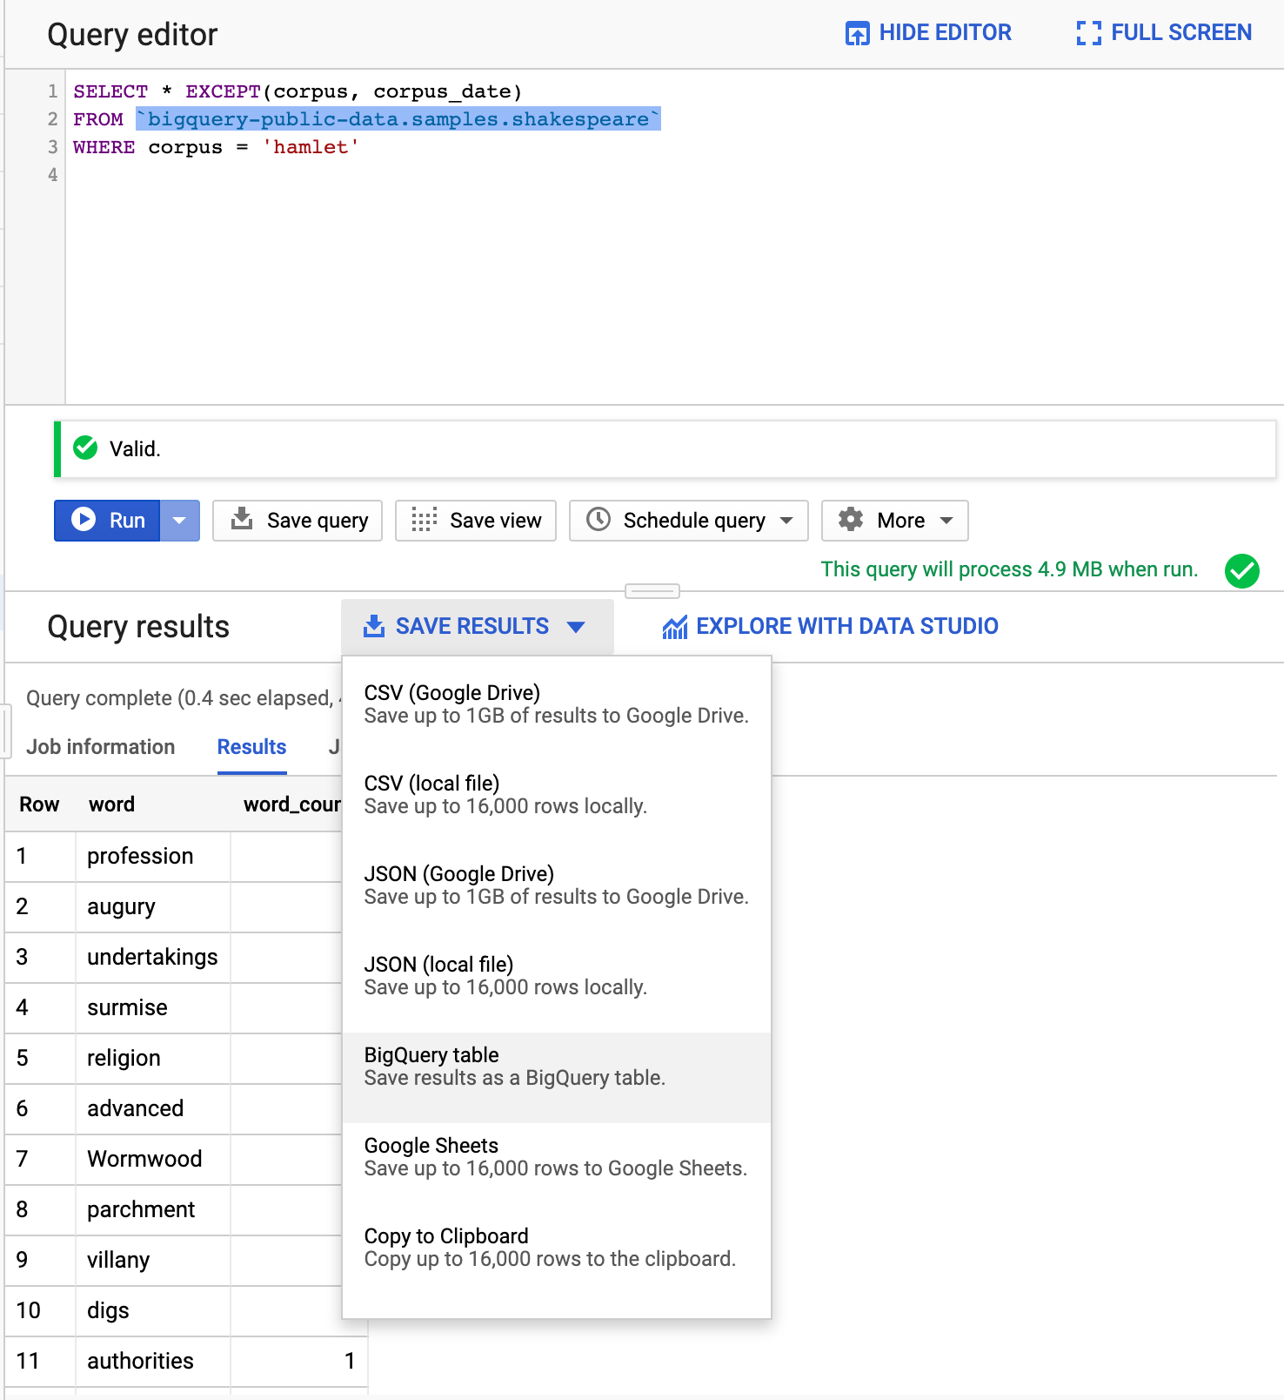
Creating a Table From a Query Result
Run the following query:
SELECT * EXCEPT(corpus, corpus_date)
FROM `bigquery-public-data.samples.shakespeare`
WHERE corpus = 'hamlet'
Under Save Results tab select BigQuery table
Select correct project and temp_dataset dataset
Name it hamlet
Click Create
Confirm that your table is there

Slide 37
Creating a New Table from a Query
The following query writes the result of the query followed by AS to a new table:
CREATE TABLE IF NOT EXISTS temp_dataset.hamlet2
OPTIONS(
description="This table contains all the words and their counts from Hamlet"
) AS
SELECT * EXCEPT(corpus, corpus_date) FROM `bigquery-public-data.samples.shakespeare`
WHERE corpus = 'hamlet'

Slide 38
CREATE VIEW Statement
The following query creates a view of our query:
CREATE OR REPLACE VIEW temp_dataset.hamlet_vw
OPTIONS(
description="A view of Hamlet words and their counts"
) AS
SELECT * EXCEPT(corpus, corpus_date)
FROM `bigquery-public-data.samples.shakespeare`
WHERE corpus = 'hamlet'

Slide 39


DEMO
Load Data into BigQuery

Slide 40
Where Can I Learn More about SQL?
Standard SQL Query Syntax
Standard SQL Functions & Operators
SQL Style Guide
stackoverflow.com
google.com

Slide 41

Your Turn - Lab Session
QLab: Using BigQuery in the GCP Console - 00:40
What you will learn in this lab
Query a public dataset
Create a dataset in your project and load data into a table.
Query your own table using GROUP BY and ORDER BY keywords.
**NOTE** OPEN QWIKLABS IN AN incognito MODE GOOGLE CHROME PAGE

Slide 42

Activity
Assignment 1 is accessible under the Assessment tab in Blackboard.
Due: March 1, 2022
DataCamp assignments according to the syllabus
Lab session: Using BigQuery in the GCP Console

