Slide 1
Business Analytics
Toolbox - BA775
Summer 2021
Lecture 02
Professor: Mohammad Soltanieh-ha

Slide 2


Slide 3
Previous Class Overview
Created a project, used a coupon for billing and added a budget to it.
Created a storage bucket and added a data file both through the console as well as with command-line tool (Google Cloud SDK).
Got familiar with the cloud shell and learned how to edit files and run commands.
Learned how to create a virtual machine, VM, as well as a Vertex AI instance.

Slide 4
Topics Covered
Databases
BigQuery
MySQL (via Cloud SQL)
Basic SQL syntax

Slide 5

Databases
What kind of databases are out there?
Relational (tabular) databases
Non-relational databases
When to use a relational database?
What are the benefits of using a relational database management system (RDBMS)?

Slide 6
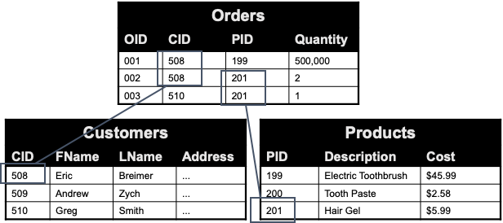

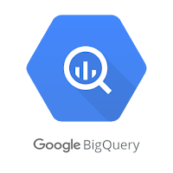
Relational Databases
These databases model data as rows and columns in a series of tables, and use SQL for writing and querying data.

Slide 7
SQL Language
Structured Query Language, SQL, is designed for a specific purpose: to query data contained in a relational database.
There are many different variations of SQL. BigQuery supports two versions:
Standard SQL (preferred)
Legacy SQL (previously known as BigQuery SQL)
We will get an overview of basic functionalities of standard SQL.
Note 1: Most SQL engines are cAse-iNseNsItivE by default
Note 2: Use UPPERCASE for the reserved keywords like SELECT and WHERE

Slide 8

BigQuery
Google’s Big Data Database
BigQuery is a serverless analytics database and data warehousing service that enables interactive analysis of massively large datasets
It’s fast, highly scalable, cost-effective, NoOps, and fully managed
BigQuery is foundation for modern BIs
It’s been GA since November 2011
Datasets can be queried using standard SQL
More info here!

Slide 9
BigQuery’s Public Dataset
Go to console.cloud.google.com/bigquery
If it’s your first time, you will need to sign up and accept terms and conditions.
Please make sure you are within your BU account and BA775 project.
Now, go to this link to access BigQuery’s public dataset
Under Resources you should see a project called bigquery-public-data.
Click on it and then on the right hand side click on PIN PROJECT.
You can now browse all of the public data sources.

Slide 10
Query
Query is the command that gets executed in order to communicate with the database.
Consider the following query:
SELECT word FROM `bigquery-public-data.samples.shakespeare`
Command Column Command Project Dataset Table
shakespeare table: contains a word index of the works of Shakespeare, giving the number of times each word appears in each corpus.
Note: `project.dataset.table` is surrounded by backticks ``

Slide 11
Table Properties
Consider shakespeare table of samples dataset from bigquery-public-data project.
Locate this table in BigQuery and check out the following properties:
Schema: provides the field names within the table with their data types, mode, and optional description
Details: gives details about the table, such as its size, number of rows, location, and more
Preview: gives you a glimpse of the first rows. Looking at the preview doesn’t count against your 1TB/mo free query, and is always the best way to get a sense of the data.
Note: no matter how small the table is, the minimum amount of charges billed for each query is 10MB

Slide 12
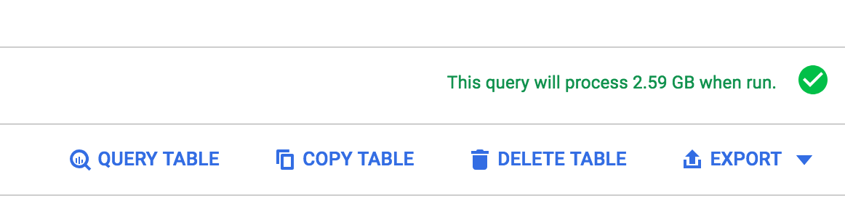
BigQuery Best Practices
BigQuery allows you to query 1TB/Mo for free
The volume is calculated based on the amount of data processed.
Here are a few tips
Avoid SELECT *
Select only the columns that are needed.
Don't run queries to explore or preview table data.
On the Table Details page, click Preview to sample the data.
Do not use a LIMIT clause as a method of cost control, doesn’t work!
Use the default table expiration time to remove the data when it's no longer needed.
Before running queries, preview them to estimate cost:

Slide 13
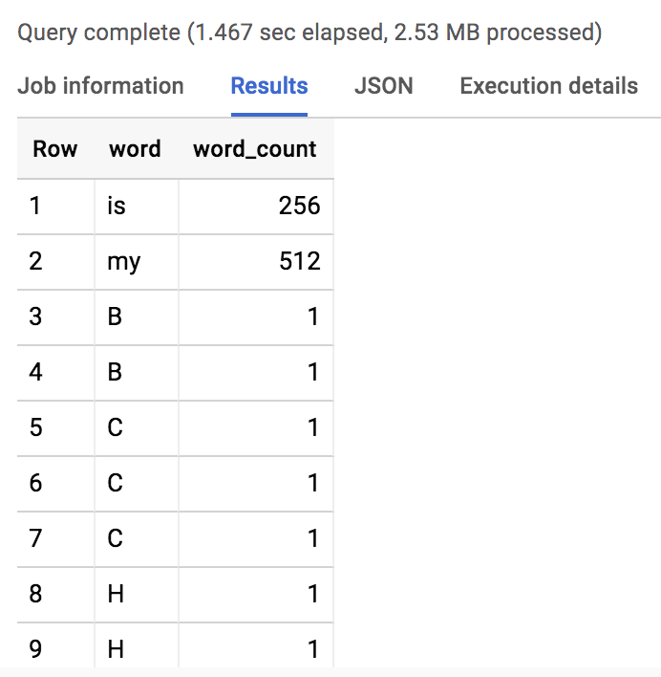
SELECT list
SELECT word, word_count FROM `bigquery-public-data.samples.shakespeare`
With SELECT we can select one or more columns
This query will print out word & word_count columns.
Number of rows printed are limited to the UI settings, but in fact all the rows are processed.

Slide 14
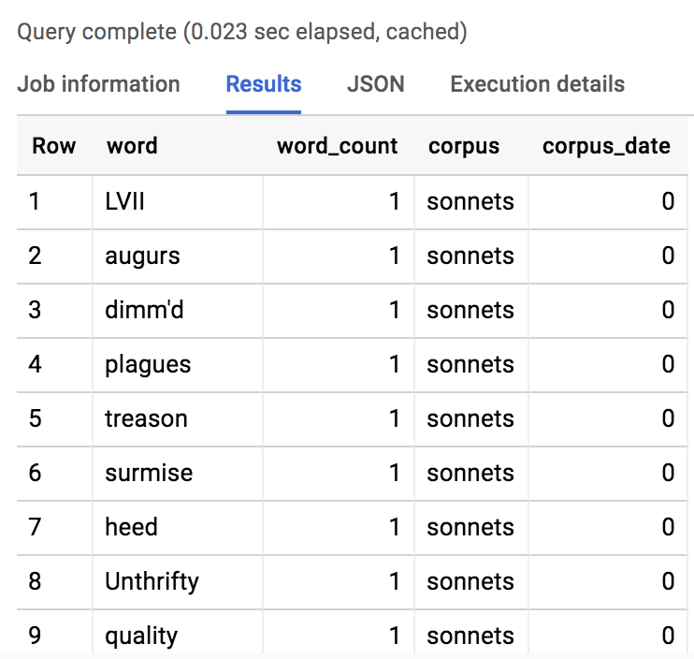
SELECT *
SELECT * FROM `bigquery-public-data.samples.shakespeare`
This query will print out all of the columns (fields).
Notice that we are not being billed for this query since it was cached.

Slide 15
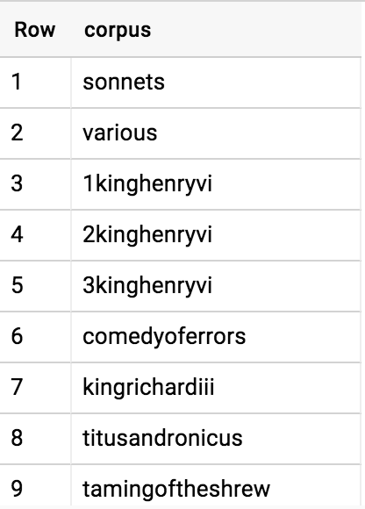
SELECT DISTINCT
SELECT DISTINCT corpus FROM `bigquery-public-data.samples.shakespeare`
SELECT DISTINCT discards duplicate rows and returns only the distinct ones.

Slide 16
COUNT
SELECT COUNT(*) FROM `bigquery-public-data.samples.shakespeare`
Returns total number of rows
SELECT COUNT(DISTINCT corpus) FROM `bigquery-public-data.samples.shakespeare`
Returns number of distinct corpus

Slide 17
Filtering with WHERE
SELECT word FROM `bigquery-public-data.samples.shakespeare` WHERE word_count >= 100
Returns all the words that have at least 100 word_count in one single corpus.
SELECT word, word_count FROM `bigquery-public-data.samples.shakespeare`
WHERE corpus = "hamlet" AND LENGTH(word) > 1
Returns all the words with at least two characters in Hamlet and the number of times each has appeared.

Slide 18
ORDER BY
SELECT word, word_count FROM `bigquery-public-data.samples.shakespeare`
WHERE corpus = "hamlet"
ORDER BY word_count DESC
This query ranks the most popular words in Hamlet.
DESC has to be used in order to give us a descending order. If we don’t specify DESC the default ranking gives us an ascending order. One could use ASC for more clarity, but it’s not necessary.

Slide 19
BETWEEN
SELECT DISTINCT corpus, corpus_date FROM `bigquery-public-data.samples.shakespeare`
WHERE corpus_date BETWEEN 1600 AND 1603
Lists all the corpora and their published year from 1600 to 1603 (inclusive)
This is a useful shorthand for filtering values within a specified range. It is equivalent to:
SELECT DISTINCT corpus, corpus_date FROM `bigquery-public-data.samples.shakespeare`
WHERE corpus_date >= 1600 AND corpus_date <= 1603

Slide 20
LIKE and NOT LIKE
SELECT word, word_count FROM `bigquery-public-data.samples.shakespeare`
WHERE corpus = "hamlet" AND word LIKE "%love%"
SQL engine is looking for any character value that contains “love” and may or may not start with those character, and may or may not end with them. If we use “love%” instead, we wouldn’t get “beloved” in the outcome.
SELECT word, word_count FROM `bigquery-public-data.samples.shakespeare`
WHERE corpus = "hamlet" AND word LIKE "%love%" AND word NOT LIKE "%loved%"
Selects words from Hamlet that contain “love”, but excludes the ones that contain “loved”.
Note: As we’ve seen SQL commands are case-insensitive but character values are case-sensitive.

Slide 21
SUM
SELECT SUM(word_count) FROM `bigquery-public-data.samples.shakespeare`
WHERE corpus = "hamlet"
The query returns 32,446, which is the number of words Shakespeare used to write Hamlet.

Slide 22
MAX & MIN
SELECT MAX(corpus_date) FROM `bigquery-public-data.samples.shakespeare`
According to the database the last corpus written by Shakespeare goes back to 1612
SELECT MIN(corpus_date) FROM `bigquery-public-data.samples.shakespeare`
WHERE corpus_date <> 0
And the first ones is dated 1590. Notice that we have used unequal sign <> to exclude the year 0 which represents an unknown year

Slide 23
ORDER BY multiple criteria
SELECT DISTINCT corpus, corpus_date FROM `bigquery-public-data.samples.shakespeare`
ORDER BY corpus_date DESC, corpus
This will give us a unique list of all the corpora and their year, ranked by year (most recent first), and breaks the ties by corpus, which will be based on alphabetical order.

Slide 24
GROUP BY
SELECT
corpus,
corpus_date AS year,
SUM(word_count) AS word_count,
COUNT(DISTINCT LOWER(word)) AS distinct_word_count
FROM `bigquery-public-data.samples.shakespeare`
GROUP BY corpus, year
ORDER BY word_count DESC
Aggregates by groups (here corpus and corpus_date)
Note that we are using operator AS to rename some of columns

Slide 25
HAVING
SELECT corpus FROM `bigquery-public-data.samples.shakespeare`
GROUP BY corpus
HAVING SUM(word_count) > 30000
We use HAVING clause to filter the outcome of a GROUP BY.
This query will return any corpus that contains more than 30,000 words
Exercise: Recreate the query above without using HAVING.

Slide 26
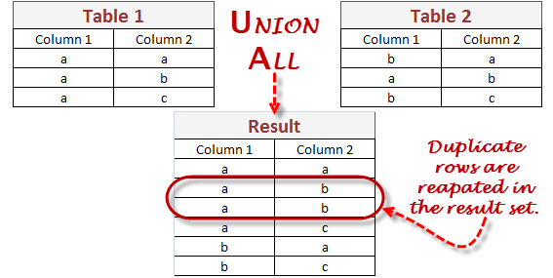
UNION ALL & UNION DISTINCT
SELECT * FROM `bigquery-public-data.cms_medicare.inpatient_charges_2015`
UNION ALL
SELECT * FROM `bigquery-public-data.cms_medicare.inpatient_charges_2014`
UNION ALL will merge two queries. They must have same column name/type. Duplicates, if any, will persist.
UNION DISTINCT will remove the duplicates during the merge.

Slide 27
Load Data into BigQuery
Create a new dataset called examples
Create a table, call it customer_churn
Upload data/Telco-Customer-Churn.csv into this table
Use the following settings
Upload from file
File format: CSV
Turn auto detect for schema and input parameters on

Slide 28


DEMO
Load Data into BigQuery

Slide 29
Where Can I Learn More?
Google BigQuery: The Definitive Guide
Getting Started with SQL: A Hands-On Approach for Beginners
Standard SQL Query Syntax
Standard SQL Functions & Operators
SQL Style Guide
stackoverflow.com
google.com

Slide 30
Hands-on Practice
For this practice use the following publicly available COVID-19 John Hopkins dataset on BigQuery: `bigquery-public-data.covid19_jhu_csse.summary`
Open questions:
Which US states have had the biggest number of new cases in the last available date? Note, first you would need to find the latest date which the data is available for.
How about in the last 7 days in the dataset? Note that we are looking at the absolute values and we are not considering the population of the states. In a later exercise we will normalize these numbers by population.

Slide 31

Activity
Online Courses
Ch 1.3 Intro to SQL for Data Science - Aggregate Functions
Ch 1.4 Intro to SQL for Data Science - Sorting, grouping and joins
Due Monday - 08/16
Assignment 1
Accessible from the QTools under Tests & Quizzes
Make sure you provide rationale for each question. The correct answer in the multiple choice section gives you 50% of the points, the rest is the rationale you provide.
Due Thursday - 08/19
Qwiklabs should be completed before the next class. Submission instruction for Qwiklabs will be provided at the end of the course.

Slide 32

Your Turn - Lab Session
QLab E*: Using BigQuery in the GCP Console - 00:40
What you will learn in this lab
Query a public dataset
Create a dataset in your project and load data into a table.
Query your own table using GROUP BY and ORDER BY keywords.
**NOTE** OPEN QWIKLABS IN AN incognito MODE GOOGLE CHROME PAGE

Slide 33
Your Turn - Home Session
QLab D: Introduction to SQL for BigQuery and Cloud SQL - 01:15
What you will learn in this lab
Understand the relationship among project, database, and table.
Get familiar with BigQuery console, e.g. loading databases and tables into BigQuery.
Use SELECT, FROM, WHERE, COUNT, GROUP BY, AS, and ORDER BY keywords to fetch meaningful data from datasets.
Export query results to local repository and upload them to Cloud Storage bucket.
Create a new Cloud SQL instance and load files from Cloud Storage bucket as new tables.
Know basic knowledge of keywords CREATE, DELETE, INSERT INTO, and UNION. Be able to run queries in Cloud SQL using Cloud Shell.
**NOTE** OPEN QWIKLABS IN AN incognito MODE GOOGLE CHROME PAGE

