Slide 1
Business Analytics
Toolbox - BA775
Summer 2021
Lecture 03
Professor: Mohammad Soltanieh-ha

Slide 2
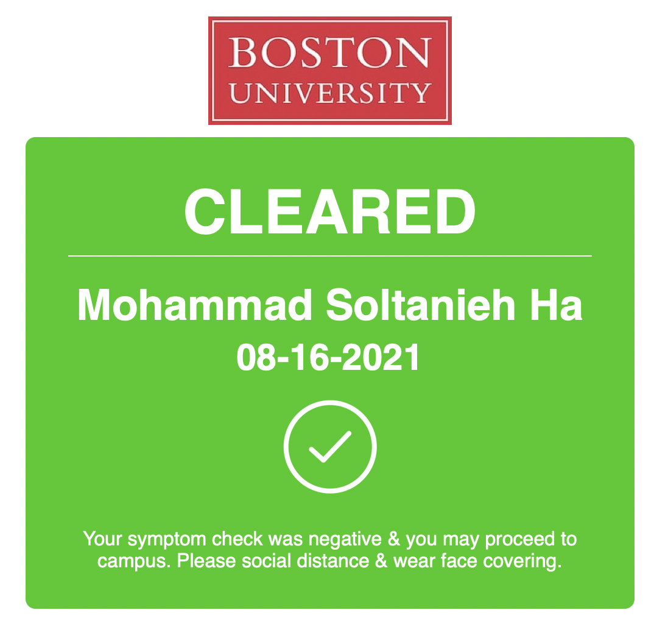

Slide 3
Announcements
No extension on assignments will be granted - the late submission option remains open though
There will be one extra quiz at the end which will be optional. You may choose to take this quiz to replace it with your lowest grade.
Deadlines:
DataCamp is due before the assigned class (8 am). It’s a pre-work for each lecture
Qwiklabs are due before the next class (8 am). It’s a post work for each lecture
Assignments are due before the specified class (8 am)

Slide 4
Topics Covered
Vertex AI and Colab notebooks and visualizing BigQuery results
Nested query statements
Interactive querying on large datasets
Brief intro to Data Studio

Slide 5

Vertex AI Notebooks
An easy to use interactive tool for data exploration, analysis, visualization and machine learning.
Vertex AI is based on Jupyter (formerly IPython) so you can use a large number of existing packages for statistics, machine learning, etc.
Vertex AI notebook is free. However, you will incur compute, storage and other cloud services costs based on usage.
Here is an example.
Note: before running the queries make sure that your query works fine and the volume of the data processed is reasonable. Within Colab or Vertex AI notebooks the volume to be processes is not shown by default.

Slide 6
Delete/Stop Your VM

Slide 7
Your Turn - Home Session
QLab F: Analyzing Natality Data Using AI Platform and BigQuery - 00:30
What you will learn in this lab
Launch AI Platform notebook
Invoke a BigQuery query
Create charts in Jupyter
Export data for machine learning
NOTE: There are some Python script in this lab...please copy/paste/run the scripts but don’t worry if you are not familiar with the syntax.

Slide 8
Accessing BigQuery from Colab
In this example we will see how Colab notebooks can access the data in BigQuery.
Note: before running the queries make sure that your query works fine and the volume of the data processed is reasonable. Within Colab or Vertex AI notebooks the volume to be processes is not shown by default.

Slide 9


Slide 10
CASTing
Consider the following query:
SELECT * FROM `bigquery-public-data.noaa_gsod.gsod2021`
WHERE CAST(year AS INT64) = 2021
AND CAST(mo AS INT64) = 8
AND CAST(da AS INT64) = 12
AND stn="994971" -- Boston
CAST() function is used to convert the type of a column.
Note: we can use “--” to leave comments inside our query. Any character after that will be ignored.

Slide 11
CONCAT() Function
We can concatenate strings with the CONCAT() function. E.g.:
SELECT CONCAT(year,"-",mo,"-",da) AS date2, *
FROM `bigquery-public-data.noaa_gsod.gsod2021`
WHERE CAST(year AS INT64) = 2021
AND CAST(mo AS INT64) = 8
AND CAST(da AS INT64) = 12
AND stn="994971" -- Boston
Note: This only works with characters. If you need to concatenate integers or other types you can first convert their type with a CAST and then concatenate them.

Slide 12
EXTRACT() & TIMESTAMP() Functions
In the following query we are using a subquery to extract the day component of the timestamp:
SELECT EXTRACT(day FROM timestamp) AS day FROM
(
SELECT TIMESTAMP(CONCAT(year,"-",mo,"-",da)) AS timestamp, *
FROM `bigquery-public-data.noaa_gsod.gsod2021`
WHERE CAST(year AS INT64) = 2021
AND CAST(mo AS INT64) = 8
AND CAST(da AS INT64) = 12
AND stn="994971" -- Boston
)

Slide 13
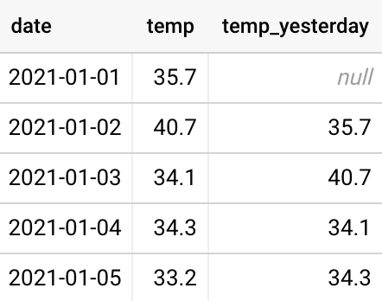
LAG()
Returns the value of the expression on a preceding row:
SELECT
date,
temp,
LAG(temp) OVER(ORDER BY date) AS temp_yesterday
FROM `bigquery-public-data.noaa_gsod.gsod2021`
WHERE stn="994971" -- Boston
ORDER BY date

Slide 14
IF(cond, true_result, else_result)
If cond is true, returns true_result, else returns else_result. E.g.:
SELECT
TIMESTAMP(CONCAT(year,"-",mo,"-",da)) AS timestamp,
IF(dewp = 9999.9, NULL, dewp) AS dewp
FROM `bigquery-public-data.noaa_gsod.gsod2021`
WHERE CAST(year AS INT64) = 2021
AND CAST(mo AS INT64) = 8
AND CAST(da AS INT64) = 12
AND stn="994971" -- Boston

Slide 15
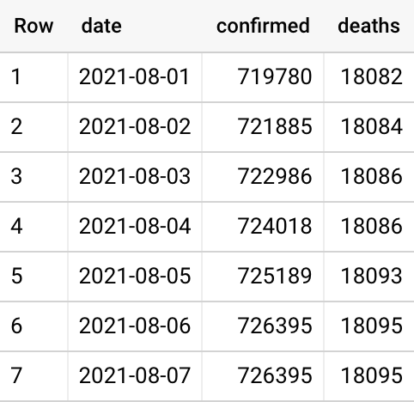
Hands-on Practice (1)
For this practice use the following publicly available COVID-19 Johns Hopkins dataset on BigQuery: `bigquery-public-data.covid19_jhu_csse.summary`
Open questions:
How many TOTAL confirmed COVID-19 cases and deaths have we had at each day in Massachusetts during the month of August?
Check your numbers with another data source to make sure your query is not off. E.g., https://www.nytimes.com/interactive/2021/us/massachusetts-covid-cases.html

Slide 16
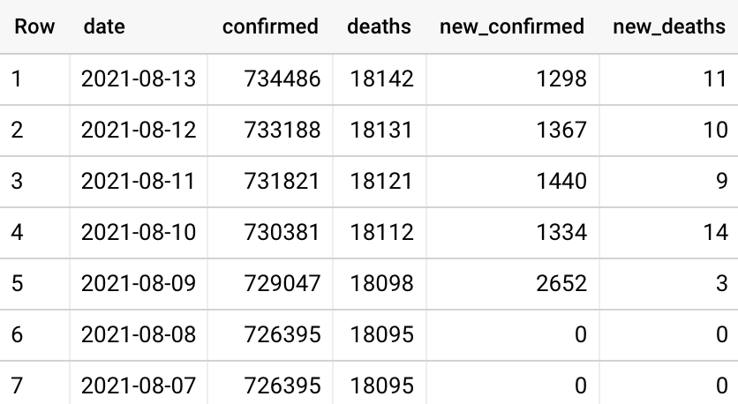
Hands-on Practice (2)
For this practice use the following publicly available COVID-19 John Hopkins dataset on BigQuery: `bigquery-public-data.covid19_jhu_csse.summary`
Open questions:
In addition, how many NEW confirmed COVID-19 cases and deaths have we had at each day in Massachusetts during the month of August?
Hint: you will have to use a new function called LAG()
Check your numbers with another data source to make sure your query is not off. E.g., https://www.nytimes.com/interactive/2021/us/massachusetts-covid-cases.html

Slide 17
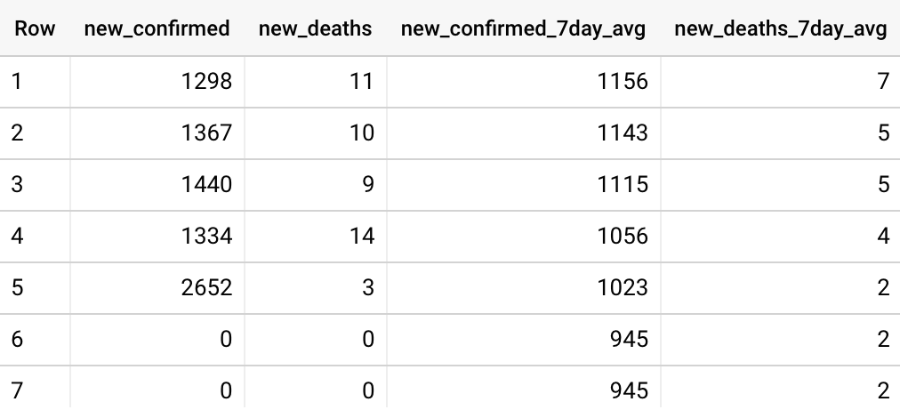
Hands-on Practice (3)
For this practice use the following publicly available COVID-19 John Hopkins dataset on BigQuery: `bigquery-public-data.covid19_jhu_csse.summary`
Open questions:
Can you include 7-day moving average with the previous results?

Slide 18
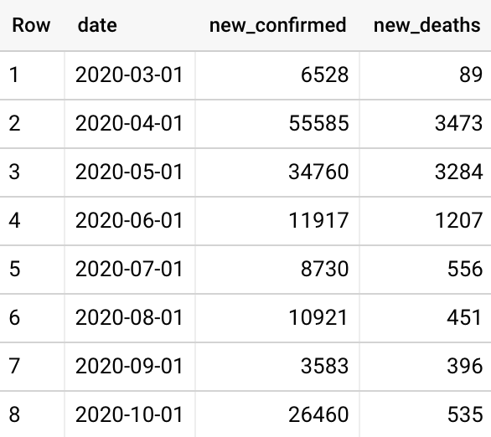
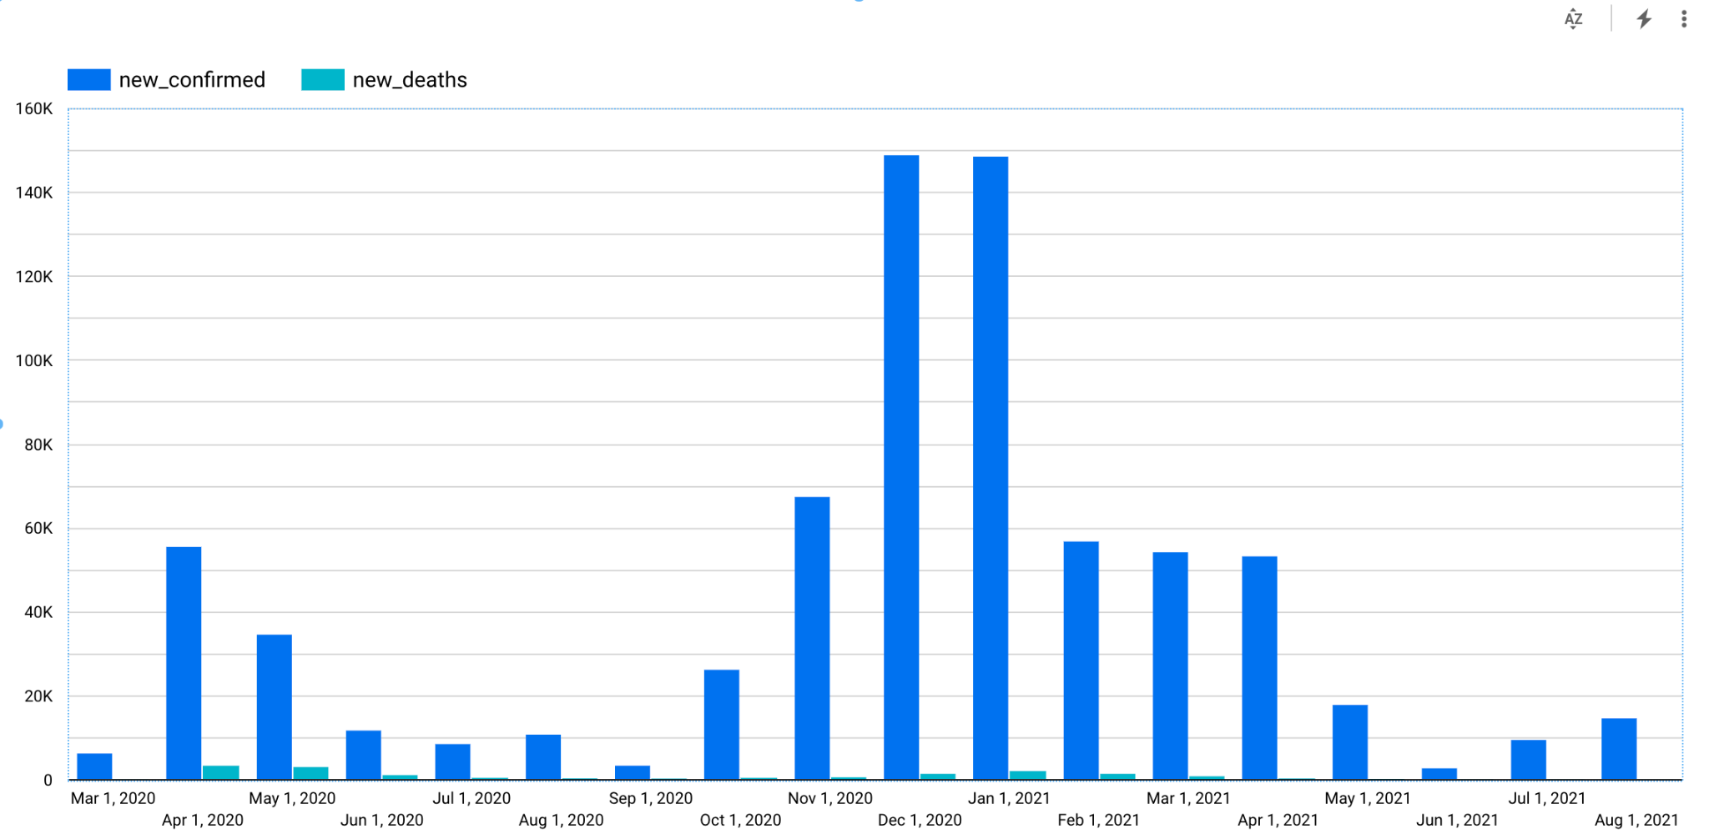
Hands-on Practice (4)
For this practice use the following publicly available COVID-19 John Hopkins dataset on BigQuery: `bigquery-public-data.covid19_jhu_csse.summary`
Open questions: How many NEW confirmed COVID-19 cases and deaths have we had for each month in Massachusetts? Bonus: Can you explore your results in Data Studio?

Slide 19

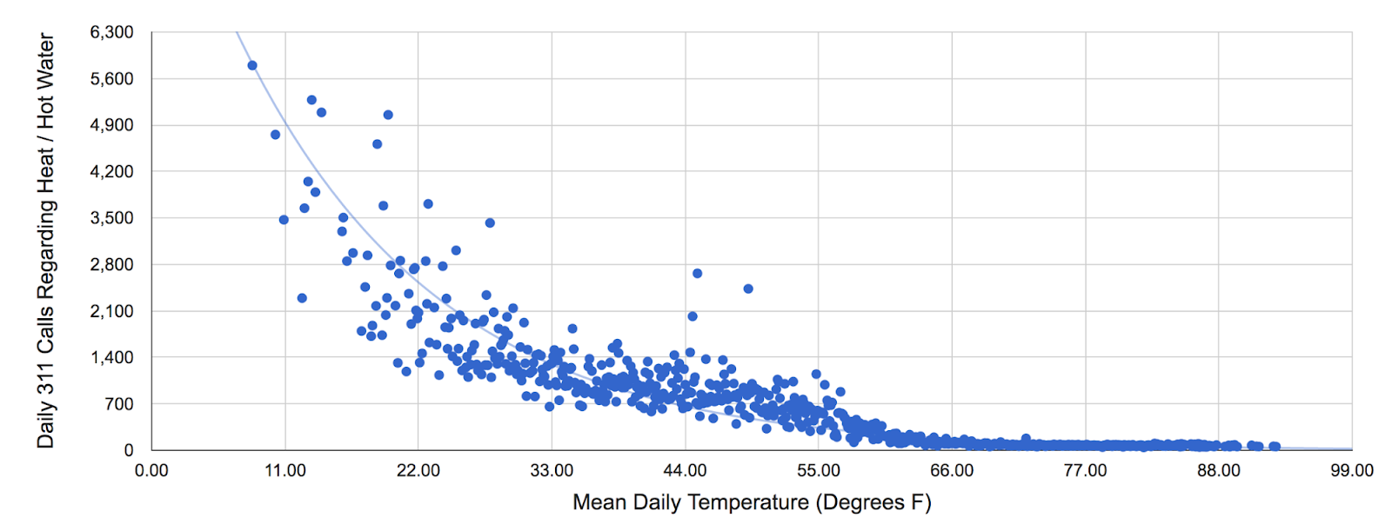
Your Turn - Lab Session
QLab G: Weather Data in BigQuery - 00:45
What you will learn in this lab
Carry out interactive queries on large datasets
Combine and run analytics on multiple datasets
Understand nested query statements with multiple functions
Get familiar with table and column alias
Hint: When you are asked to update the project ID typically it is safe to remove <YOUR-PROJECT-NUMBER>. all together since you are already in that project. A better practice would be to provide the ID but in this case it’s a long temporary ID and takes time to copy/paste.
NOTE: In this lab you will be using a JOIN command to “join” two tables. Don’t worry if you haven’t encountered it before. We will discuss it in depth in the future lectures.

Slide 20

Project Leads
We would like to identify project leads. Leads should
have some prior SQL knowledge
be willing to help their fellow team members during the class for in-class exercises
be willing to coordinate their team to set up meetings related to the team assignment and project
Project leads will be evaluated by their fellow team members at the end of the semester.
A satisfactory evaluation guarantees a complete class participation grade.
If interested, please fill out the form here.

Slide 21

Project Cohort
Please check this spreadsheet to ensure you are assigned to the correct cohort. Moving forward, you are expected to attend your assigned cohort.
If your preferred name is different from your first name, please add it to this spreadsheet.

Slide 22

Activity
Reminder: Apply to get a free 1-year Tableau student license
Assignment 1
Accessible from the QTools under Tests & Quizzes
Make sure you provide rationale for each question. The correct answer in the multiple choice section gives you 50% of the points, the rest is the rationale you provide.
Due Thursday - 08/19
DataCamp
Ch 2.1 Introduction to SQL Server - SELECTion Box
Ch 2.2 Introduction to SQL Server - Groups, strings, and counting things
Due Tuesday - 08/17
Quiz on Tuesday

Slide 23
Your Turn - Home Session
QLab H*: Exploring NCAA Data with BigQuery - 00:45
What you will learn in this lab
Query the NCAA Public Dataset
Writing and executing more queries

