Slide 1
Business Analytics
Toolbox - BA775
Summer 2021
Lecture 05
Professor: Mohammad Soltanieh-ha

Slide 2
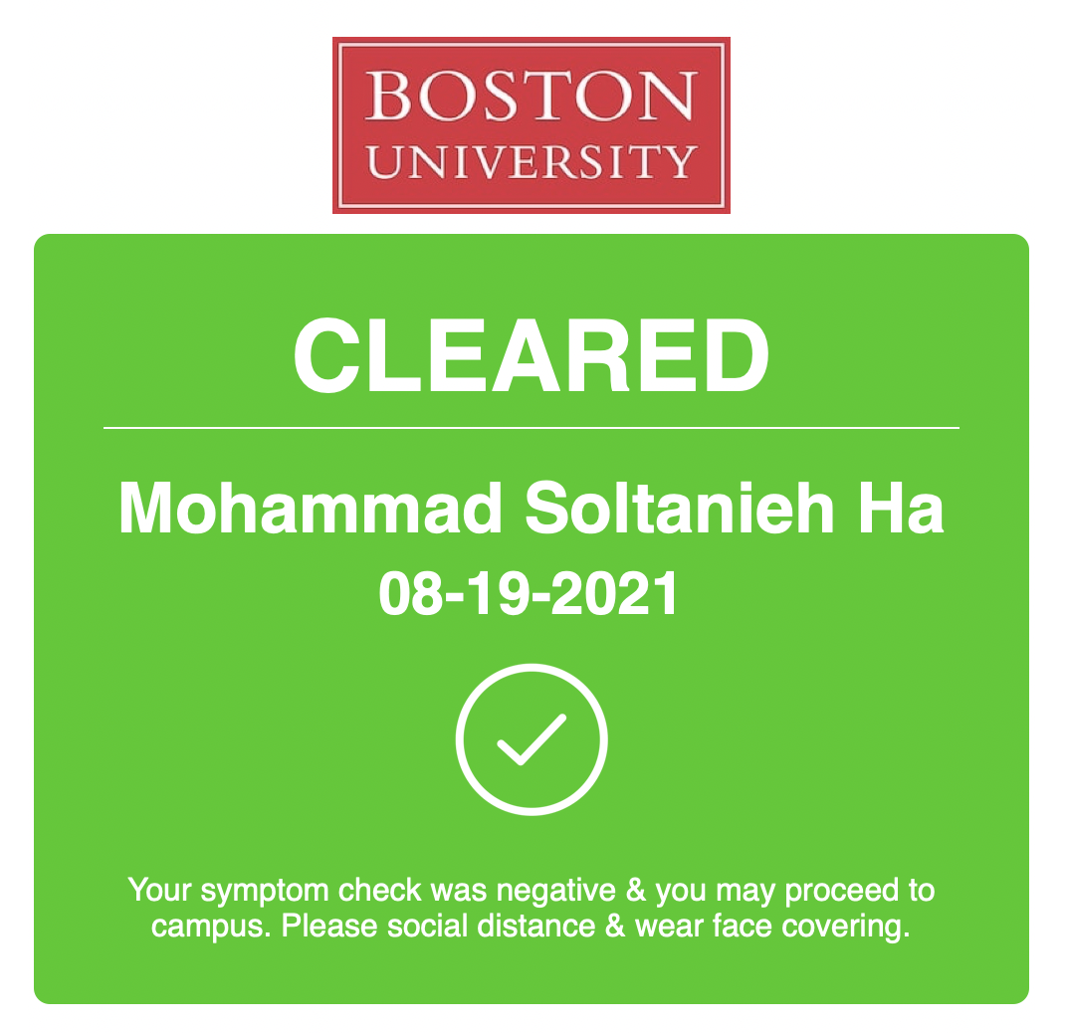

Slide 3
Survey Summary
Encourage screen sharing in breakout rooms - DONE!
Explain the complicated queries on the qwiklab and more clarification - Will do
More SQL - Please give us more practice material for SQL - Will do
More data Visualization, More applications of Jupyter notebooks and more sample codes
More ML - classes 8 & 9 will cover that
Key concepts in the lab - Will do
Go through Qwiklabs after we’re done - This can be done sometimes
Can’t hear questions in the classroom - Will try to repeat
Start noticing raised hands on Zoom - Will do my best
Sharing the codes to the in class exercise answers - I have been sharing them in chat but will share in the deck as well

Slide 4
Survey Summary
Can you by any chance use a headset?
Please teach us more about how you did your job as a data scientist - Will do when possible
Go slower - It would be best to ask clarifying questions to slow me down and make me repeat
Stop
Quiklabs
SQL - we are good with datacamp
Continue
hands on practices on SQL functions
having people share code answers for hands-on practice
Qlabs
Breakout sessions
DataCamp
Teaching pace

Slide 5
Survey Summary
Continue
I like the way you teach, it's straightforward and efficient. So please continue this way of teaching.
Doing in-class exercises and qwiklabs in class (helps to absorb the information)
Everything else is going great! Really appreciate how the class is going so far. I appreciate how the class is organized, and the overall structure is easy to follow.
The layout of the class, not condensed, have some time to do homeworks
Love the datacamp and labs-- really great external learning resources.
I appreciate the pace of the class at the moment
I love how organized the class material is!
Continue reminding us of deadlines towards the end of each class.
The course is well planned. The labs, data camp, group projects, quizzes, assignments are very wholesome.

Slide 6
Recorded video topic suggestions
More SQL examples: JOIN, CASE, LAG, WITH, Subqueries. Exercises like class 3
shell commands
cloud functionality
ML/AI

Slide 7
Topics Covered
Creating new tables in BigQuery
Tableau
Google Data Studio
Fundamentals of creating an effective dashboard

Slide 8


Slide 9
Creating a Table in BigQuery
You can create a table in BigQuery:
Manually using the GCP Console, the classic BigQuery web UI, or the command-line tool's bq mk command
Programmatically by calling the tables.insert API method
From query results
By defining a table that references an external data source
When you create a table in BigQuery, the table name must be unique per dataset. The table name can:
Contain up to 1,024 characters
Contain letters (upper or lower case), numbers, and underscores
More info here.

Slide 10
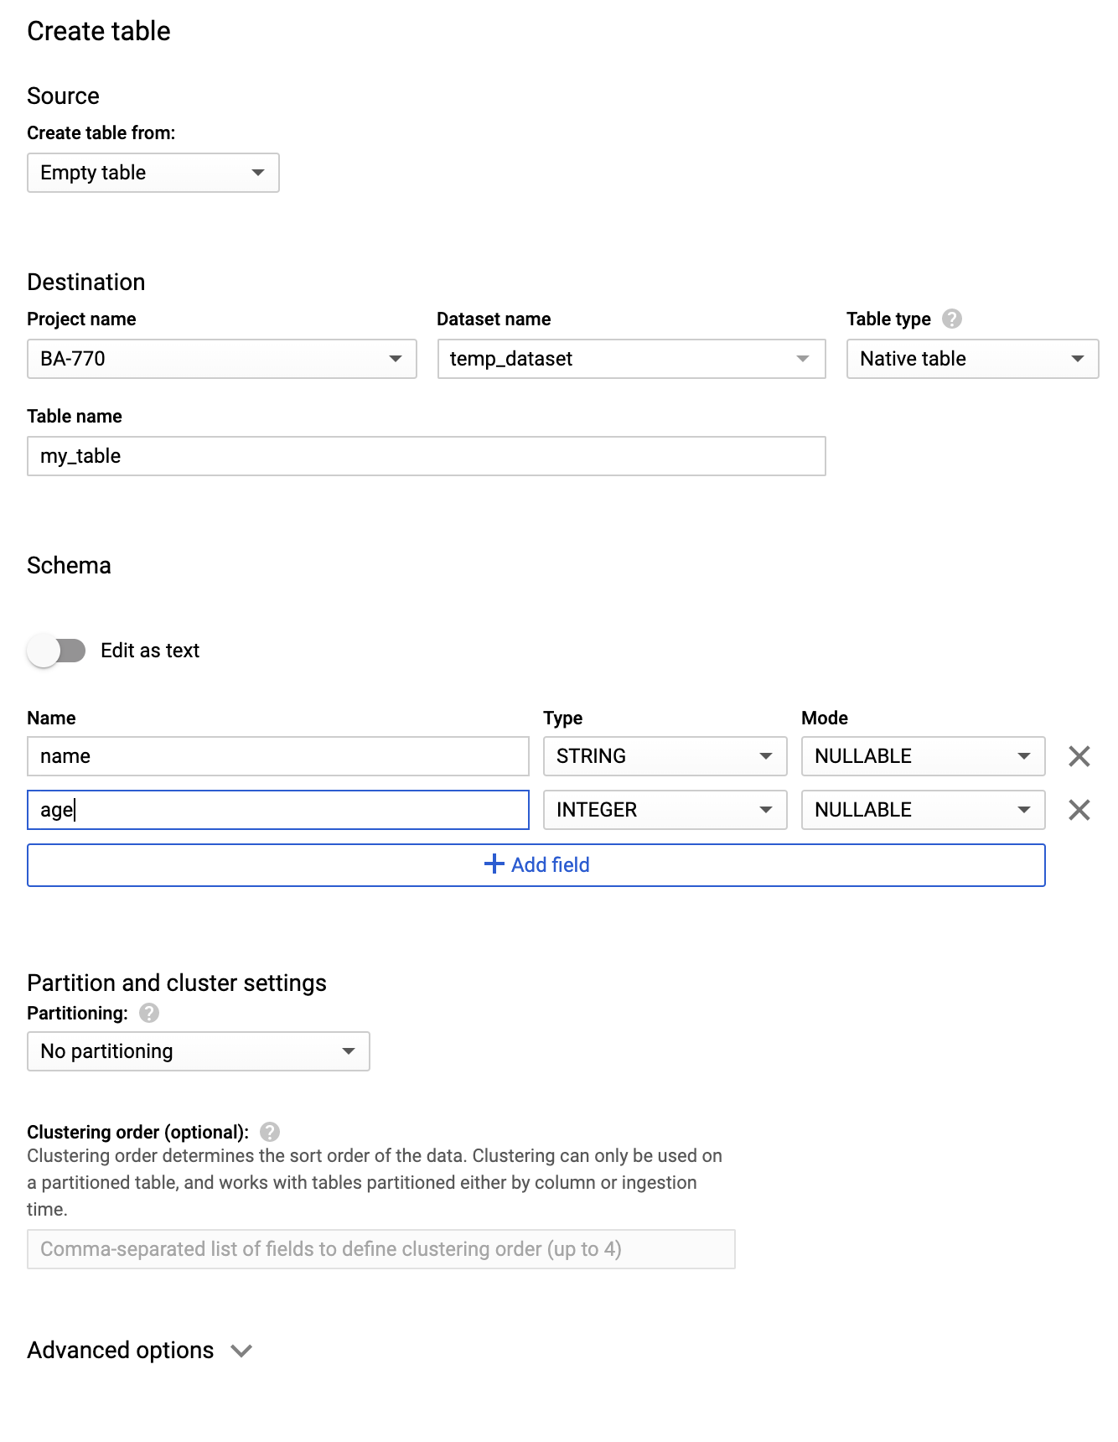
Creating an Empty Table Manually
Click on your project name under resources
Create a new dataset
On the right hand side click on CREATE DATASET
Give a Dataset ID such as temp_dataset
Optionally provide an expiration date for this dataset
Number of days after table creation: 3
Click create
Select the temp_dataset dataset and click on CREATE TABLE
For Dataset name, choose the appropriate dataset (temp_dataset)
In the Table name field, enter the name of the table you're creating in BigQuery (my_table)
Verify that Table type is set to Native table
In the Schema section, enter the schema definition. Enter schema information manually by adding one field at a time. You will need to specify the name, type and mode of each column
In the Advanced options section, leave the default values
Click Create table

Slide 11
Update the Dataset Description
Click on the temp_dataset dataset and modify the description to something like:
Tables in this temporary dataset have an expiration of 3 days and are used for practice.

Slide 12
CREATE TABLE Statement
Simple CREATE TABLE statement:
Using more options:
NOTE: my_table2 already exists, so the query above won’t do anything. Relace CREATE TABLE IF NOT EXISTS with CREATE OR REPLACE TABLE.
CREATE TABLE temp_dataset.my_table2
(
name STRING,
age INT64
)
CREATE TABLE IF NOT EXISTS temp_dataset.my_table2
(
name STRING NOT NULL OPTIONS(description="A required STRING field"),
age INT64 OPTIONS(description="An optional INT64 field")
)
OPTIONS(description="Created by a SQL command")

Slide 13
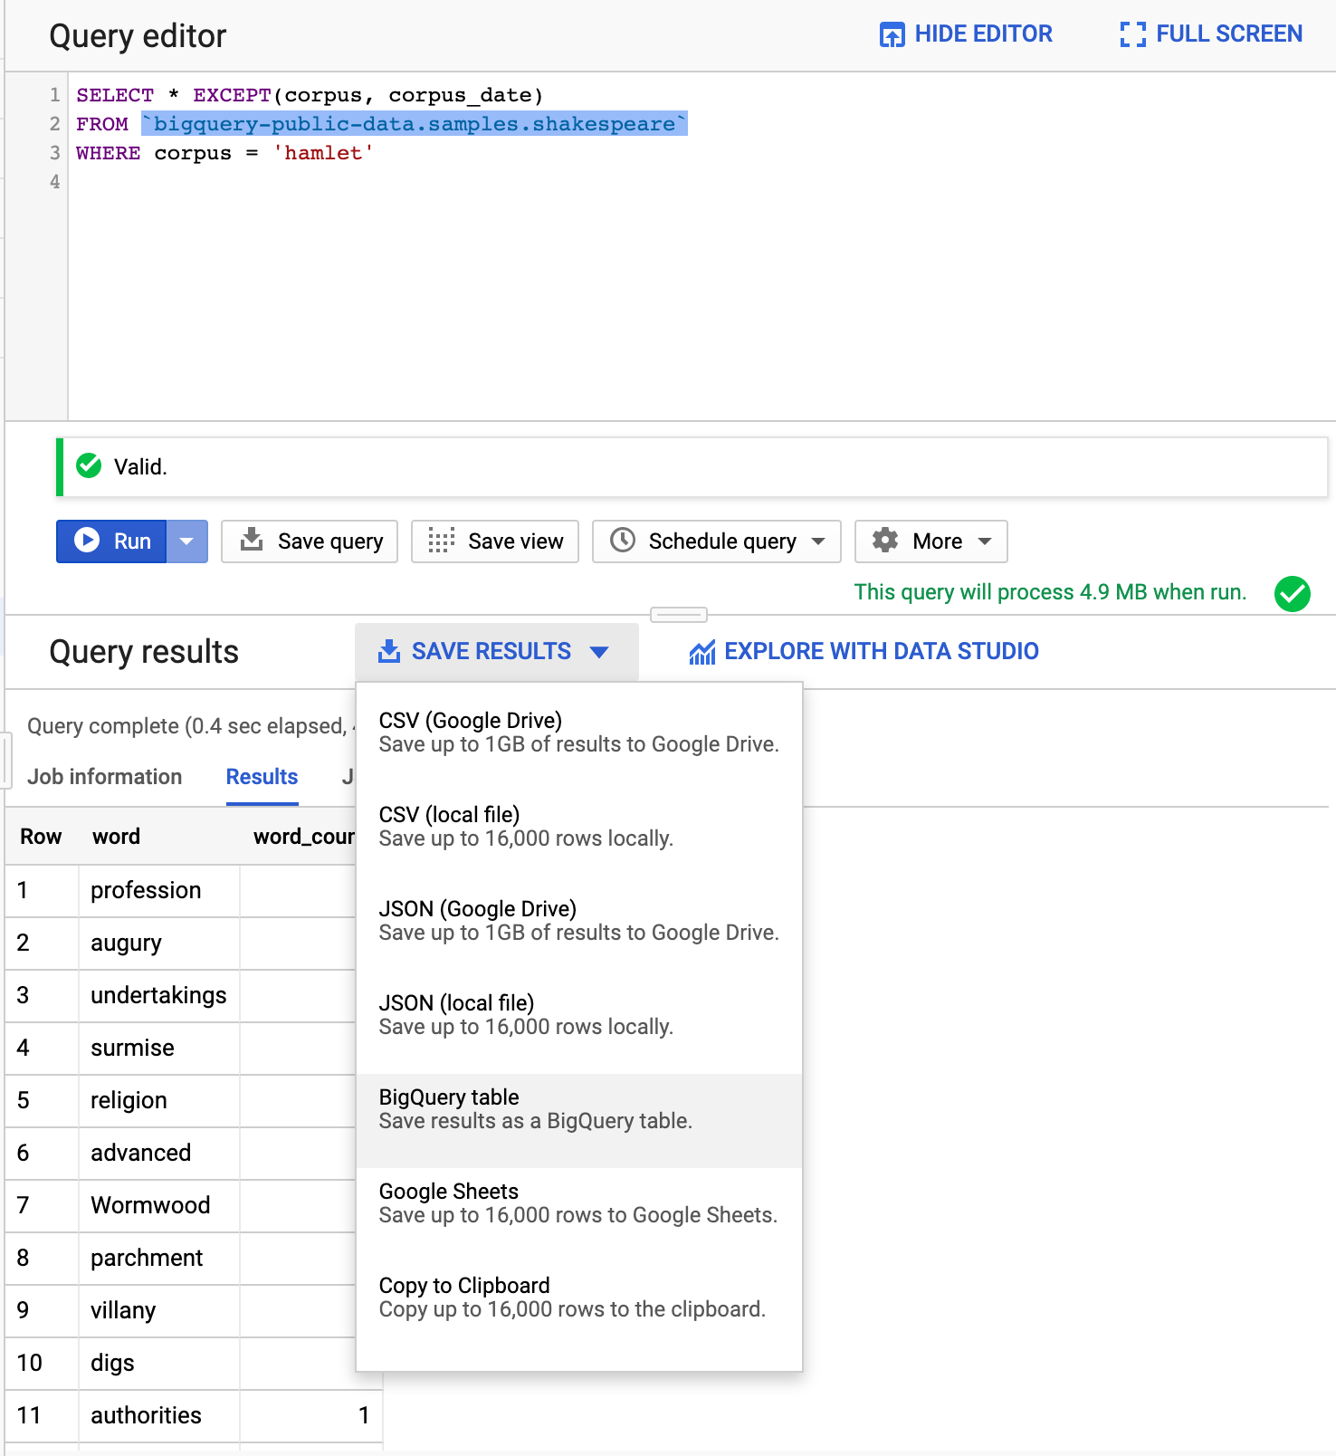
Creating a Table From a Query Result
Run the following query:
SELECT * EXCEPT(corpus, corpus_date)
FROM `bigquery-public-data.samples.shakespeare`
WHERE corpus = 'hamlet'
Under Save Results tab select BigQuery table
Select correct project and temp_dataset dataset
Name it hamlet
Click Create
Confirm that your table is there

Slide 14
Creating a New Table from a Query
The following query writes the result of the query followed by AS to a new table:
CREATE TABLE IF NOT EXISTS temp_dataset.hamlet2
OPTIONS(
description="This table contains all the words and their counts from Hamlet"
) AS
SELECT * EXCEPT(corpus, corpus_date) FROM `bigquery-public-data.samples.shakespeare`
WHERE corpus = 'hamlet'

Slide 15
CREATE VIEW Statement
The following query creates a view of our query:
CREATE OR REPLACE VIEW temp_dataset.hamlet_vw
OPTIONS(
description="A view of Hamlet words and their counts"
) AS
SELECT * EXCEPT(corpus, corpus_date)
FROM `bigquery-public-data.samples.shakespeare`
WHERE corpus = 'hamlet'

Slide 16

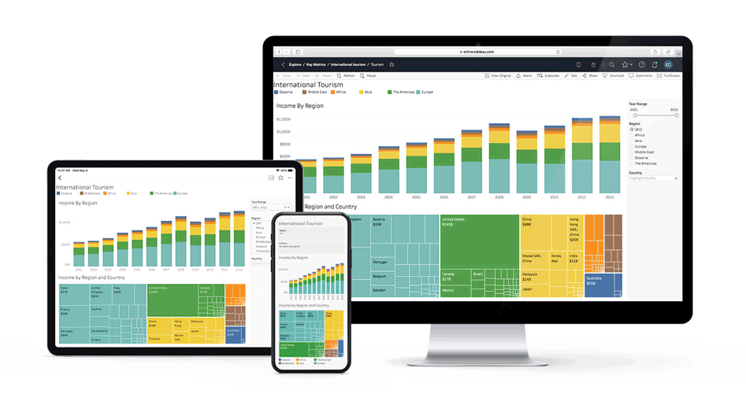
Tableau Dashboards
If you haven’t already done so, please apply for a student license here.

Slide 17
Tableau in Action (1)
We will create a COVID-19 dashboard (follow along in the recorded video):
* aggregation_level=0 ensures we are not double counting. 0 is country level, 1 is state, 2 is county
SELECT A.*, B.country, B.year_2018 population FROM
(
SELECT iso_3166_1_alpha_3 country_code,
FORMAT_DATETIME("%B", date) month, EXTRACT(year FROM date) year, EXTRACT(month FROM date) month_n,
SUM(new_confirmed) confirmed, SUM(new_deceased) deceased
FROM `bigquery-public-data.covid19_open_data.covid19_open_data`
WHERE aggregation_level=0
GROUP BY country_code, year, month, month_n
) A
INNER JOIN
(
SELECT country, country_code, year_2018
FROM `bigquery-public-data.world_bank_global_population.population_by_country`
) B
ON A.country_code=B.country_code
WHERE B.year_2018 IS NOT NULL
ORDER BY country ASC, year, month_n

Slide 18
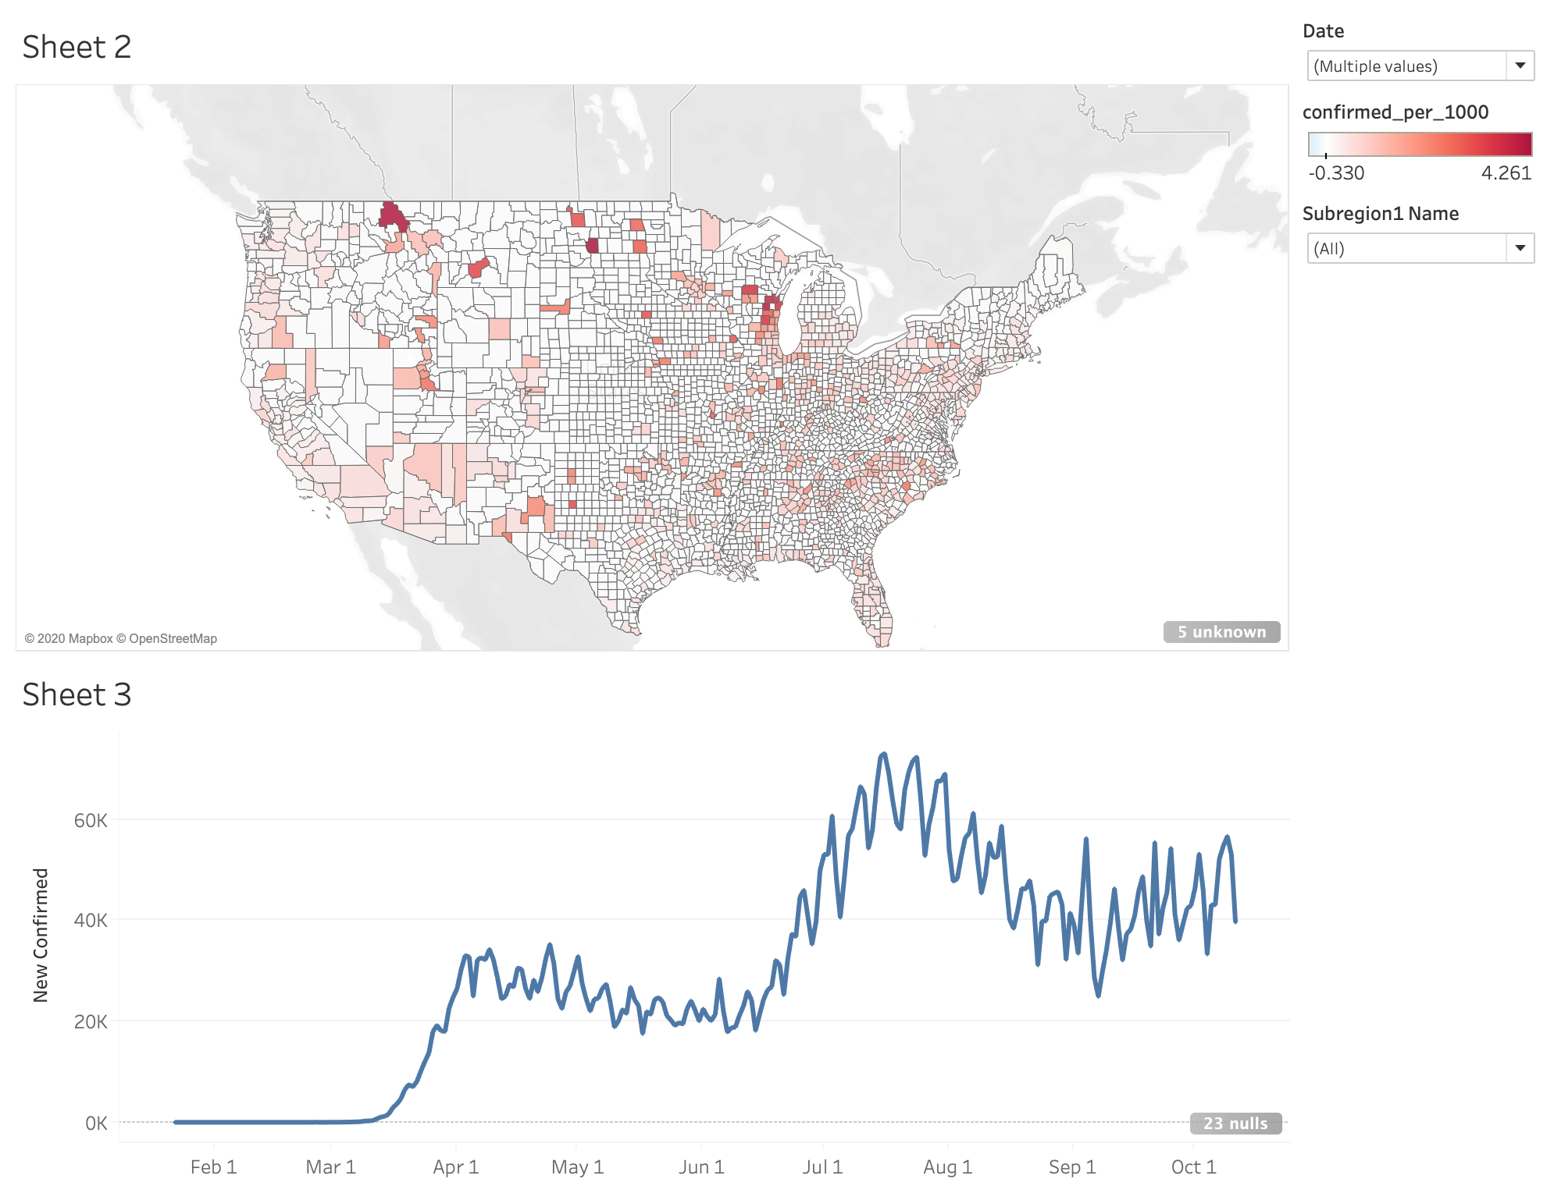
Tableau in Action (2)
For this exercise we will use the following datasets:
SELECT
date, country_name, iso_3166_1_alpha_3,
aggregation_level, new_confirmed, new_deceased,
subregion1_code, subregion1_name, subregion2_code,
subregion2_name
FROM `bigquery-public-data.covid19_open_data.covid19_open_data`
SELECT geo_id, total_pop FROM `bigquery-public-data.census_bureau_acs.county_2018_5yr`

Slide 19

DEMO
Tableau in Action

Slide 20

Google Data Studio
Visualize your data through highly configurable charts and tables
Easily connect to a variety of data sources
Share your reports with others in a similar way you share Google Docs
Collaborate on reports with your team

Slide 21
Data Sources
Data Studio provides over 100 types of connectors to plug in the data into a custom designed dashboard. To name a few:
The fastest way to get started building dashboards is using the sample datasets.
Database connections are highly beneficial. We will create our own BigQuery database and learn how to query it and bring its result inside Data Studio.
File upload
BigQuery
Google Sheets
MySQL
PostgreSQL
Google Analytics
Google Ads
Youtube Analytics
Facebook Ads
Salesforce

Slide 22
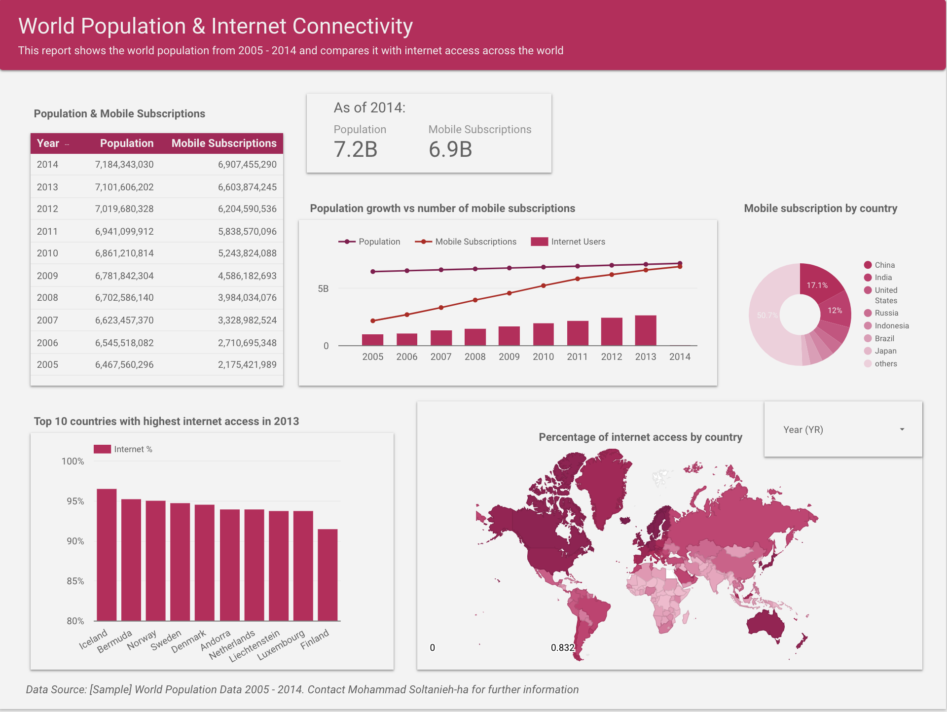
My 1st Report
Example: My First Report - World Population
For view access to the dashboard click here!

Slide 23
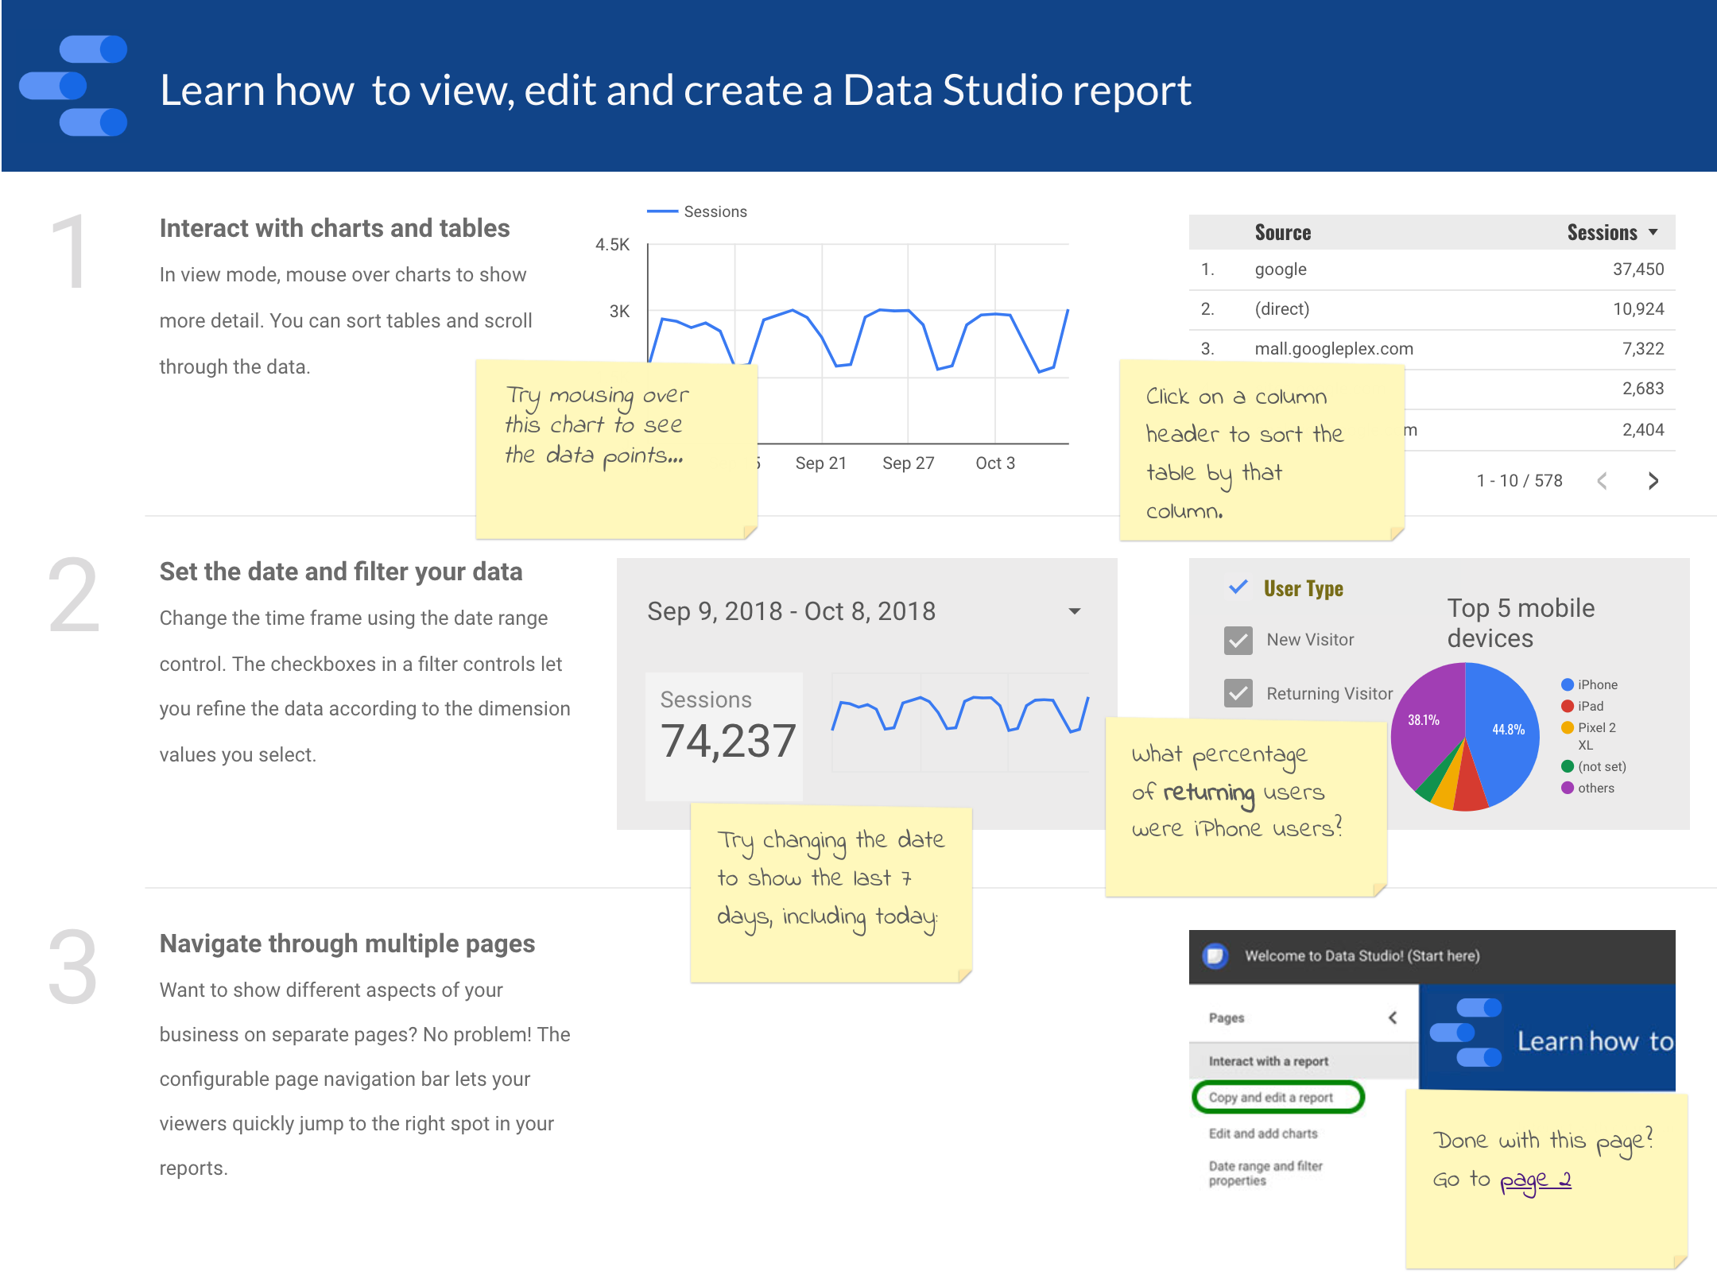
Step-by-Step Tutorial
We will start with Data Studio’s tutorial
To get to this report click here and follow the instructions!
Time: ~30 minutes

Slide 24

Data Studio in Action
We will now recreate the World Population dashboard.
Go to datastudio.google.com and follow along.

Slide 25
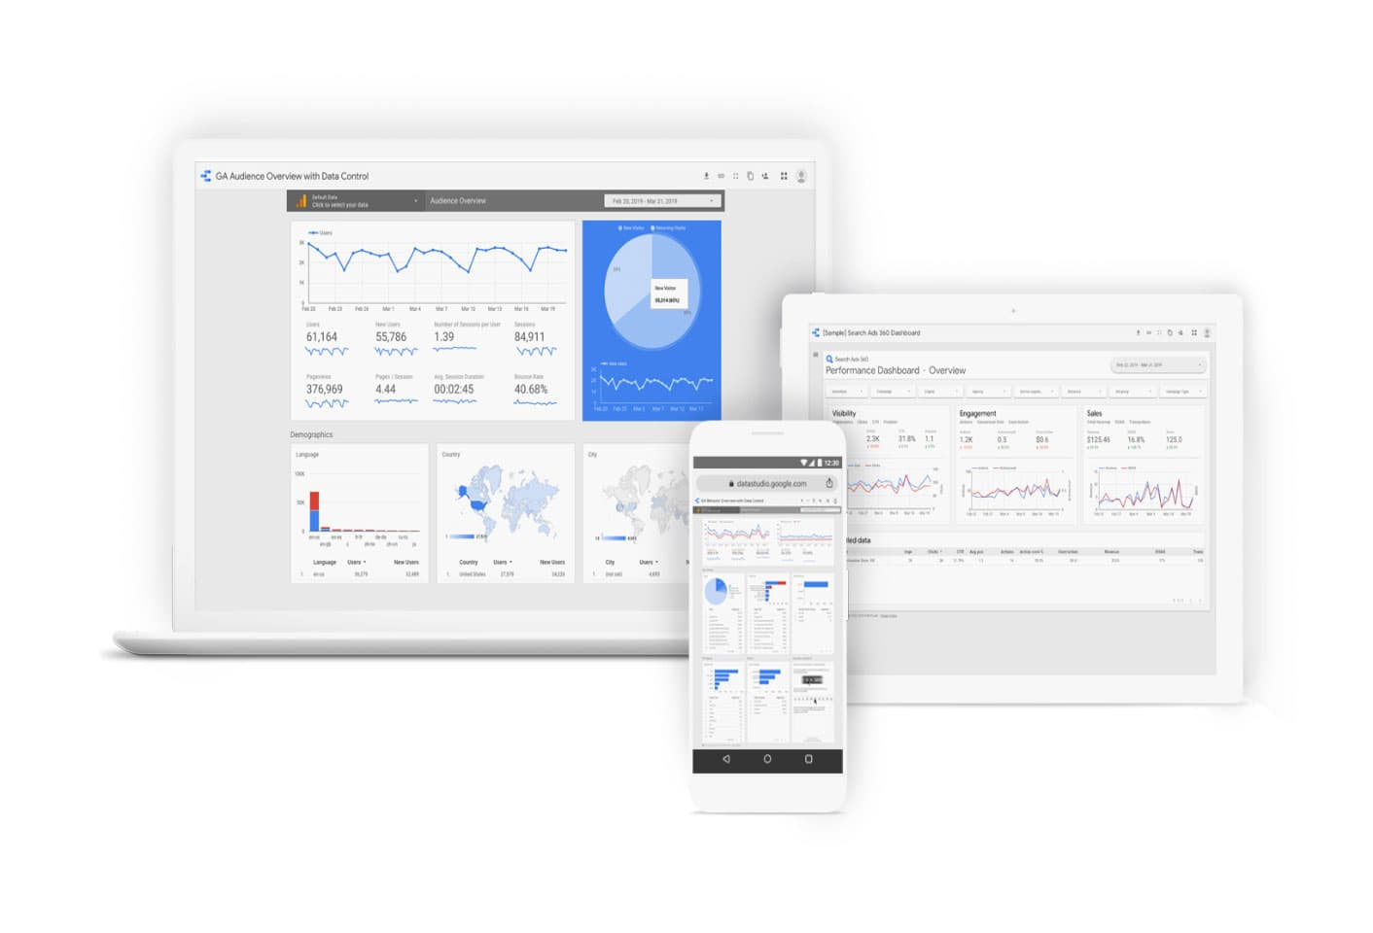
Your Turn (OPTIONAL)
QLab K*: Explore and Create Reports with Data Studio - 00:40
What you will learn in this lab
Launch Data Studio
Import data from BigQuery to Data Studio
Create and manipulate a report
Create an interactive filter for your report

Slide 26
Your Turn
QLab L*: How to Build a BI Dashboard Using Google Data Studio and BigQuery - 01:00
What you will learn in this lab
How to build a Data Studio dashboard that is powered by BigQuery as the back end.

Slide 27
Resources
Books
The Big Book of Dashboards: Visualizing Your Data Using Real-World Business Scenarios
Storytelling with Data: A Data Visualization Guide for Business Professionals
Templates
Google Data Studio - Report Gallery
Tableau templates and starters
Discussions and tutorials
Data Studio’s forum
Tableau public tutorials

Slide 28

Activity
DataCamp
Ch 3.2 Joining Data in SQL - Outer joins and cross joins
Ch 3.3 Joining Data in SQL - Set theory clauses
Due Monday - 08/23
Team Assignment Phase 1 (proposal: dataset + problem)
Due Monday - 08/23
Assignment 2
Due Tuesday - 08/24
Team Assignment Phase 2 (summary report)
Due Thursday - 08/26
Quiz on Monday
Reading material: A Guide to Data Analytics Toolbox
Due Monday - 08/23

Slide 29

Your Turn
QLab M: Creating Permanent Tables and Access-Controlled Views in BigQuery - 01:00
What you will learn in this lab
how to create new permanent tables and logical reviews from an existing ecommerce dataset.

