Slide 1
Business Analytics
Toolbox - BA775
Summer 2021
Lecture 06
Professor: Mohammad Soltanieh-ha

Slide 2
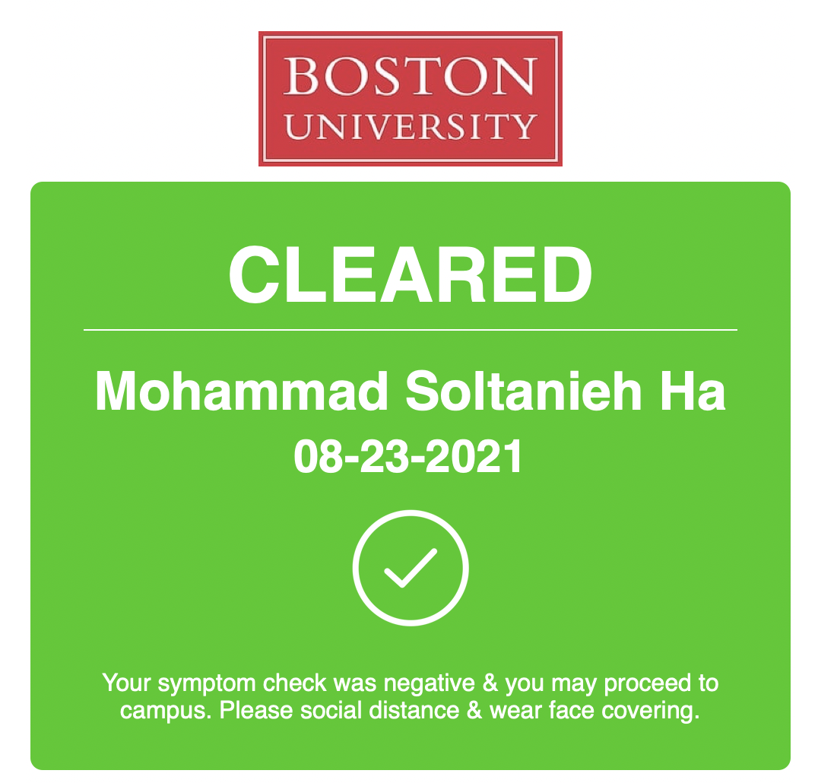

Slide 3
Team Assignment
By Aug 26 please provide a notebook that includes the followings:
A brief project title
Should not exceed 10 words or so
The project proposal that you submitted already
Minor modifications are OK!
A reference to your data source. If your data source is BigQuery public data, please try to find the original data source. Often times this information can be found under the details tab or you might be able to find it in the documentation page for the source.
Your exploratory phase of the project within the notebook. Questions and answers to them and tables.
Try to keep the notebook short and on point. Tell a story that one can follow along from top to bottom.
A dashboard is not necessary for this phase but you will create one for the final presentation.

Slide 4
Topics Covered
Data Studio
BigQuery dashboard
Ingesting New Datasets into BigQuery
From a local file
From Cloud Storage
From Google Sheets
SQL topics
INSERT
Unique keys
STRING_AGG()

Slide 5

Google Data Studio
Visualize your data through highly configurable charts and tables
Easily connect to a variety of data sources
Share your reports with others in a similar way you share Google Docs
Collaborate on reports with your team

Slide 6
Data Sources
Data Studio provides over 100 types of connectors to plug in the data into a custom designed dashboard. To name a few:
The fastest way to get started building dashboards is using the sample datasets.
Database connections are highly beneficial. We will create our own BigQuery database and learn how to query it and bring its result inside Data Studio.
File upload
BigQuery
Google Sheets
MySQL
PostgreSQL
Google Analytics
Google Ads
Youtube Analytics
Facebook Ads
Salesforce

Slide 7
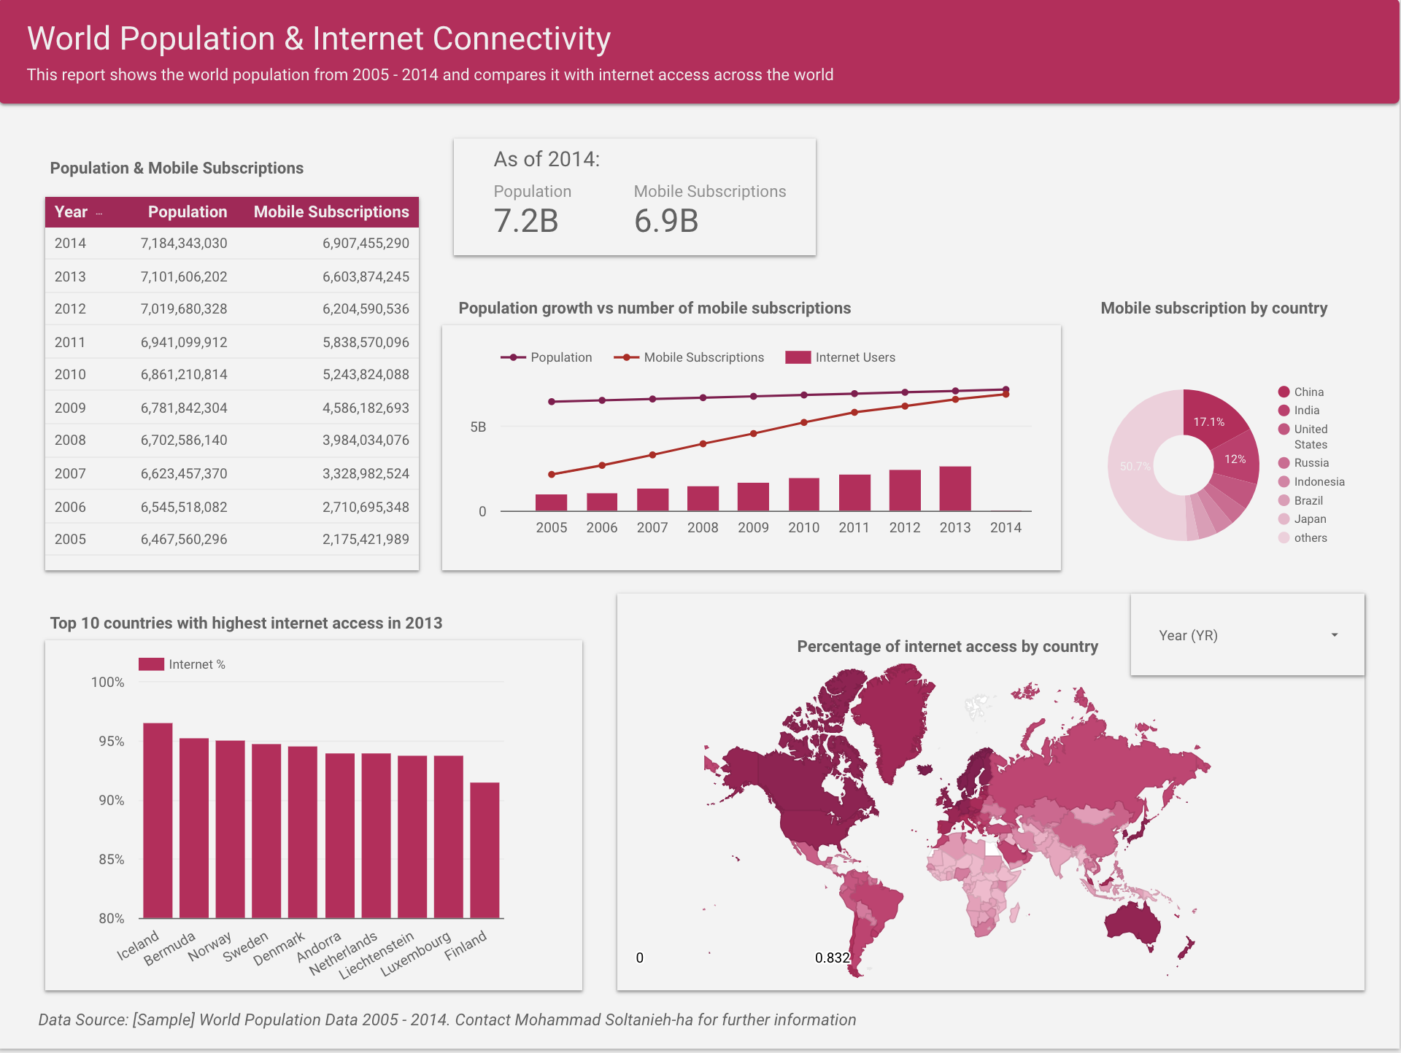
My 1st Report
Example: My First Report - World Population
For view access to the dashboard click here!

Slide 8

Data Studio in Action
We will now recreate the World Population dashboard.
Go to datastudio.google.com and follow along.

Slide 9
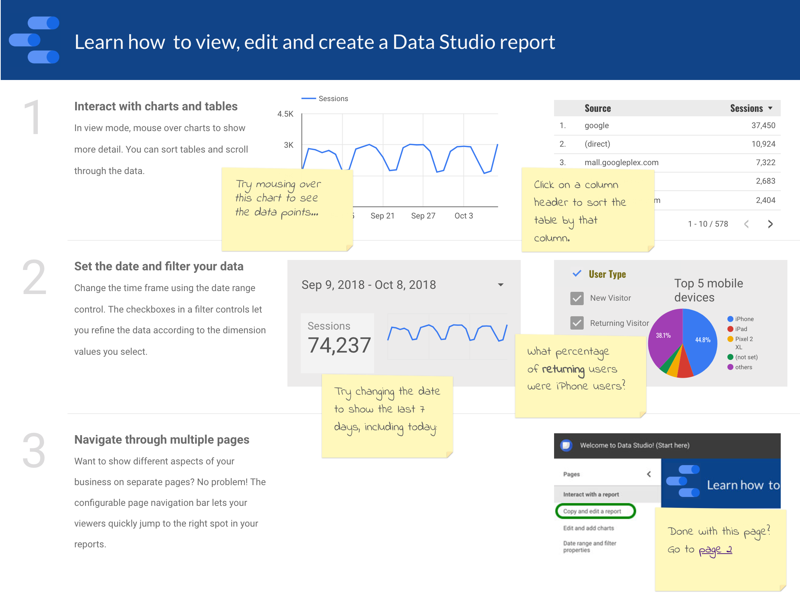
Step-by-Step Tutorial
We will start with Data Studio’s tutorial
To get to this report click here and follow the instructions!
Time: ~20 minutes

Slide 10
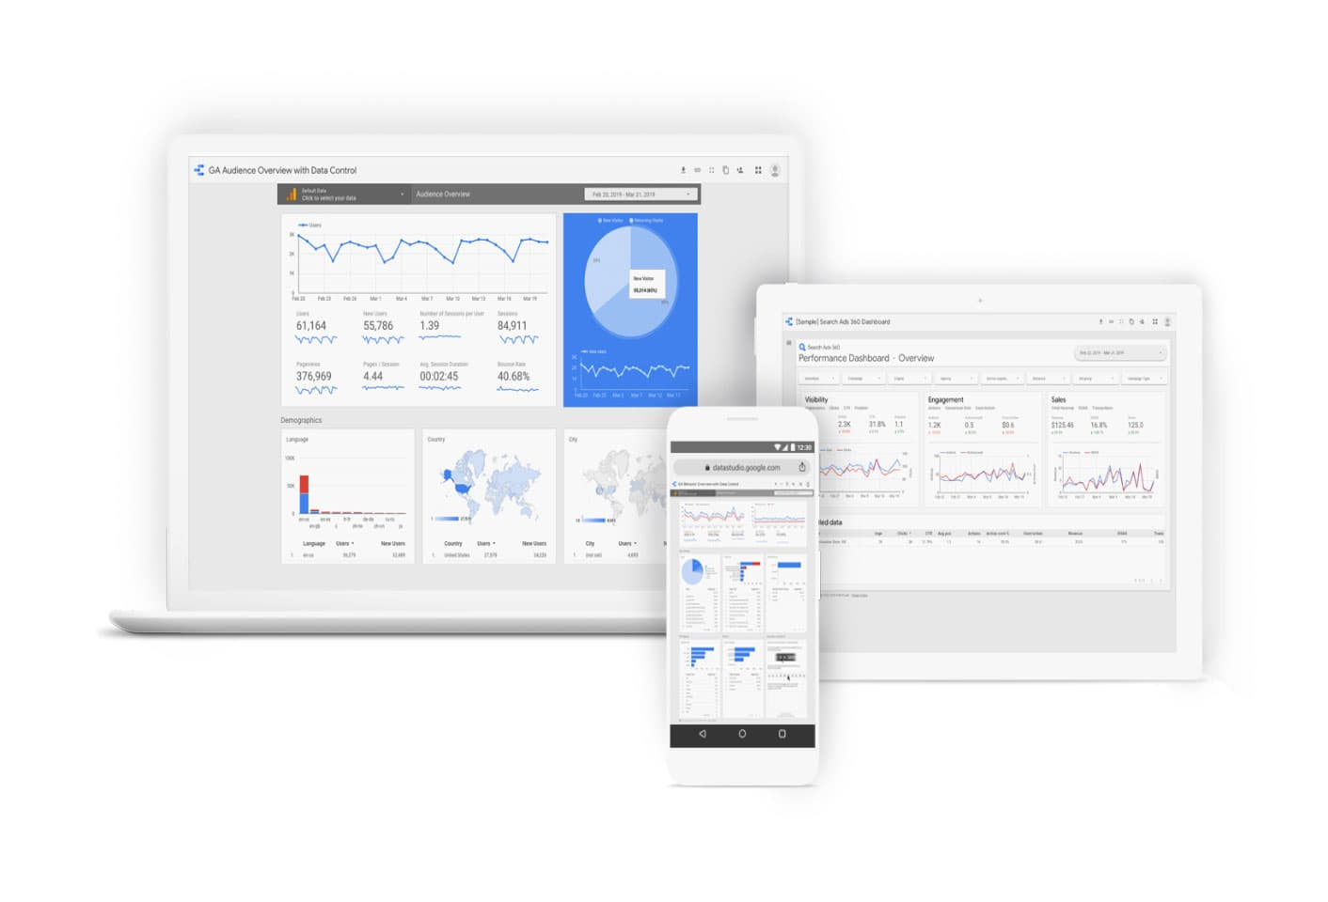
Your Turn (OPTIONAL)
QLab K*: Explore and Create Reports with Data Studio - 00:40
What you will learn in this lab
Launch Data Studio
Import data from BigQuery to Data Studio
Create and manipulate a report
Create an interactive filter for your report

Slide 11
Your Turn - Home
QLab L*: How to Build a BI Dashboard Using Google Data Studio and BigQuery - 01:00
What you will learn in this lab
How to build a Data Studio dashboard that is powered by BigQuery as the back end.

Slide 12
Resources
Books
The Big Book of Dashboards: Visualizing Your Data Using Real-World Business Scenarios
Storytelling with Data: A Data Visualization Guide for Business Professionals
Templates
Google Data Studio - Report Gallery
Tableau templates and starters
Discussions and tutorials
Data Studio’s forum
Tableau public tutorials

Slide 13
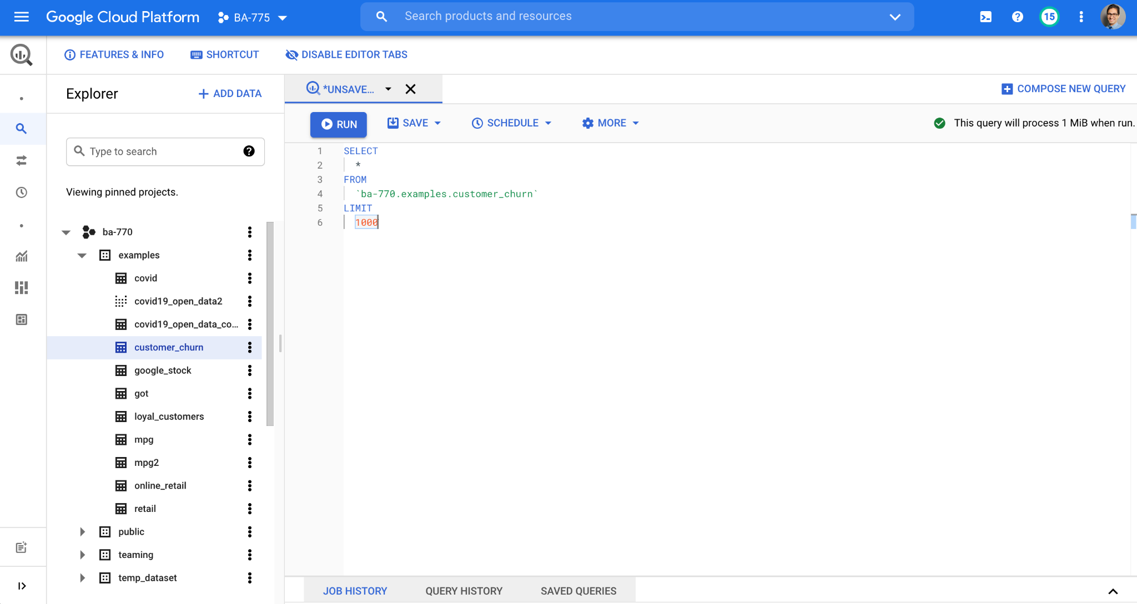
BigQuery UI

Slide 14
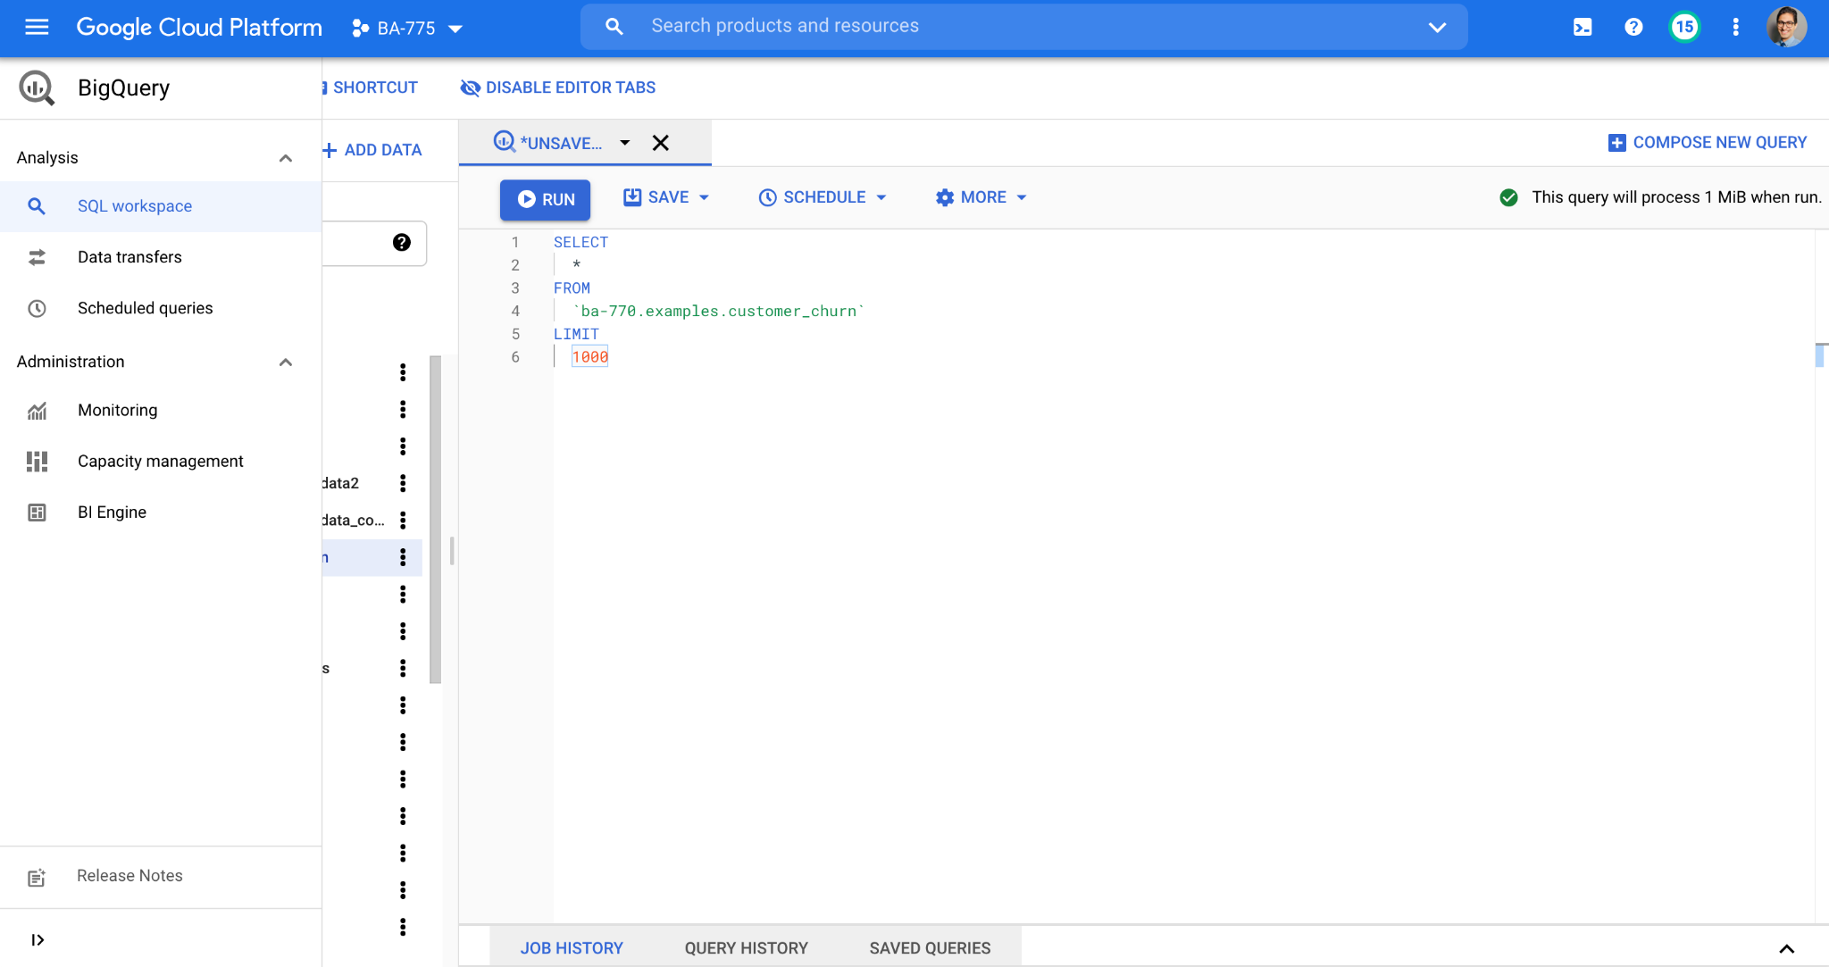
BigQuery UI

Slide 15
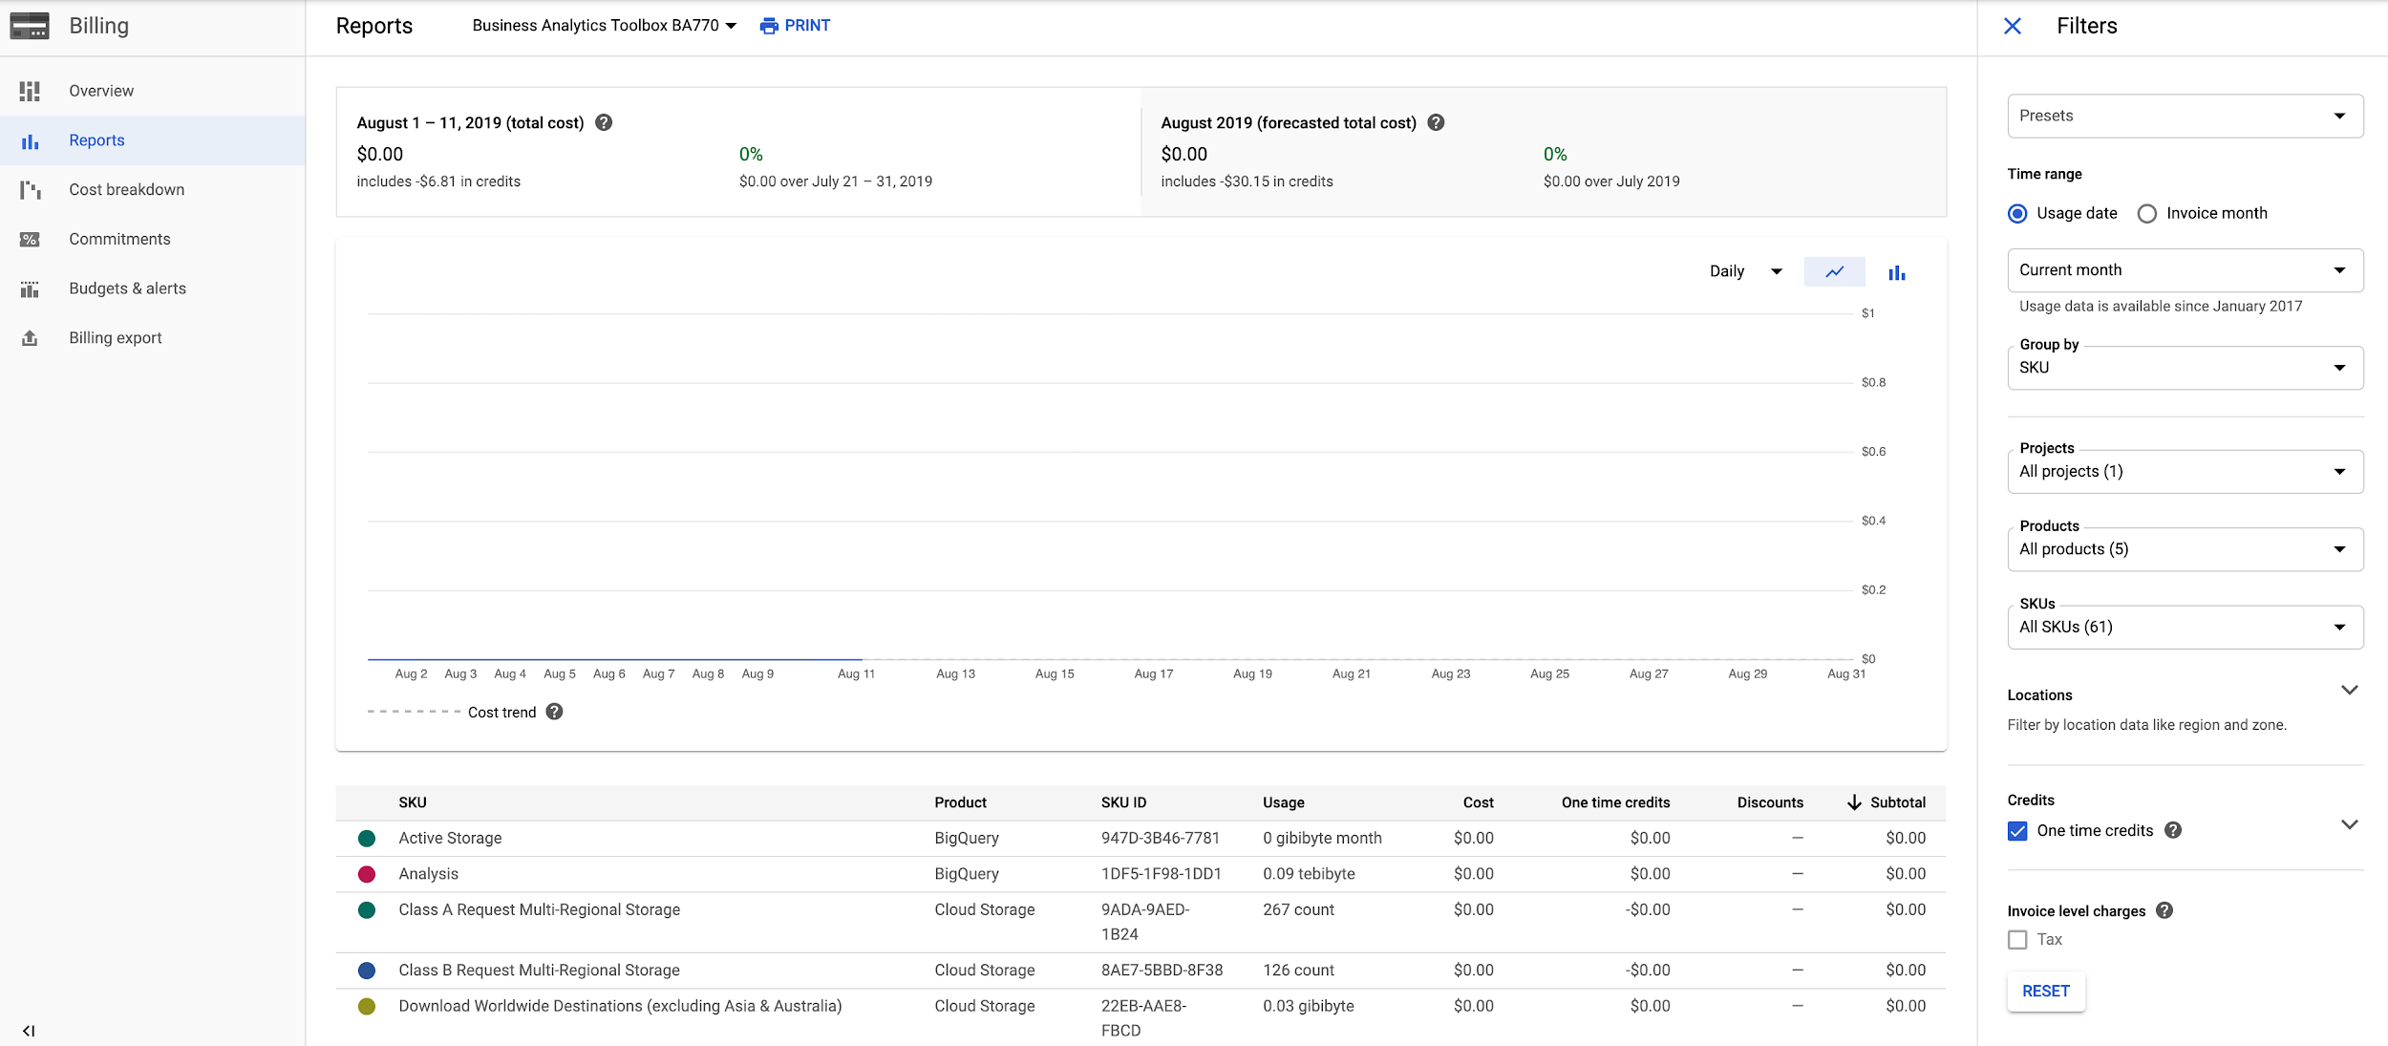
Check BigQuery’s Usage
From the Home page of the project click on View detailed charges under Billing.
Active storage (10 GB free) and Analysis (1 TB free) SKUs show your usage.
Note: there usually is a delay of 3-6 hours for the billing to show accurate information.

Slide 16
Ingesting New Datasets into BigQuery
We will look at different data loading options for:
From a CSV file
From Cloud Storage
From Google Sheet

Slide 17
Load a Local CSV File into BigQuery
We will create a new table from a local file that contains GOOGL stock prices.
From BigQuery pick your examples dataset and create a table.
Select the Upload method, give the file path to GOOGL.csv that you downloaded from the data folder of course GitHub and choose CSV for the file format.
Select the right dataset, make it a native table and call it google_stock
Turn automatic detection for schema
Create table
Note: Local uploads are limited to 10 MB.

Slide 18
Load a CSV File into BigQuery From Cloud Storage
We will upload data/GOT-battles.csv into a new table in our examples dataset.
Since we have already uploaded it to our Cloud Storage (first class) we can directly use that path as our source.
Select the examples dataset and create table.
Select Cloud Storage as the source and locate the file where you previously saved it during the first class.
Select CSV for file format.
Select the right dataset, make it a native table and call it got
Turn automatic detection for schema
Create table

Slide 19

Your Turn ~8 min
Let’s upload data/online-retail-dataset.csv into a BigQuery table.
Add this table to the temp_dataset dataset and call it online_retail.
This dataset contains some issues that infer schema cannot handle. We will have to import everything as STRING and then fix them in BQ.
CREATE OR REPLACE TABLE examples.online_retail
AS
SELECT
InvoiceNo,
StockCode,
Description,
CAST(Quantity AS INT64) Quantity,
PARSE_DATE('%m/%d/%y', SPLIT(InvoiceDate, ' ')[OFFSET(0)]) InvoiceDate,
PARSE_TIME('%H:%M', SPLIT(InvoiceDate, ' ')[OFFSET(1)]) InvoiceTime,
CAST(UnitPrice AS NUMERIC) UnitPrice,
CustomerID,
Country
FROM temp_dataset.online_retail

Slide 20
External Tables - Google Sheets
Upload data/auto-mpg.csv to your Google Drive
Convert this CSV file to a Google Sheet
Add a first row and include the following header names:
mpg - cyl - disp - hp - weight - acc - year - origin - name
Click on Share > Get sharable link
Go to BigQuery > examples dataset > Create table
Select Drive as the source and paste the URL. Choose Google Sheet as format
Call the table mpg > select the auto detect schema
Advanced options > Header rows to skip: 1 > create table
Now you can run SELECT * FROM `examples.mpg` to see your data
Notice that the preview tab is not populated since this is an external table and not a native one

Slide 21
External Data Source Limitations
BigQuery does not guarantee data consistency for external data sources
Query performance might not be as high as native tables
You are not able to query them directly from Vertex AI
When you query an external data source, the results are not cached and you pay for every query

Slide 22


Slide 23
INSERT Statement
Use the INSERT statement when you want to add new rows to a table.
CREATE OR REPLACE TABLE temp_dataset.sales
(SKU STRING,
total_ordered INT64)
INSERT INTO temp_dataset.sales
(SKU, total_ordered)
VALUES('GGOEGHPA002910', 101)

Slide 24
Unique Keys
A primary key is a table column (or combination of columns) designated to uniquely identify all table records.
Primary key’s main features are:
It must contain a unique value for each row of data
It cannot contain null values
What is a good primary key in the customer_churn dataset?
SELECT customerID, count(*) repeat FROM `ba-770.examples.customer_churn`
GROUP BY customerID
HAVING repeat > 1

Slide 25
STRING_AGG() Function
Returns an aggregated value obtained by concatenating non-null values.
If a delimiter is specified, concatenated values are separated by that delimiter; otherwise, a comma is used as a delimiter.
SELECT StockCode,
COUNT(DISTINCT Country) AS NumberOfCountries,
STRING_AGG(DISTINCT Country, " - " ORDER BY Country LIMIT 10) AS Countries
FROM `examples.online_retail`
GROUP BY StockCode
ORDER BY NumberOfCountries DESC

Slide 26

Activity
DataCamp
Ch 3.1 Intermediate SQL - We'll take the CASE
Ch 3.2 Intermediate SQL - Short and Simple Subqueries
Due Tuesday - 08/24
Assignment 2
Due Wednesday - 08/25
Team Assignment Phase 2 (summary report)
Due Thursday - 08/26

Slide 27
Videos to Watch
These videos will give you exposure to a few different datasets and a review of some of the functionalities we saw on Class 05. Also, you will be introduced to loading Excel files. You can access these videos here. Please note that you can download the dataset for each video right under the title:
1. Tableau Public Overview (7:10)
2. Connecting to Excel and Text Files (4:32)
3. Connecting to Google Sheets (3:15)
8. Data Preparation – Pivoting your Data (4:54)
9. Data Preparation – Splitting your Data (2:26)
10. Data Preparation – Joins and Unions (6:28)
11. Creating Your First Chart (2:34)
12. Using the Show Me Tool Bar (4:15)
13. Understanding the Logic of Charts (5:05)
14. Combining Sheets on a Dashboard (5:27)
15. Adding Interactivity to Dashboards (4:30)
16. Dashboard Formatting (4:05)
21. Adding a custom Viz in Tooltip (2:49)

Slide 28
Your Turn ~20 min
Open 06-01-Exercise-New-Data.ipynb in Vertex AI and follow the instructions.

Slide 29
Your Turn ~15 min
Open 06-02-Exercise-STRING-AGG.ipynb in Vertex AI and follow the instructions.

Slide 30
Your Turn - Home Session
QLab N: Ingesting New Datasets into BigQuery - 01:00
What you will learn in this lab
How to ingest several types of datasets into tables inside of BigQuery
From a local file
From Cloud Storage
From Google Sheets

