Slide 1
Business Analytics
Toolbox - BA775
Summer 2021
Lecture 07
Professor: Mohammad Soltanieh-ha

Slide 2


Slide 3
Topics Covered
SQL topics
is null & is not null
JOINs
Date and Timestamp
CASE Statement
Partitioned Table
Join pitfalls

Slide 4


Slide 5
IS NULL & IS NOT NULL
NULL represents a missing or unknown value. IS NULL operator can be used for filtering the NULL values. It is contrary to IS NOT NULL, where filters the records with a definite value.
SELECT * FROM `examples.online_retail`
WHERE CustomerID IS NOT NULL
406,829 out of 541,909 records have a CustomerID.

Slide 6
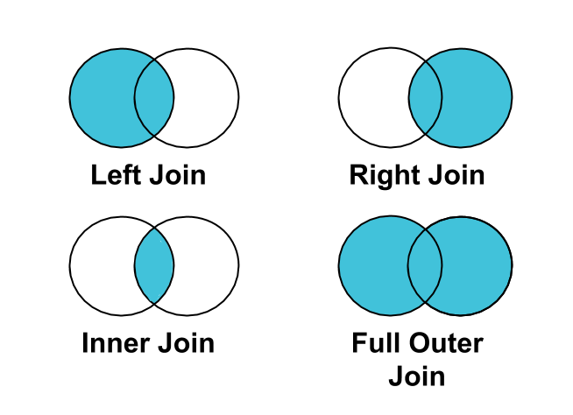
SQL Joins
A JOIN clause is used to combine records from two tables, based on related column(s) between them.

Slide 7
JOIN Types
[INNER] JOIN: requires that key values exist in both tables for the records to appear in the results table. Records appear in the merge only if there are matches in both tables for the key values.
LEFT [OUTER] JOIN: Each row in the left table appears in the results, regardless of whether there are matches in the right table.
RIGHT [OUTER] JOIN: the reverse of a left join. Each row in the right table appears in the results, regardless of whether there are matches in the left table.
FULL [OUTER] JOIN: Left join + Right join, which returns all records from both tables regardless of matching join keys.
CROSS JOIN: combines each row of the first dataset with each row of the second dataset, where every combination is represented in the output. Use with caution!

Slide 8
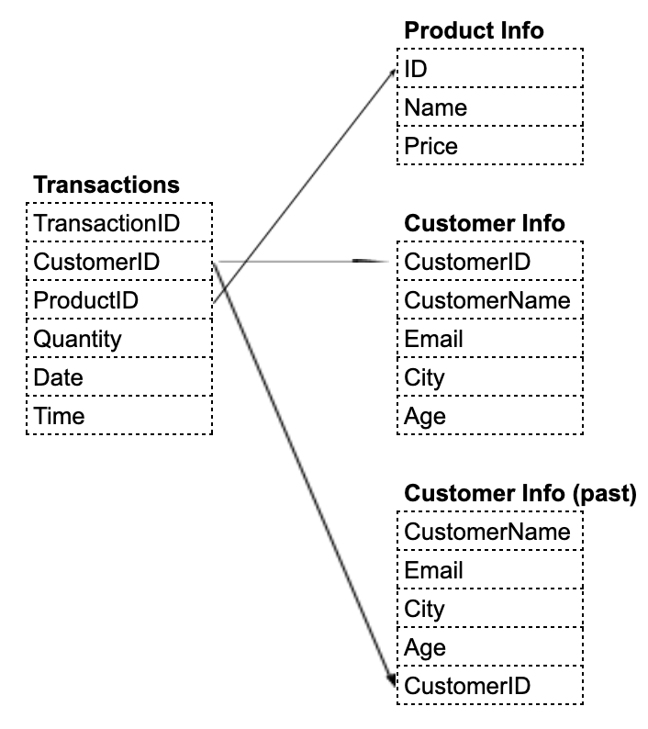
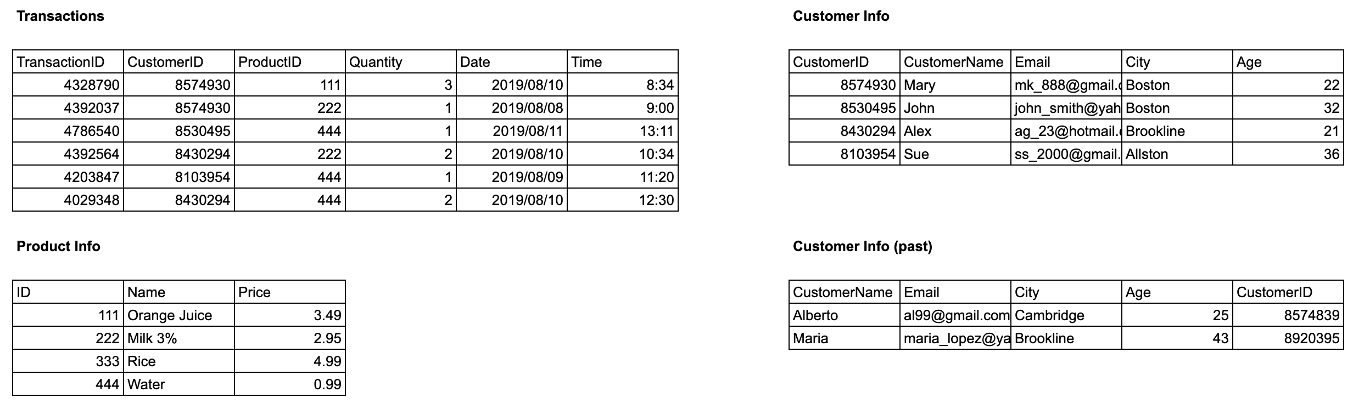
Sample Data
Google Sheet here.

Slide 9
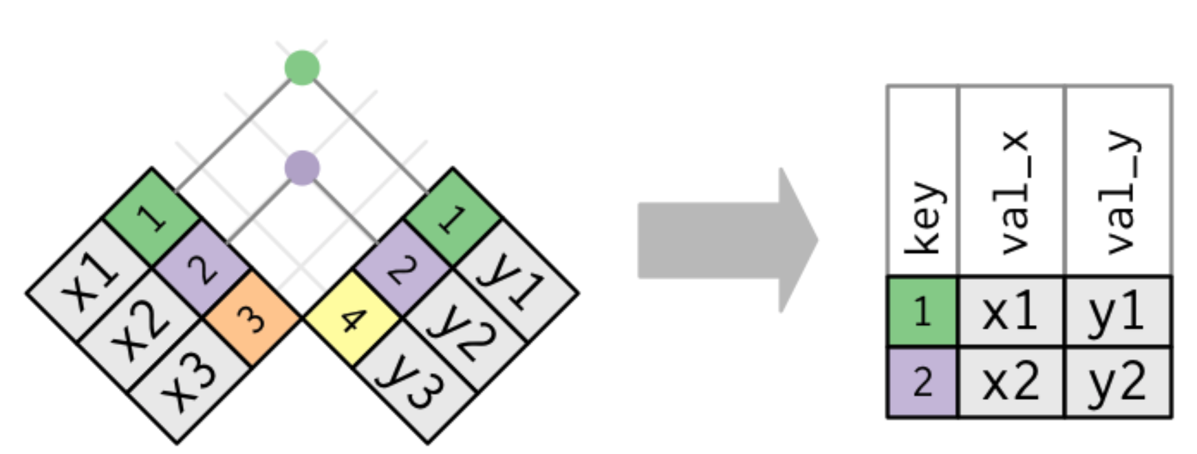
[INNER] JOIN
SELECT
A.*,
B.CustomerID,
B.Quantity,
B.Date
FROM
`ba-770.public.product_info` A
JOIN
`ba-770.public.transactions` B
ON A.ID = B.ProductID
Returns all the products with their corresponding transactions where a product match exists in both tables. It also appends additional columns from table B: CustomerID, Quantity, Date.
The INNER JOIN (or simply JOIN) selects all rows from both participating tables as long as there is a match between the joining columns specified by ON.

Slide 10
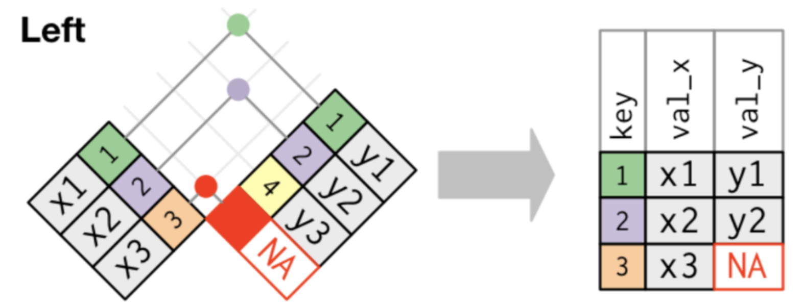
LEFT [OUTER] JOIN
SELECT
A.*,
B.CustomerID,
B.Quantity,
B.Date
FROM
`ba-770.public.product_info` A
LEFT JOIN
`ba-770.public.transactions` B
ON A.ID = B.ProductID
Returns all the products from table A with their corresponding transactions (even if there is none). It also appends additional columns from table B: CustomerID, Quantity, Date.
The LEFT OUTER JOIN (or simply LEFT JOIN) selects all rows from the left table and brings additional column(s) from the table on the right.

Slide 11
RIGHT [OUTER] JOIN
The result of a RIGHT OUTER JOIN (or simply RIGHT JOIN) is similar and symmetric to that of LEFT OUTER JOIN. You can get the same output if you change LEFT to RIGHT and replace the position of the tables in the JOIN statement. The following joins are equivalent:
SELECT A.*, B.CustomerID,
B.Quantity, B.Date
FROM `ba-770.public.product_info` A
LEFT JOIN `ba-770.public.transactions` B
ON A.ID = B.ProductID
SELECT A.*, B.CustomerID,
B.Quantity, B.Date
FROM `ba-770.public.transactions` B
RIGHT JOIN `ba-770.public.product_info` A
ON A.ID = B.ProductID

Slide 12
FULL [OUTER] JOIN
A FULL OUTER JOIN (or simply FULL JOIN) returns all fields for all rows in both tables that meet the join condition.
SELECT A.*, B.Quantity
FROM `ba-770.public.product_info` A
FULL JOIN `ba-770.public.transactions` B
ON A.ID = B.ProductID

Slide 13
CROSS JOIN
A cross join combines each row of the first dataset with each row of the second dataset, where every combination is represented in the output. As a result, the number of total rows in the join are:
Rows(TableA) * Rows(TableB)
NOTE: Depending on the size of your datasets, a cross join can greatly expand the size of the output, which may increase costs in some environments.
SELECT A.Name, B.*
FROM `ba-770.public.product_info` A
CROSS JOIN `ba-770.public.transactions` B

Slide 14

Your Turn ~30 min
Open 07-01-Exercise-JOIN.ipynb in Datalab and follow the instructions.

Slide 15
CURRENT_DATE()
Returns the current date as of the specified or default timezone.
CURRENT_DATE([time_zone])
For instance:
SELECT CURRENT_DATE() as today_date
For China Standard Time (CST) would become:
SELECT CURRENT_DATE("Asia/Shanghai") as today_date_China
More info about timezones here.

Slide 16
CURRENT_TIMESTAMP()
Produces a TIMESTAMP value that is continuous. Parentheses are optional.
SELECT
now,
EXTRACT(YEAR FROM now) year,
DATETIME(now, "America/New_York") datetime_ET_US,
DATETIME(now, "Asia/Shanghai") datetime_Shanghai,
DATE(now, "Asia/Shanghai") date_Shanghai,
TIME(now, "Asia/Shanghai") time_Shanghai
FROM
(SELECT CURRENT_TIMESTAMP() now)

Slide 17
PARSE_DATE()
Uses a format_string and a string representation of a date to return a DATE object.
SELECT PARSE_DATE("%y/%m?%d", "19/08?15") AS date_formatted
For more info on Supported Format Elements for DATE check out this page.

Slide 18
CASE Statement
Maps one or more conditions to a corresponding value for each condition
CASE
WHEN wind_speed >= 40 THEN 'HIGH'
WHEN wind_speed >= 30 AND wind_speed < 40 THEN 'MODERATE'
ELSE 'LOW'
END as wind_severity

Slide 19
CASE Statement Example
SELECT
start_station_name,
end_station_name,
duration_minutes,
CASE
WHEN duration_minutes >= 60 THEN 'LONG RIDE'
WHEN duration_minutes >= 30 AND duration_minutes < 60 THEN 'MODERATE RIDE'
ELSE 'SHORT RIDE'
END AS ride_length
FROM `bigquery-public-data.austin_bikeshare.bikeshare_trips`
ORDER BY start_station_name, end_station_name, duration_minutes DESC

Slide 20
Grouping CASE Statements
SELECT
start_station_name,
end_station_name,
CASE
WHEN duration_minutes >= 60 THEN 'LONG RIDE'
WHEN duration_minutes >= 30 AND duration_minutes < 60 THEN 'MODERATE RIDE'
ELSE 'SHORT RIDE'
END AS ride_length,
count(*) AS total_rides
FROM `bigquery-public-data.austin_bikeshare.bikeshare_trips`
GROUP BY 1, 2, 3
ORDER BY start_station_name, end_station_name, total_rides DESC

Slide 21
Create a Partitioned Table Based on Date
CREATE OR REPLACE TABLE temp_dataset.all_sessions_raw_partition_by_day
PARTITION BY date_formatted
AS
SELECT
PARSE_DATE("%Y%m%d", date) AS date_formatted,
* EXCEPT(date)
FROM `data-to-insights.ecommerce.all_sessions_raw`
Now run the following query; you can see that only 22MBi was process:
SELECT * FROM temp_dataset.all_sessions_raw_partition_by_day
WHERE date_formatted = '2016-08-01'
As opposed to 5.6GBi:
SELECT * FROM `data-to-insights.ecommerce.all_sessions_raw`
WHERE PARSE_DATE("%Y%m%d", date) = '2016-08-01'

Slide 22
Partitioned Table with Expiration Date
CREATE OR REPLACE TABLE temp_dataset.days_with_rain
PARTITION BY date
OPTIONS (partition_expiration_days=60) AS
SELECT DATE(CAST(year AS INT64), CAST(mo AS INT64), CAST(da AS INT64)) AS date,
(SELECT ANY_VALUE(name) FROM `bigquery-public-data.noaa_gsod.stations` AS stations
WHERE stations.usaf = stn) AS station_name, -- Stations may have multiple names
prcp
FROM `bigquery-public-data.noaa_gsod.gsod*` AS weather
WHERE prcp < 99.9 -- Filter unknown values
AND prcp > 0 -- Filter
AND CAST(_TABLE_SUFFIX AS int64) >= 2020
Run the following to check for the date range:
SELECT min(date), max(date) FROM temp_dataset.days_with_rain

Slide 23
Confirm the oldest partition_age is at or below 60 days
SELECT
AVG(prcp) AS average,
station_name,
date,
CURRENT_DATE() AS today,
DATE_DIFF(CURRENT_DATE(), date, DAY) AS partition_age
FROM temp_dataset.days_with_rain
WHERE station_name = 'WAKAYAMA' #Japan
GROUP BY station_name, date, today, partition_age
ORDER BY partition_age DESC

Slide 24

Activity
DataCamp
Ch 5.1 Machine Learning for Everyone - What is Machine Learning?
Ch 5.2 Machine Learning for Everyone - Machine Learning Models
Ch 5.3 Machine Learning for Everyone - Deep Learning
Due Thursday - 8/26
Assignment 2
Due Wednesday - 08/25
Team Assignment Phase 2 (summary report)
Due Thursday - 8/26
Final Project
Deliverable: updated notebook (with link to dashboard embedded)
Monday 8/30 @ 5 pm
Final presentations (fully on Zoom with the same link as the lectures)
Cohort B1: Tuesday, 8/30 - 9 a.m. - noon ET
Cohort B2: Tuesday, 8/30 - 1 p.m. - 4 p.m. ET

Slide 25

Your Turn
QLab O: Troubleshooting and Solving Data Join Pitfalls - 01:00
What you will learn in this lab
Be able to figure out the relationship (one-to-many, many-to-many) among multiple columns from different datasets.
Understand the join types

Slide 26
Your Turn - Home Session
QLab P*: Creating a Data Warehouse Through Joins and Unions - 01:00
What you will learn in this lab
More practice with JOINs
Append historical data with unions and table wildcards
Get familiar with sentiment analysis API

Slide 27
Your Turn - Home Session
QLab Q*: Creating Date-Partitioned Tables in BigQuery - 01:00
What you will learn in this lab
How to partition a table to improve the performance and lower the cost
How to query a partitioned table

