Slide 1
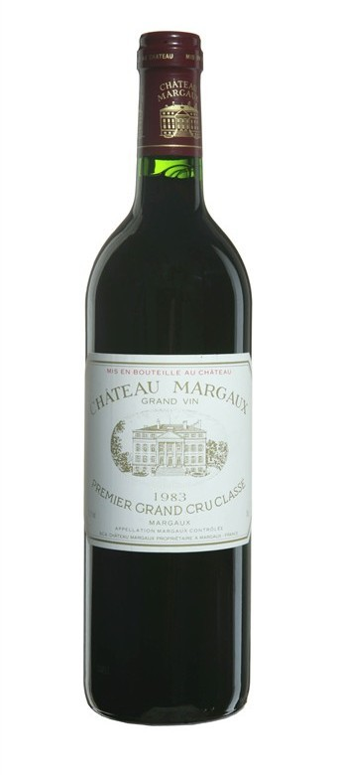
Predicting Wine Quality
Linear Regression
The Analytics Edge
Notes:
Image from http://larrythewineguy.net/tag/chateau-margaux/

Slide 2

Bordeaux Wine
Large differences in price and quality between years, although wine is produced in a similar way
Meant to be aged, so hard to tell if wine will be good when it is on the market
Expert tasters predict which ones will be good
Can analytics be used to come up with a different system for judging wine?
Notes:
Image from http://www.luxetravel.com/destinations/europe/france/

Slide 3
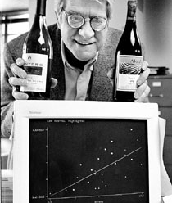
Predicting the Quality of Wine
March 1990 - Orley Ashenfelter, a Princeton economics professor, claims he can predict wine quality without tasting the wine

Slide 4
Building a Model
Ashenfelter used linear regression
Predicts an outcome variable, or dependent variable
Predicts using a set of independent variables
Independent variables:
Age – older wines are more expensive
Weather
Average Growing Season Temperature
Harvest Rain
Winter Rain
Dependent variable:
Log(Price Index)
Price Index measured price of many different wineries in thousands of 1990-1991 wine auctions

Slide 5
Why Log(Price)?
A better linear fit
Discover through plotting
Right skewed distribution fix using log -> Normal Distribution.
Doesn’t work for left skewed distribution.
Interpretation
When predicting the log of the dependent variable, the interpretation of the coefficients changes
Percent change instead of absolute change

Slide 6
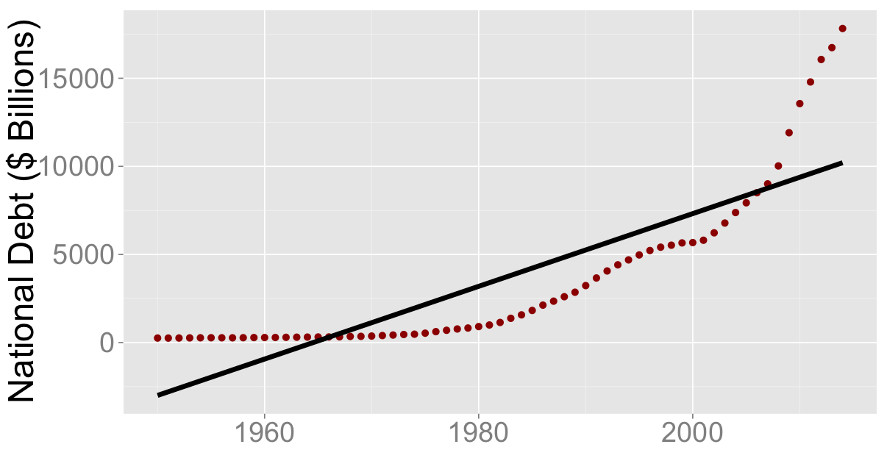
US National Debt (1950 – 2014)
Coefficient for Year = 206
R² = 0.72

Slide 7
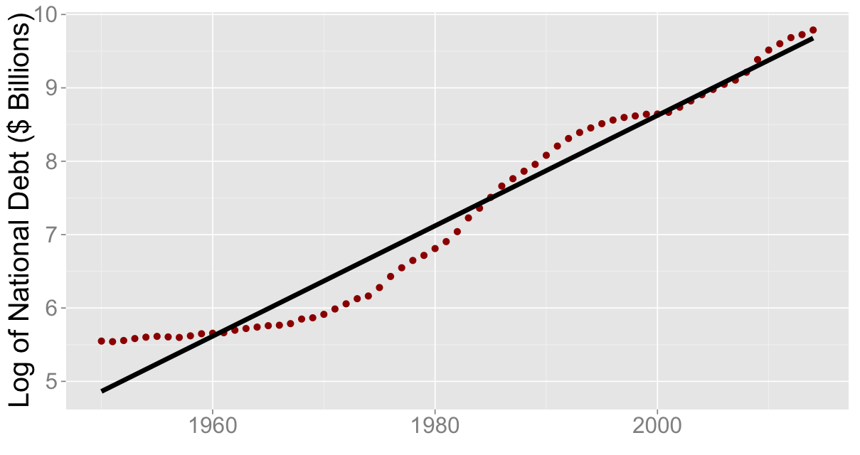
US National Debt (1950 – 2014)
Coefficient for Year = 0.075
R² = 0.96

Slide 8
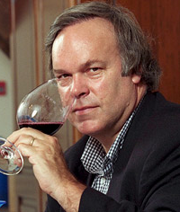
The Expert’s Reaction
Robert Parker, the world's most influential wine expert:
“Ashenfelter is an absolute total sham”
“rather like a movie critic who never goes to see the movie but tells you how good it is based on the actors and the director”

Slide 9
Multiple Linear Regression
If we have n observations and k independent variables:
Coefficients selected to minimize the Sum of Squared Errors

Slide 10
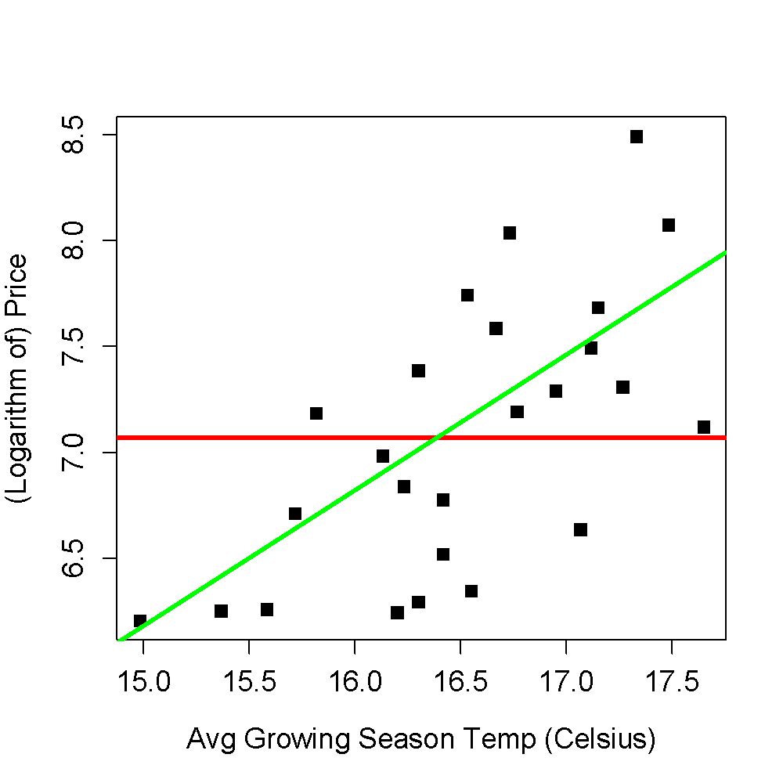
R²
Compares the best model to a “baseline” model
The baseline model does not use any variables
Predicts same outcome (price) regardless of the independent variable (temperature)

Slide 11
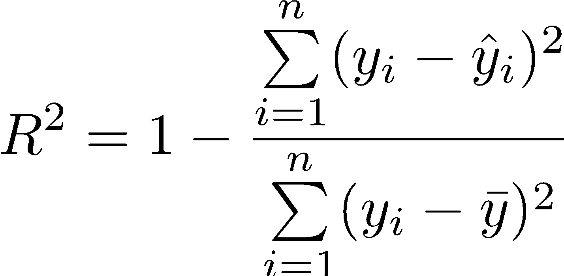
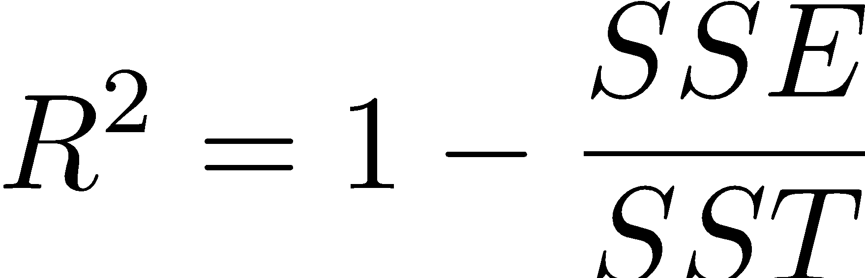
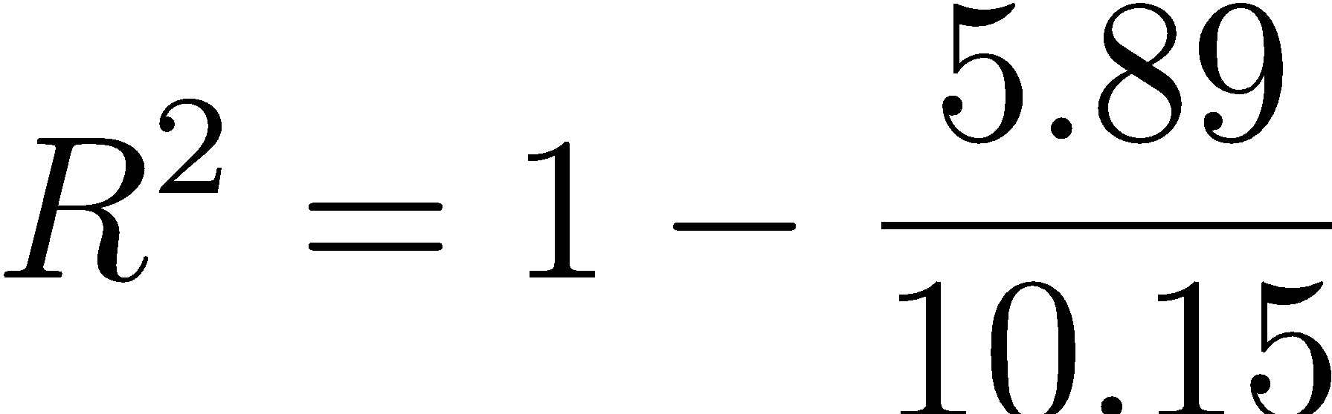
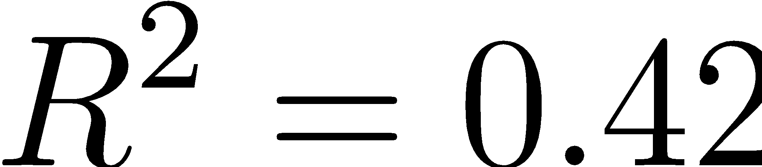
R²
SSE = 5.89
SST = 10.15

Slide 12
Selecting Variables
Not all available variables should be used
Each new variable requires more data
Causes overfitting: high R² on data used to create model, but bad performance on unseen data
Check for significance
Check for multicollinearity
Then build a linear regression model

Slide 13
The Results
Parker (in 1991):
1986 is “very good to sometimes exceptional”
Ashenfelter (in 1991):
1986 is mediocre
1989 will be “the wine of the century” and 1990 will be even better!
In 2003, virtually unanimous agreement that 1989 and 1990 are outstanding
1989 sold for more than twice the price of 1986
1990 sold for even higher prices!
In 2003, Ashenfelter predicted 2000 and 2003 would be great
Parker has stated that “2000 is the greatest vintage Bordeaux has ever produced”

Slide 14
The Analytics Edge
A linear regression model with only a few variables can predict wine prices well
In many cases, outperforms wine experts’ opinions
A quantitative approach to a traditionally qualitative problem

Slide 15
Further Learning Resources
Linear Regression
An Introduction to Linear Regression Analysis
R² explained
R-Squared or Coefficient of Determination
Calculating R-squared
Log transformation
Why Log Transformations? (0:30 - 3:30)
Multicollinearity

