Slide 1

Opening an Indian Restaurant in New York
By: Aditya Sinha

Slide 2
Business Problem
Where in New York City, should an entrepreneur open an Indian Restaurant?

Slide 3
Data
The following datasets and information are considered for analysis to build a restaurant recommendation model.
Neighborhood data of NYC along with latitudes, and longitudes from https://cocl.us/new_york_dataset.
Obtained geographical coordinates of the New York using Python Geocoder package.
Foursquare API venues explore method to get the venues of NYC neighborhoods.

Slide 4
Methodology
Python libraries to extract, clean, and visualize New York City neighborhoods data.
Foursquare API to get a list of all the Venues in NYC.
Performed One hot encoding to change Categorical Data to Numerical Data for Machine Learning algorithms.
Used K-Mean clustering to cluster neighborhoods into 4 clusters which has same similar mean frequency of Indian Restaurants.

Slide 5
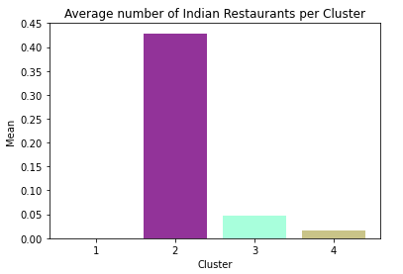
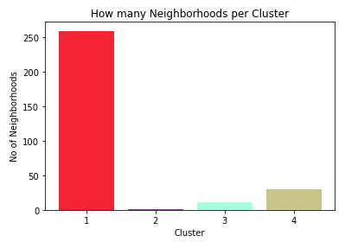
Analysis/Results
Cluster 1 (Red) has 259 neighborhoods, 394 unique Venue Category but only two Indian restaurants. Cluster 1 has lowest average of Indian Restaurants equating to 0.0003.
Cluster 2 (Purple) has 7 neighborhoods, 5 unique Venue Category out of which 3 were Indian restaurants. Cluster 2 has highest average of Indian Restaurants equating to 0.43.
Cluster 3 (Turquoise) has 361 neighborhoods, 114 unique Venue Category out of which 17 were Indian restaurants. Cluster 3 has 2nd lowest average of Indian Restaurants equating to 0.047.
Cluster 4 (Dark-Khaki) has 30 neighborhoods, 293 unique Venue Category out of which 40 were Indian restaurants. Cluster 3 has 2nd highest average of Indian Restaurants equating to 0.047.

Slide 6
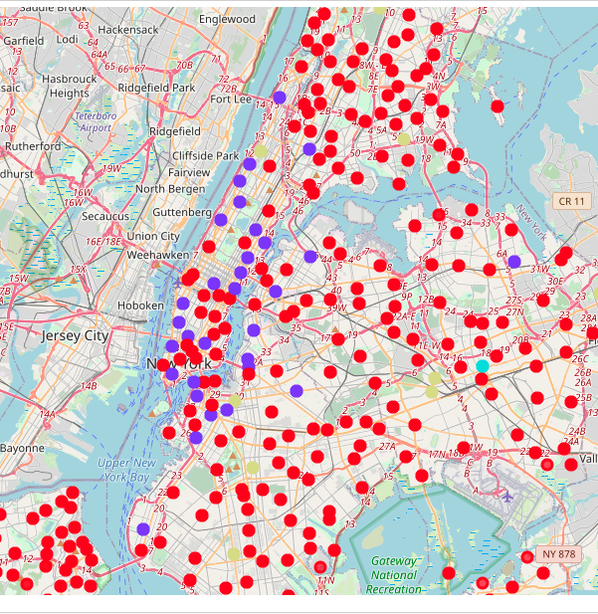
Discussion
Cluster 1 has huge number of neighborhoods and distinct venues but there is little to no Indian Restaurants as a result Murray Hill in Manhattan would be optimal place to open an Indian restaurant.
All the above analysis is based on data obtained from Foursquare API. Moreover, analysis does not take into Indian population which could play an important role while choosing the to open an Indian Restaurant.

Slide 7
Conclusion
In this project we had an opportunity to analyses a business problem and use data science methodology to solve that business problem. We utilized various Python libraries and Foursquare API to extract, prepare, and visualize data, perform data analysis, and finally recommend a solution to a business problem.
At the end of this project, we can answer the question: “What is the optimal location to open an Indian restaurant in NYC.” This answer was based on the competition aspect of the Indian restaurant business.

