Slide 1




Artificial Intelligence &
Machine Learning
Twitter Sentiment Analysis Using Logistic Regression
Aditya Gupta
Artificial Intelligence Internship
B.Tech – Computer Science & Engineering
Codec Technologies Pvt. Ltd.
IILM University, Greater Noida, U.P. | Session 2025–2029
30 July 2026 – 30 August 2026 | 30 Days

Slide 2


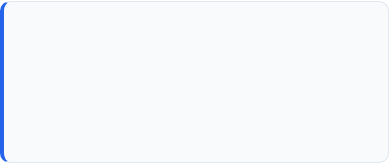



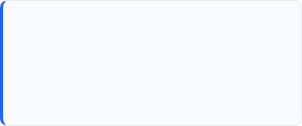

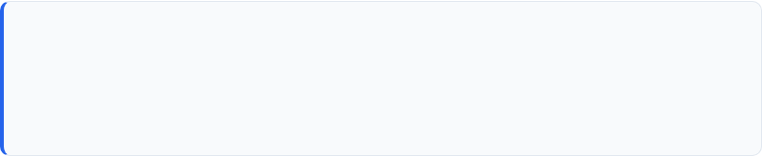
Candidate Profile
PROGRAMME
INSTITUTE
B.Tech Computer Science & Engineering
IILM University, Greater Noida, U.P.
SESSION
INTERNSHIP DOMAIN
Aditya Gupta
2025–2029
Artificial Intelligence & Machine Learning
B.Tech – Computer Science & Engineering
DURATION
30 Days | 30 July – 30 August 2026

Slide 3
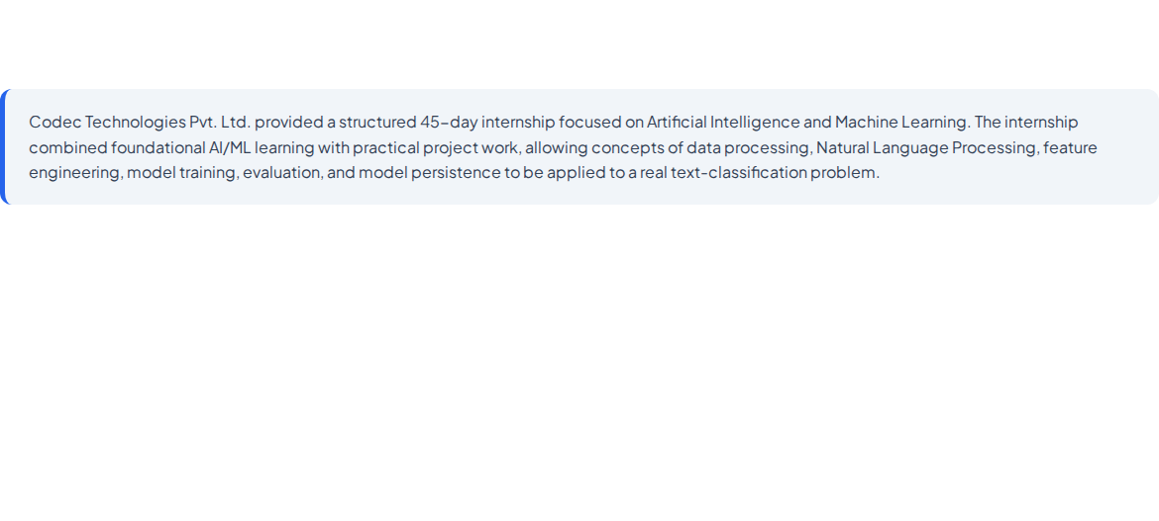

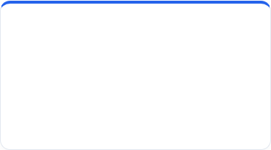


Codec Technologies & AI Internship
CARD 1
CARD 2
CARD 3
Artificial Intelligence
Practical Project
Industry Exposure
Foundation
Twitter Sentiment Analysis
Practical Workflow
Understanding AI, Machine Learning, supervised learning, classification, and the overall machine learning workflow.
Applying NLP and machine learning techniques to classify tweets into positive and negative sentiment categories.
Working through data acquisition, preprocessing, feature extraction, model development, evaluation, prediction, and model persistence.

Slide 4
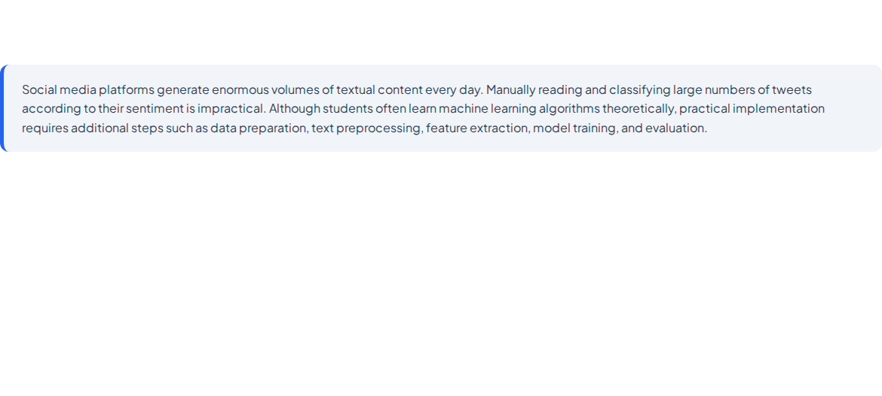
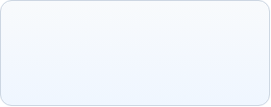
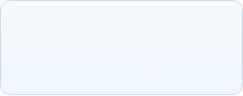
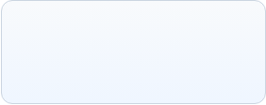




Bridging AI Theory and Practical NLP
Collect Data
Preprocess Text
Train Model
Predict Sentiment

Slide 5
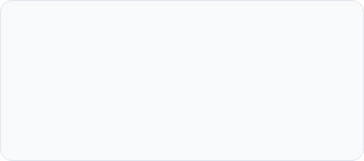
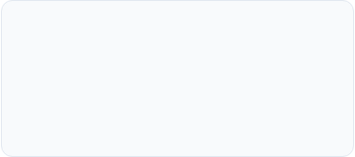

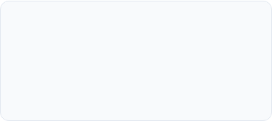
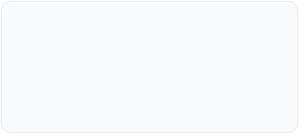
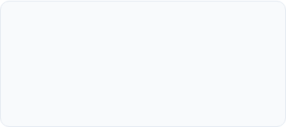
What the Internship Set Out to Achieve
AI & ML Fundamentals
Data Preparation
Natural Language Processing
Build a foundational understanding of Artificial Intelligence, Machine Learning, supervised learning, and classification.
Learn to acquire, load, inspect, clean, and prepare a large-scale dataset for machine learning.
Apply text preprocessing techniques including regular-expression cleaning, lowercase conversion, stop-word removal, and stemming.
Feature Extraction
Model Development
Evaluation & Prediction
Convert processed tweet text into numerical representations using TF-IDF vectorization.
Train a Logistic Regression classifier for binary sentiment classification using an 80:20 stratified train-test split.
Evaluate model performance using accuracy, save the trained model, reload it, and perform sentiment predictions.

Slide 6
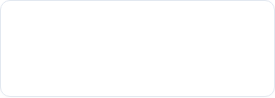
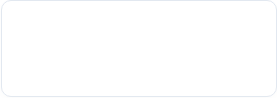
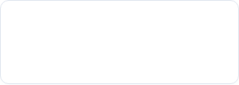


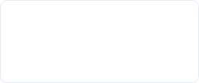
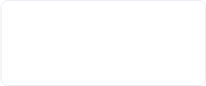

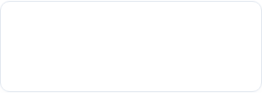
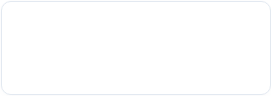
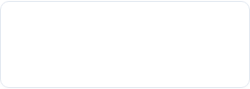

The Toolkit Behind the Project
Python
Google Colab
Kaggle
Pandas
Primary programming language for data processing and machine learning.
Cloud notebook environment used to develop and execute the project.
Source platform used to obtain the Sentiment140 dataset.
CSV loading, DataFrame creation, inspection, and manipulation.
NumPy
NLTK
Scikit-learn
TF-IDF + LogReg
Numerical and array-oriented operations.
Natural Language Processing utilities, stop-word processing, and stemming.
Feature extraction, train-test splitting, Logistic Regression, and evaluation.
TF-IDF converts text into numerical features; Logistic Regression classifies sentiment.
RegEx
PorterStemmer
Pickle
accuracy_score
Cleaning non-alphabetic characters from tweet text.
Reducing related word forms to common stem representations.
Saving and loading the trained machine learning model.
Measuring training and testing classification accuracy.

Slide 7
Raw Tweet to Sentiment Prediction
LAYER 1
LAYER 2
LAYER 3
LAYER 4
LAYER 5
LAYER 6

Slide 8
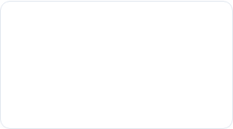
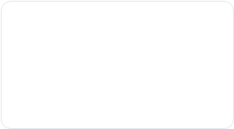


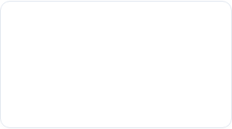
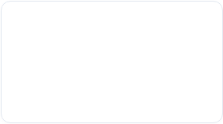
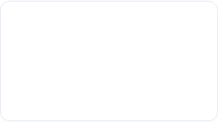
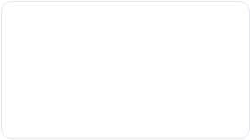
The 30-Day Learning Journey
AI & ML Fundamentals
Python for AI/ML
Data Analysis
NLP Concepts
Introduction to AI, Machine Learning, supervised learning, classification, and ML workflows.
Using Python, libraries, functions, data structures, and notebook development.
Loading datasets, checking dimensions, missing values, and target distributions.
Understanding text data, tokenization, normalization, stop-words, and stemming.
Text Preprocessing
TF-IDF Extraction
Logistic Regression
Evaluation & Pickle
Cleaning tweets with regex, lowercase conversion, and creating stemmed content.
Converting processed tweets into numerical feature matrices for ML models.
Training a binary classification model with an 80:20 stratified train-test split.
Measuring accuracy, saving model using Pickle, reloading, and predicting.

Slide 9
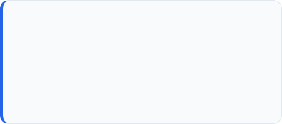
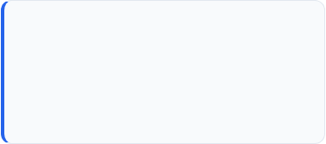
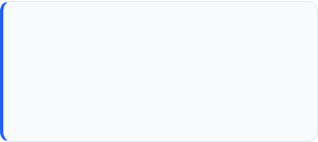
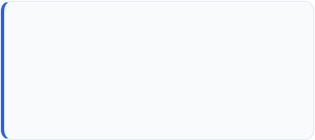
Skills & Capabilities Gained
1. AI/ML Workflow
2. Data Handling
3. Natural Language Processing
Understanding how a machine learning problem progresses from data acquisition to prediction and model persistence.
Practical experience in loading, inspecting, cleaning, transforming, and preparing a large dataset.
Understanding and applying text preprocessing techniques specifically tailored for social-media text.
4. Machine Learning
5. Model Evaluation
6. Engineering Practices
Practical experience with TF-IDF feature extraction and Logistic Regression for binary classification.
Understanding train-test splitting and evaluating model performance using classification accuracy on unseen data.
Developing skills in reproducibility, model persistence, systematic problem solving, and computational awareness.

Slide 10

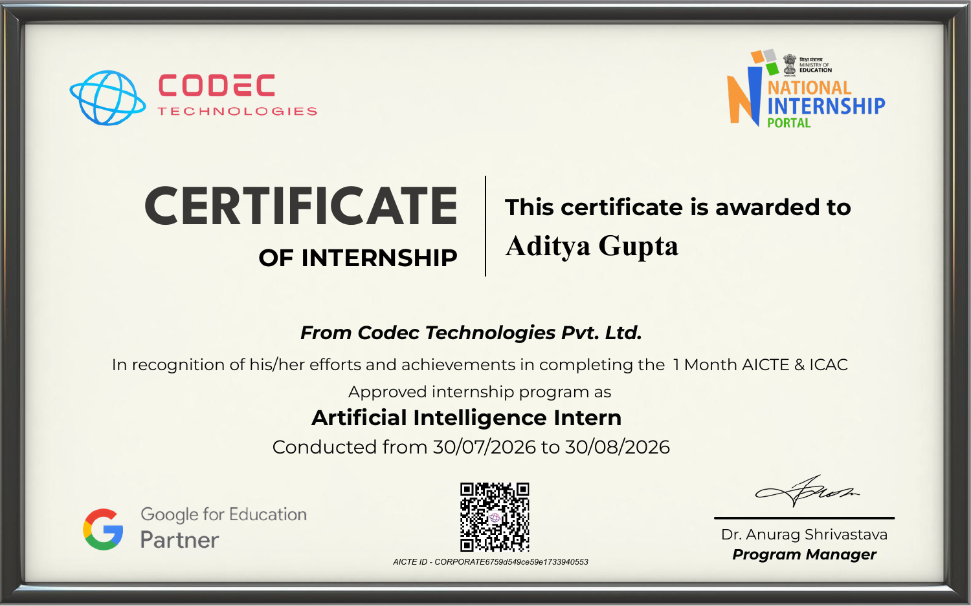

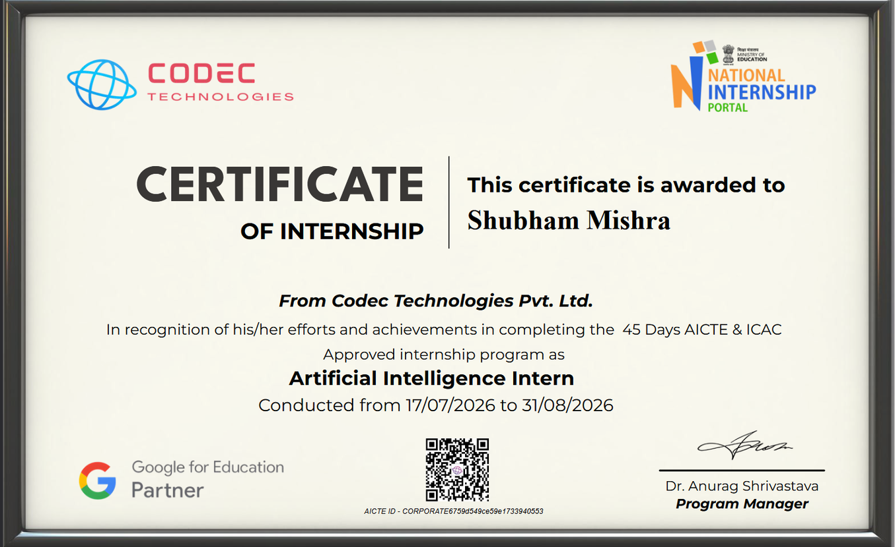
Successfully Completed
ORGANIZATION
Codec Technologies Pvt. Ltd.
DURATION
30 Days
MODE
Pan India, Hybrid
DESIGNATION
Artificial Intelligence Intern
INTERNSHIP PERIOD
30 July 2026 – 30 August 2026
REPORTING
Assigned Project Head(s)

Slide 11

Thank You
Artificial Intelligence & Machine Learning Internship
Aditya Gupta
Degree: B.Tech – Computer Science & Engineering
University: IILM University, Greater Noida
Internship: Codec Technologies Pvt. Ltd.
Project: Twitter Sentiment Analysis Using Logistic Regression

