Slide 1
Task Analysis
Lab Meet 8:

Slide 2
01
REVIEW MATERI
Task Analysis

Slide 3
GOMS Models
Simplified Cognitive Architectures
A well-developed tool for Model-based Evaluation that in their current modern form, are based on simplified cognitive architectures.
GOMS focuses on the cognitive processes required to achieve a goal using a particular device.
SUMBER :https://www.cs.cmu.edu/~bej/CognitiveModelingForUIDesign/2a_GOMS_Architectures.pdf

Slide 4
GOMS Models
Simplified Cognitive Architectures
Goals. What are people trying to do using some system (e.g. make a call using a cell phone.)
Operators. These are the actions that the system allows people to perform, such as clicking on menus, scrolling through lists, pressing buttons and so on.
Methods. These are sequences of subtasks and operators. Subtasks are described at a more abstract level than operators - things such as ‘select name from address book’ or ‘enter phone number’.
Selection rules. These are the rules that people use to choose between methods of achieving the same subtask (if there are options). For example, to select a name from an address book a person could scroll through the names or type in the first letter and jump to a part of the address book.
SUMBER : BENYON, D; DESIGNING INTERACTIVE SYSTEMS( 3RD EDITION); PEARSON
Notes:
Tujuan model GOMS ini untuk mendeskripsikan hal berikut:

Slide 5
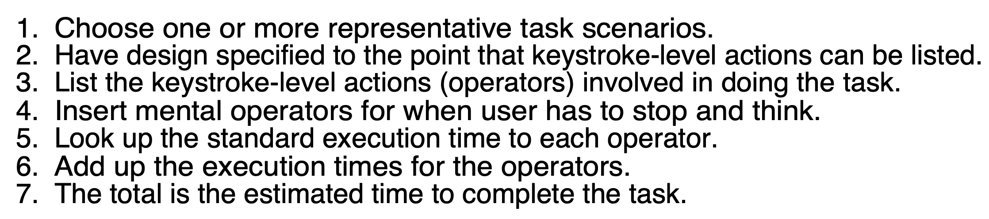
Langkah
SUMBER :https://www.cs.cmu.edu/~bej/CognitiveModelingForUIDesign/2a_GOMS_Architectures.pdf

Slide 6
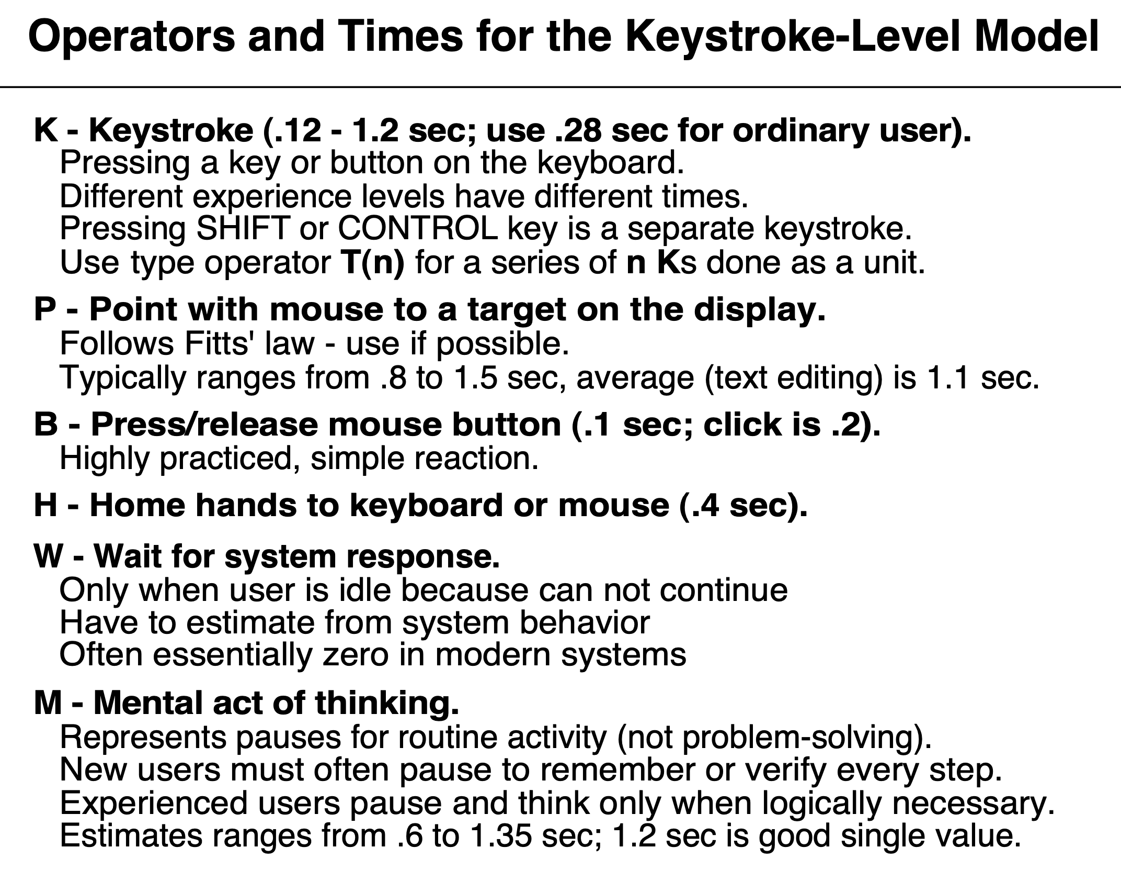
SUMBER :https://www.cs.cmu.edu/~bej/CognitiveModelingForUIDesign/2a_GOMS_Architectures.pdf

Slide 7
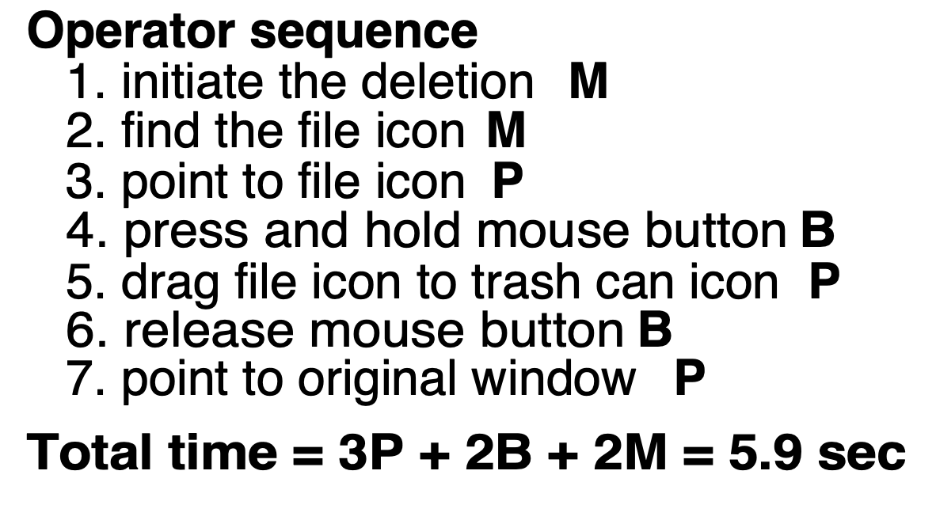
Case example
Delete file on MacOS
SUMBER :https://www.cs.cmu.edu/~bej/CognitiveModelingForUIDesign/2a_GOMS_Architectures.pdf

Slide 8
02
PEMILIHAN CASE

Slide 9
Case
shopee.co.id (Website)
tokopedia.com (Website)
blibli.com (Website)

Slide 10
Task Skenario
Pembelian 1 box masker 3ply merk Sensi isi 50pcs (checkout pembayaran menggunakan Bank account)

Slide 11
03
TUGAS
Membuat Task Analysis

Slide 12
TUGAS
Membuat akun di ecommerce sesuai case yang didapat (jika belum memiliki akun)
Melakukan aktivitas belanja online sesuai skenario
List keystroke level action dalam melakukan task sesuai skenario
Jangan lupa tulis juga mental-operator di saat user berhenti dan berpikir
Masukkan waktu sesuai standar execution time dan jumlahkan.
Bandingkan hasil dengan 2 teman dengan case ecommerce yang berbeda.
Submit laporan praktikum (dalam bentuk PPT) melalui LMS
Deadline minggu depan

