Slide 1
CONVEX HULL
Group 19
Aditiya Kumar (2017018)
Ashish Dodiyar (2017059)
Hemant Kumar Verma (2017106)

Slide 2
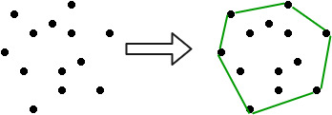
Definition
Given a set of points in the plane. the convex hull of the set is the smallest convex polygon that contains all the points of it.

Slide 3
Application of the Convex Hull
Linear Programming –Simplex Method
visual pattern matching (e.g. detecting car license plates)
Onion Peeling
Geographical Information Systems (GIS) (e.g. computing accessibility maps)
Geometry (e.g. diameter computation)
Path finding (e.g. embedded AI of Mars mission rovers)

Slide 4
Classical Algorithms
Jarvis’s Algorithm or Wrapping
The idea of Jarvis’s Algorithm is simple, we start from the leftmost point (or point with minimum x coordinate value) and we keep wrapping points in counterclockwise direction.
Worst case time complexity of Jarvis’s Algorithm is O(n^2).
Gift Wrapping aka Jarvis march — O(nh) One of the simplest (although not the most time efficient in the worst case) planar algorithms. Created independently by Chand & Kapur in 1970 and R. A. Jarvis in 1973. It has O(nh) time complexity, where n is the number of points in the set, and h is the number of points in the hull. In the worst case the complexity is Q(n2).
Graham Scan — O(n log n) A slightly more sophisticated, but much more efficient algorithm, published by Ronald Graham in 1972. If the points are already sorted by one of the coordinates or by the angle to a fixed vector, then the algorithm takes O(n) time.
Quickhull Created independently in 1977 by W. Eddy and in 1978 by A. Bykat. Just like the quicksort algorithm, it has the expected time complexity of O(n log n), but may degenerate to O(n2) in the worst case.
Divide and Conquer — O(n log n) Another O(n log n) algorithm, published in 1977 by Preparata and Hong. This algorithm is also applicable to the three dimensional case.

Slide 5
Propose Algorithm
The Main Idea and Selection of the Points of Interest
This algorithm is based on the fact that in a given set of randomly scattered points only the points to the exterior of the region covered by the point set, participate in constructing the convex hull. Rests of the interior points are not of any importance. So we try to obtain the exterior points near the boundary and check whether they are proper candidates for being convex hull points.

Slide 6
Propose Algorithm
For this purpose we divide the point set into four rectangular region or p-Rects (see Figure 1). The four pRects are called Bottom-Left (BL), Bottom-Right (BR), Top-Left (TL) and Top-Right (TR). The points inside the p-Rects are called points of interest. Each of the four pRects is constructed by two corner points which have extreme x/y coordinates chosen as explained next.

Slide 7
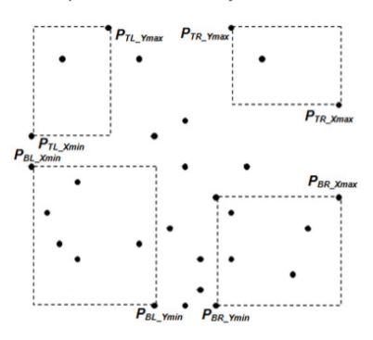
Propose Algorithm
Four regions (p-Rect) with the points of interest constructed by their two corner points

Slide 8
Processing Left-most
The points in Bottom-Left (BL) region are bounded by a pRect whose two opposite corner points
are PBL_Xmin and PBL_Ymin, where
PBL_Xmin is the point with minimum x-coordinate.
PBL_Ymin is the point with minimum y-coordinate.
If number of points having minimum x-coordinate is greater than 1 then, for Bottom-Left p-Rect we take the point with minimum y-coordinate and make it PBL_Xmin. While for Top-Left p-Rect we take the point with maximum y-coordinate and make it PTL_Xmin.

Slide 9
Processing Left-most-Processing the Points of Interest
For this section the points of interest is the set of points {p1, p2, p3 ...} where each pi = (xi, yi) such that
PBL_Xmin.x < xi < PBL_Ymin.x
PBL_Ymin.y < yi < PBL_Xmin.y
Out of this set find out PƍBL_Xmin and PƍBL_Ymin the same way we found PBL_Xmin and PBL_Ymin for the outer BottomLeft p-Rect. Further processing depends upon the following 3 cases.

Slide 10
Processing Left-most-Processing the Points of Interest
Case 1: If there are no such points then terminate further processing in this p-Rect.
Case 2: If both are same point then check whether the point is clockwise or anticlockwise from point PBL_Ymin with respect to point PBL_Xmin (see Figure 3). If it is clockwise or collinear then include it to the convex hull candidate point set and terminate further processing.

Slide 11
Processing Left-most-Processing the Points of Interest
Case 3: If both are different than we check whether they are clockwise or anticlockwise from point PBL_Ymin with respect to point PBL_Xmin. Again we will have 3 scenarios:
If none of them are clockwise from PBL_Ymin then leave further processing.
If only any one of them is clockwise from PBL_Ymin then we include it to the convex hull point set and terminate further processing in this section.
If both of them are clockwise from PBL_Ymin or collinear then construct a smaller p-Rect keeping PƍBL_Xmin and PƍBL_Ymin as corner points and recursively process the points of interest in the new Bottom-Left (BL') pRect using above steps in search of new convex hull points

Slide 12
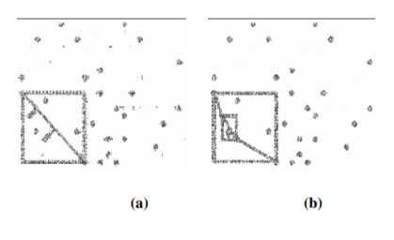
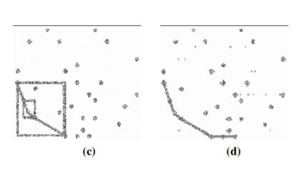

Slide 13
Similarly we process upper left ,upper right and bottom right and get candidate point for convex hull

Slide 14
RESULT
Input point set
{4.4, 14}, {6.7, 15.25}, {6.9, 12.8}, {2.1, 11.1}, {9.5, 14.9},
{13.2, 11.9}, {10.3, 12.3}, {6.8, 9.5}, {3.3, 7.7}, {0.6, 5.1}, {5.3, 2.4},
{8.45, 4.7}, {11.5, 9.6}, {13.8, 7.3}, {12.9, 3.1}, {11, 1.1}}
Output
{{13.8, 7.3}, {13.2, 11.9}, {9.5, 14.9}, {6.7, 15.25}, {4.4, 14},
{2.1, 11.1}, {0.6, 5.1}, {5.3, 2.4}, {11, 1.1}, {12.9, 3.1}}

Slide 15
Comparison in time taken
NUMBER OF INPUT | Graham scan (time in micro second) | Proposed algorithm(time in micro second)
50 | 13 | 293
100 | 268 | 318
500 | 753 | 463
5000 | 3770 | 3430
10000 | 8153 | 8438
20000 | 14895 | 20909
30000 | 29237 | 21367
40000 | 663032 | 63428
50000 | 149615 | 48287
60000 | 330093 | 41149
70000 | 458891 | 46232
80000 | 490361 | 51923
90000 | 704789 | 59365
100000 | 716779 | 94612
500000 | 6620421 | 318820
1000000 | 922140 | 678497

Slide 16
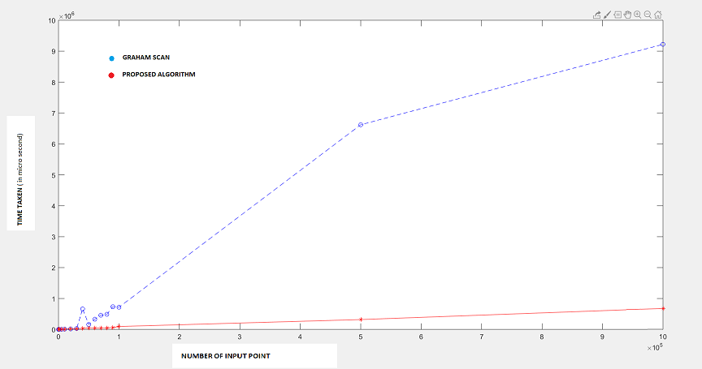

Slide 17
Conclusion
For point set up to 10000 Graham Scan takes less time than proposed algorithm .
When input point is more than 10000 then proposed algorithm perform better Graham Scan.
When input point is more the 100000 then proposed algorithm takes 10 times less time than Graham Scan.

Slide 18
Conclusion
In this paper preprocessing algorithm was discussed for finding convex hull points, which is based on the fact that only the points existing to the boundary of a region covered by a randomly scattered set of points, take part in constituting the convex-hull.Running time complexity have been discussed.
Although the purpose of developing this algorithm was to find all valid convex hull points and use it as a standard Quick Convex Hull algorithm. But it was found that the algorithm outputs some invalid convex hull points too and removing them was not possible, keeping the running time constraint into consideration. So, this algorithm can be only used as a preprocessing step.

Slide 19
REFERENCES
1. A Pre-processing Algorithm for Faster Convex Hull Computation
(L. Dolendro Singh1 , Prasenjit Das2 , Nirmalya Kar3)
https://ieeexplore.ieee.org/stamp/stamp.jsp?tp=&arnumber=6832364
Convex hull algorithm by wikipedia-https://en.wikipedia.org/wiki/Convex_hull_algorithms
3.Codegolf-https://codegolf.stackexchange.com/questions/11035/find-the-convex-hull-of-a-set-of-2d-points
4.Stack exchange-
https://stackoverflow.com/questions/482278/test-case-data-for-convex-hull

