Slide 1
Image Captioning using Deep Learning Framework
Sai Aditya Thalluri

Slide 2
OUTLINE
Introduction
Background
Proposed Method
Results & Discussion

Slide 3
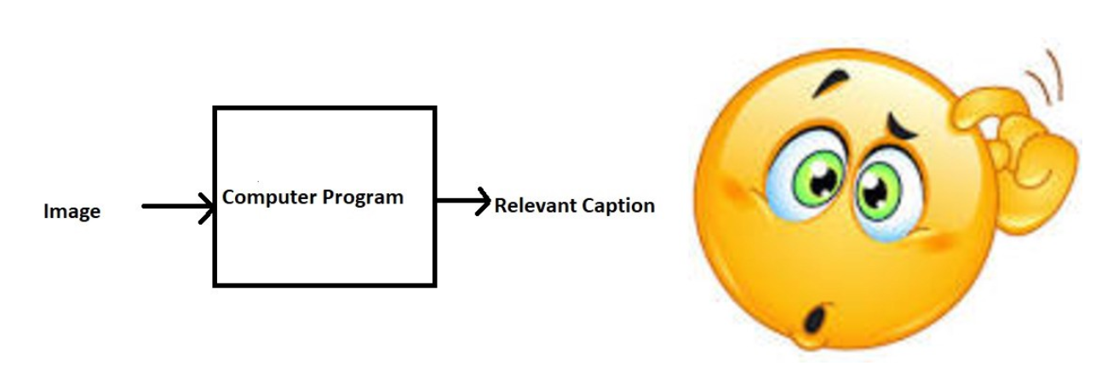
INTRODUCTION & Motivation
Captioning an image is so easy for humans. Looking at a picture, we can describe it in many ways. But it is not that simple for computers.
Image captioning project is to train computers to describes the images in natural language. It’s interesting because it concerns what we understand about perception with respect to machines.
We must first understand how important this problem is to real world scenarios. Below are the few applications where a solution to this problem can be very useful.
Self driving cars
CCTV cameras
Automatic Captioning for Image search
Aid to the blind

Slide 4
BACKGROUND
Prior to the recent development of Deep Neural Networks this problem was inconceivable even by the most advanced researchers in Computer Vision.
But with the advent of Deep Learning this problem can be solved very easily if we have the required dataset.
This problem was well researched by Andrej Karapathy in his PhD thesis at Stanford, who is also now the Director of AI at Tesla.

Slide 5
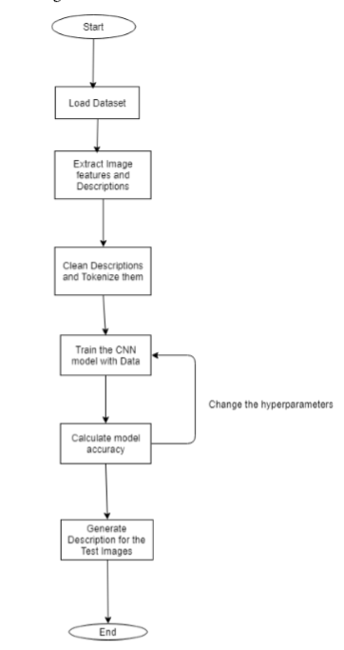
Proposed method
In this project, we will be using Flickr_8k dataset among which 6k images are for training, 1k for validation and 1k for testing.
First we will extract the features of all the images and token the corresponding descriptions using natural language tool kit.
Feed the clean descriptions to the selected model in multiple epochs. Since it is unsupervised learning, batch size in each epoch must be high to get more accuracy.
Started with VGGNet Model. As it is very slow, applied transfer learning on the Inception V3 Model.
As is involves text sequences, keras classes LSTM and Embedding are included in the model.

Slide 6
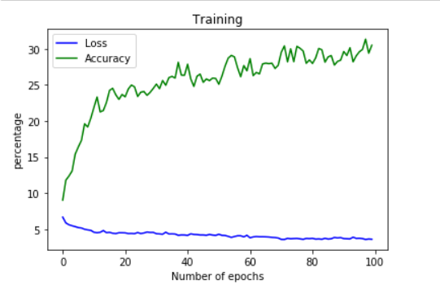
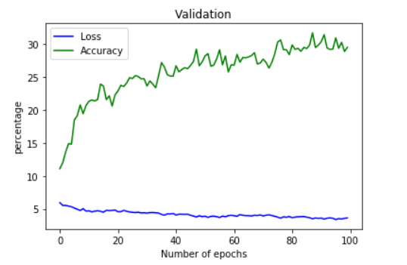
Results
After fitting the model with training and validation datasets for 100 epochs, got the below loss and accuracies for training and validation sets. As we can see that, loss keeps decreasing and accuracy keeps increasing gradually.

Slide 7
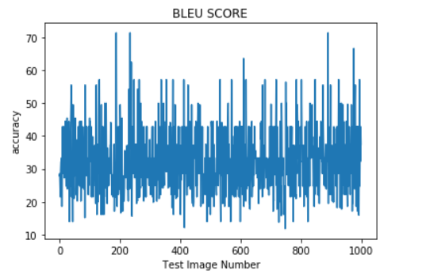
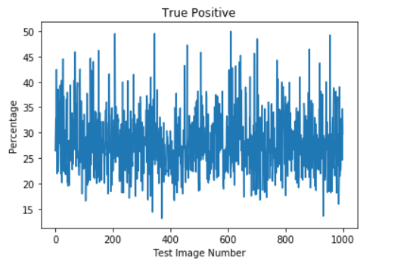
RESULTS
Since it is not a classification problem, ROC curves are not possible.
For this kind of problems we have metrics such as BLEU SCORE, CHRF in natural language tool kit to determine test accuracy.
BLEU SCORE: Bilingual Evaluation Understudy, is a score for comparing predicted translation of text to one or more reference translations.
CHRF: Determines the True positive percentage between the predicted image description and its original descriptions.
Below plots are the test results of the model.

Slide 8
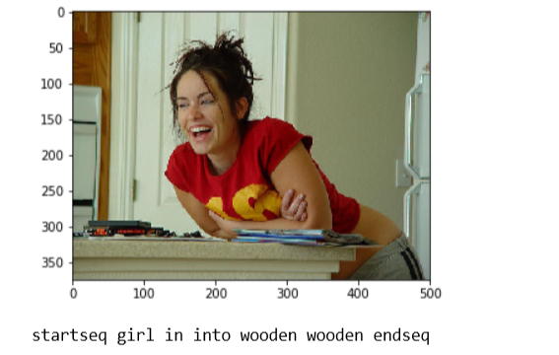
RESULTS
Below is one of the test image and its caption as predicted by the model.

Slide 9
Conclusion
So far, I have completed the whole process of training the model and testing with corresponding measures.
But this project needs a lot of training to get as more accuracy as possible. Model has to go through all kinds of images in multiple iterations to analyze the objects in images and map their actions.
As a future work, this can be extended to videos where computers can caption continuous frames in videos which can be useful in many more real time applications.

Slide 10
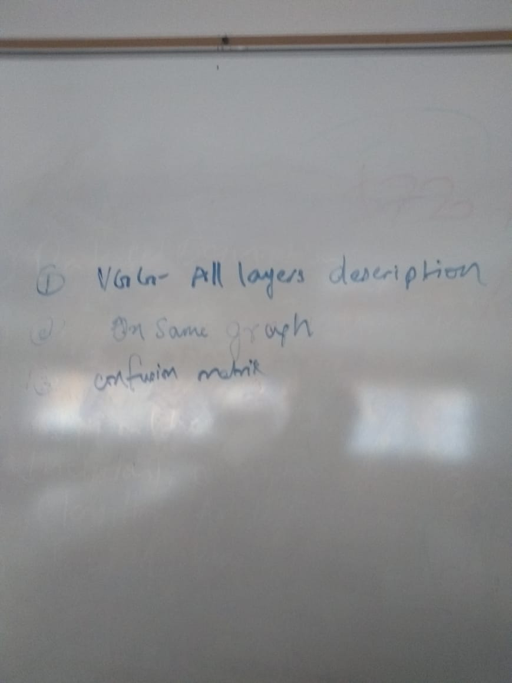
fEEDback

