Slide 1

Unpaired Image-to-Image Translation with CycleGAN: A Comprehensive Overview

Slide 2
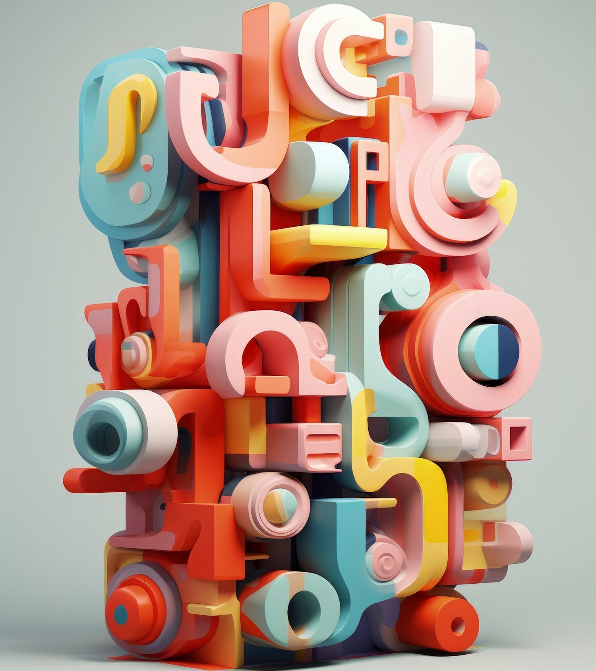
Abstract
Image-to-image translation aims to learn mappings between input and output images without paired training data.
The proposed approach introduces a method for learning translation mappings between domains X and Y without paired examples
Key components include adversarial loss and cycle consistency loss.
Qualitative and quantitative results demonstrate superior performance compared to prior methods.

Slide 3
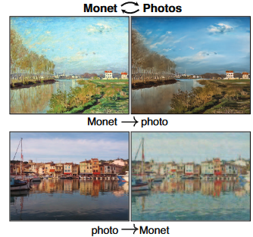
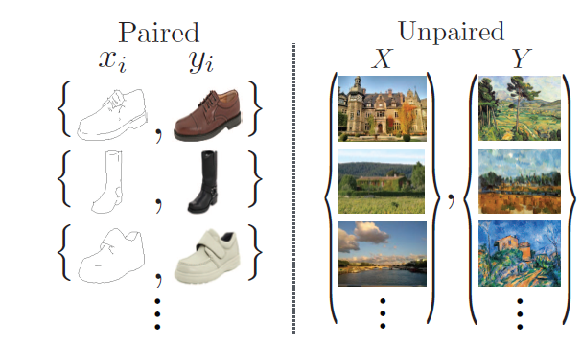
Introduction
Illustration with Claude Monet's paintings to introduce the concept of image translation.[1]
Motivation: Lack of paired training data for many tasks in image processing and computer vision.
Proposal: Learning to translate images between domains X and Y without paired examples.[2]
Challenges in obtaining paired data include scarcity, expense, and ambiguity in defining desired outputs, motivating the development of unpaired image-to-image translation techniques.
Figure: 1
Figure: 2

Slide 4
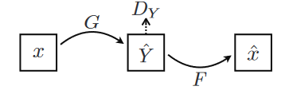
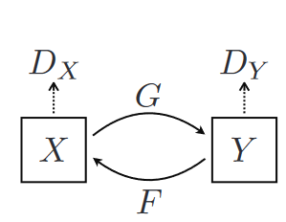
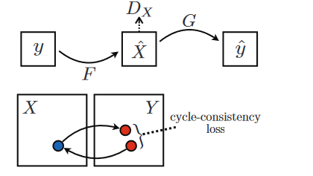
Related Work
GAN: GANs revolutionized machine learning by pitting two neural networks against each other: one generates content, the other evaluates its realism, transforming image generation and editing.
Prior methods in image-to-image translation: pix2pix is an important methods.
CycleGAN introduced the concept of cycle consistency loss, ensuring that translated images can be converted back to their original form, thus enforcing bijective mappings between domains, which was not explicitly addressed in previous techniques like "pix2pix."

Slide 5
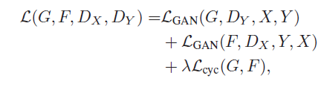

Formulation
Objective: Learn mappings G: X → Y and F: Y → X without paired examples.
Adversarial Loss: Encourage G to generate images resembling Y and F to generate images resembling X.
Introduction of cycle consistency loss to ensure forward and backward mappings are consistent.
The full objective function is:
Ultimately, we aim to solve:

Slide 6
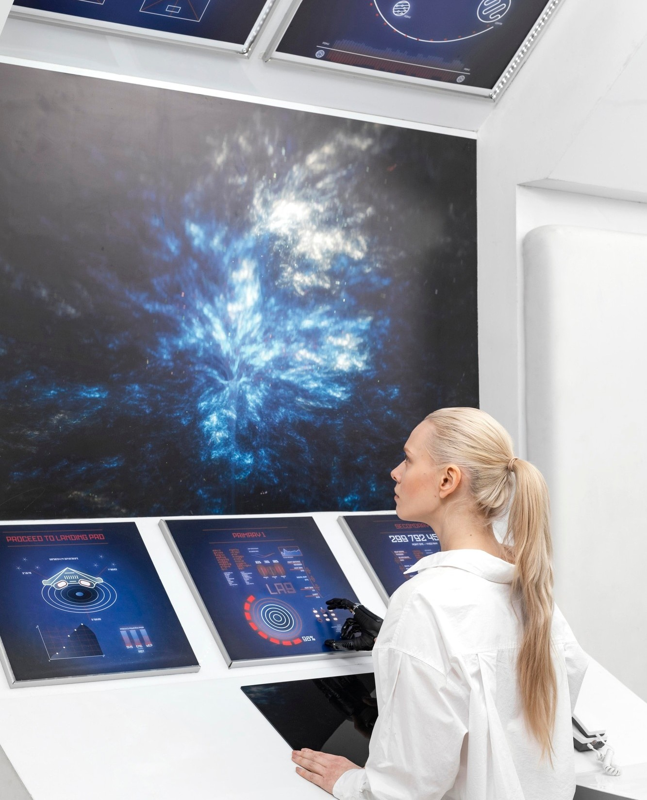
Implementation
Network Architecture: Adaptation of architecture from prior work with stride-2 convolutions and residual blocks.
Training Details: Use of least square loss for stability, update strategy for discriminators, and techniques to stabilize training.
Insights into Training: Huge time in training was one of the biggest challenges faced.

Slide 7
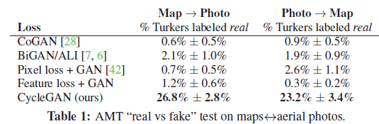
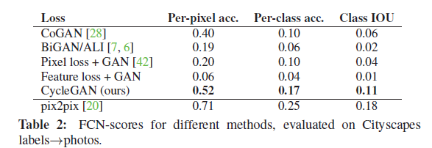
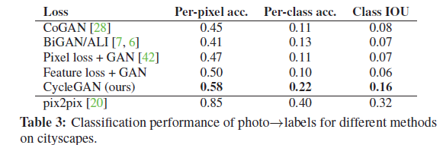
Results:
Here, in this table, we show the results of cycleGAN and other prominent algorithms:
Various tests are conducted, which show cycleGAN as one of the best performing algorithms.
Various tests are conducted, which show cycleGAN as one of the best performing algorithms.

Slide 8
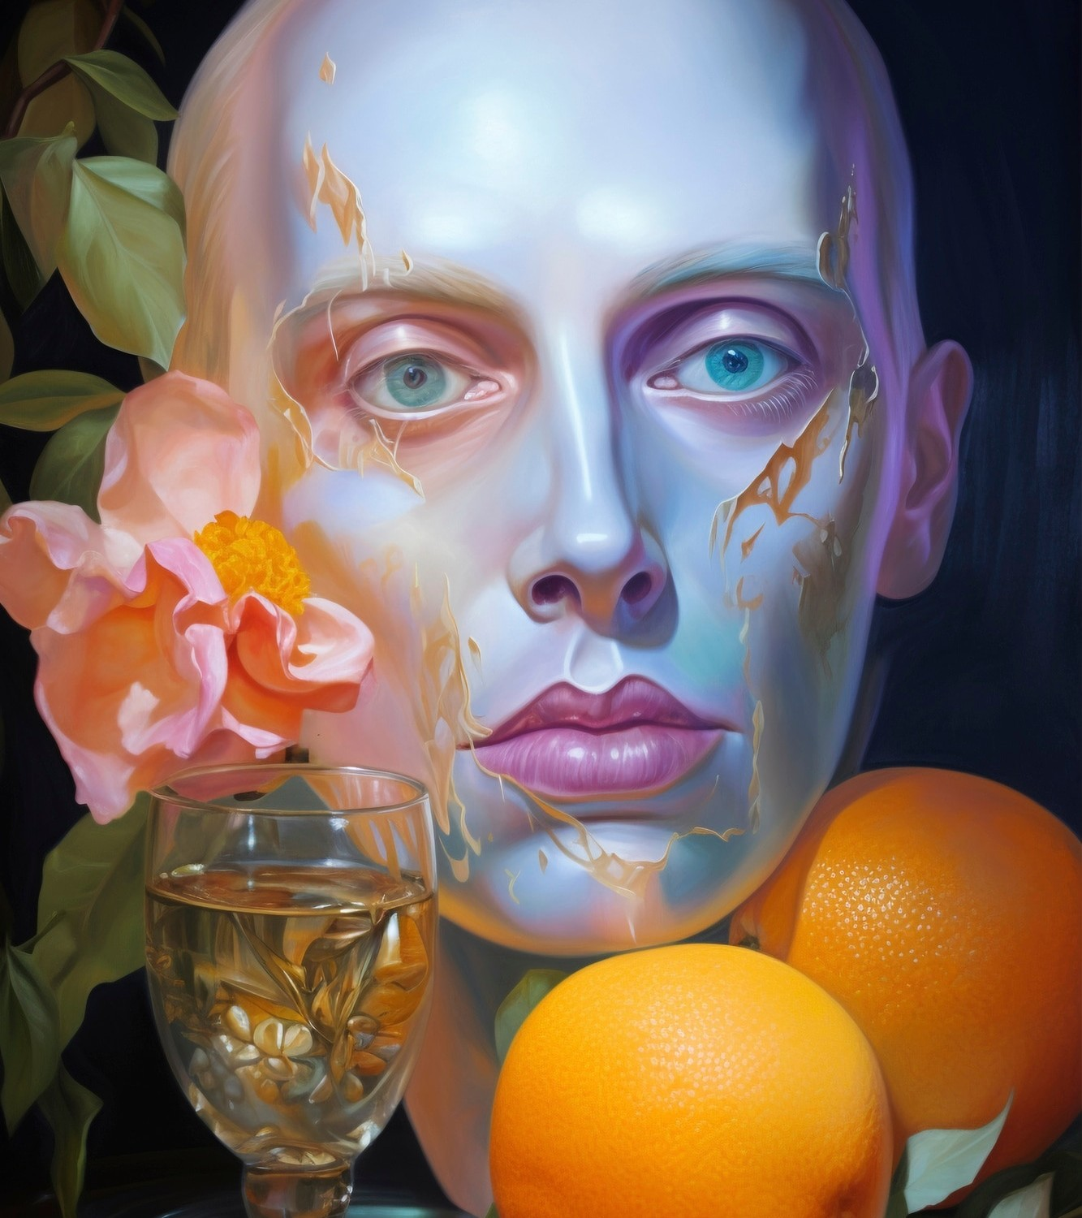
Applications in Artistic Style Transfer
CycleGAN has revolutionized artistic style transfer by enabling the transformation of images to adopt the style of a different domain. This has profound implications for creative expression and digital artistry.

Slide 9
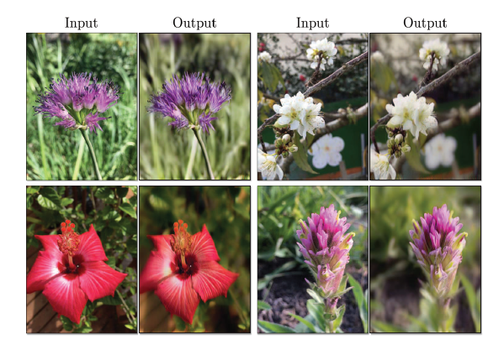
Other applications
Object Transfiguration: Translate objects between visually similar categories.
Season Transfer: Transform images between different seasons.
Collection Style Transfer: Mimic the style of entire sets of artworks.
Photo Generation from Paintings: Translate paintings into realistic photographs.
Photo Enhancement: Generate photos with shallower depth of field.
Fig: Results of photo enhancement

Slide 10

Challenges and Limitations
Despite its remarkable capabilities, CycleGAN faces challenges such as mode collapse and training instability. Understanding these limitations is crucial for harnessing the full potential
of CycleGAN.

Slide 11

Future Directions
The future of image translation with CycleGAN holds promise for advancements in multimodal translation, video synthesis, and cross- domain adaptation. Embracing these frontiers will unlock new possibilities in visual content manipulation.

Slide 12
Conclusion
In conclusion, this presentation has provided a comprehensive understanding of the capabilities, applications, and challenges of CycleGAN in enhancing image translation. The potential for future innovations in this ﬁeld is immense.

Slide 13
Thanks!
Aditya Kumar Sharma
Vansh Agrawal
Abhishek Joshi
2021A7PS3112H
2021A7PS2998H
2021A7PS2727H

