Slide 1
Supervised Classification Model training on HAR UCI dataset.
By : Aditya Kumar

Slide 2
About dataset
Dataset contain pre-splitted train / test directories , so we have to handle train and test set separately.
Feature values are being provided into text files not csv. But feature labels are given into separate text file , we need to process it and use it as columns.
There are 30 different people whose physical activities are being recorded on 6 different activity labels (walking standing etc)

Slide 3
Step 1 – Accessing all feature col name and prepare them for data frame
In the train/ test txt files we just got reading separated by “spaces” but we don’t have feature labels for corresponding records. But we have given feature names in separate txt file in the same order as we have recorded body activity.
So we will access the file (features.txt) and store into list, later we can assign it as columns to the dataframe.

Slide 4
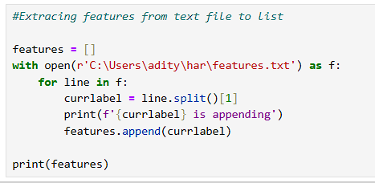

Slide 5
Step 2 – Accessing all feature data from train set and prepare them for data frame
In this step we will read the train data and store them into a dataframe and the delimiter we are going to set is “space”, So after this we will be having a table like structure (dataframe) which consist of all input features in the recording from (xtrain.txt)
Then we will set feature columns (from STEP 1) to dataframe
Then add subject_id as new column in dataframe
Then read data from ytrain.txt and append to dataframe

Slide 6
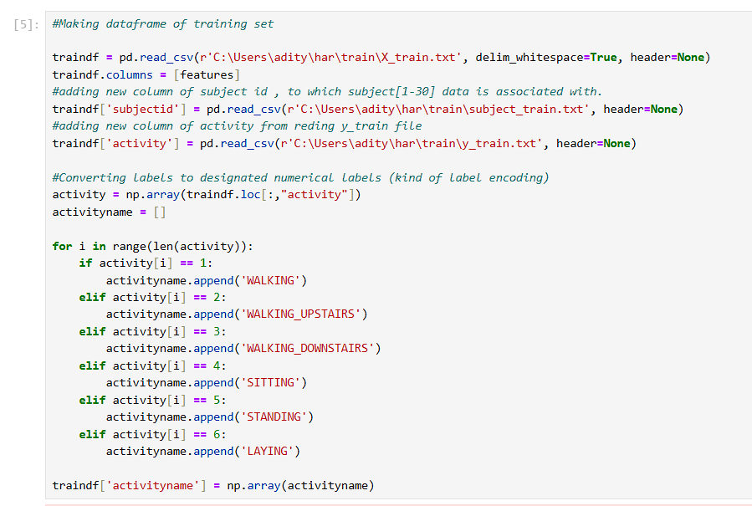

Slide 7
Step 3 - Accessing all feature data from test set and prepare them for data frame
This process is exactly same as STEP 2 , we will access all important files from test folder – x test, y test, subject_id, and append them all in a single dataframe and given column names same as feature names we have extracted from STEP 1.
Later this dataframe will help us to validate performance of our model.

Slide 8
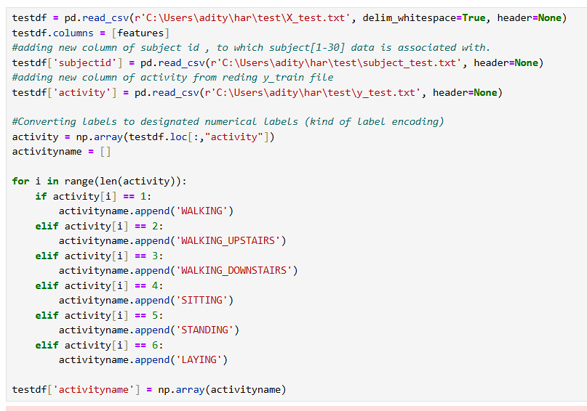

Slide 9
STEP 4 data preprocessing
We will try to find and NA values , if exists then we will remove the record as it will affect the model training as well it’s performance.
Usually we find duplicate records and delete it, but here we will let it be as one activity might be having same kind of reading For example LYING will have Acceleration (X,Y,Z)= 0 SO DELETING RECORDS WOULD NOT HELP.
Then we will add another column in data frame according to the mapping of activity number and names.
Renaming columns name by removing special character.

Slide 10
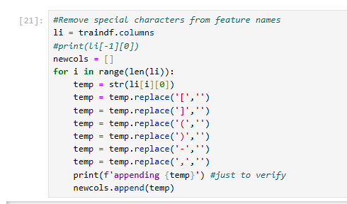

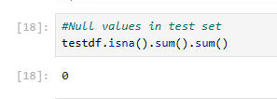

Slide 11
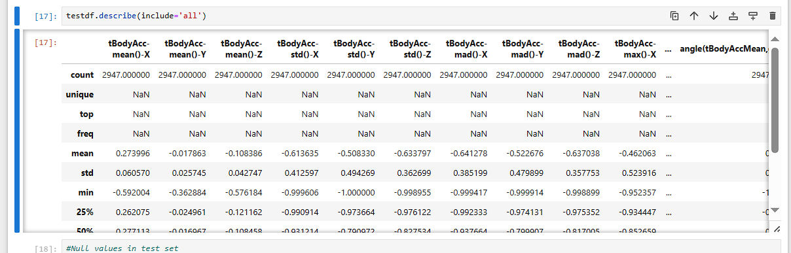
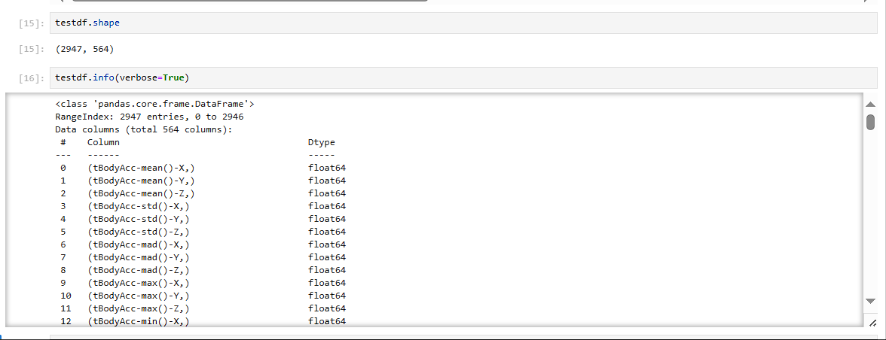

Slide 12
STEP 5 – Check for Imbalance data w.r.t to target column
To check this we will simply count the labels in each group (STANDING, LYING, ETC) the we can plot histogram. If data imbalance found then we need to delete records to balance it or we can use SMOTE .

Slide 13
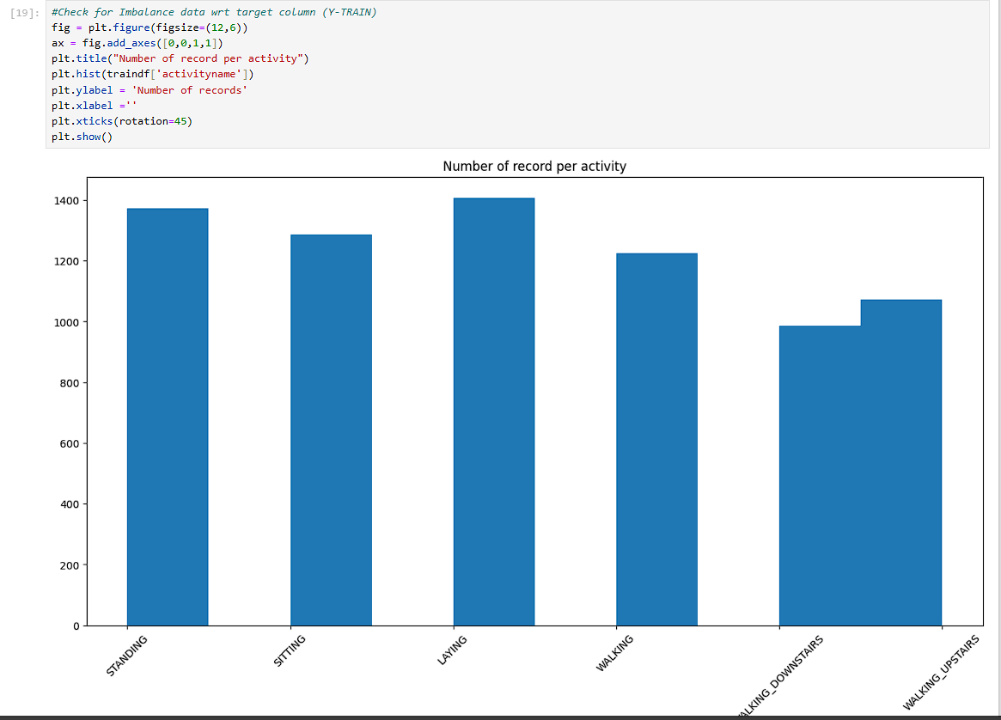

Slide 14
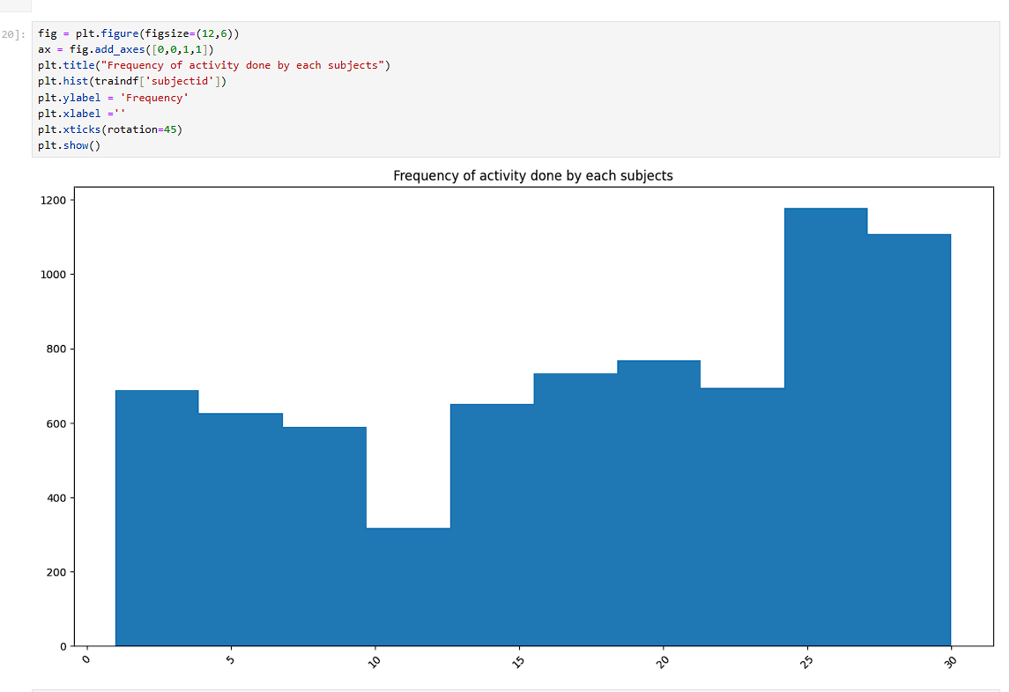

Slide 15
STEP 6 – Converting train / test data to cleaned & preprocessed CSV files
Now we have cleaned the train set / test set and we have in form of dataframe so we will export it into test/train csv files. Dataframe.to_csv() function will help us to do it.

Slide 16
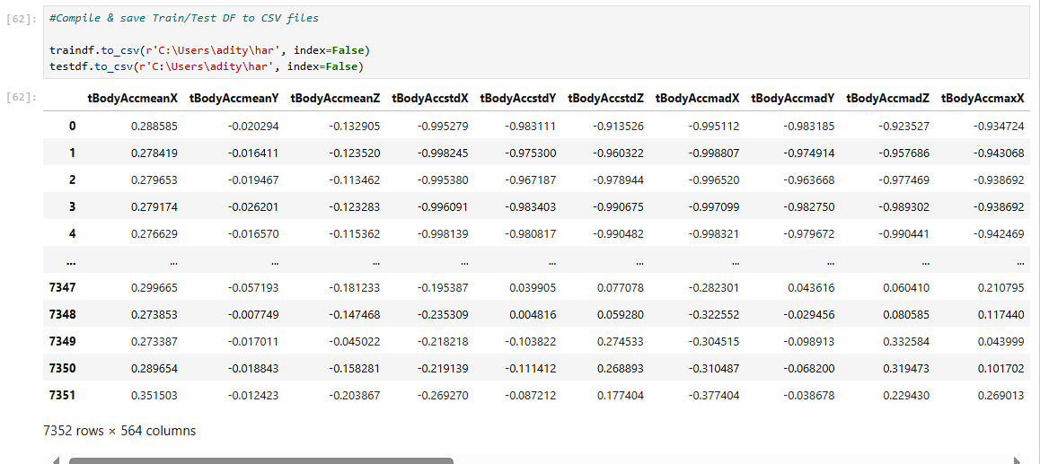

Slide 17
STEP 7 – Select Xtrain, Ytrain, Xtest, Ytest for training
We will select Xtrain by dropping last 3 columns 'subjectid','activity','activityname‘ as these do not contribute in training w.r.t target column ‘activity’.
We will select ytrain by selecting only, 'activity‘ as this is our target column to classifiy based on input features.
Same above process we need to do for Xtest, ytest, as we need to validate out trained model.

Slide 18
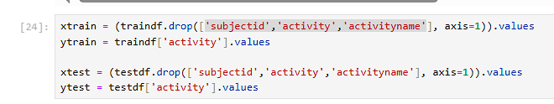

Slide 19
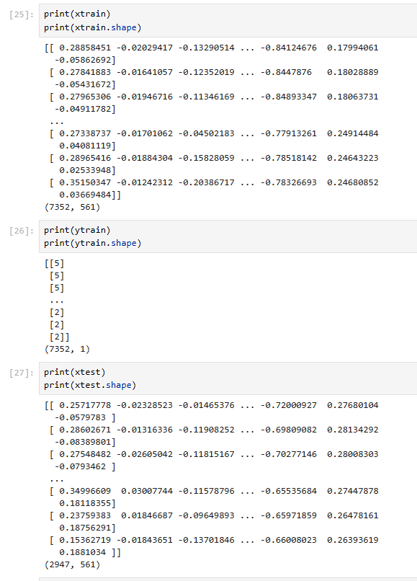
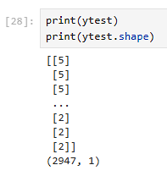

Slide 20
Step 8 – Model Algorithm selection.
As our problem is a classification problem , so we are going to train models on supervised classification algorithms. HERE ARE THE LIST OF ALGORITHMS I USED TO TRAIN SAME DATA.
‘Logistic regression', 'Naïve Bayes', 'KNN', 'SVC-RBF', 'SVC-LINEAR', 'Decision-Trees', 'Gadient Boosting Classifier' ,'Random Forest Classifier'

Slide 21
STEP 9 – Model Training
We will import respective classes of Algorithm and train them on (Xtrain, ytrain) using .fit() function .

Slide 22
STEP 10 – Predict labels on test data
By now we have trained our model on Xtrain, ytrain , now we need to see what labels output does our model give on Xtest. What ever results model is going to provide we will count it as ypred (predicted outcomes for Xtest)

Slide 23
STEP 11 - Model Performance Evaluation
As our model is a classifier , so for evaluation we will use confusion matrix which actually counts Number of correct / incorrect labels in ypred and ytest, by calculating TP,TN, FP, FN
We will also use accuracy score class which is inbuilt in sklearn library.

Slide 24
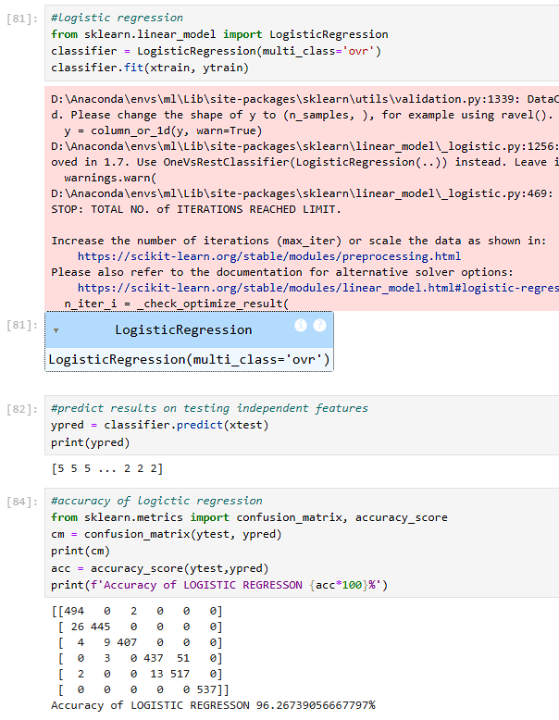
LOGISTIC REGRESSION

Slide 25
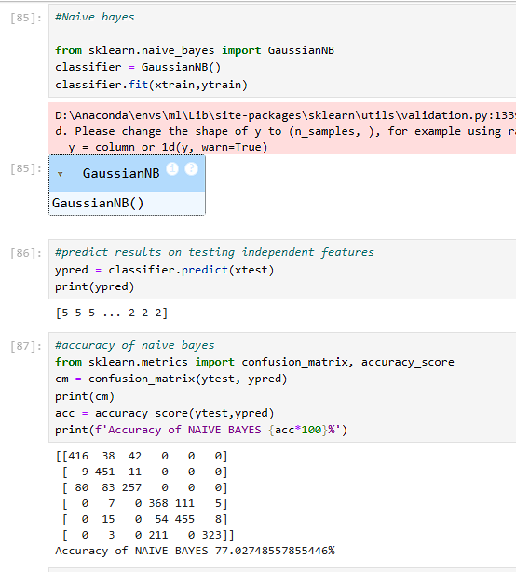
Naïve Bayes

Slide 26
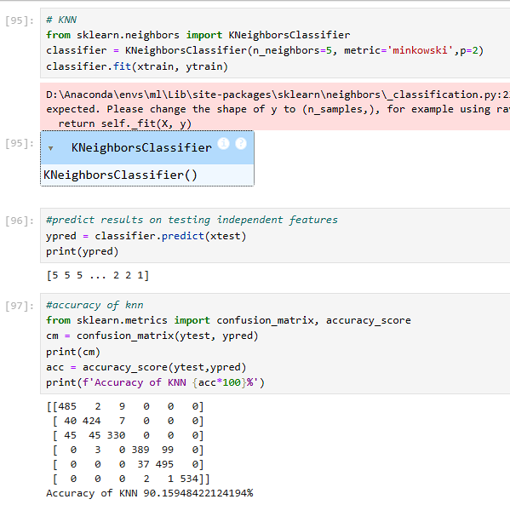
KNN – K nearest Neighbor

Slide 27
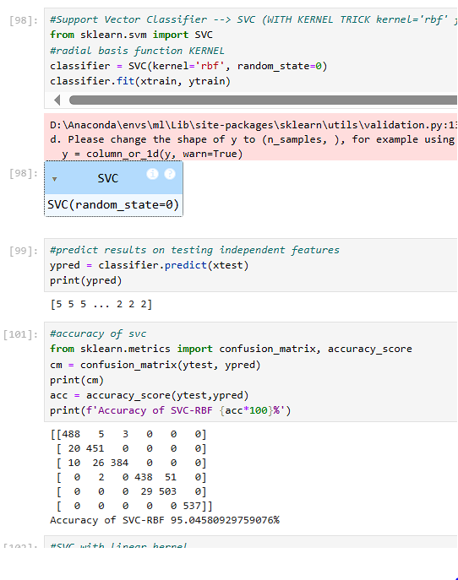
Support Vector Classifier - RBF

Slide 28
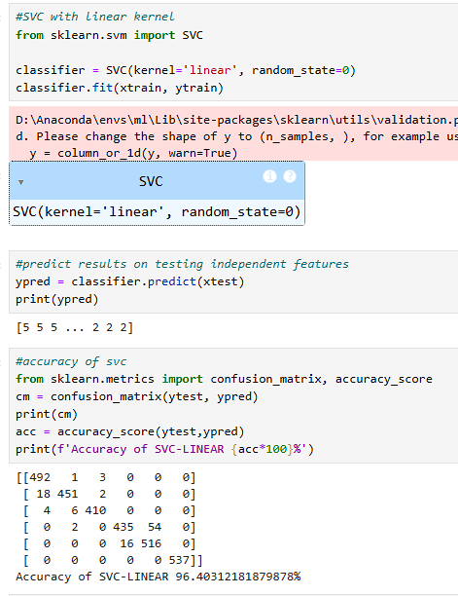
Support Vector classifier – linear kernel

Slide 29
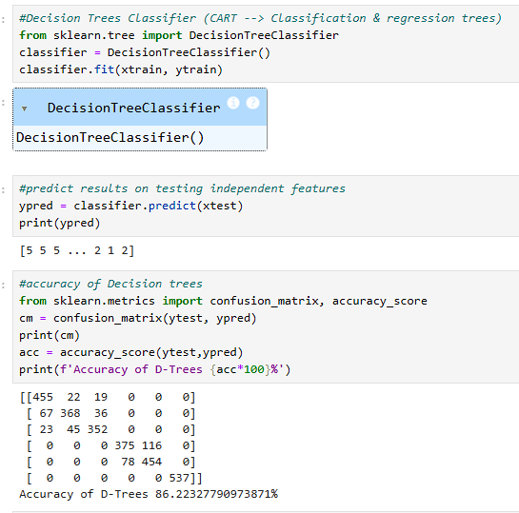
Decision Tree Classifier

Slide 30
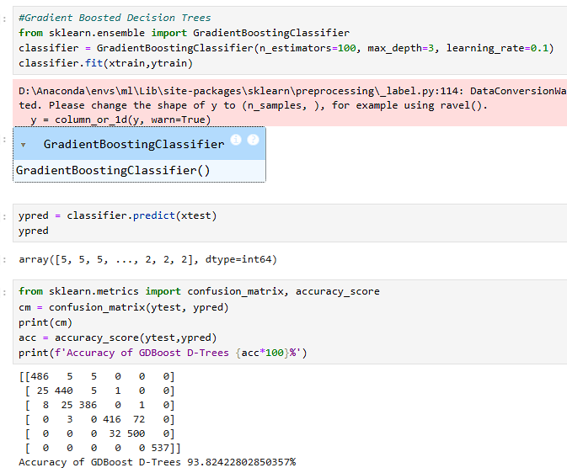
Gradient Boosting Classifier

Slide 31
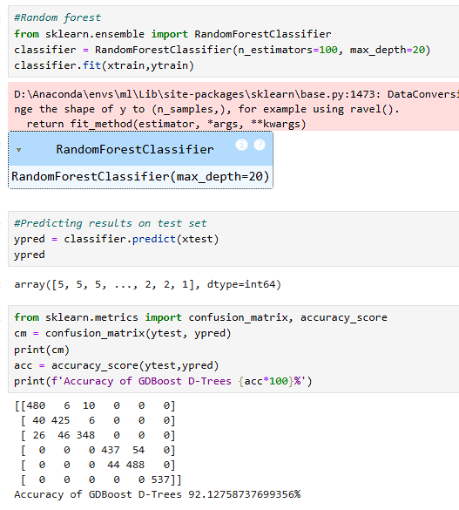
Random Forest

Slide 32
STEP 12 – Model comparison & Model selection
Till now we have trained our model using different algorithms , and which ever algo is performing best we will surely select that as the probability of given incorrect label will be vey less.

Slide 33
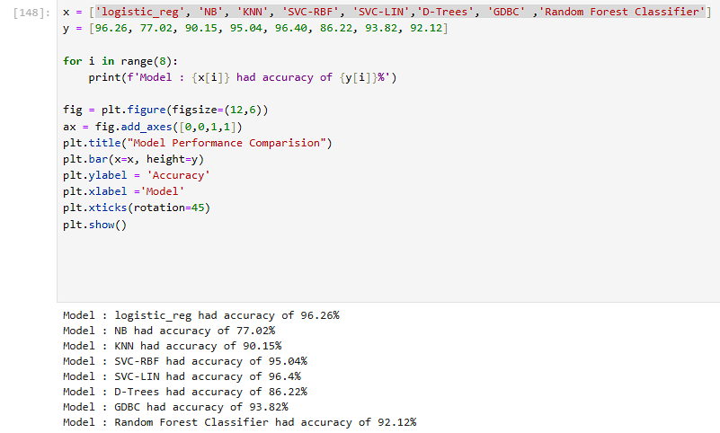

Slide 34
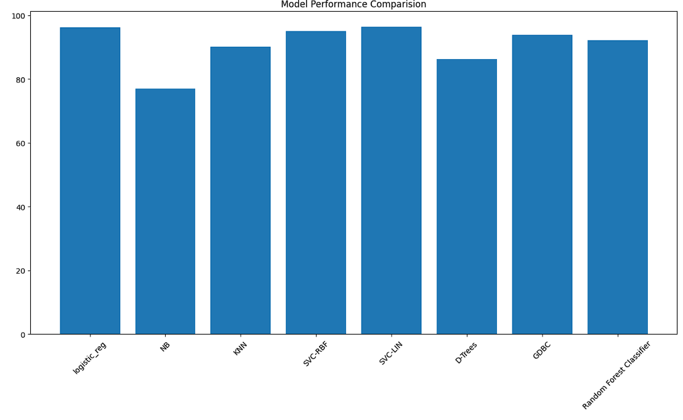

Slide 35
THANK YOU

