Slide 1

Toronto City Food Analysis

Slide 2
Toronto City is visited by people from different places all over the world. Many people would like to explore different cuisines which are available in the city. Analysis of different Neighborhoods would be helpful in finding out what kind of food options are available.

Slide 3
Data Acquisition
Data Description: Data Link : https://en.wikipedia.org/wiki/List_of_postal_codes_of_Canada:_M
Latitude and Longitude locations were collected from Geospatial_Coordinates.csv for each of the postal code.
Foursquare API Data: Information related to all the neighborhood Venues and Venue Category is obtained by making call to the foursquare api.
The data retrieved from Foursquare contained information of venues within a specified distance of the longitude and latitude of the postcodes.

Slide 4


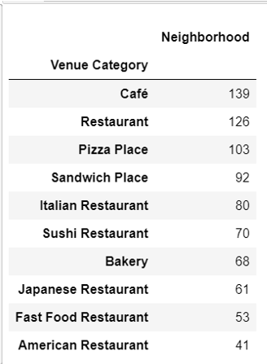



Sample Data of Food Options

Slide 5
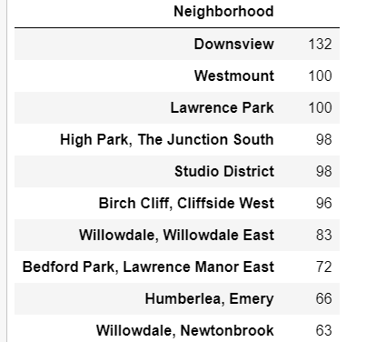
Top 10 Neighborhoods with most Venue Categories

Slide 6
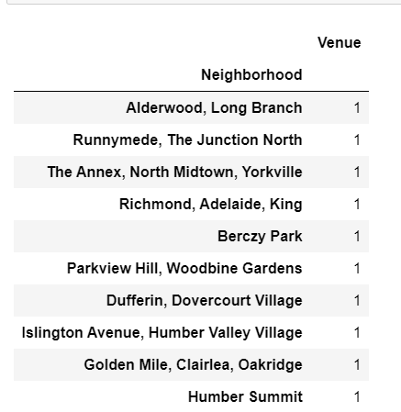
Neighborhoods with least number of Venue Categories

Slide 7
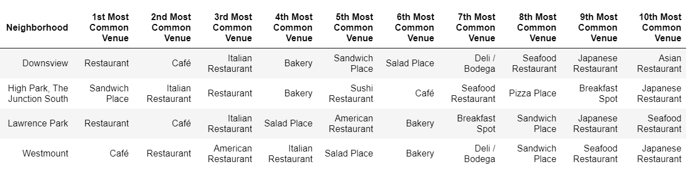
Most Common Type of Venue Categories in top Neighborhoods

Slide 8
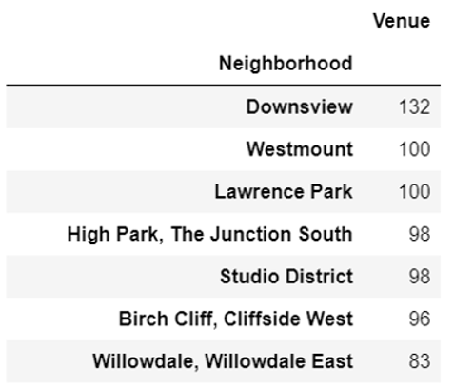
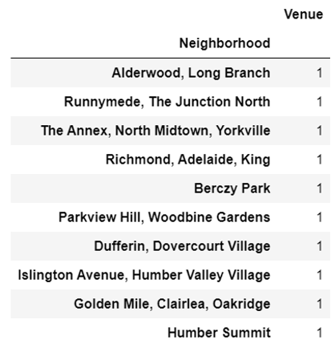
Conclusion
Most number of venues in terms of neighborhood
Least number of venues in terms of neighborhood

