Slide 1
D
DHAAL
Digital Harm Analysis & Alert Layer
A real-time AI shield against digital-arrest & UPI scams — active in the two minutes the scam is actually happening.
ET AI Hackathon 2.0 · Problem Statement 6 — AI for Digital Public Safety
Live demo: dhaal-eta.vercel.app · API: aditya501gupta-dhaal-api.hf.space
Notes:
DHAAL is a real-time, explainable AI shield that tells a citizen whether a message or call is a scam — and exactly why — in the seconds the scam is happening. Live today.

Slide 2
THE PROBLEM
A ₹22,495 crore crime wave — every phone is a target
Where the money goes (share of 2025 losses)
₹22,495
Investment / trading scams
76%
CRORE
Digital-arrest scams
9% ≈ ₹2,000 Cr
lost by Indians to cyber fraud in 2025 — across 28.15 lakh reported cases, a 24% jump in a single year.
Other: UPI, KYC, task, romance
15%
Source: I4C / NCRP national data, 2025
1 in 5 UPI users has faced fraud — and 51% never report it.

Slide 3
WHY TODAY'S DEFENSES FAIL
By the time a bank or the police can act, the money is gone
1
2
3
The window is ~2 minutes
The victim is isolated
Help is post-mortem
The scam is a live performance — authority, fear, urgency, secrecy — engineered to make a person act before they can think.
“Don't tell anyone, stay on the call.” The one moment a second opinion would help is the exact moment it's designed away.
Blocklists, 1930 and bank freezes all act after the transfer. Nothing intervenes in the citizen's hand, in their language, in the moment.
DHAAL closes exactly that gap — a second opinion in the seconds that matter.

Slide 4
THE SOLUTION
One shield, three layers
L1
Citizen Shield
L2
Intelligence
L3
Command Centre
Paste, share or screenshot any message → an explained verdict in seconds: scam or not, the manipulation tactics, official advice, and a ready-to-file 1930 complaint. 6+ languages.
PII-redacted reports cluster into fraud campaigns via script embeddings + HMAC-pseudonymised indicators — early warning after as few as 5 reports.
Geospatial hotspots, campaign explorer and SHA-256 hash-chained evidence dossiers with BSA s.63-style certificates for investigators.
Live today: Layer 1 is deployed and running. Layers 2–3 are the build-out.

Slide 5
LIVE TODAY — NOT A MOCKUP
Open it on your phone right now
✓
Verdict in under 3 seconds
🛡 DHAAL
Paste any SMS / WhatsApp / email — get SCAM · SUSPICIOUS · SAFE with a confidence score.
“This is FedEx. Your parcel has illegal items. Mumbai Police issued an arrest warrant…”
✓
Scam anatomy, in their words
The manipulative phrases are highlighted inside the message, with the tactics named.
🚨 SCAM
✓
English ⇄ हिंदी
digital arrest · 98%
Whole interface, samples and warnings switch language in one tap.
authority impersonation
fear + urgency
isolation
payment pressure
✓
One-tap 1930 complaint
Auto-drafts a cybercrime.gov.in / 1930-ready complaint, and a share-warning for family.
Draft 1930 complaint
Try it: dhaal-eta.vercel.app · API + live docs: aditya501gupta-dhaal-api.hf.space/docs

Slide 6
DESIGNED FOR THE PEOPLE SCAMMERS TARGET MOST
Consent-first, family-aware, and built for elders
🔐
👪
🔎
📲
🛡
Consent first
Family guardian
Easy-view mode
Install as an app
Native SMS shield
A 6-language onboarding screen with an explicit “what DHAAL will never do” promise. Every scan is opt-in and off by default.
Set a trusted relative. On a SCAM verdict the phone vibrates and offers a one-tap WhatsApp / call warning to them.
One switch enlarges text and buttons for elderly users — the people digital-arrest gangs target most.
Add-to-home-screen PWA — opens like a native app, no store needed, works on any phone.
The Android build scans incoming SMS in the background and fires a vibrate + alert even when the app is closed.
Privacy: message and call text is analysed over HTTPS and never stored on the device — consent is built in, not bolted on.

Slide 7
UNDER THE HOOD
How a verdict is built — four signals, honestly fused
1
2
3
4
Rules
→
Forensic Agent
→
LLM reasoning
→
Calibrated fusion
Deterministic & explainable. 8 scam classes via manipulation-lever combinations + benign guardrails.
Live URL threat-intel (Safe Browsing + URLhaus) plus look-alike / punycode heuristics.
Llama-3.3-70B on Groq → Gemini fallback. Injection-hardened, schema-validated, cached.
Combines all three; max disagreement → SUSPICIOUS + human-review flag. Never over-claims.
SSRF-safe by design: the Forensic Agent never fetches or opens the scammer's link — it only asks trusted threat databases about it, and strips any victim PII from the URL before it ever leaves the box.

Slide 8
DOES IT ACTUALLY WORK?
IndiaScam-Bench — measured, and reproduced on every commit
98%
98%
2%
103
labelled samples
73 scam / 30 benign
EN · HI · Hinglish
scam recall
precision
false-positive rate
Honest caveat: we report a conservative ~98% / ~98% / ~2% rather than a “perfect” score — live traffic is harder than any fixed benchmark. The deterministic floor re-runs in CI on every push, so the numbers can't silently rot.
Detects 8 scam classes: digital arrest · KYC/re-verify · UPI collect · task/investment · loan · lottery · sextortion · delivery-OTP.

Slide 9
TRUST IS THE PRODUCT
Safe & private by design
✓
No SSRF hole
✓
PII never leaves the box
Treats every link as an untrusted string — never fetches or resolves it. Private/loopback hosts are flagged, never contacted.
Query strings carrying phone numbers, OTPs and tokens are stripped before any third-party lookup.
✓
Prompt-injection hardened
✓
DPDP-mapped & pseudonymised
Message content is data, never instructions — the LLM can't be hijacked by text inside the scam.
Consent-based, auto-redaction before storage, HMAC-only indicators — no raw scammer identifiers in the graph.
A misbehaving or offline feed degrades gracefully to offline heuristics — it can never crash a verdict.

Slide 10
WHY IT SCALES
Built to reach every phone — at near-zero marginal cost
₹0
6+
Any
infrastructure cost
languages
channel
Groq, Gemini, Vercel & Hugging Face free tiers — the rules engine is dependency-free.
Explainable output in the citizen's own language — designed for Bharat, not just metros.
SMS, WhatsApp, email, screenshots and (next) live-call audio — one verdict engine behind all of them.
The prize isn't detection accuracy alone — it's putting an explainable second opinion in the hand of the person on the call, before the transfer. That is a public-safety utility, not a product.

Slide 11
WHAT'S NEXT
From a working shield to a national early-warning system
1
2
3
4
NOW
NEXT
THEN
SOON
L1 shield + native app
L2 campaign clustering
L3 command centre
More languages + on-device
6-language app, consent, guardian alerts, elderly mode, hybrid API and a native Android SMS shield — all live, CI-green.
Script-embedding clusters raise an early warning after ≤5 reports.
Geo hotspots + SHA-256 hash-chained evidence dossiers for police.
Bengali/Tamil/Telugu/Marathi corpus, and on-device live-call alerts.
Already done: IndiaScam-Bench grown to 673 samples with a temporal hold-out; 100% recall on the real hold-out, and survived a 32-case red-team.

Slide 12

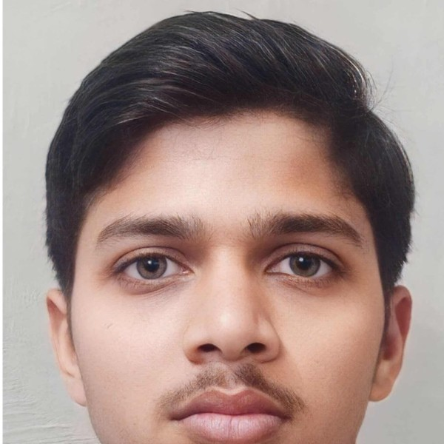
THE TEAM
Team DHAAL
Aditya Gupta
Gaurav Vishwakarma
Two builders · one shield — an explainable, privacy-first AI defence against digital-arrest & UPI fraud.
ET AI Hackathon 2.0 · PS-6 · AI for Digital Public Safety

Slide 13
D
A shield in the two minutes
that actually matter.
Rules + Forensic Agent + LLM, honestly fused — explainable, private, and live today.
CITIZEN APP
LIVE API + DOCS
CODE
dhaal-eta.vercel.app
aditya501gupta-dhaal-api.hf.space/docs
github.com/aditya501gupta/dhaal
Team DHAAL · ET AI Hackathon 2.0 · PS-6 · AI for Digital Public Safety
Notes:
Close: DHAAL is explainable, private, and live today. The differentiator is intervention in the moment, in the citizen's language — a public-safety utility.

