Slide 1
Relational Database Systems: Why?
Notes:
Today we will open the main topic of this class, which is databases. Before we start talking about databases do you have any questions about what we have done so far? Do you have any questions about the homework?
In todays world, databases are used practically in every system. Pretty much any website is built up on top of a database. All organizations (banks, hospitals, universities etc) have their own databases. So we will start with the definition. Anyone want to try? What is the first thing that comes in mind when you hear the word “database”?

Slide 2
Why do we need databases?

Slide 3
Databases vs. Spreadsheets
When should you use a database instead of Excel?
Insertion anomalies
Deletion anomalies
Update anomalies
Notes:
Talk about the anomalies
Then show how to organize in separate tables

Slide 4
Anomalies in un-normalized data
Insertion anomalies
Inability to insert a piece of information about an object without having to insert a (bogus) piece of information about something else
Example: Adding a new customer/book before it is ordered How can you add the book “Harry Potter” in the file below?
Notes:
Go through the table in the previous slide and find the problems encountered when one wants to insert, delete, or update data in it.
Talk about Anomalies
Write down an example of one anomaly (individual then consult pairs).

Slide 5
The $3.3 billion insertion anomaly error
Insertion anomalies
Real Example: https://deadbar.com/greece/it-was-found-that-the-retired-cretan-owed-to-the-tax-administration-3-billion-euros/
In 1995, pensioner recorded to owe “999,999,999,999” Greek drachmas (the amount used whenever the exact amount was unknown)
In 2001, Greece transitions to Euro.
The “999,999,999,999” becomes 2,941,176,470 euros (~$3.3 billion)
Government moves forward assuming ~€3B as “accounts receivable” (probably assuming some huge corporation owed that amount)
Government realizes that the €3B was a figment of imagination
Notes:
Go through the table in the previous slide and find the problems encountered when one wants to insert, delete, or update data in it.
Talk about Anomalies
Write down an example of one anomaly (individual then consult pairs).

Slide 6
Anomalies in un-normalized data
Deletion anomalies
The loss of a piece of information about one object when a piece of information about a different object is deleted
Example: Deleting order 2 => deleting customer Lee Sproull
Example: Deleting order 1 => deleting book “Code…”
Notes:
Go through the table in the previous slide and find the problems encountered when one wants to insert, delete, or update data in it.
Talk about Anomalies
Write down an example of one anomaly (individual then consult pairs).

Slide 7
Anomalies in un-normalized data
Update anomalies
Need to change multiple times the same piece of information about an object
Example: Changing Jeff Bezos address in order 1 leaves orders 6 and 8 unchanged…
Notes:
Go through the table in the previous slide and find the problems encountered when one wants to insert, delete, or update data in it.
Talk about Anomalies
Write down an example of one anomaly (individual then consult pairs).

Slide 8
The “normalized” version of the spreadsheet
Corresponding ER diagram
Entities: Customer, Book
Relationship: Customer orders Book (many-to-many)
Customer table
Book table
Orders table (“bridge” table, implementing many-to-many relationship)
Notes:
Go through the table in the previous slide and find the problems encountered when one wants to insert, delete, or update data in it.
Talk about Anomalies
Write down an example of one anomaly (individual then consult pairs).

Slide 9
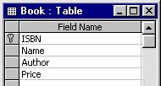
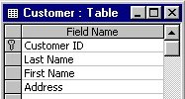
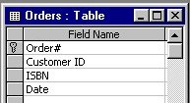
The “normalized” version of the spreadsheet
Normalization
All data stored in tables (similar to spreadsheet “worksheets” but more rigid)
Each cell contains a single value (e.g., no list of “orders” in cell)
Prevents insertion, deletion and update anomalies
Notes:
Go through the table in the previous slide and find the problems encountered when one wants to insert, delete, or update data in it.
Talk about Anomalies
Write down an example of one anomaly (individual then consult pairs).

Slide 10
Database schema
Primary, keys, foreign keys, relationships, oh my…
The tables in your database, along with each of their fields, keys
The relationships between the tables
Primary key
Primary key
Primary key
Foreign key
Foreign key

Slide 11
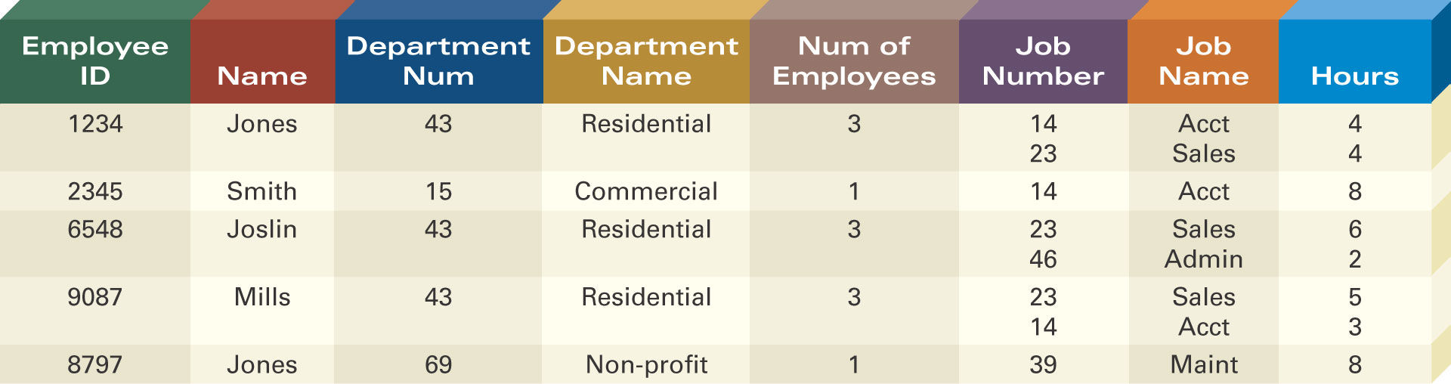
Defining Entity Classes and Primary Keys
What are the entity classes and primary keys for the report below?
What entities/tables should we create?
Are there fields that are redundant once you create the tables?

