Slide 1
Creating Tables in SQL

Slide 2
SQL Statements to create tables
CREATE TABLE table_name
(
column_name1 data_type(size),
column_name2 data_type(size),
column_name3 data_type(size),
....
);

Slide 3
SQL Statements to create tables
CREATE TABLE Rate ( id INT, name VARCHAR(20), price FLOAT, startdate DATE );

Slide 4
Define primary key
CREATE TABLE Rate ( id INT, name VARCHAR(20), price FLOAT, startdate DATE,
PRIMARY KEY(id)
);

Slide 5
Define FOREIGN KEY
CREATE TABLE Rate ( id INT,
customerid INT, price FLOAT, startdate DATE,
PRIMARY KEY(id)
FOREIGN KEY (customerid) REFERENCES Customer(id) );

Slide 6
“Enforcing participation” in a relationship
To specify that a relationship has a minimum cardinality of one, we specify that the attribute cannot be NULL (ie empty)
In this case, the rate needs to be associated with a customer
CREATE TABLE Rate ( id INT,
customerid INT NOT NULL, price FLOAT, startdate DATE,
PRIMARY KEY(id),
FOREIGN KEY (customerid) REFERENCES Customer(id) );

Slide 7
“Enforcing 1-1” in a relationship
To specify that a relationship has a maximum cardinality of one, we specify that the foreign key is UNIQUE
In this case, the rate needs to be associated with a customer, and a customer can be assigned with only one rate (due to the UNIQUE)
CREATE TABLE Rate ( id INT,
customerid INT NOT NULL, price FLOAT, startdate DATE,
PRIMARY KEY(id),
UNIQUE (customerid),
FOREIGN KEY (customerid) REFERENCES Customer(id) );

Slide 8

Facilitating the process in practice
MySQL Workbench many of these steps for you:
Create the ER diagram
Go to Database -> Forward Engineer -> Follow the instructions
Your database schema is (almost) ready!
Often, you need to fine-tune the output based on what we learned

Slide 9
Importing Data into Tables
Option 1: INSERT statements
INSERT INTO Rate VALUES (1023, ‘Winter Promotion’, 2.25, 2020-01-15), (1054, ‘Regular Rate’, 3.25, 2015-01-15), (1076, ‘Senior Discount’, 1.95, 2015-01-15)

Slide 10
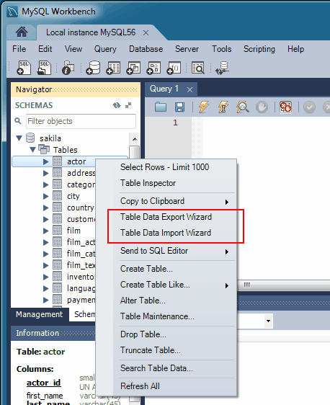
Importing Data into Tables
Option 1: INSERT statements
INSERT INTO Rate VALUES (1023, ‘Winter Promotion’, 2.25, ‘2020-01-15’), (1054, ‘Regular Rate’, 3.25, ‘2015-01-15’), (1076, ‘Senior Discount’, 1.95, ‘2015-01-15’)
Option 2: MySQL Workbench Data Import Wizard
https://dev.mysql.com/doc/workbench/en/wb-admin-export-import-table.html

