Slide 1
SQL

Slide 2

Intro
“S.Q.L.” or “sequel”
Supported by all major commercial DBMS
Standardized
Interactive via GUI or command line, or embedded in programs (e.g., in Python programs)
Declarative
Notes:
When sequel is used, you can use it through GUIs in databases or through programs, for example python programs that directly interact with the database.
SQL is declerative, in the sense that you just declare what you need , and no how to get it.

Slide 3
Terminology
Data Definition Language (DDL)
Create Table
Drop Table
Indexes
Data Manipulation language (DML)
Select
Insert
Delete
Update
Other Commands
constraints, views, triggers etc.

Slide 4
Choosing a database in MySQL
SHOW DATABASES;
Lists the available databases in MySQL
USE <database>;
Chooses which database to work with
Example: USE imdb;
SHOW TABLES;
Lists the tables in the database
DESCRIBE <table>;
Lists the attributes and data types for a table

Slide 5
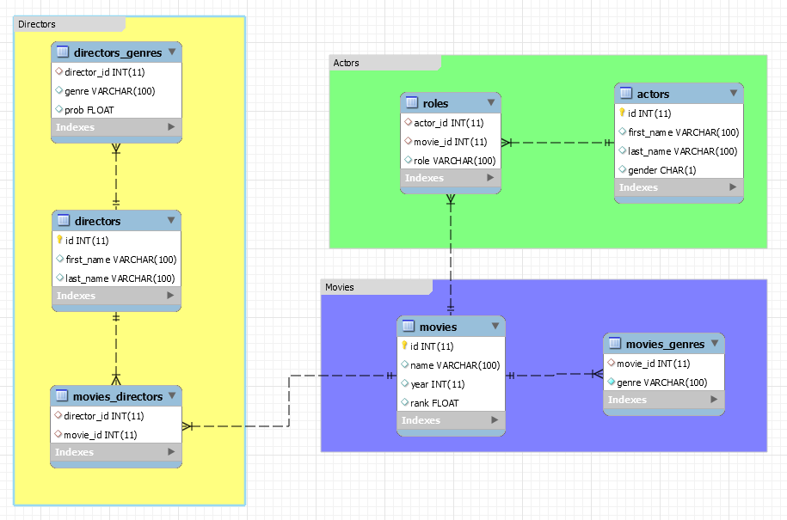
Example 1: IMDB

Slide 6
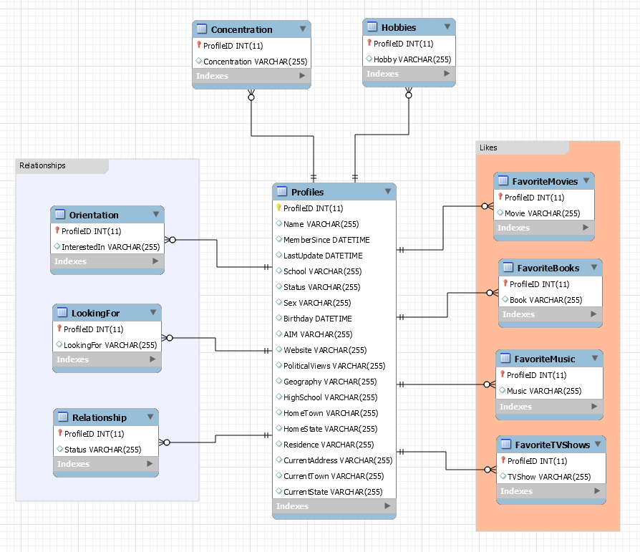
Example 2: Facebook

Slide 7
The SELECT statement
SELECT A1 , A2, A3, …, An
FROM T1, T2, … Tm
WHERE condition
ORDER BY A1 [ASC|DESC], A2 [ASC|DESC]
What to return
Tables (or “relations”)
Combines/Filters
Sort
The result of a query is a relation.
Note that a table is always a relation, but not vice versa.

Slide 8
The SELECT statement
SELECT *
FROM TableName

Slide 9
Practice queries
IMDB Database (“use imdb;”)
Return all movies
Return all directors
Return all actors
Return all roles
Return all genres for the movies
Facebook Database (“use facebook;”)
Return all students

Slide 10
Practice queries
Facebook Database (“use facebook;”)
Return all students
Return the hobbies of all students
Return the relationship status for all students
Return what students are looking for

Slide 11
The SELECT statement
SELECT A1 , A2, … ← Columns to return
FROM TableName

Slide 12
Practice queries
IMDB Database (“use imdb;”)
Return the first and last names of actors
Return year and ranking for each movie
Facebook Database (“use facebook;”)
Return Name, Sex, and Birthday of all students
Return Sex, and Political Views of all students
Return the Relationship status column

Slide 13
The SELECT statement: The AS clause
Sometimes we want to rename a column to have a more descriptive name in the results.
SELECT A1 AS Name1, AS2, …AS Name2, …
FROM TableName

Slide 14
Practice queries
IMDB Database (“use imdb;”)
Return id, first, and last names of actors. Rename id to “actor_id”
Return name, year, and rank for each movie. Rename name to “movie_title”, year to “release_year”, and rank to “rating”
Facebook Database (“use facebook;”)
Return Sex and Status of all students. Rename Sex to Gender and Status to UniversityStatus

Slide 15
The SELECT DISTINCT statement
Used to eliminate duplicates in the results.
SELECT DISTINCT A1 , A2, A3, …, An
FROM TableName

Slide 16
Practice queries
IMDB Database (“use imdb;”)
Find all the movie genres
Facebook Database (“use facebook;”)
Return the distinct PoliticalViews from the Profiles table
Return the distinct Sex values from the Profiles table
Find what students are “LookingFor”
Find all possible “Relationship” statuses
Find all possible Concentrations

Slide 17
The ORDER BY and LIMIT clause
ORDER BY: Used to sort the result rows based on attribute values
Can order in ascending (ASC, default) or descending (DESC) order
We can list multiple attributes for ordering. We order first using the first attribute, and if there are ties, we order using the second, etc.
Potentially useful tip: the “order by” attributes do not need to appear in the results
LIMIT n: Limits the number of rows in the results
OFFSET m: Omit the first m rows of the result, fetch the next n
MySQL Workbench limits all queries to 1000 rows by default
Different databases use different ways to say “LIMIT”
SELECT A1 , A2, A3, …, An
FROM TableName
ORDER BY A1 [ASC|DESC], A2 [ASC|DESC],…
LIMIT N [OFFSET M]

Slide 18
Practice queries
IMDB Database (“use imdb;”)
Find the top-10 ranked movies
Rank by “rank” first (descending order)
Break ties using “year”
Break remaining ties using “name”
List all the distinct years of the movies, in descending order
Facebook Database (“use facebook;”)
List the first 50 students that joined Facebook at NYU (use the “MemberSince” attribute)
List the 10 students that have not updated their profiles for the longest time (use the “LastUpdate” attribute)

Slide 19
The WHERE clause
The WHERE clause defines which rows will appear in the results.
SELECT A1 , A2, A3, …, An
FROM T1
WHERE condition
ORDER BY A1 [ASC|DESC], A2 [ASC|DESC]

Slide 20
Equality Conditions
Condition | Description | Example
attr = ‘text’ | Equality comparison for a textual attribute | gender = ‘Male’
attr = number | Equality comparison for a numeric attribute | year = 2006

Slide 21
Practice WHERE queries: IMDB
Equality Queries
Find the movie entry with id 64729.
Find the movie entry with movie title ‘Pulp Fiction’
Find the id of the movie “Schindler's List”. (Attention to the quote)
List all the roles for the movie with id 290070. Sort them alphabetically

Slide 22
Boolean Conditions
Condition | Description | Example
attr = ‘text’ | Equality comparison for a textual attribute | gender = ‘Male’
attr = number | Equality comparison for a numeric attribute | year = 2006
cond1 AND cond2 | Both conditions should hold
cond2 OR cond2 | At least one of the conditions should hold

Slide 23
Practice WHERE queries: IMDB
Boolean queries
Fetch all info for actresses (female gender) whose first name is Skyler
Fetch all info for the director Steven Spielberg
Fetch all info for the directors with last names Scorsese, Polanski, and Spielberg. Use the OR for your Boolean query.
Fetch all info for the directors Quentin Tarantino, Stanley Kubrick, and Orson Welles.

Slide 24
Inequality Conditions
Condition | Description | Example
attr = ‘text’ | Equality comparison for a textual attribute | gender = ‘Male’
attr = number | Equality comparison for a numeric attribute | year = 2006
cond1 AND cond2 | Both conditions should hold
cond2 OR cond2 | At least one of the conditions should hold
attr <> value attr != value | Attribute is not equal to value | genre <> ‘Drama’ genre != ‘Drama’
attr > value | Attribute is greater than value | rating > 7.8
attr < value | Attribute is smaller than value | year < 1900
attr >= value | Attribute is equal or greater than value | year >= 1900
attr <= value | Attribute is equal or smaller than value | year <=1900

Slide 25
Practice WHERE queries: IMDB
Inequality Queries and Boolean
Find all information about movies that were released before 1895 (excl)
Find all information about movies released between 1895 and 1898 (excl)
Try both using Boolean operators and using the BETWEEN operator
Find all information about movies that were released before 1895 and after 2006 (inclusive)

Slide 26
IN Conditions
Condition | Description | Example
attr = ‘text’ | Equality comparison for a textual attribute | gender = ‘Male’
attr = number | Equality comparison for a numeric attribute | year = 2006
cond1 AND cond2 | Both conditions should hold
cond2 OR cond2 | At least one of the conditions should hold
attr <> value attr != value | Attribute is not equal to value | genre <> ‘Drama’ genre != ‘Drama’
attr > value | Attribute is greater than value | rating > 7.8
attr < value | Attribute is smaller than value | year < 1900
attr >= value | Attribute is equal or greater than value | year >= 1900
attr <= value | Attribute is equal or smaller than value | year <=1900
attr IN (x1, x2, x3, …) | Attribute value is either x1, or x2 or x3, or … | genre IN (‘Drama’, ‘Comedy’)
attr NOT IN (x1, x2, x3, …) | Attribute value is not x1, nor x2, nor x3, … | genre NOT IN (‘Adult’, ‘War’)

Slide 27
Practice IN queries: IMDB
IN queries
Fetch all info for the directors with last names Scorsese, Polanski, and Spielberg. Use “IN” for your Boolean query.
SELECT * FROM directors WHERE last_name IN ( 'Scorsese’, ‘Spielberg’, ‘Polanski’ );
Fetch all info for the directors Quentin Tarantino, Stanley Kubrick, and Orson Welles. Use “IN” for your Boolean query.
SELECT * FROM directors WHERE (first_name, last_name) IN (
(‘Quentin’, ‘Tarantino’), (‘Stanley’, ‘Kubrick’), (‘Orson’, ‘Welles’)
);

Slide 28
Need for approximate queries
IMDB Queries
Find the entry for Alfred Hitchcock
Hint: Query using only the last name, and notice his first name
Find the entries for the Godfather movies, released in 1972, 1974, and 1990
Hint: The actual names for the movies are
“Godfather, The”
“Godfather: Part II, The”
“Godfather: Part III, The”

Slide 29
LIKE
LIKE allows to write simple approximate queries
“%” to match an arbitrary number of characters
Example: Find all movies that start with B
SELECT *
FROM movies
WHERE name LIKE “B%”;
“_” to match any single character
Example: Find all movies with names starting with B, being exactly 5 characters long, and ending with B
SELECT *
FROM Profiles
WHERE name LIKE “B__B”;

Slide 30
LIKE: Practice queries
IMDB Queries
Find the entry for Alfred Hitchcock
Hint: Use an approximation for his first name
Find the Godfather movies, released in 1972, 1974, and 1990

Slide 31
The NULL value
When columns do not have a value, they are assigned a “NULL” value, which is a special way that SQL handles the “empty value”
To check if something is NULL you use the expression: “attr IS NULL”
Example: Find all movies that do not have a rating
SELECT * FROM movies
WHERE rating IS NULL
Similarly, you use “attr IS NOT NULL” is you want only results that have non-NULL values

Slide 32
Incorrect approaches when using NULL
NULL is not equal to empty string. The query below will NOT work
SELECT * FROM movies WHERE rank = '';
We do not use = to compare with NULL. The query below will NOT work
SELECT *
FROM movies
WHERE rank = NULL;

Slide 33
Floating Point Bizarreness
In SQL, and in many computer languages, handling decimal numbers tends to be strange, due to the limited accuracy when storing floating point numbers.
SELECT * FROM movies WHERE rank > 7.8
SELECT * FROM movies WHERE rank = 7.8
SELECT * FROM movies WHERE rank LIKE 7.8

Slide 34
Practice queries
Facebook Queries
Find all students who live in “Weinstein Hall”
Find all students with first name “Richard”
Find all students with first names starting with P and last names starting with I (e.g. Panos Ipeirotis)

Slide 35
Practice queries
Get the names and sex of all liberal students
Get the names, sex, and political views of liberal and very liberal students
Find all possible values for the “Residence” attribute in Profiles, eliminating duplicates. Make the limit 10,000 so that you can see all entries

Slide 36
REGEXP
REGEXP allows a standard regular expression query
Example: Find all names that contain a digit
SELECT *
FROM Profiles
WHERE name REGEXP '[0-9]+'

Slide 37
Practice queries
Write down three queries that you would like to answer
(Ensure that the information exists in a single table, for now)
Let’s answer them in class…

Slide 38
Go to the Facebook database
Find all the students that have New York as the home state.
Deal with all the different ways that students have written New York in the “HomeState” attribute

Slide 39
Joins
A SQL join clause combines records from two or more tables in a database. (Wikipedia)

Slide 40
The need for joins: Currently awkward queries
Use the table directors_genres and find all genres of films and the corresponding probabilities for the director ID that corresponds to Steven Spielberg. Sort the results by probability.

Slide 41
Joins
Student Has Class
Class
Student_id | Class Id | Grade
1 | 1 | 19
2 | 1 | 16
3 | 1 | 20
2 | 2 | 18
1 | 3 | 19
1 | 4 | 14
Class_id | Class
1 | Algebra
2 | Analysis
3 | Physics
4 | History
Question: Find the
class name for all the
classes that each student is taking.
SELECT student_id, class
FROM Student_Has_Class s
INNER JOIN Class c ON c.class_id = s.class_id

Slide 42
Result
Student_id | Class Id | Grade
1 | 1 | 19
2 | 1 | 16
3 | 1 | 20
2 | 2 | 18
1 | 3 | 19
1 | 4 | 14
Class_id | Class
1 | Algebra
2 | Analysis
3 | Physics
4 | History
Inner Join
on
Class_id
Student_id | Class
1 | Algebra
2 | Algebra
3 | Algebra
2 | Analysis
1 | Physics
1 | History

Slide 43
Simple Joins Practice Queries: IMDB
List all the movies and their genres
List the movie genres for the movies directed by Steven Spielberg and sort them in decreasing order of their probability (use the director_genres table)
List all the movies and their directors
List all the movies directed by Steven Spielberg

Slide 44
Joins Practice Queries: IMDB
List all the movies from year 2000
List all the movies from year 2000 and their genres
List all the Drama movies from year 2000
List all the Drama movies from year 2000 with ratings
List the top-50 Drama movies from year 2000, based on the ratings
List all the movies where there is an actor with the role ‘James Bond’
List the actors who played ‘James Bond’
List the actors who played ‘James Bond’ and the name of the movie
Rank the result by (a) rating, and (b) year
List all the movies where Brad Pitt is playing
Exclude the movies where he plays “himself”
Rank the result by (a) movie rating, and (b) year

Slide 45
Joins Practice Queries: Facebook
List all the Single students
List all the Single students who live in Palladium (as declared in the “Residence” attribute).
Allow for flexible matching of the “Residence” as people list Palladium in different manner (e.g “Palladium 101” vs “Palladium”)
List all the Single students LookingFor “random play”.
List their AIM and their gender in the results.
List all the students who have “The Killers” as favorite Music
List all the Finance students who like the book “1984”

Slide 46
Self Joins
List the movies in the database that have both drama and comedy listed among their genres
List the Profile IDs and for students majoring in computer science and another concentration (Concentration table); show the second concentration as well

Slide 47
Outer Join
Student_Has_Class
Class
Student_id | Class Id | Grade
1 | 1 | 19
2 | 1 | 16
3 | 1 | 20
2 | 2 | 18
1 | 3 | 19
1 | 4 | 14
Question: List the students for all the
classes.
Note: No class with class_id=5 exists in the Student_has_class table
Class_id | Class
1 | Algebra
2 | Analysis
3 | Physics
4 | History
5 | Calculus
SELECT student_id, class
FROM Class c LEFT OUTER JOIN Student_Has_Class s ON c.class_id = s.class_id
Refers to the table on the “left” side of the join: Class

Slide 48
Outer Join
Student_id | Class Id | Grade
1 | 1 | 19
2 | 1 | 16
3 | 1 | 20
2 | 2 | 18
1 | 3 | 19
1 | 4 | 14
Class_id | Class
1 | Algebra
2 | Analysis
3 | Physics
4 | History
5 | Calculus
Left outer Join
on
Class_id
Class | Student_id
Algebra | 1
Algebra | 2
Algebra | 3
Analysis | 2
Physics | 1
History | 1
Calculus | NULL
A left outer join returns all the values that an inner join returns, plus all values in the "left" table that do not match any entry to the right table.

Slide 49
Outer Joins Practice Queries
Important: Understand why we need an outer joins here
List all the movies without actors
List all the movies without an associated genre
List all the Students that have not listed a Concentration

Slide 50
Group By: Aggregation Queries

Slide 51
Aggregation Functions
count, sum, avg, min, max:
Applied to full content of columns
SELECT AggFunc1(attr1), AggFunc2(attr2), … FROM T1, T2, … Tm
WHERE condition

Slide 52
Basic aggregation functions
Operator | Description
count(*) | Counts the number of rows in the group
count(attr) | Counts the number of rows in the group with non-null values for the attribute
count(DISTINCT attr) | Counts the number of distinct, non-null values for the attribute in the group
max(attr) | Row with maximum attribute value in the group
min(attr) | Row with minimum value in the group
sum(attr) | Sums values of selected rows in the group
avg(attr) | Estimates the average the attribute in the group

Slide 53
Aggregation practice queries: IMDB
COUNT(*)
Find the number of movies in the database
Find the number of actors in the database
COUNT(attr)
Find the number of movies with a rating
Find the number of roles where the role is not empty
COUNT(DISTINCT attr)
Find the number of distinct genres in the database
Find the number of movies that have a genre associated with them
MIN(attr), MAX(attr), AVG(attr), STDEV(attr), SUM(attr)
Find the earliest release year and the latest release year for movies
Find the average rating of the movies and the standard deviation

Slide 54
Group by
count, sum, avg, min, max:
Applied to columns, split in groups of rows
SELECT A1,…, AggFunc1(attr1), …
FROM T1, T2, … Tm
WHERE condition
Group By A1,…
Note: Whatever attributes you list in SELECT (in this case A1,…) they must appear in the GROUP BY clause.

Slide 55
Group by Toy Example
Table1
SELECT Student_id, count(*)
FROM Table1
GROUP BY Student_id
Student_id | Class | Grade
1 | Algebra | 19
2 | Algebra | 16
3 | Algebra | 20
2 | Analysis | 18
2 | Physics | 13
1 | Analysis | 17
1 | Physics | 19
1 | History | 14
Student_id | Count
1 | 4
2 | 3
3 | 1

Slide 56
Group by Toy Example
Table1
SELECT Student_id, avg(Grade)
FROM Table1
GROUP BY Student_id
Student_id | Class | Grade
1 | Algebra | 19
2 | Algebra | 16
3 | Algebra | 20
2 | Analysis | 18
2 | Physics | 13
1 | Analysis | 17
1 | Physics | 19
1 | History | 14
Student_id | Avg(grade)
1 | (19+17+19+14)/4 = 17.25
2 | (16+18+13)/3 = 15.67
3 | 20

Slide 57
Group by Toy Example
Table1
SELECT Class, avg(Grade)
FROM Table1
GROUP BY Class
Student_id | Class | Grade
1 | Algebra | 19
2 | Algebra | 16
3 | Algebra | 20
2 | Analysis | 18
2 | Physics | 13
1 | Analysis | 17
1 | Physics | 19
1 | History | 14
Class | Avg(grade)
Algrebra | (19+16+20)/3 = 18.33
Analysis | (18+17)/2 = 17.5
History | 14
Physics | (19+13)/2 = 16

Slide 58
Aggregation example queries: IMDB Movies
Count the number of movies that were released in each year
Compute the average rank for the movies released in each year
Compute the min, max, and standard deviation of the movies in each year
Examine the difference between COUNT(*) and COUNT(rank) when reporting movies per year

Slide 59
Aggregation example queries: IMDB
Compute the number of movies per director ID,
Rank first the directors with the most movies
Compute the number of movies per actor ID,
Rank first the actors with the most movies
Compute the number of actors per movie ID
Rank first the movies with the most actors
Count the number of male actors and the number of female actors
Compute the number of movies for each genre

Slide 60
Aggregation practice queries: Facebook
List the number of males and females
List the number of students for each political view
List the number of males and female students for each political view
Find the most popular TV Shows and Books
Find the number of students in various relationship statuses
Find the most popular majors (concentration)
List the number of students per each birth year
Use the YEAR(date) function to get the year value from a datetime column
(Try to) List only years that have at least 10 students

Slide 61
Having
SELECT A1, Aggregation Function
FROM T1, T2, … Tm
WHERE condition
GROUP BY A1
HAVING Aggregation Function Condition

Slide 62
Group by Toy Example
Table1
SELECT Class, avg(Grade)
FROM Table1
GROUP BY Class
HAVING avg(Grade) > 15
Student_id | Class | Grade
1 | Algebra | 19
2 | Algebra | 16
3 | Algebra | 20
2 | Analysis | 18
2 | Physics | 13
1 | Analysis | 17
1 | Physics | 19
1 | History | 14
Class | Avg(grade)
Algrebra | (19+16+20)/3
Analysis | (18+17)/2
Physics | (19+13)/2
History class is not included in the result because its average is 14 (less than 15)

Slide 63
Group by Toy Example
Table1
SELECT Student_id, count(*)
FROM Table1
GROUP BY Student_id
HAVING count(*) > 2
Student_id | Class | Grade
1 | Algebra | 19
2 | Algebra | 16
3 | Algebra | 20
2 | Analysis | 18
2 | Physics | 13
1 | Analysis | 17
1 | Physics | 19
1 | History | 14
Student_id | count
1 | 4
2 | 3
Student with id=3 is not included in the results because he/she is taking only one class

Slide 64
HAVING practice queries: IMDB
Find the movies (just movie IDs) with more than 100 actors
Find the first names of actors that appear more than 1000 times

Slide 65
Differences of WHERE and HAVING
WHERE applies to rows
HAVING applies to aggregate value only
In a sense, HAVING is the “WHERE” for aggregate results

Slide 66
Differences of WHERE and HAVING
WHERE applies to rows, before computing the aggregate
Compare:
SELECT COUNT(*), COUNT(rank) FROM movies WHERE rank IS NOT NULL
Vs
SELECT COUNT(*), COUNT(rank) FROM movies

Slide 67
Another Example
SELECT first_name, COUNT(*)
FROM actors
GROUP BY first_name
HAVING COUNT(*)>1000;
SELECT first_name, gender, COUNT(*)
FROM actors
GROUP BY first_name, gender
HAVING COUNT(*)>1000;
SELECT first_name, gender, COUNT(*)
FROM actors
WHERE gender='F’
GROUP BY first_name
HAVING COUNT(*)>1000;

Slide 68
Integrated Examples

Slide 69
Joins + Group By Practice Queries
For each movie genre, list the average rating of the movies from year 2000. Also list:
the maximum and minimum ratings
the standard deviation of the ratings
the number of rated movies and the total number of movies
For each director, compute:
The number of rated and total number of movies
The average, min, max, and standard deviation of the movie ratings
Limit the results to directors who directed at least 40 movies, with at least 30 rated movies
What roles have the best movie ratings?
Do not include movies without ratings in the calculations for number of movies
Limit to only roles that appear in at least 10 distinct movies
Limit only to roles played by at least 10 distinct actors

Slide 70
Self-Joins + Group By Practice Queries
Find the most common double majors in the Facebook database
What are the favorite bands for students that like Radiohead?

Slide 71
Subqueries

Slide 72
Saving Queries: CREATE TEMPORARY TABLE
We can save the results of a query in order to reuse the results easier, using the “CREATE TEMPORARY TABLE” command.
Example:
CREATE TEMPORARY TABLE movies_all AS
SELECT R.*,
M.name AS title, M.year, M.rank AS rating,
A.first_name, A.last_name, A.gender
FROM roles R
JOIN actors A ON A.id = R.actor_id
JOIN movies M ON M.id = R.movie_id

Slide 73
CREATE TEMPORARY TABLE
CREATE VIEW
CREATE TABLE
CREATE TEMPORARY TABLE movies_all AS…
Creates a temporary table with the results of the query. Table is only visible within the session (until the user disconnects). Contents do not update if the underlying tables change.
CREATE TABLE movies_all AS…
This command creates a permanent table with the results of the query. It is visible to all users. Contents do not update if the underlying tables change.
CREATE VIEW movies_all AS…
A VIEW is similar to a TEMPORARY TABLE, but it is visible to everyone, it does not disappear. A view does not actually store the results, and the results are updated when the underlying table change. (There the concept of “materialized view” which stores the results and updates automatically, but not supported by MySQL.)

Slide 74
Building on top of “saved” queries
CREATE TEMPORARY TABLE actor_stats AS
SELECT actor_id,
ROUND(AVG(rating),2) AS rating,
COUNT(*) AS num_movies,
COUNT(rating) AS rated_movies
FROM movies_all
GROUP BY actor_id
Practice: Using the table above, find “great actors”. A “great actor” has a an average rating of 6.5 and above, and starred in at least 40 rated movies.

Slide 75
Further Practice
Longer example:
Find the movies with at least 5 “great actors”.
A “great actor” has a an average rating of 6.5 and above, and starred in at least 40 rated movies.
Hints:
Write a query that retrieves the “great actors” (there are 221 of them), and return their actor ids.
Then write a query on roles, limiting your query to only include actors with ids in the list of “great actors” ids.
Use GROUP BY to count the number of “great actors” for each movie and use HAVING to limit the results

Slide 76
Subqueries Practice Query
Write a query that returns how many actors played in just one movie, how many actors played in just two movies, and so on

Slide 77
Subqueries Practice Query
Compare the favorite books of liberal and conservative students
Subquery 1: Get the list of books (with counts) of all liberal students
Subquery 2: Get the list of books (with counts) of all conservative students
Join the two on book name and compare counts
Normalize the counts by the size of the liberal / conservative population
Compute the ratio (or log-ratio) of the normalized counts for each book
Add-on: Consider only books that have at least 5 likes, to avoid noise

Slide 78
Subqueries / WHERE
The “IN” clause allows us to check if an attribute appears within a list returned by another SQL query
SELECT A1, A2, A3, …, An
FROM T1, T2, … Tm
WHERE Aj attribute IN (SELECT attr FROM ….)

Slide 79
WHERE …. IN …. practice
Using a WHERE…IN subquery, find the Drama movies.
Your subquery should return the IDs of Drama movies
Try also the same query with a JOIN
Using a WHERE…IN subquery, remove the Drama movies.
Use the NOT IN construct now
Notice that the JOIN query does not work for movies that have “Drama” and other genres associated with them
Find the movies where Brad Pitt and George Clooney played.
Use the movies_all temporary table that we defined before to find movie ids for Brad Pitt and George Clooney
Use the SELECT * FROM movies WHERE id IN (…) AND id IN (…) construct
Use the movie ids for Brad Pitt as a subquery, and the movie ids by George Clooney as another subquery
Use a WHERE…IN subquery to find the favorite bands for students who like Radiohead?
Your subquery should return the IDs of students that like Radiohead

Slide 80
Subqueries / FROM
SELECT A1, A2, A3, …, An
FROM T1, T2, … Tm
WHERE condition
What to return
Tables (or queries)
Combines/Filters
A table can be directly replaced by another query, placed within parentheses. For readability, better to define a VIEW or TEMPORARY TABLE and use that.
SELECT A1, A2, A3, …, An
FROM T1, (SELECT * FROM… ) T2,.. WHERE condition
What to return
Tables (or queries)
Combines/Filters

Slide 81
Variables

Slide 82
Variables
Variables in SQL allow us to store values in generic names and reuse the generic names instead of the literal values
Sometimes we want to make our queries generic, and have placeholders
SET @band = ‘Radiohead’
Other times we want to store the (single value) result of a query in a variable to use later.
Number of liberal students
SET @liberal = (SELECT COUNT(*) FROM Profiles WHERE PoliticalViews=‘Liberal’)
Variables are especially useful when we execute a sequence of SQL statements and we want to reuse results from previous queries.

Slide 83
Subqueries, Variables, and so on
Find the Music that people that like Radiohead tend to like.
Repeat the query above for Jay Z
Make your query generic, by using a @band variable and then set it appropriately:
SET @band = ‘Radiohead’
vs
SET @band = ‘Jay Z’

Slide 84
Functions

Slide 85
Aggregation vs ‘regular’ functions
SQL also has functions that apply on the attribute level
Date functions
YEAR(), MONTH(), DAY(), MONTHNAME(), DAYNAME()….
CURRENT_DATE()
Math functions
ROUND(), CEIL(), FLOOR()
EXP(), LN(), LOG2(), LOG10()…
POWER(), SQRT(),….
String functions
UPPER, LOWER
TRIM, LTRIM, RTRIM, SUBSTRING
CONCAT
NULL
CASE, IF, COALESCE, IFNULL,

Slide 86
Conditional Construct: CASE

Slide 87
Conditional Construct: CASE
Syntax
CASE
WHEN condition THEN result
[WHEN condition THEN result] ...
[ELSE result]
END
Example: Send targeted ads to Single Females. Do not show ads to Males. Others TBD
SELECT P.ProfileID, P.Name, P.Sex, R.Status,
CASE
WHEN P.Sex = 'Female' AND R.Status = 'Single' THEN `TargetAd’
WHEN P.Sex = 'Male' THEN ‘NoAd’
ELSE 'TBD'
END AS AdTargeting
FROM Profiles P JOIN Relationship R ON R.ProfileID = P.ProfileID

Slide 88
CASE, alternatives
Syntax
CASE value
WHEN compare_value THEN result
[WHEN compare_value THEN result] ...
[ELSE result]
END
Example: Is the student at Stern or not?
SELECT P.ProfileID, P.Name, P.Sex, C.Concentration,
CASE C.Concentration
WHEN 'Finance' THEN 'Sternie’
WHEN 'Accounting' THEN 'Sternie'
WHEN 'Marketing' THEN 'Sternie’
ELSE 'Not a Sternie'
END AS SternieOrNot
FROM Profiles P JOIN Concentration C ON C.ProfileID = P.ProfileID

Slide 89
Practice Query
Mark the “Very Liberal” and “Liberal” students as “Left” and mark the “Conservative”, “Very Conservative”, and “Libertarian” students as “Right”

Slide 90
Subqueries: ANY, ALL

Slide 91
ANY / ALL
The ANY and ALL operators are used with a WHERE or HAVING clause.
The ANY operator returns true if any of the subquery values meet the condition.
The ALL operator returns true if all of the subquery values meet the condition
Find movies that have rating higher than the average rating of ALL the actors that play in that movie
SELECT *
FROM roles R JOIN movies M ON R.movie_id = M.id
WHERE M.id < 1000 AND M.rank IS NOT NULL
AND M.rank >= ALL (
SELECT rating FROM actor_stats A WHERE A.actor_id = R.actor_id
)
Similarly for ANY (find movies with rating higher than the average rating of ANY of the actors)

Slide 92
Subqueries: UNION

Slide 93
UNION / UNION ALL
The UNION operator is used to combine the result-set of two or more SELECT statements.
Each SELECT statement within UNION must have the same number of columns
The columns must also have similar data types
The columns in each SELECT statement must also be in the same order
List the first names and last names of actors and directors
Append ‘A’ in front of the actor id and ‘D’ in front of a director ID
Since directors do not have gender listed, put NULL as the value for that column
SELECT CONCAT('A',id) AS id, first_name, last_name, gender
FROM actors
UNION ALL
SELECT CONCAT('D', id) AS id, first_name, last_name, NULL AS gender
FROM directors

