Slide 1
From ER diagrams to Tables

Slide 2

ER Diagram → Relational Model
Step 0: Identify:
Entities
Relationships (many-to-many, one-to-many, one-to-one)
Special attributes (primary key)
Step 1: Entities
Step 2: Many-to-many relationships
Step 3: One-to-many relationships
Step 4: One-to-one relationships

Slide 3
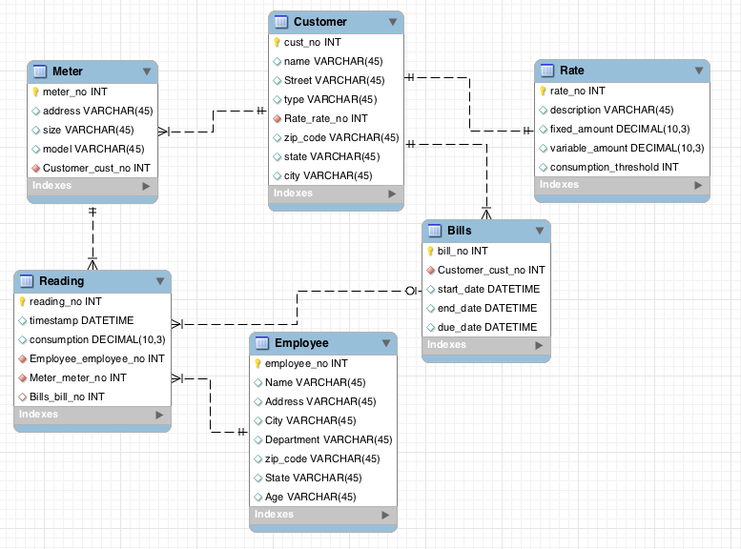
Example - Water Utility

Slide 4
Step 0: Entities map to Tables
Each entity maps to a table
Each attribute maps to a column in the table
The primary key of the entity maps to the primary key of the table
Primary keys are underlined

Slide 5
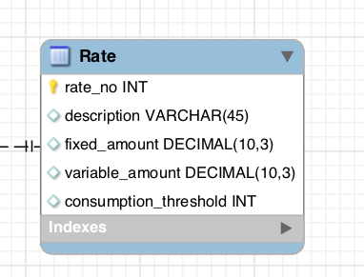
Step 1: Water Utility Entities
Rate
Customer
Meter
Reading
Employee
Bill
Rate
Rate_no | Description | Fixed amount | Variable amount | Consumption Threshold
R1278 | Rate descr 1 | 40 | 10 | 0.7
R982 | Rate descr 3 | 70 | 20 | 0.7
R1908 | Rate descr 7 | 120 | Null | Null

Slide 6
Step 2: One to many relationships
For each One-to-Many relationship
Add a foreign key (FK) to the table corresponding to the “many” entity

Slide 7
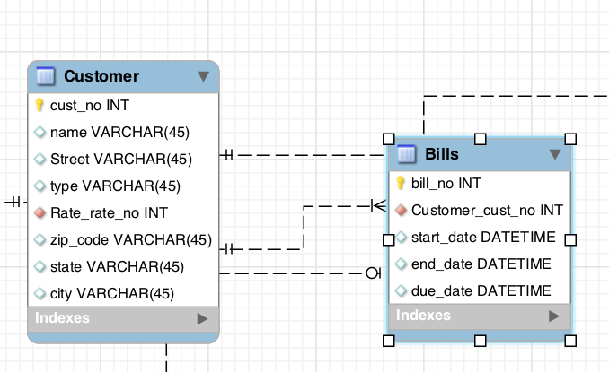
Step 2: Example
Foreign Key

Slide 8
Step 3: One to one Relationships
We treat One-to-One relationship similarly as we treat One-to-Many relationship
Option 1: Add a Foreign Key to either of the two tables
Option 2: Merge the two tables (sometimes ok, sometimes bad style)

Slide 9
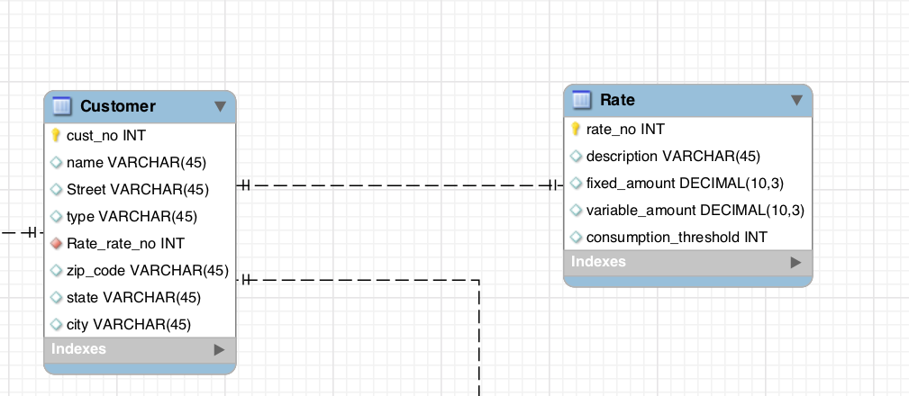
Step 3: Example
Foreign Key

Slide 10
Step 4: Many to many relationships
Need to introduce bridge table (Each Many-to-Many relationship becomes a separate table)
The primary key of the bridge table is the combination of the primary keys of the entity types participating in the relationship
Each of the primary keys stored in the bridge table is a foreign key, pointing to the original entity table

Slide 11
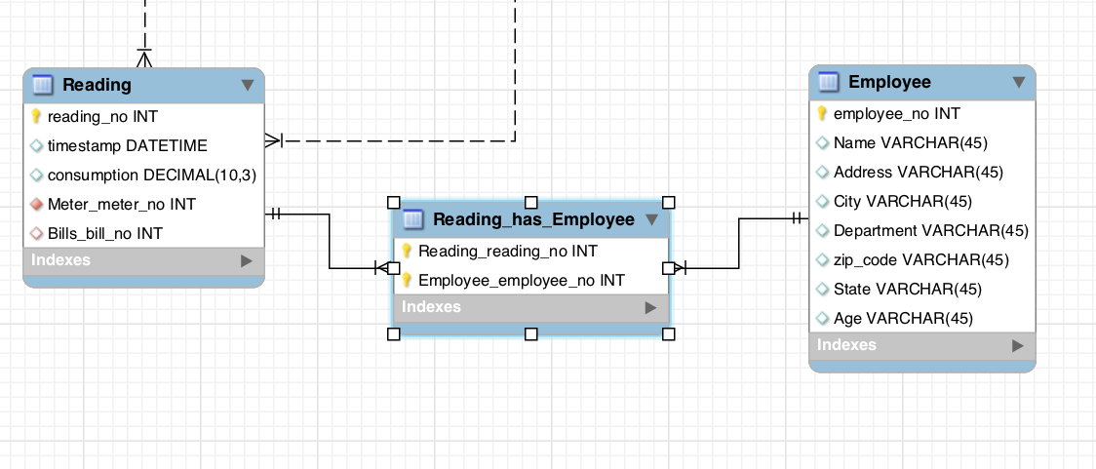
Step 4: Example
Lets assume that a reading can be done by many employees
Reading No | Employee No
Reading No | Timestamp | …
Employee No | Name | …

Slide 12
Final Results
Meter (meter_no, address, size, model, cust_no)
Customer (cust_no, name, street, type, rate_no, zip_code, state, city)
Rate (rate_no, description, fixed_amount, variable_amount, consumption_threshold)
Reading (reading_no,timestamp,consumption, meter_no, bill_no)
Reading_has_Employee (reading_no, employee_no)
Employee (employee_no, name, address, city, dept, zip_code, state, age)
Bills (bill_no, cust_no, start_date, end_date, due_date)

