Slide 1

AMAZON REVIEWS ANALYSIS
Project by :-
1. Nitesh SINGH
2. ANURAG PAWAR
3. Aditya kumar
4. Varun verma

Slide 2
Project Introduction
The year was 1994 when Bezos launched Amazon out of his garage. In 1995, the first product was launched by Amazon. It was a book that was sold to 50 states in 45 different countries within 30 days (Oberlo 2021).
Within 26 years, Amazon holds the title of the world’s largest online retailer and has become a household name. Amazon has become synonymous with online shopping and continues to grow by developing new products, acquisitions, and different service offerings to enlarge the customer base
PRODUCT CATEGORIES –
Tools And Home Improvement,
Patio, Lawn and Garden

Slide 3
Problem Statement
Based on the ‘review text’ and ‘summary’ of the data, identify how a review can be classified into a particular category (for example, positive, negative and neutral). Analyze the text well to build the categories. In case of many negative sentiments associated with a product, try to find out the reasons.
Identify the names of few products by analyzing your input text data.
Predict future data trends: How the sentiments of reviewers change with time. Suppose input data is provided for the period 1996-2014. Your task is to predict the trends after 2014.
Can you find any relations/buying trends of customers/any other interesting analysis between given pair of categories (Example, Beauty and Clothing categories).

Slide 4
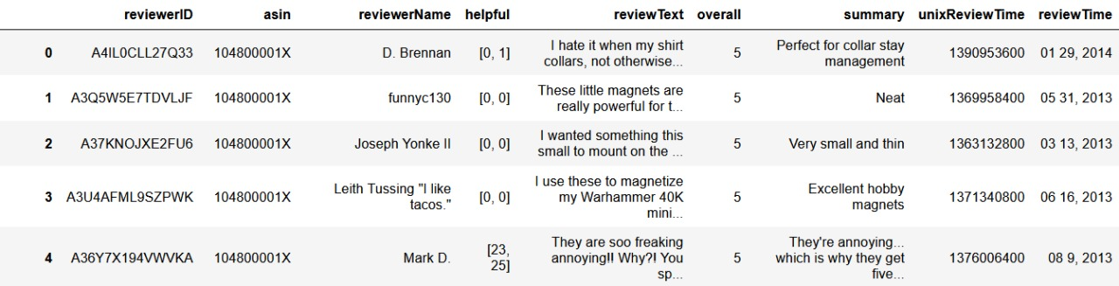
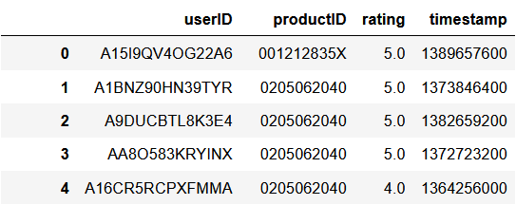
ORIGINAL DATA FOR PRODUCT REVIEWS AND RATINGS

Slide 5
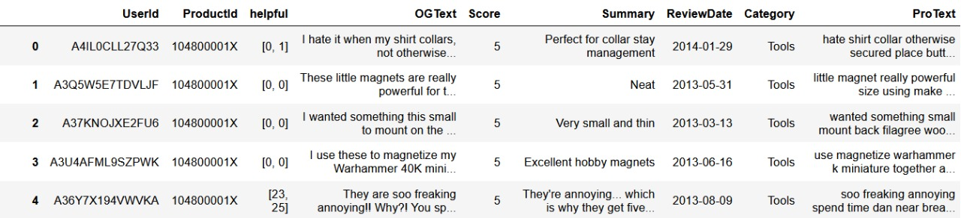
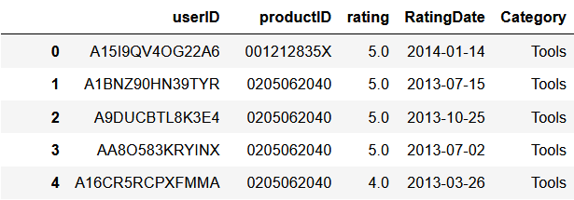
DATA AFTER PRE-PROCESSING

Slide 6
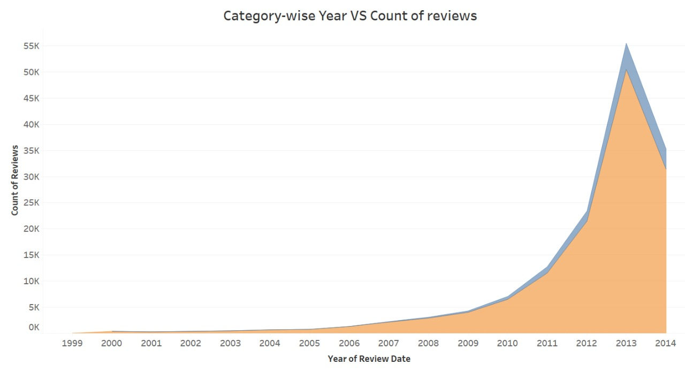
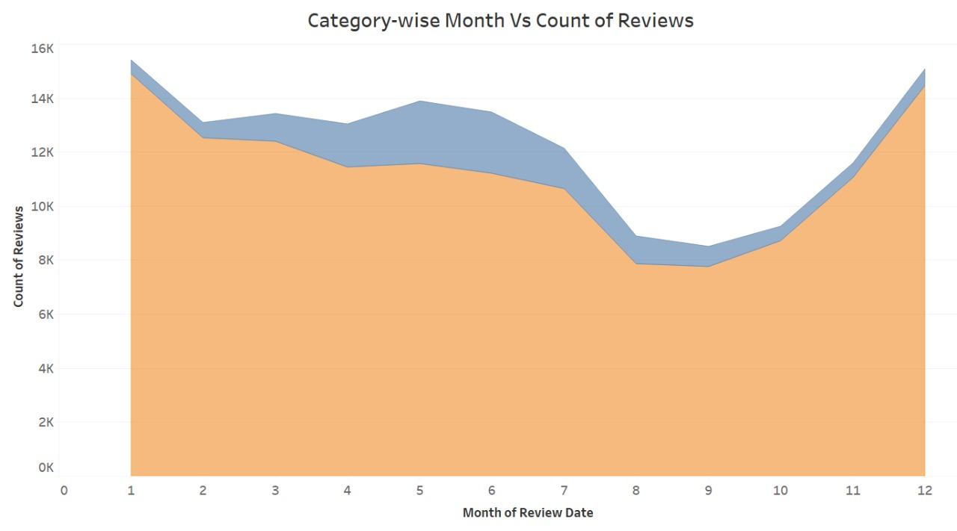
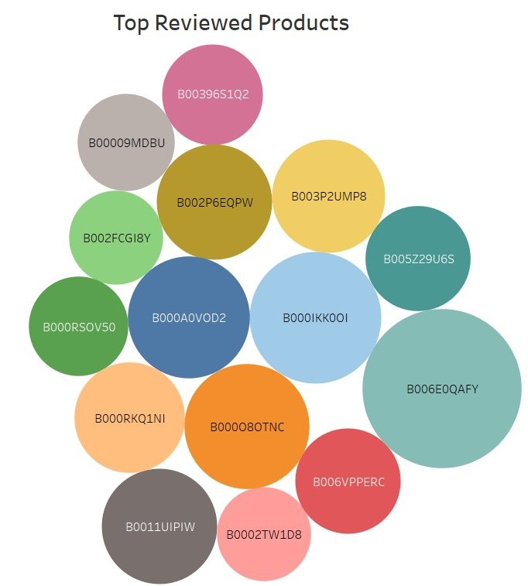
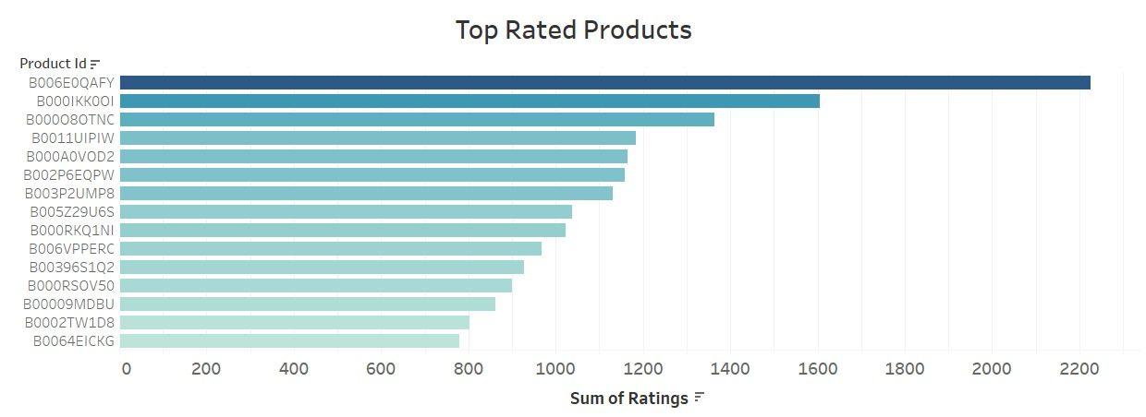
Exploratory Data Analysis(E D A)

Slide 7
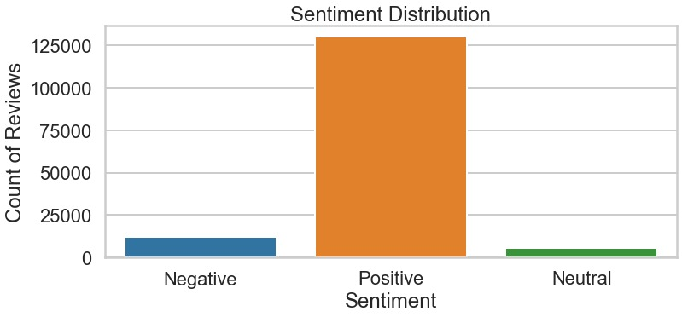
For doing sentiment analysis, the feature, ReviewText was analyzed and based on the analysis, The reviews were classified into Positive, Negative and Neutral.
The feature ReviewText was to be processed first. This included removing punctuations and other symbols, removing stopwords and Lemmatization.
For classifying the reviews, the polarity of the reviews was found. For finding the polarity we used TextBlob classification model, from NLTK library.
The range of -1 to 1 was divided into three parts (- 1 to - 0.01, - 0.01 to 0.01, 0.01 to 1) to classify them into negative, neutral and positive, respectively.
The corresponding graph shows the distribution of the sentiment for all the reviews.
Problem Statement – 1, Based on the ‘review text’ and ‘summary’ of the data, identify how a review can be classified into a particular category (for example, positive, negative and neutral). Analyze the text well to build the categories. In case of many negative sentiments associated with a product, try to find out the reasons.

Slide 8
Positive Reviews :- Examples of Result of the classifier projecting sentiments.
The color pictures and exploded diagrams are an outstanding introduction and knowledge builder. Mr. Proulx full color pages helped me solve problems and understand better ways to use this great joinery technique.
Good simple projects to start you using the Kreg tool for joints. The book can take into the shop where you don't want to take a computer or tablet.
Negative Reviews :- Examples of Result of the classifier projecting sentiments.
I have urgently replaced this base (suppose to be mobile base) by HTC2000. Absolutely no contest. Wheels are too small to keep equipment parallel to the floor surface. In addition, it is not as sturdy as HTC2000; is more expensive and is more cumbersome
It no way effected the performance of the product, but the ones I received were silver and the ones advertised where black. The one issue I had durning set up, using the 3/8 set up that the chipper and the two outer blades carbon kept bumping into each other and it took me about 20 minutes to figure it out. Hopefully I don't have to use that set up to often.
Neutral Reviews :- Examples of Result of the classifier projecting sentiments.
I wanted something this small to mount on the back of filigree wood piece I cut. They could then be mounted on refrigerators. Works well. Should be able to remove the pieces from the refrig without breaking yet will hold well.
Mine was shipped from China, took about 2 weeks I think, IIRC. Came with the required AAA batteries. I clip it to my headboard, about 1 inch thick, it holds on there well. Two light levels from the switch (press once low, again high, again off). Flexi boom arm stays put once I put it where I want it.Solid purchase.
Examples of Reviews

Slide 9
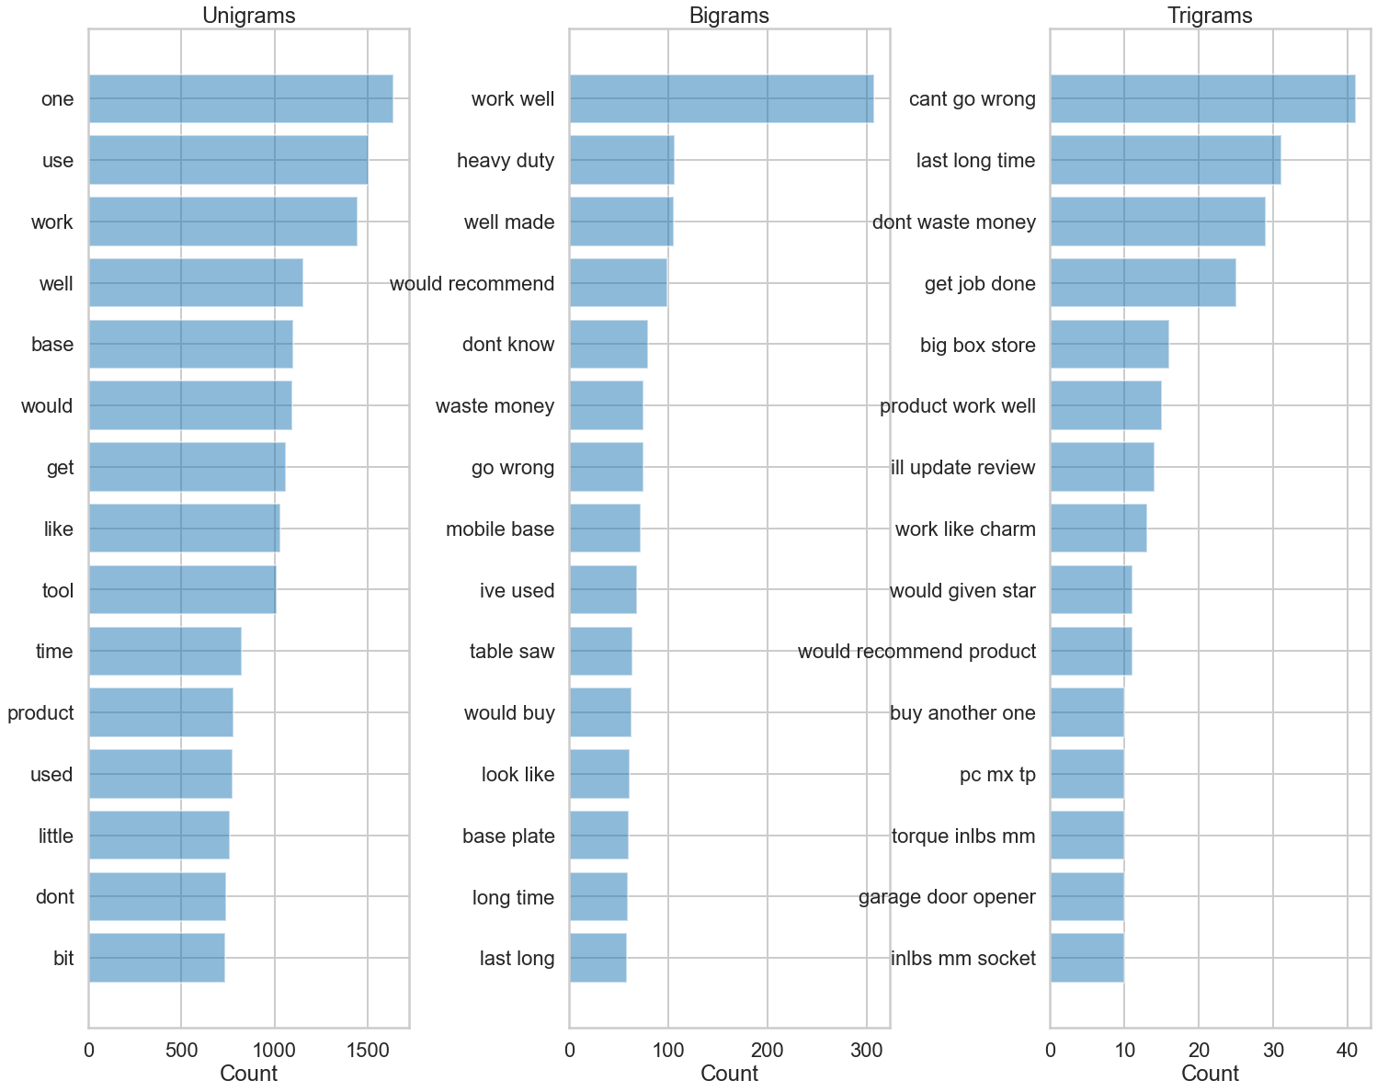
To find reasons, we have used two approaches, one being using the TextGrams and other being finding the reasons manually for most negatively rated products.
The reasons for negative ratings were as follows,
For Tools and Home Improvement
Poor quality product
Leakage in product
Poor built
Items missing
Bad quality and not working
For Patio, Lawn and Garden
Product not working
Harmful Product
Not Durable Product
Horrific Product
Manufacturing defect
Reasons for Negative reviews

Slide 10
Names of Products by analyzing the input text data
Tools And Home Improvement
B003VPMJGE (Cutting Blade)
B000BQU5QW (Alarm)
B001LJKLT4 (Table-Saw)
B00CWKTAV5 (Motor)
B000R6TW24 (Nut Driver)
Patio, Lawn and Garden
B0052W5OP2 (Animal kill Traps)
BOO8RGCA9I (Repellent)
B00AQ4BYBO (Trowel)
B00107039U (Grass Cutter)
BOO612346F (Sprinkler)
Problem Statement 2, Identify the names of few products by analyzing your input text data.

Slide 11
Time series and forecasting
In forecasting firstly done resample with sum.
Decomposition method is used to check trend and seasonality in given data set.
Then need to see if there is trend and seasonality is present in dataset given . Need to make stationery i.e. no seasonality and trend should be present there at time of prediction . Mean an covariance would be constant.
And making data stationery need to used model ARMA,ARIMA ,SARIMA. to predict the data and compare with actual data.
We had forecasting for future on unseen data by using ARIMA model and we get positive results.
Calculated the RMSE value of all the models to check which model is good for forecasting.

Slide 12
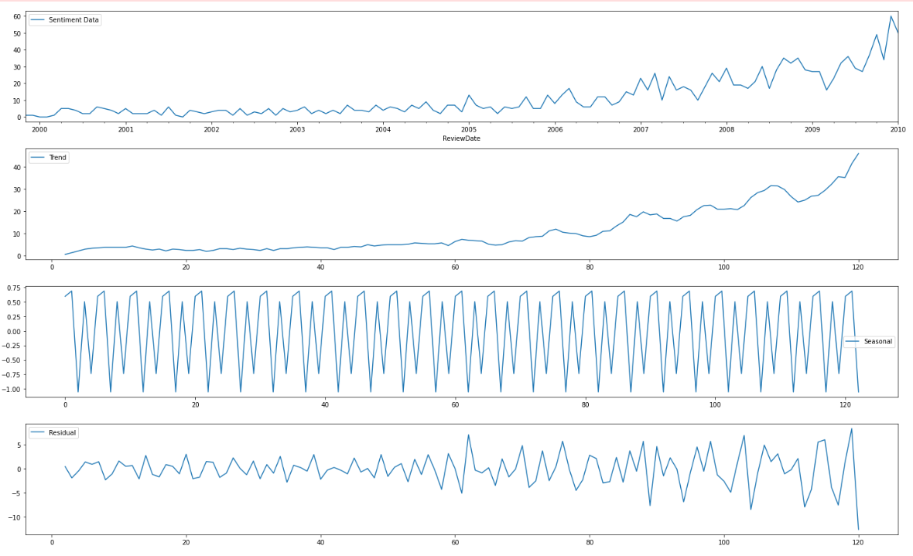
Checking Seasonal and Trend

Slide 13
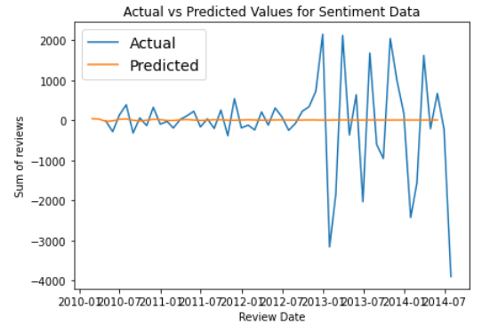
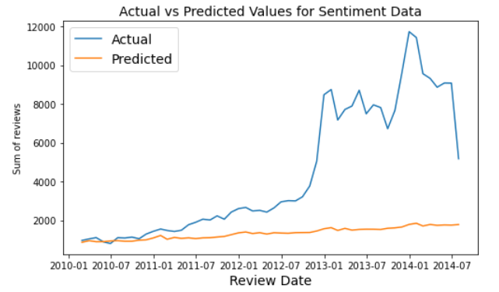
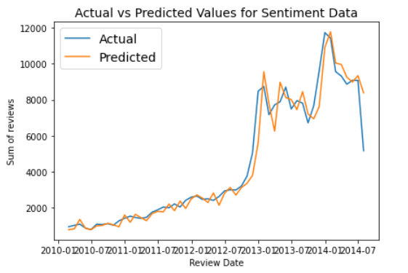



ARMA
SARIMA
ARIMA
Actual V/S Prediction for Sentiment data

Slide 14
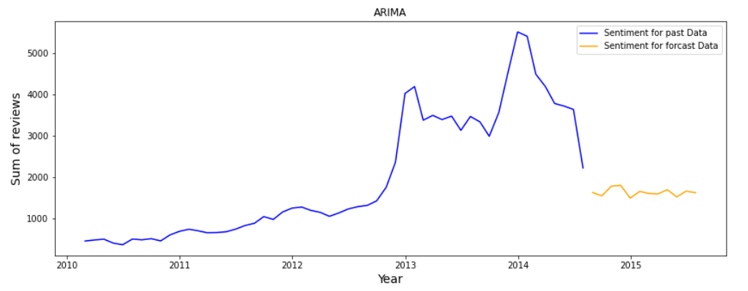
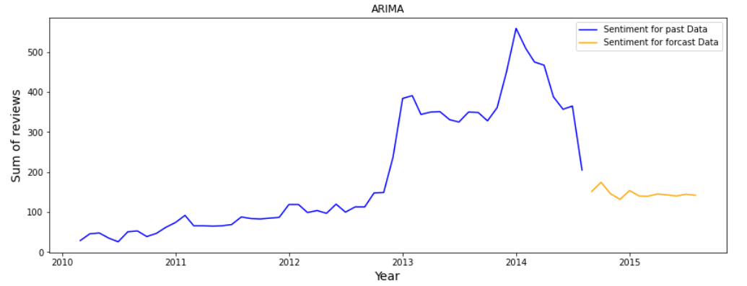
POSITIVE
SENTIMENT
FORCAST
NEGATIVE
SENTIMENT
FORCAST
Problem Statement – 3 Prediction for future on Tools And Home Improvement data using ARIMA model

Slide 15
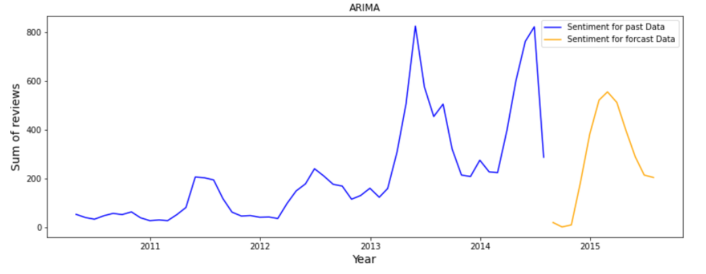
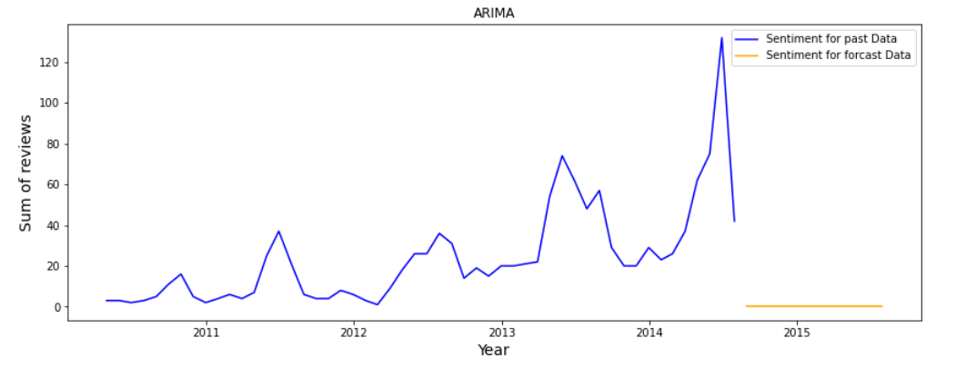
POSITIVE
SENTIMENT
FORCAST
NEGATIVE
SENTIMENT
FORCAST
Prediction for future on Patio, Lawn and Garden data using ARIMA model

Slide 16
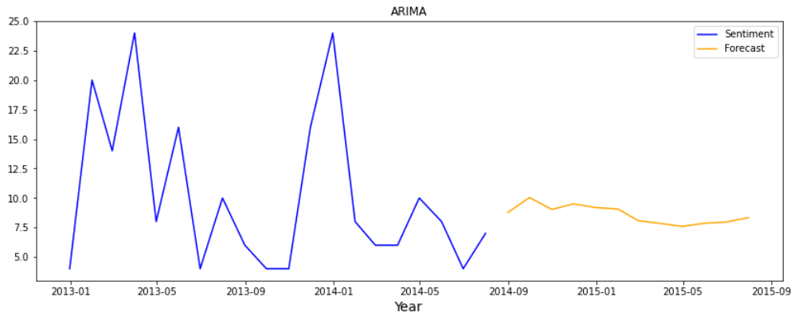
This particular product with product ID - B001LJKLT4 (Table-Saw) was one of the most negatively rated product. So, here we have plotted a time series forecasting for this product as to know how the product will fare in future by using ARIMA model.

Slide 17
Problem Statement 4 - Can you find any relations/buying trends of customers/any other interesting analysis
between given pair of categories (Example, Beauty and Clothing categories).
During our analysis we didn’t found any customer or product which were in both the data sets but we
realized that the problem faced by the customer were somewhat similar.
Regarding the trends in Tools and Home improvement dataset the reviews were at peak in 2014, but
afterword's it Declined considerably, whereas Patio, Lawn and Garden dataset reviews were at peak even
after 2014 but it had also a steep fall.

Slide 18
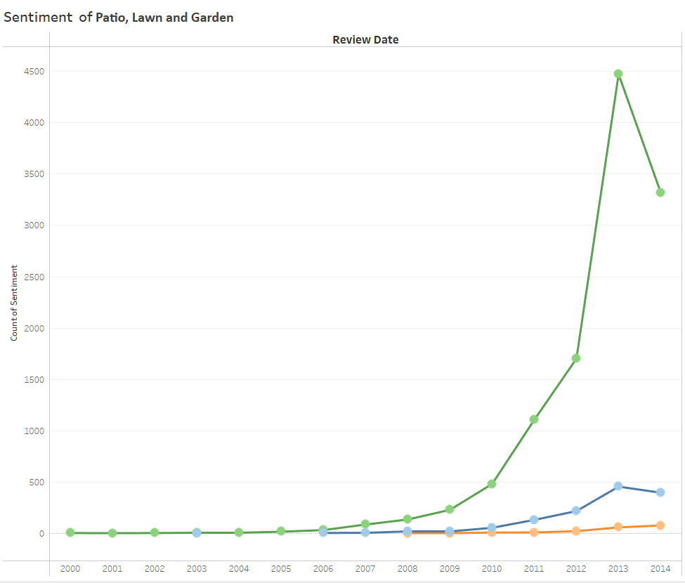
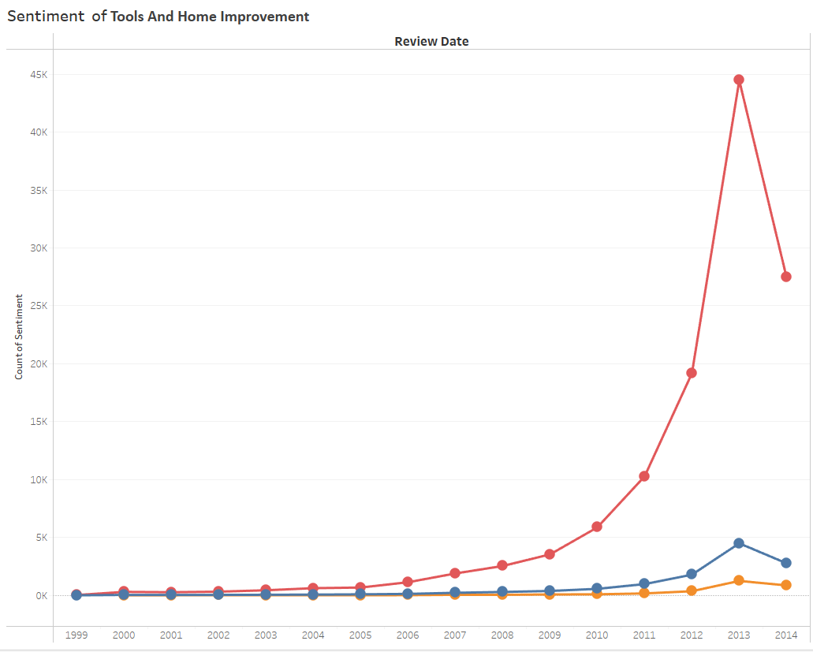
Sentiment Distribution Over the Years
and Tools

Slide 19
Prescriptive Analysis
In previous slide we showed that the prediction of positive and negative sentiments on the data set. Few of the reasons for those negative sentiment were : Over Packaging, Poor Quality Products, Items Missing or Manufacturing Defects.
So, we recommend in improvement of shipment and delivery services, to make the warehouses more robust and crosschecking to verify the missing items in the delivery.

Slide 20
Conclusions
The sentiment analysis show that most of the reviews are positive for all products followed by negative
reviews and the neutral reviews being least in number.
In ARIMA model the value of actual v/s predicted are almost similar than other models.
The Year wise pattern of sentiments trend is similar for both categories.

Slide 21


