Slide 1

Car Accident Severity Prediction for Driver Warning and Assistance Systems
Apoorva Suresh

Slide 2
Introduction & Business Problem
Many factors such as weather, road and lighting conditions influence the severity of accidents
Aim: to predict the severity of car accidents through reliable and robust machine learning models
Results are of particular interest to Seattle transportation department
Also beneficial to warn drivers in case of bad road/weather/light conditions
Could also help in developing improved Driver assistance systems, capable of handling such challenging situations

Slide 3
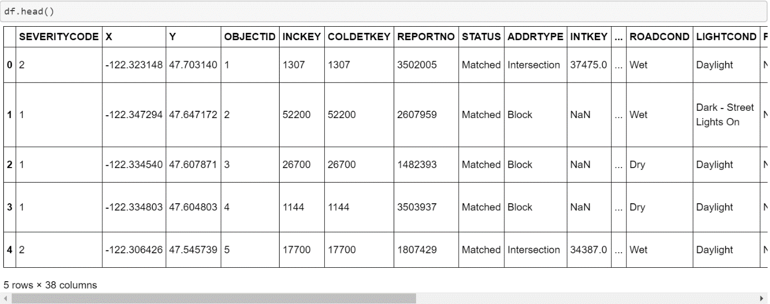
Data Understanding and Pre-processing
Collision reports from Seattle (2004-present) by the Seattle Police Department and Traffic Records department is used
Data has 37 independent variables and 194,673 records
Independent variables: “WEATHER”, “ROADCOND” and “LIGHTCOND”
Dependent variable/ target: “SEVERITYCODE” (0 to 4 levels)

Slide 4
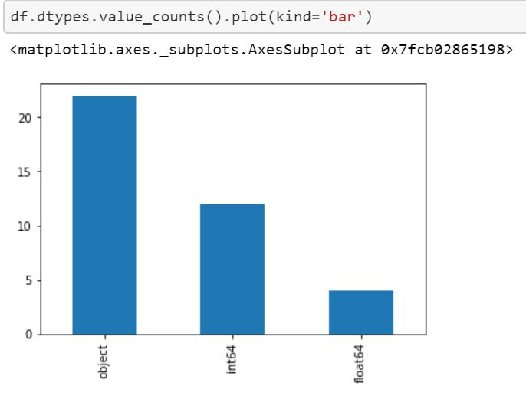
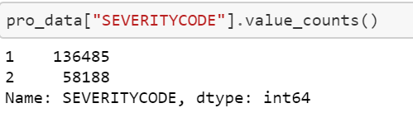
Data Understanding and Pre-processing
Columns are of type ‘object’ are encoded to ‘int8’
Rows that have null values are dropped
Attributes that are not used are also dropped
Since the dataset is imbalanced, down-sampling is done

Slide 5
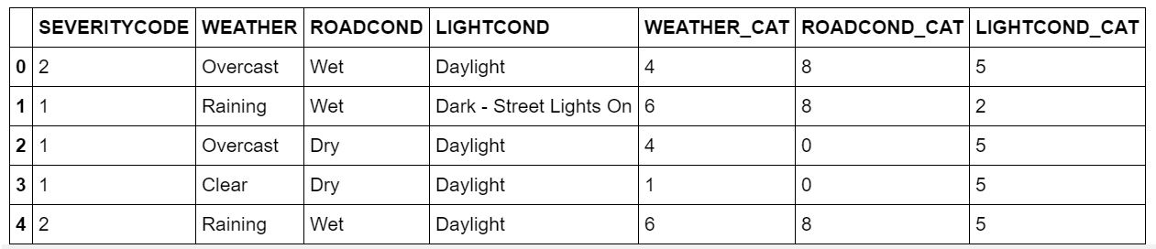
Data Understanding and Pre-processing

Slide 6
Methodology
Supervised learning models will be built using this data to predict the severity of an accident based on the inputs
The dataset has pre-defined severity codes => classification problem
Approaches used:
K Nearest Neighbour:
Decision Tree
Logistic Regression

Slide 7
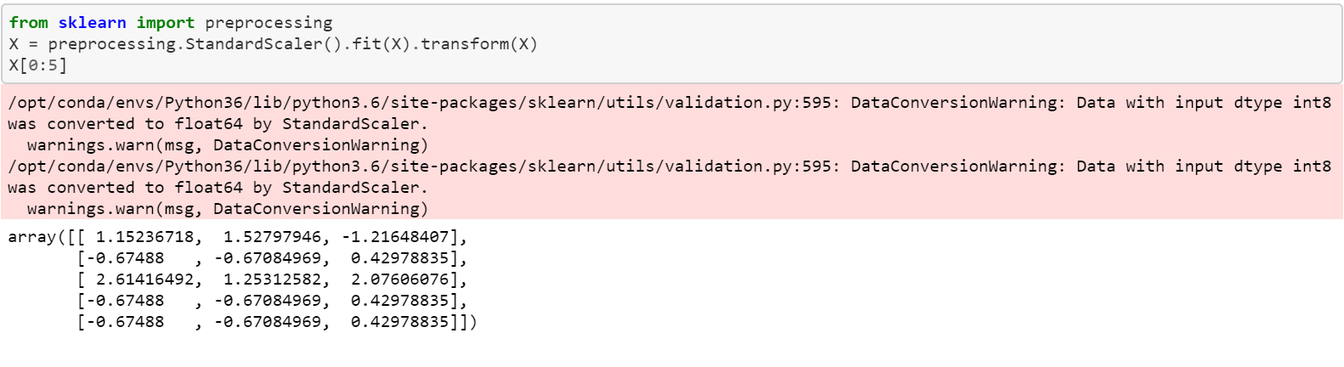
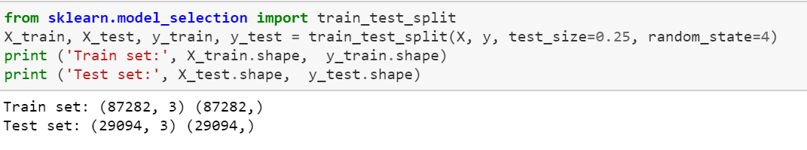
Normalization and Dataset split
Feature vectors are rescaled between 0 and 1, in order to prevent bias
A split of 3:1 has been chosen
The models would be trained using 75% of the dataset. The rest 25% of the dataset is the test set, on which the model evaluation is performed
This is done to prevent overfitting

Slide 8
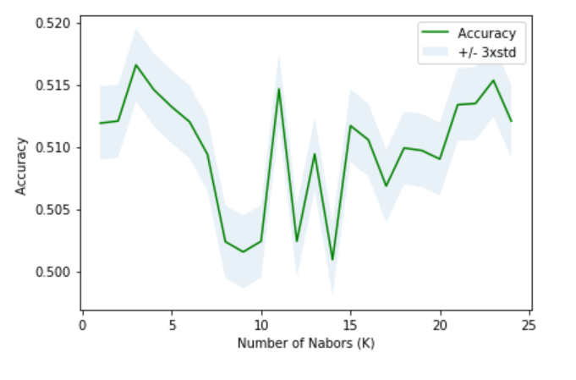
K Nearest Neighbours Model
Along with creating a KNN model, it is also essential that the correct value of K is identified
The value of K which provides the most accurate results on the test dataset would be chosen as the ideal K
In order to find this, a range of values of K starting from 1 until 10 are chosen
The accuracy on the test dataset is calculated and the K pertaining to the maximum accuracy is chosen

Slide 9
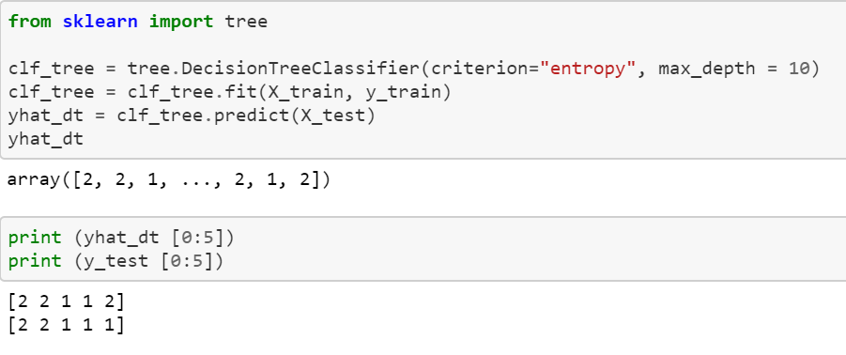
Decision Tree
A decision tree is also built using the training set
Different values of the depth is experimented with and the model corresponding to the highest accuracy is chosen

Slide 10
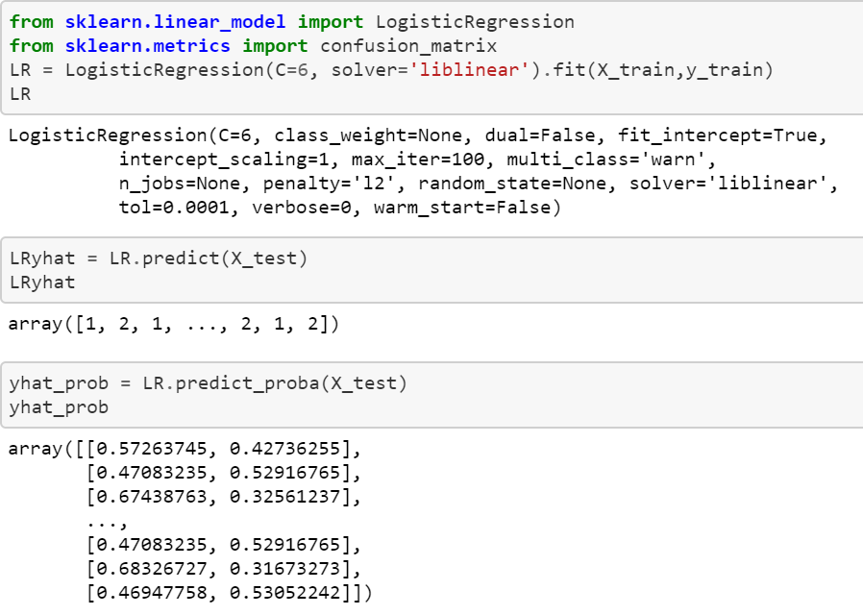
Logistic Regression
The problem can be treated as a binary classification problem
Additionally, a probability score for the occurrence and severity level of accidents would also be useful
Different values of parameter C is experimented with and the model corresponding to the highest accuracy is chosen

Slide 11
Results and Evaluation
It is important to check how the different models perform using some evaluation metrics
Model evaluation also helps in tuning hyperparameters and model parameters like the value of K in KNN, the depth of decision tree and the value of C in logistic regression
There are different metrics that are compared:
Jaccard similarity score
F1 score
Log loss for logistic regression model

Slide 12
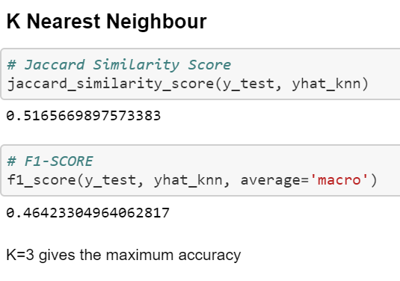
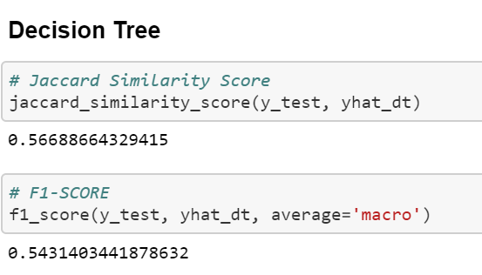
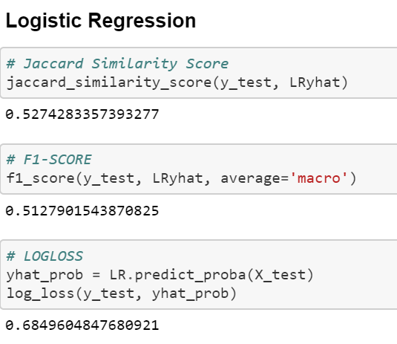
Results and Evaluation

Slide 13
Discussion
Every model’s parameters were determined based on the evaluation results
Based on the evaluation results, the decision tree was observed to perform the best
The differences amongst other models were small.

Slide 14
Conclusion and Outlook
Useful machine learning models to predict the severity of car accidents have been built
Accuracy of the models has room for improvement
Capture more influencing factors

Slide 15
Thank you

