Slide 1
Let’s start….

Slide 2
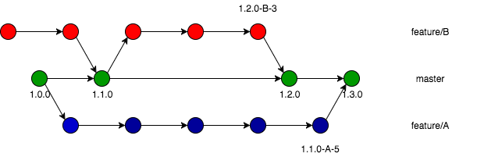
Version control ?

Slide 3




Git vs GitHub

Slide 4
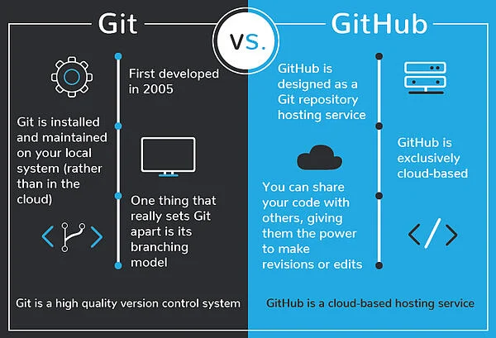

Slide 5
HTML vs HTML5
Features | HTML | HTML5
definition | A hypertext markup language (HTML) is used to develop webpages | HTML5 is a new version of HTML with more functionalities
Multimedia support | No support for video and audio. | HTML5 supports both video and audio.
Storage | Uses cookies to store data. | Uses local storage instead of cookies
Shapes | It is not possible to create shapes like circles, rectangles, triangles. | We can draw shapes like circles, rectangles, triangles.
Vector Graphics | No support for vector graphics | HTML5 vector graphics like SVG, and canvas.
Browser Support | Works with all older browsers | A new browser supports this.

Slide 6
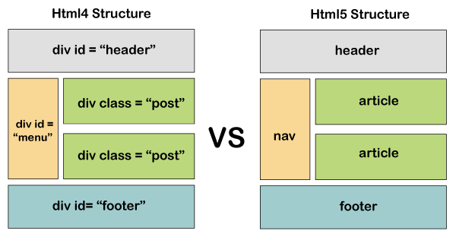

Slide 7
CSS vs CSS3
CSS is the basic version with limited functionality.
No support for responsive design.
CSS relatively slower than CSS3
It does not support 3D transformations and animations.
CSS can not split into modules.
Limited set of colors.
CSS3 is the latest version of CSS with more functionalities.
CSS3 supports responsive design.
CSS3 is faster.
We can create 3D transformations and animations.
CSS3 can be split into modules.
A wide variety of colors.

Slide 8
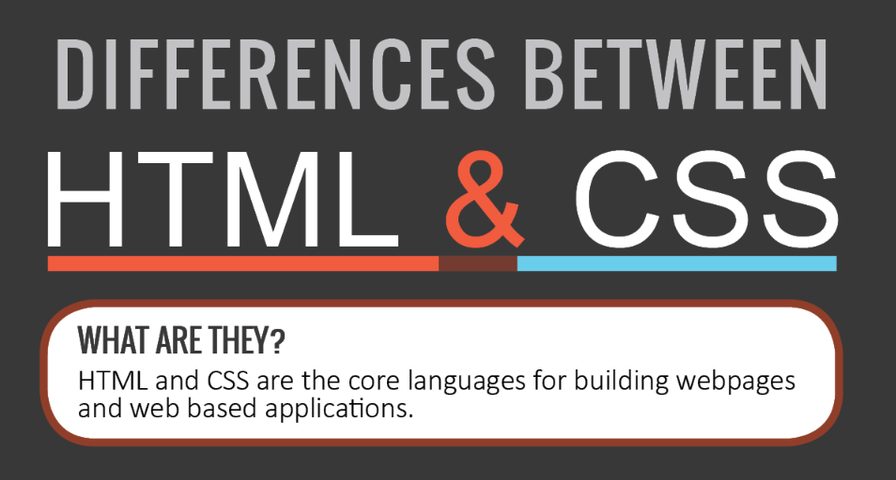
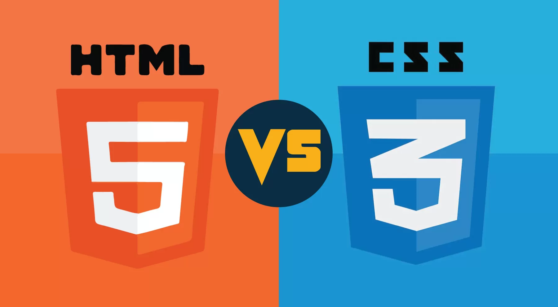

Slide 9
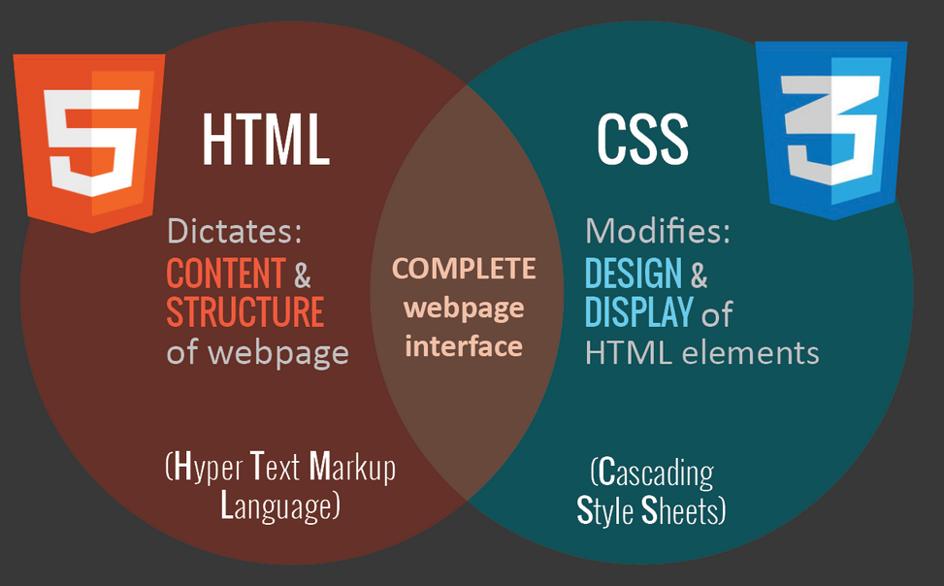

Slide 10
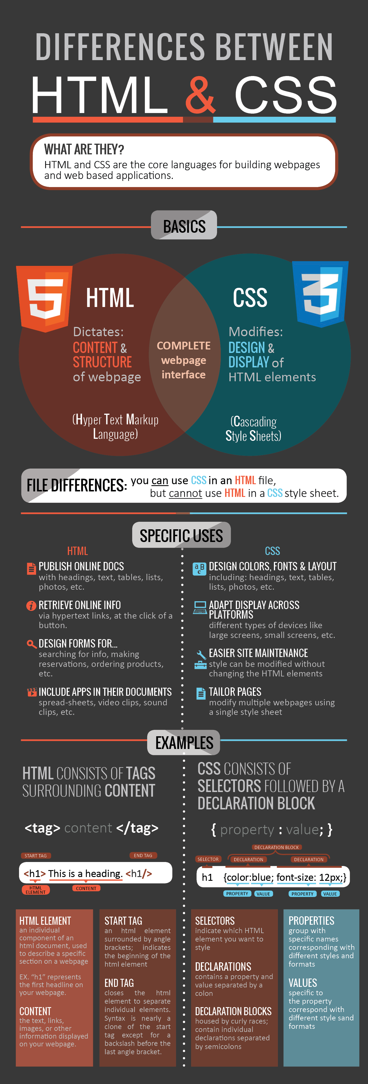

Slide 11
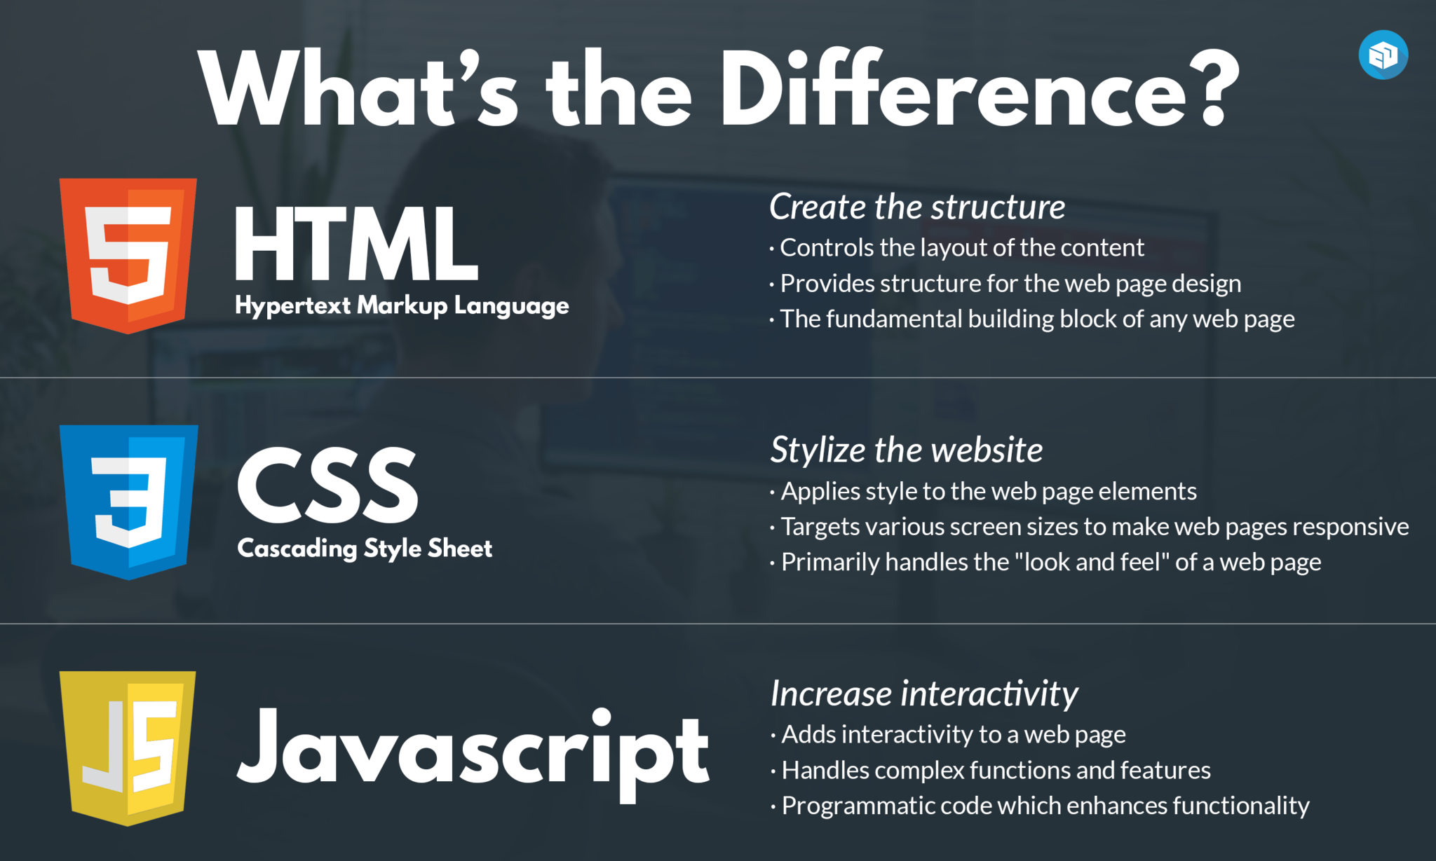

Slide 12
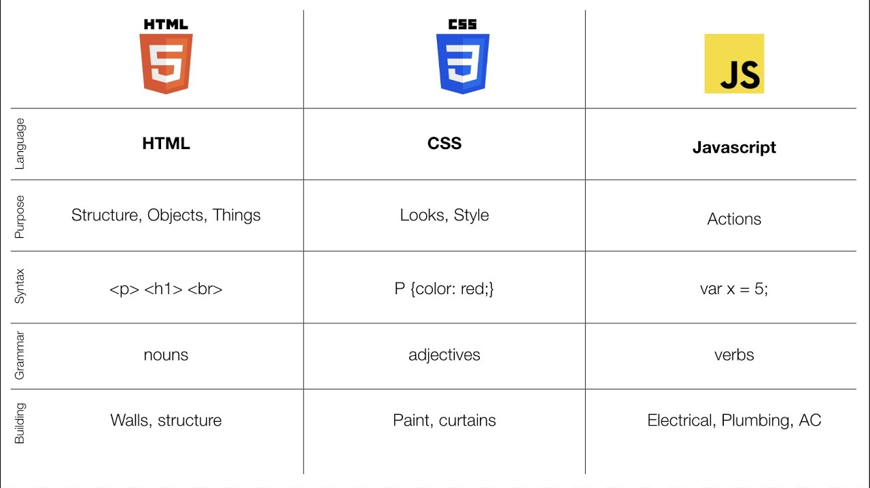

Slide 13
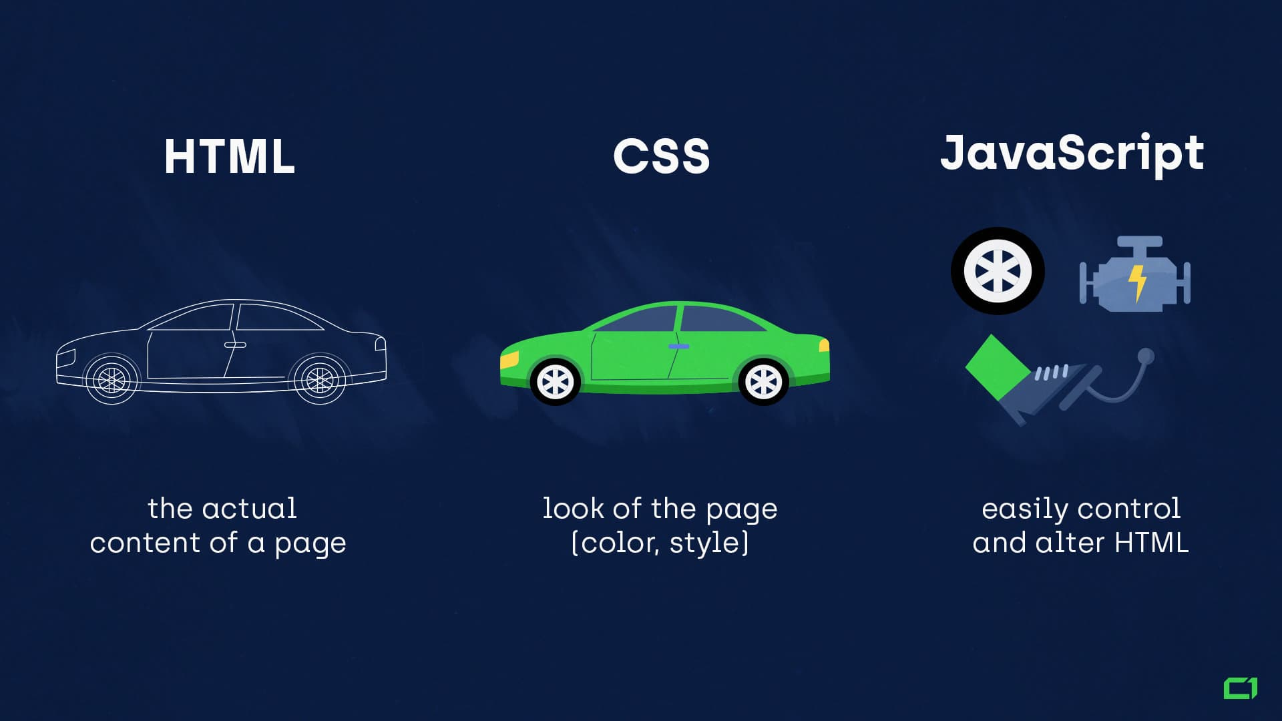

Slide 14

Enough with theory

