Slide 1
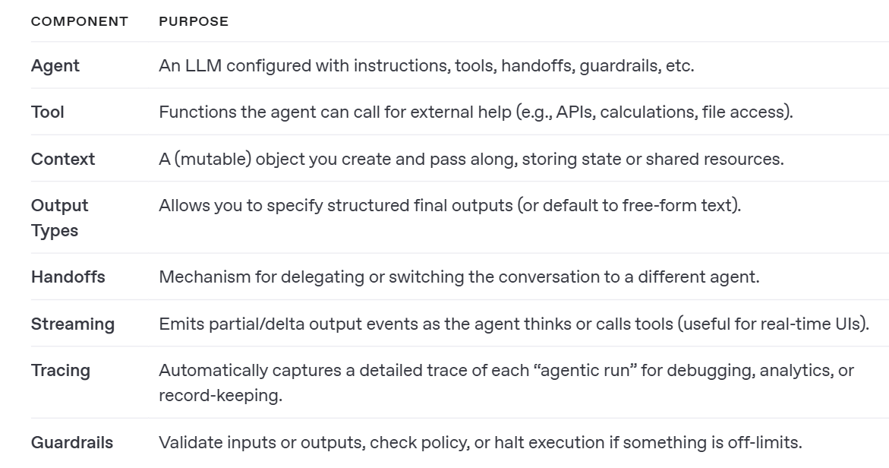
Basic Terminology

Slide 2
Lecture Plan
1.Install library
2.Create a Basic Agent
3.Basic Agent with structured output (model ,Model Settings)
4.Cloning agents
Note-”On abstraction”
5.Creating tools
6.Understanding Traces
7.Structured Outputs with Pydantic
8.Handoffs
9.Guardrails

