Slide 1
GPT OSS By-Aditya Bhatt

Slide 2
General Intro
gpt-oss-120b and gpt-oss-20b—two state-of-the-art open-weight language models that deliver strong real-world performance at low cost.
Available under the flexible Apache 2.0 license, these models outperform similarly sized open models on reasoning tasks, demonstrate strong tool use capabilities, and are optimized for efficient deployment on consumer hardware.
They were trained using a mix of reinforcement learning and techniques informed by OpenAI’s most advanced internal models, including o3 and other frontier systems.
The gpt-oss-120b model achieves near-parity with OpenAI o4-mini on core reasoning benchmarks, while running efficiently on a single 80 GB GPU
Both models also perform strongly on tool use, few-shot function calling, CoT reasoning (as seen in results on the Tau-Bench agentic evaluation suite) and HealthBench (even outperforming proprietary models like OpenAI o1 and GPT‑4o).

Slide 3
Key Points
1.These are text only models
2. The gpt-oss models are autoregresive Mixture-of-Experts (MoE) transformers [1, 2, 3, 4] that build upon the GPT-2 and GPT-3 architectures.
3. The two model sizes: gpt-oss-120b,which consists of 36 layers (116.8B total parameters and 5.1B “active” parameters per token per forward pass), and gpt-oss-20b with 24 layers (20.9B total and 3.6B active parameters).
4. Pretraining
5. Post-Training

Slide 4
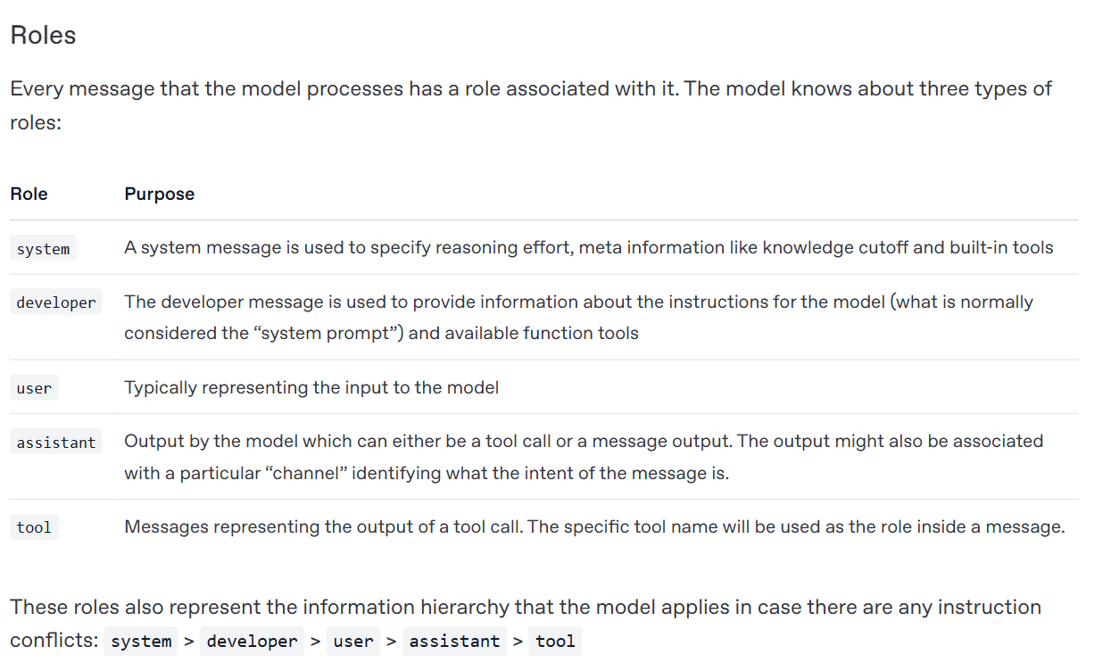
Harmony Chat Format

Slide 5
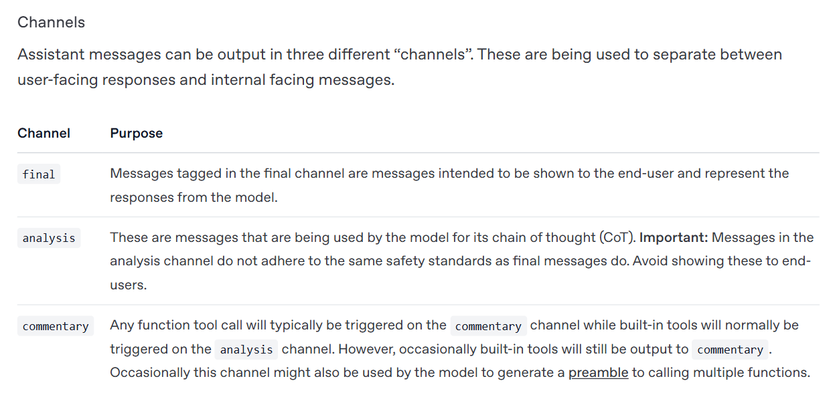
Harmony Chat Format

Slide 6
Reasoning
The models to support three reasoning levels: low, medium, and high. These levels are configured in the system prompt by inserting keywords such as "Reasoning: low". Increasing the reasoning level will cause the model’s average CoT length to increase.

Slide 7
Lets Play Now
General Inference
1.Play around the model with terminal
2.Plan around the same with chat completions api
3.Seeing the chain of thought
4.Function calling with gpt-oss.
Use cases: RAG , Chatbots, agentic workflows
Fine Tunning Guide.

