Slide 1
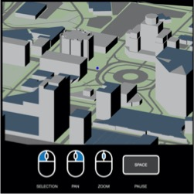


OpenStreetMap API
OSM2WORLD
Graphical
User Interface
.osm
.obj

