Slide 1
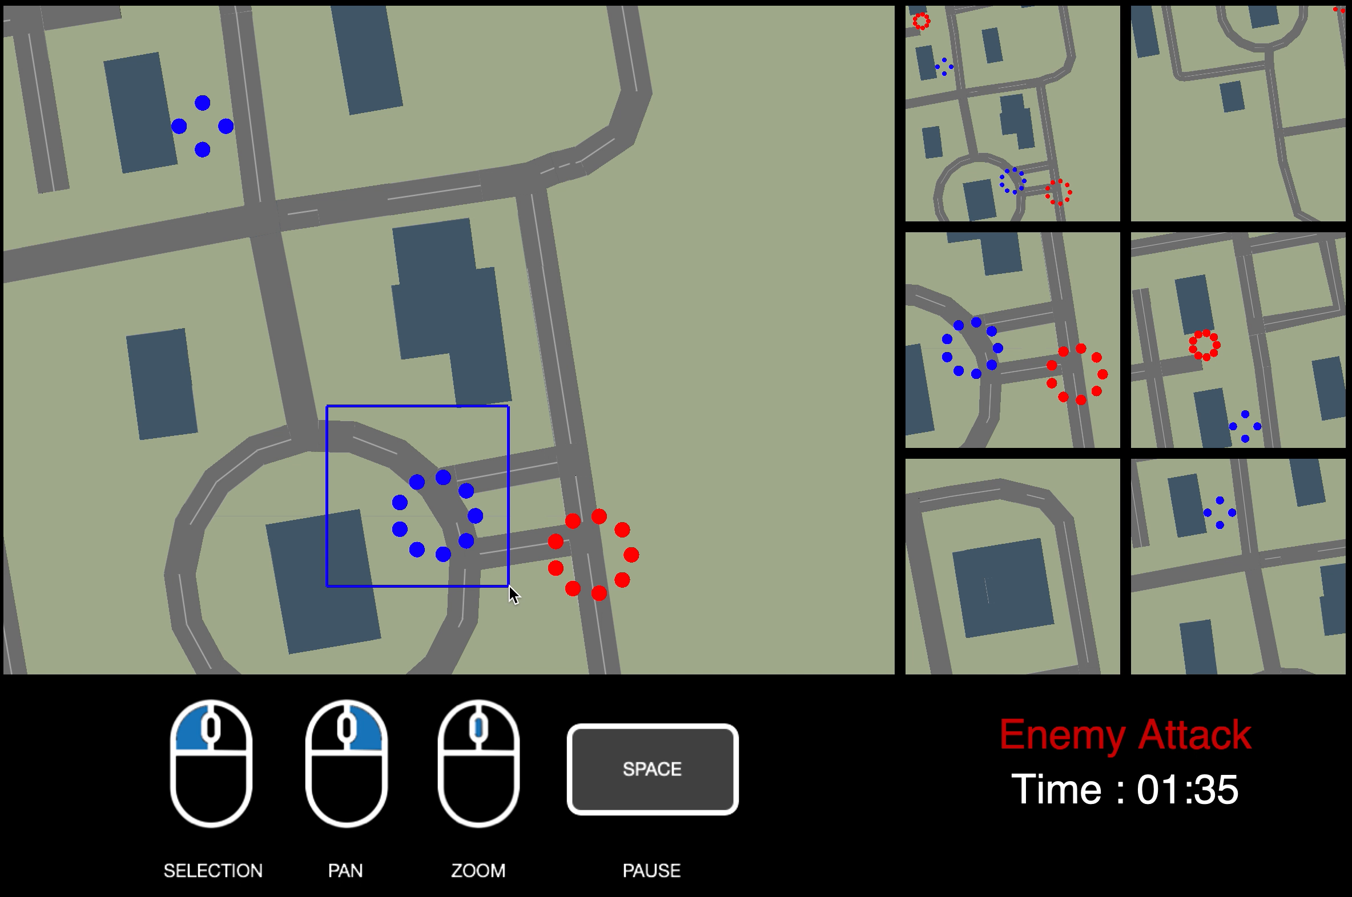
Potential
Target Building
User Selection
Adversarial
Team

