Slide 1
Sales & Operations Analysis
2026-09-01 → 2026-09-07

Slide 2
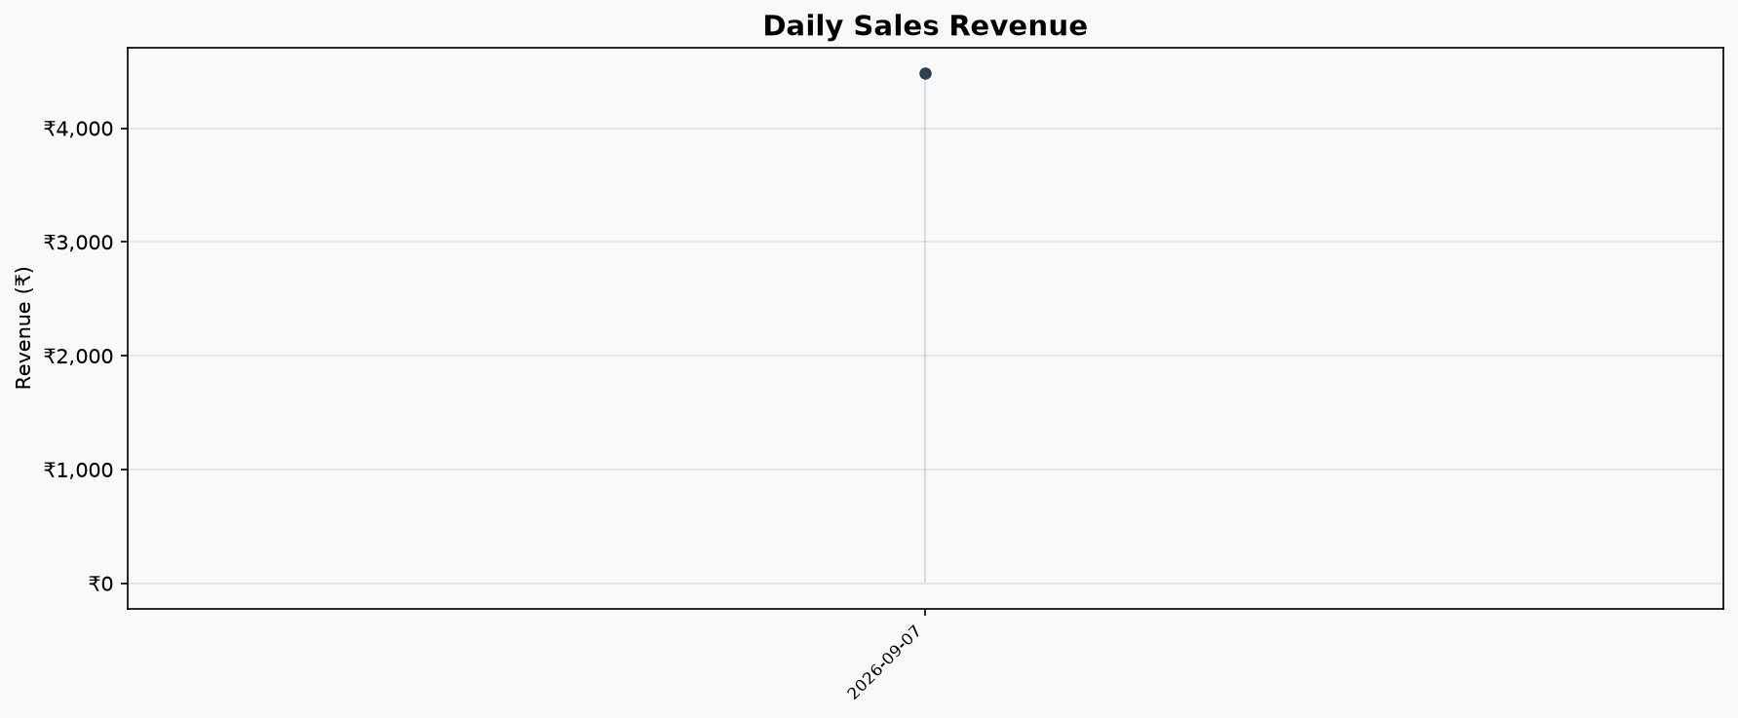
📈 Daily Sales Trend

Slide 3
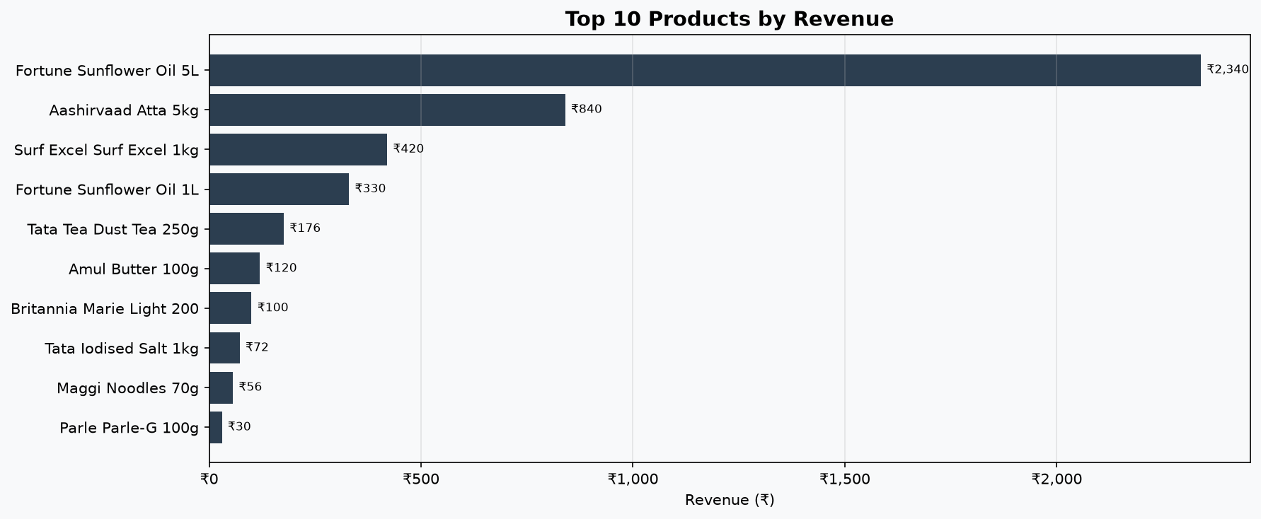
🏆 Top 10 Products by Revenue

Slide 4
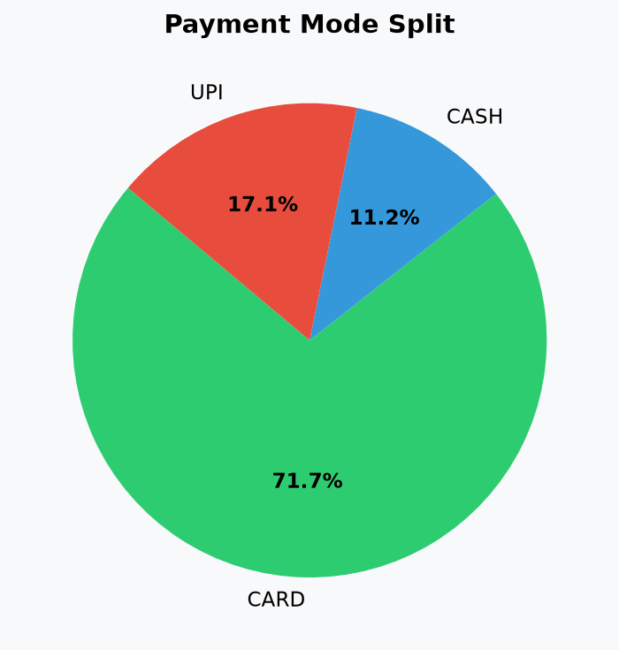
💳 Payment Mode Split

Slide 5
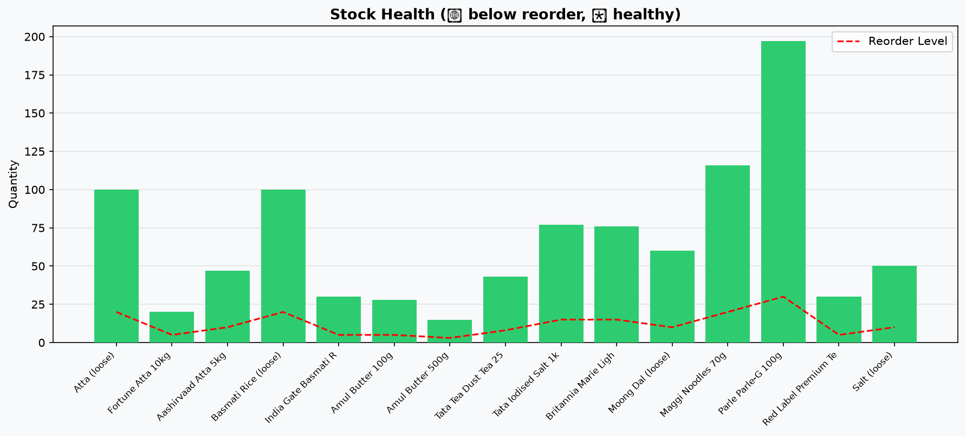
📦 Stock Health

