Slide 1
B.TECH. CSE SUMMER INTERNSHIP • SESSION 2025–2026
Personal Document Q&A Assistant via Local RAG
Six-Week AI & NLP Training at InternCourse & End-to-End Pipeline Engineering
Aditya Kumar (024101010012) | Haridwar University | github.com/aditya93416/personal-document-rag-assistant

Slide 2
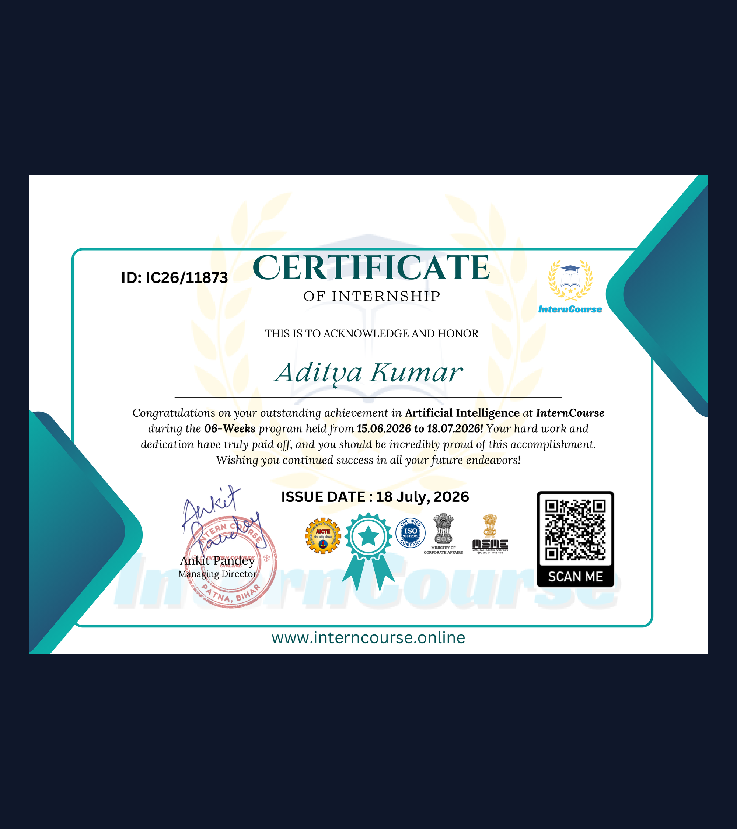
INTERNSHIP OVERVIEW • INTERNCOURSE (IC26/11873)
AI Training Built a Local RAG Pipeline
Training Profile & Core Motivation
Host & Mentorship: 6 weeks (15 Jun–18 Jul 2026) at InternCourse (ISO/AICTE) under MD Ankit Pandey and Mentor Pooja Parmar.
Hallucination & Privacy: Static LLMs fabricate ungrounded answers on private docs and risk data exposure via third-party APIs.
Engineering Objective: Build a local RAG assistant grounding answers strictly in uploaded PDF, DOCX, and TXT files.
Source: Report Ch. 1–3 (ID: IC26/11873) | Slide 2 of 10

Slide 3
SYSTEM ARCHITECTURE • END-TO-END RAG DATAFLOW
Seven-Stage Pipeline Grounds Generation in Local Vectors
1. Parse & Split
Clean Parsing: PyMuPDF and pdfplumber extract clean text and tables.
Sliding Window: Splits text into 500-token chunks with 50 overlap.
2. Embed & Index
Dense Vectors: all-MiniLM-L6-v2 maps chunks into 384D semantic space.
HNSW Graph: ChromaDB persists vectors for sub-15ms cosine lookup.
3. Search & QA
Cutoff Top-K: Retrieves top K=4 chunks above a 0.65 cosine threshold.
Grounded LLM: Local Llama-3-8B answers with strict page citations.
Source: Report Ch. 4 (Fig. 4.1) | github.com/aditya93416/personal-document-rag-assistant | Slide 3 of 10

Slide 4
TECHNICAL STACK & ENVIRONMENT • ZERO CLOUD DEPENDENCY
Open-Source Stack Runs Entirely on Workstation Hardware
Core AI & NLP
LangChain: Chains Python 3.11 loaders, splitters, and prompt rules.
MiniLM-L6-v2: Encodes 384D semantic vectors in under 25ms per chunk.
DB & Local LLM
ChromaDB: Serverless HNSW index storing vectors and page metadata.
Llama-3-8B: Runs via Ollama on RTX 3060 (6GB VRAM) and 16GB RAM.
UI & DevOps
Streamlit UI: Renders real-time PDF ingestion and Q&A citation views.
Docker & Git: Containerized Linux build hosted on GitHub repository.
Source: Internship Report Ch. 5 (Section 5.1 & Table 5.1 Hardware/Software Specifications) | Slide 4 of 10

Slide 5
HOW THE PROJECT WAS BUILT • GITHUB REPOSITORY IMPLEMENTATION
Modular Python Codebase Separates Config, Indexing, and QA
Repository Module | Core Class / Component | Key Parameters & Methods | Engineering Responsibility
config.py | RAGConfig (@dataclass) | CHUNK_SIZE=500, OVERLAP=50, TOP_K=4, THRESHOLD=0.65 | Centralizes model hyperparameters, ChromaDB paths, and strict anti-hallucination system prompt.
ingestion.py | IngestionPipeline | load_document(), ingest_file(), RecursiveCharacterTextSplitter | Parses PDF/TXT files, splits text on hierarchical separators, attaches page metadata, and indexes into ChromaDB.
query_engine.py | RAGQueryEngine | retrieve(), generate_answer(), similarity_search_with_relevance_scores() | Computes cosine similarity, filters Top-K chunks, tracks retrieval latency (ms), and formats page citations.
app.py (UI Layer) | Streamlit Web Console | Drag-and-drop uploader, hyperparameter sliders, citation cards | Provides reactive dark/light dashboard with real-time vector count, chat history, and cosine score inspector.
Source: Appendix B Source Code Listings B.1–B.3 | github.com/aditya93416/personal-document-rag-assistant | Slide 5 of 10

Slide 6
AGILE WORK LOG • 15 JUNE 2026 – 18 JULY 2026
Six Weekly Sprints Delivered Parsing, Indexing, and UI
Weeks 1–2: Setup
Week 1 (Jun 15): Set up Python 3.11, studied RAG papers, tested PyMuPDF.
Week 2 (Jun 22): Built PDF/DOCX parser and tested text splitters.
Weeks 3–4: RAG
Week 3 (Jun 29): Compared MiniLM vs BGE/mpnet; built ChromaDB schema.
Week 4 (Jul 06): Tuned Top-K=4 search and anti-hallucination rules.
Weeks 5–6: QA
Week 5 (Jul 13): Built Streamlit UI, chat memory, and latency profiler.
Week 6 (Jul 20): Ran 50-query benchmark on 120-page test corpus.
Source: Internship Report Ch. 6 (Table 6.1 Comprehensive 6-Week Internship Work Log) | Slide 6 of 10

Slide 7
EMPIRICAL BENCHMARK • 120-PAGE CORPUS & 50 GROUND-TRUTH QUERIES
500-Token Chunks Achieved 89.6% Hit Rate at 14.8ms Latency
Chunk Size vs. Accuracy Findings
Optimal 500-Token Window: 500 tokens (50 overlap) delivered peak 89.6% Hit Rate @ K=4 with fast 14.8ms retrieval latency.
Small Chunk Fragmentation: 250-token chunks ran in 11.2ms but fell to 68.4% hit rate from context loss.
Large Chunk Dilution: 1000–2000 token chunks diluted precision (74.2%, 59.8%) and raised latency.
Source: Internship Report Ch. 6 (Section 6.2 & Table 6.2 Empirical Evaluation of Chunk Sizes) | Slide 7 of 10

Slide 8
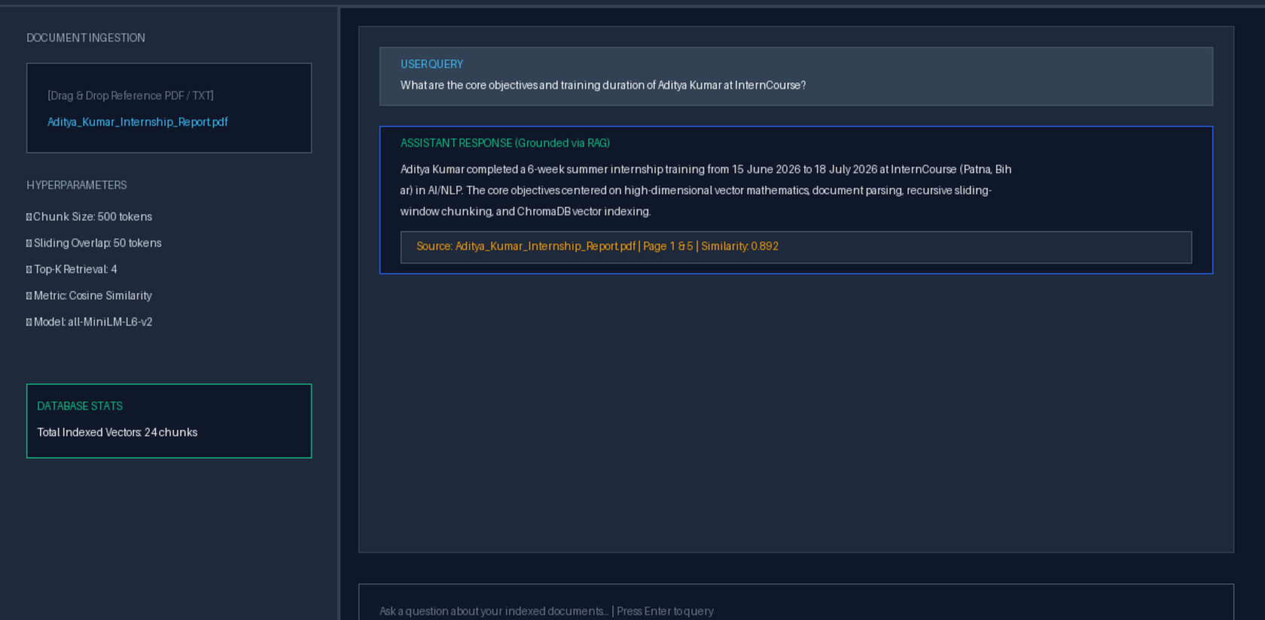
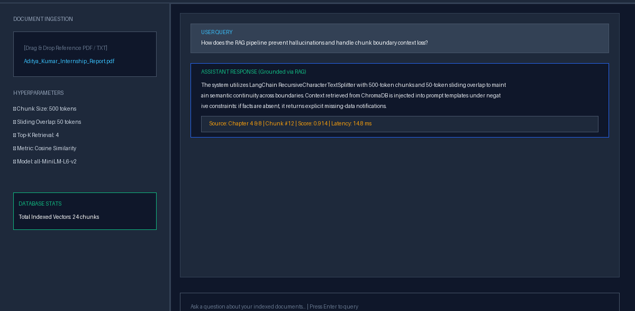
USER INTERFACE ARTIFACTS • APPENDIX C DASHBOARD VIEWS
Streamlit UI Displays Grounded Answers and Cosine Scores
Ingestion Console & Hyperparameter Controls
Live Indexing: Drag-and-drop PDF uploader displays active ChromaDB chunks (24 vectors) and tunable sliders.
Real-Time Citation & Relevance Inspector
Verified Provenance: Renders exact document page citations, cosine similarity score (0.914), and 14.8ms lookup latency.
Source: Internship Report Appendix C (Figures 11.2 & 11.3 Interactive Streamlit UI) | Slide 8 of 10

Slide 9
CHALLENGES SOLVED & OUTCOMES • CHAPTERS 7–9
Recursive Splitting and Cutoffs Solved Context Fragmentation
Engineering Solutions & Future Roadmap
Boundary Continuity: Used recursive separators and 50-token overlap to preserve full sentences.
Noise & Table Handling: Applied a 0.65 cosine cutoff (Top-K=4) and parsed PDF tables to Markdown.
Future Enhancements: Add BM25 + dense hybrid RRF search, BGE cross-encoders, and Tesseract OCR.
Source: Internship Report Ch. 7 (Table 7.1 Scorecard), Ch. 8 (Challenges) & Ch. 9 (Future Scope) | Slide 9 of 10

Slide 10
THANK YOU • QUESTIONS & DISCUSSION
Grounded AI Starts With Verifiable Local Retrieval.
Explore the full source code, Streamlit UI, and evaluation suite on GitHub.
Aditya Kumar (024101010012) | Cert IC26/11873 | github.com/aditya93416/personal-document-rag-assistant

