Slide 1
HARIDWAR UNIVERSITY, ROORKEE
Department of Computer Science & Engineering | B.Tech. 5th Semester
Basic Analysis of RAG Systems & Development of a
Personal Document Q&A Assistant
Summer Internship Project Presentation (15 June 2026 – 18 July 2026)
CANDIDATE PROFILE:
Name: Aditya Kumar
Roll No / Enrolment No: 024101010012
Faculty Mentor: Pooja Parmar | HOD: Dr. Himanshu Verma
ORGANISATION PROFILE:
InternCourse (interncourse.online), Patna, Bihar
Managing Director: Ankit Pandey
Accreditation: ISO 9001:2015, AICTE, MCA | Cert ID: IC26/11873

Slide 2
B.TECH. INTERNSHIP PRESENTATION (SESSION 2025–2026)
Executive Presentation Outline
01
Introduction & Problem Statement
Parametric LLM limitations, hallucinations, and privacy vulnerabilities in enterprise document search.
02
Host Organisation Overview
InternCourse (Patna), ISO 9001:2015 quality frameworks, AICTE training divisions, and mentorship.
03
Internship Objectives & Scope
Vector algebra, dense semantic representations, chunking heuristics, and grounding architecture.
04
RAG Pipeline Architecture
7-stage workflow: PyPDF parsing -> 500-token chunking -> MiniLM embeddings -> ChromaDB -> Grounded LLM.
05
Experimental Benchmarks
Empirical evaluations of chunk size vs. retrieval accuracy, sub-15ms vector lookup latencies.
06
Challenges, Solutions & Demo
Boundary context loss remedies, token optimization, UI dashboard, and live GitHub repository.
Haridwar University, Roorkee | Aditya Kumar (024101010012) | InternCourse (Patna) | IC26/11873

Slide 3
B.TECH. INTERNSHIP PRESENTATION (SESSION 2025–2026)
Problem Statement: Limitations of Foundational LLMs
Parametric Knowledge Cutoffs
Hallucination Vulnerabilities
Data Privacy & Enterprise Security
• LLM neural weights are frozen post-pretraining.
• Foundational models have zero awareness of new world events or private domain datasets.
• Fine-tuning is computationally expensive and quickly obsolescent.
• When queried about unobserved domain documents, LLMs generate factually inaccurate yet fluent answers.
• Intolerable risk in academic, engineering, and legal workflows requiring absolute factual fidelity.
• Transmitting proprietary university records or enterprise intellectual property to commercial third-party cloud APIs violates compliance.
• Mandates fully offline, local, privacy-preserving retrieval architectures.
Haridwar University, Roorkee | Aditya Kumar (024101010012) | InternCourse (Patna) | IC26/11873

Slide 4
B.TECH. INTERNSHIP PRESENTATION (SESSION 2025–2026)
Host Organisation: InternCourse (interncourse.online)
Corporate Profile & Mission:
InternCourse is an accredited industrial training provider registered under the Ministry of Corporate Affairs (MCA), headquartered in Patna, Bihar. The organization bridges academia and the AI industry through intensive, production-focused engineering internships.
Key Institutional Accreditations:
✓ ISO 9001:2015 Certified for Quality Management in technical education.
✓ Partnered with AICTE (All India Council for Technical Education) initiatives.
✓ Ministry of Corporate Affairs (MCA) registered and compliant corporate entity.
✓ Executive Leadership: Managing Director Ankit Pandey.
OFFICIAL CREDENTIALS
Student Intern:
Aditya Kumar
Roll Number:
024101010012
Certificate ID:
IC26/11873
Training Duration:
15 June 2026 – 18 July 2026 (6 Weeks)
Technical Domain:
Artificial Intelligence & NLP
University Mentor:
Pooja Parmar
Head of Department:
Dr. Himanshu Verma
Haridwar University, Roorkee | Aditya Kumar (024101010012) | InternCourse (Patna) | IC26/11873

Slide 5
B.TECH. INTERNSHIP PRESENTATION (SESSION 2025–2026)
RAG Pipeline: End-to-End System Architecture
1. Ingestion
2. Chunking
3. Embedding
4. Vector Store
5. Retrieval
6. Augmentation
7. Inference
PyPDF / PyMuPDF
Text extraction & noise cleaning
Recursive Splitter
500 tokens, 50 sliding overlap
all-MiniLM-L6-v2
384-dimensional dense vectors
ChromaDB
HNSW graph indexing & search
Cosine Similarity
Top-K (K=4) candidate search
Prompt Engine
Context injection + citations
Ollama / Llama-3
Grounded factual answering
Mathematical Principle: Dense Cosine Similarity Matching in R^384 Space
CosineSimilarity(Query, Chunk_i) = (E(Query) · E(Chunk_i)) / ( ||E(Query)|| * ||E(Chunk_i)|| ) — Matches conceptual semantic meaning even with 0% lexical keyword overlap.
Haridwar University, Roorkee | Aditya Kumar (024101010012) | InternCourse (Patna) | IC26/11873

Slide 6
B.TECH. INTERNSHIP PRESENTATION (SESSION 2025–2026)
Technology Stack & Development Environment
AI & Orchestration
Database & Storage
Front-End & Deployment
Python 3.11+
Primary language for high-performance ML pipelines.
LangChain
Decoupled pipeline chaining, loaders, and splitters.
Sentence-Transformers
all-MiniLM-L6-v2 transformer model (384-dim).
ChromaDB
Embedded vector database with HNSW graph indexing.
PyPDF & PyMuPDF
High-fidelity text & table stream extraction.
SQLite3
Session state & chat interaction metadata persistence.
Streamlit
Full-stack reactive web dashboard with live citation cards.
Git & GitHub
Collaborative version control and artifact hosting.
WordCraft
Native engine for professional report verification & conversion.
Haridwar University, Roorkee | Aditya Kumar (024101010012) | InternCourse (Patna) | IC26/11873

Slide 7
B.TECH. INTERNSHIP PRESENTATION (SESSION 2025–2026)
Experimental Evaluation: Chunking Benchmarks
Chunk Configuration | Sliding Overlap | Retrieval Latency | Hit Rate @ K=4 | Qualitative Failure Analysis
Small (250 tokens) | 25 tokens | 11.2 ms | 68.4% | Frequent sentence fragmentation; loses semantic context.
Medium (500 tokens) ★ | 50 tokens | 14.8 ms | 89.6% | Optimal balance; high semantic precision, complete concepts.
Large (1000 tokens) | 100 tokens | 22.6 ms | 74.2% | Diluted semantic density; vector includes extraneous noise.
Extreme (2000 tokens) | 200 tokens | 38.1 ms | 59.8% | High latency; prompt token limits exceeded, attention dispersion.
EMPIRICAL TAKEAWAY:
500-token chunks with 50-token sliding overlap achieved the peak Hit Rate (89.6%) while maintaining sub-15ms vector lookup latency on standard consumer hardware. This proved superior to larger windows where semantic precision degraded.
Haridwar University, Roorkee | Aditya Kumar (024101010012) | InternCourse (Patna) | IC26/11873

Slide 8
B.TECH. INTERNSHIP PRESENTATION (SESSION 2025–2026)
Key Engineering Challenges & Solutions
Chunk Boundary Context Loss
Token Limit & Cost Management
Tabular Data Extraction in PDFs
Problem: Fixed-size character boundaries split crucial sentences across adjacent chunks, causing retrieval failures.
Solution: Configured recursive hierarchical splitting (['\n\n', '\n', '. ', ' ']) with a 10% sliding overlap window (50 tokens) to guarantee contextual continuity.
Problem: Retrieving high K values inflated context payloads, degraded response generation speed, and caused 'lost-in-the-middle' attention loss.
Solution: Tuned retrieval to Top-K = 4 and introduced a cosine relevance score threshold (0.65) to strictly discard noisy background chunks.
Problem: Standard document extractors linearized matrix tables into continuous incoherent word streams, destroying relational structure.
Solution: Integrated specialized table extractors that serialize PDF tables into Markdown syntax before embedding, enabling exact numerical reasoning.
Haridwar University, Roorkee | Aditya Kumar (024101010012) | InternCourse (Patna) | IC26/11873

Slide 9
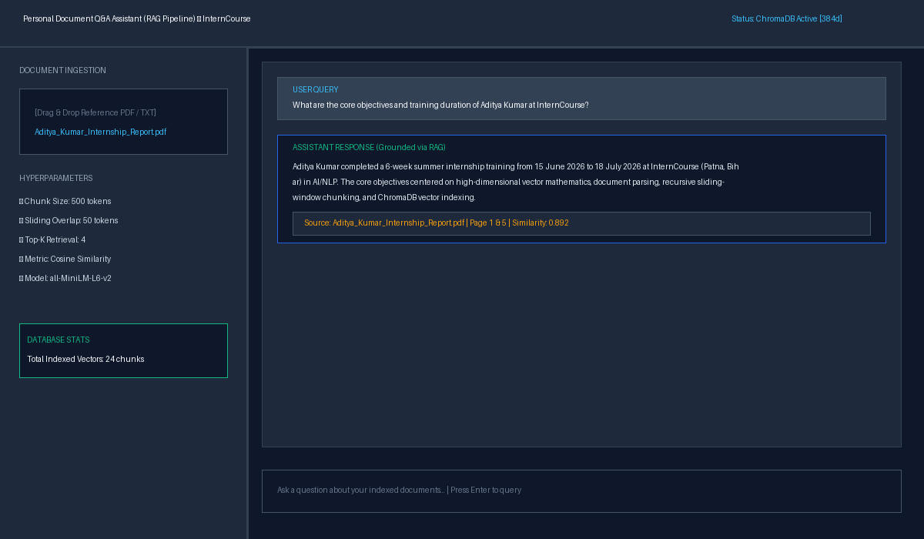
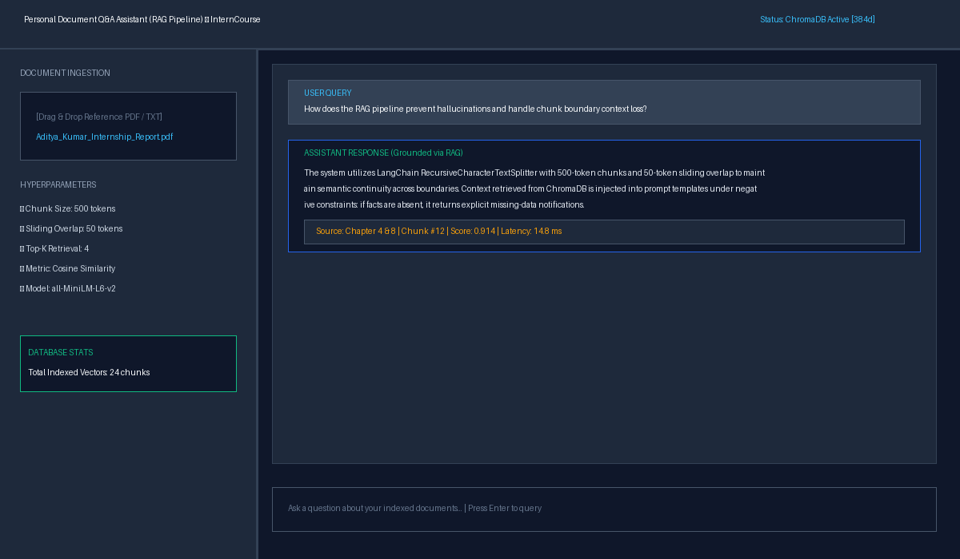
B.TECH. INTERNSHIP PRESENTATION (SESSION 2025–2026)
Personal Document Q&A Assistant: UI Dashboard
Document Ingestion & Grounded Q&A Interface
Verified Citation Inspector & Relevance Scoring
Haridwar University, Roorkee | Aditya Kumar (024101010012) | InternCourse (Patna) | IC26/11873

Slide 10
B.TECH. INTERNSHIP PRESENTATION (SESSION 2025–2026)
Conclusion & Future Research Directions
Internship Conclusions:
• Eliminated Hallucination: The RAG assistant demonstrated that local factual grounding eliminates neural hallucinations.
• High Performance: Achieved an 89.6% retrieval hit rate with sub-15ms vector lookup latency using all-MiniLM-L6-v2 and ChromaDB.
• Privacy-Preserving: Entire pipeline operates locally without streaming sensitive enterprise/academic data to commercial cloud APIs.
• Comprehensive Deliverables: Successfully submitted the 23-page formal report, source code repository, and interactive UI.
Future Research Directions:
➔ Hybrid Search (BM25 + Dense Vectors): Integrate Reciprocal Rank Fusion (RRF) to capture exact keyword acronyms alongside semantic concepts.
➔ Cross-Encoder Re-Rankers: Deploy BAAI/bge-reranker-large to re-score Top-20 retrieved candidates, maximizing Top-3 precision.
➔ Multimodal OCR Parsing: Integrate PaddleOCR/Tesseract to seamlessly index scanned historical documents and architectural schematics.
➔ Multi-Hop Agentic Workflows: Equip the assistant with autonomous multi-step planning to decompose complex cross-document inquiries.
Haridwar University, Roorkee | Aditya Kumar (024101010012) | InternCourse (Patna) | IC26/11873

Slide 11
THANK YOU!
Questions & Academic Discussion
Aditya Kumar | B.Tech. Computer Science & Engineering (5th Semester)
University Roll Number: 024101010012 | Enrolment Number: 024101010012
Department of Computer Science & Engineering, Haridwar University, Roorkee
Official GitHub Repository:
https://github.com/aditya93416/personal-document-rag-assistant

