Slide 1
ZBD
Focusing on attribution modeling, performance analysis, and strategic recommendations for a mobile app

Slide 2
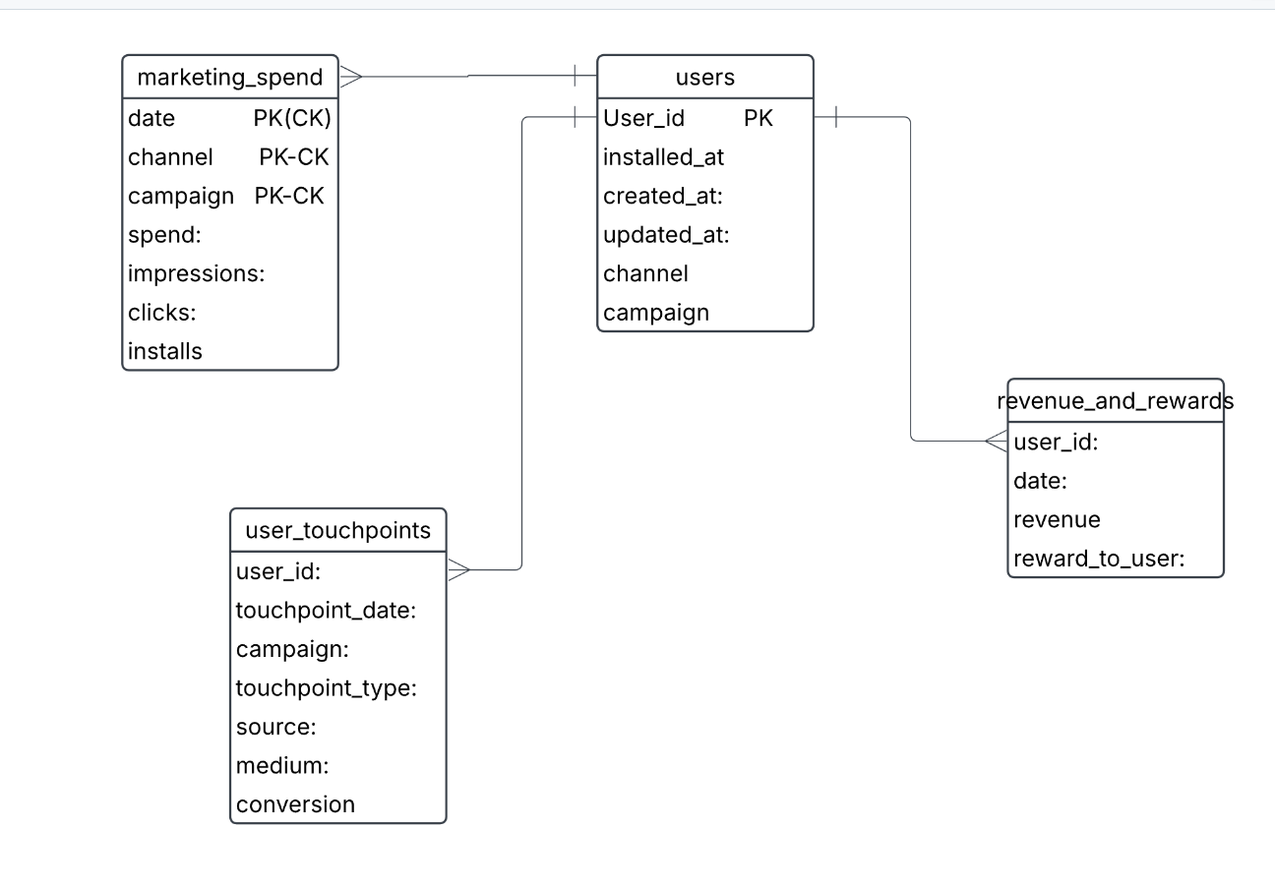
Modeling

Slide 3
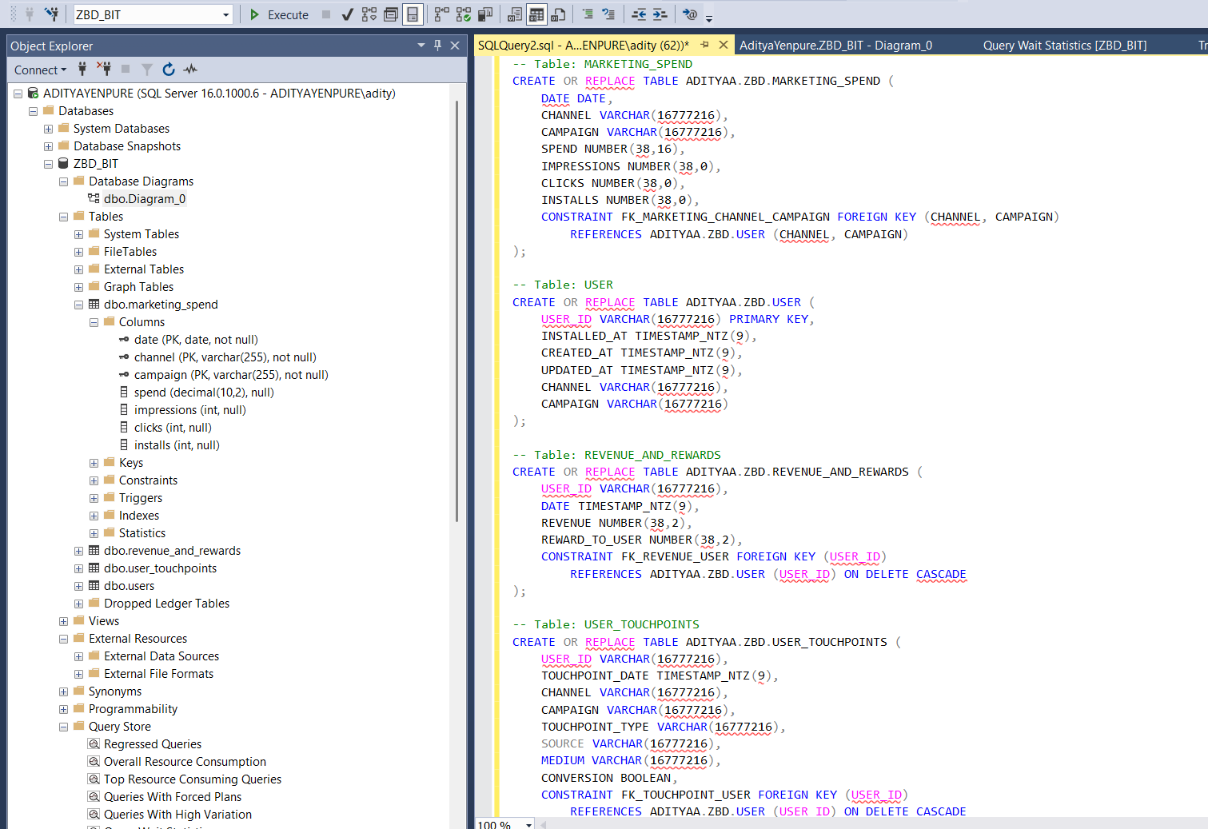
Mysql-micosoft

Slide 4
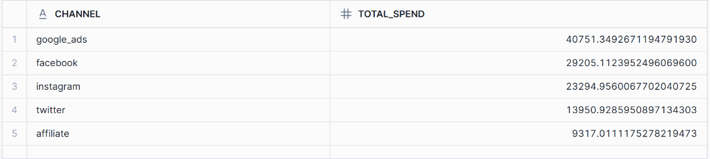
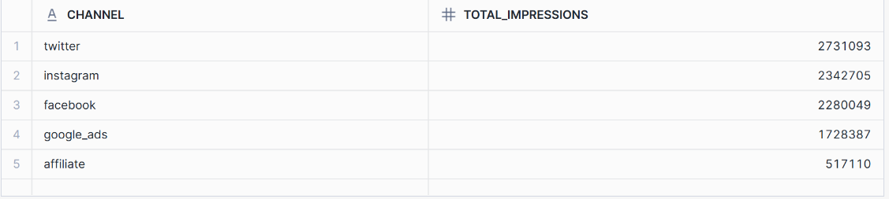
Total spend and total impression

Slide 5
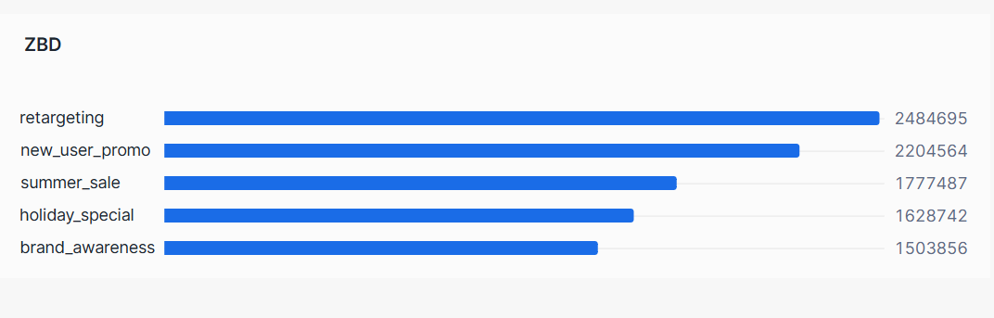
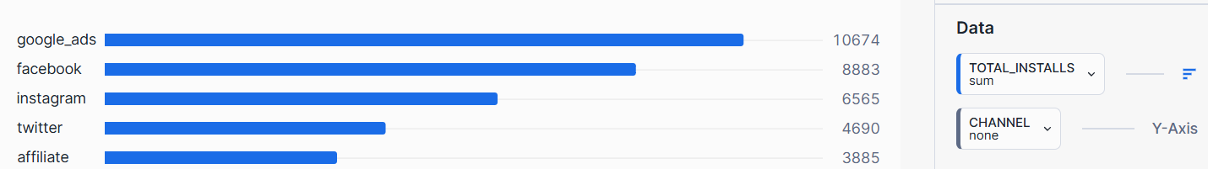
Impression generate /install by channel

Slide 6
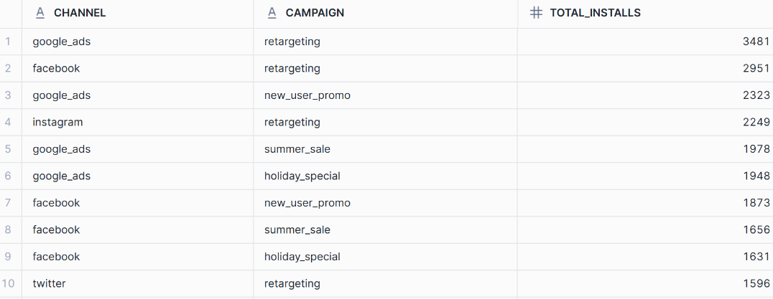
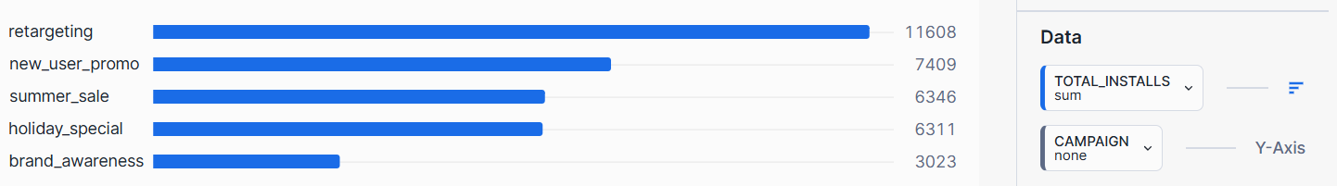
Top performing channel and campaign

Slide 7
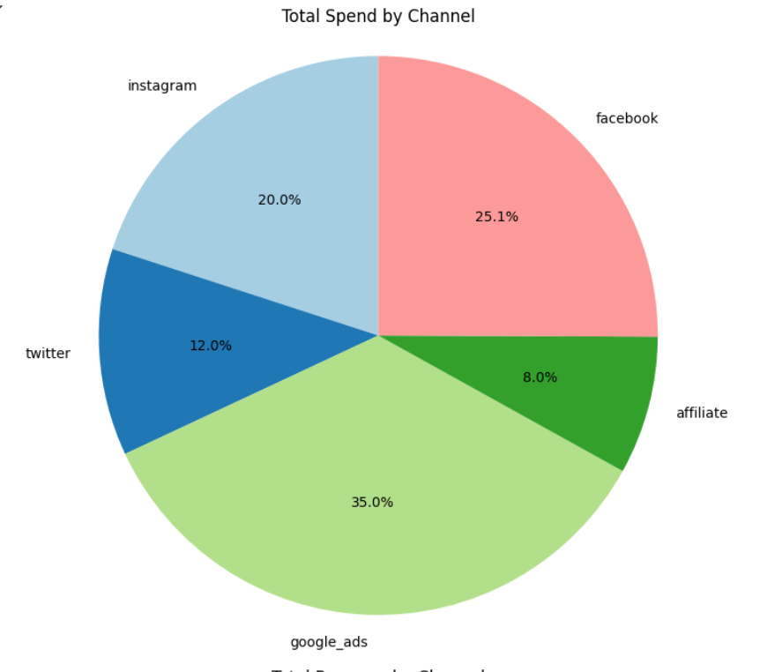
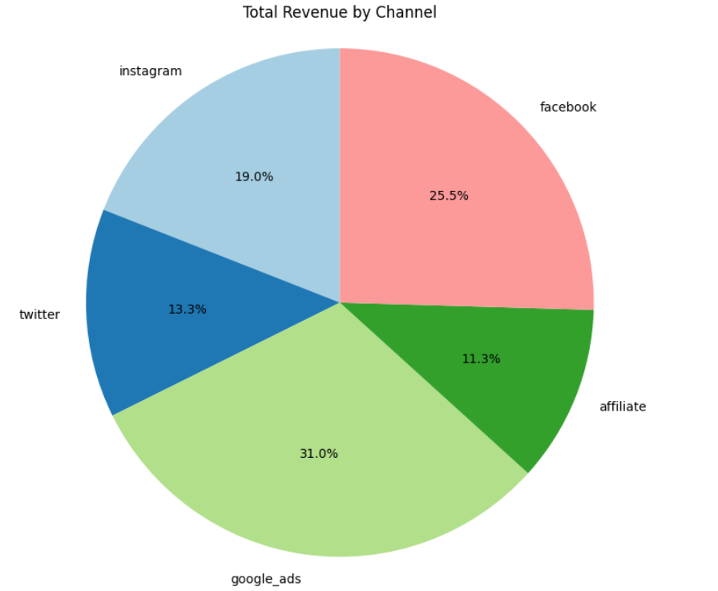
Percentage share Total spend

Slide 8
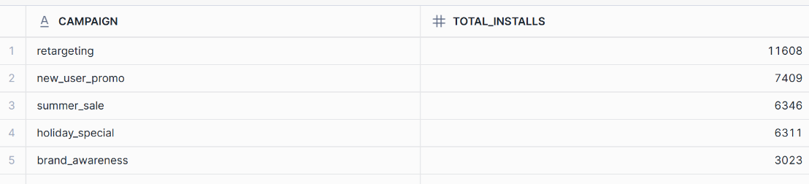
Channel and campaign Focus

Slide 9
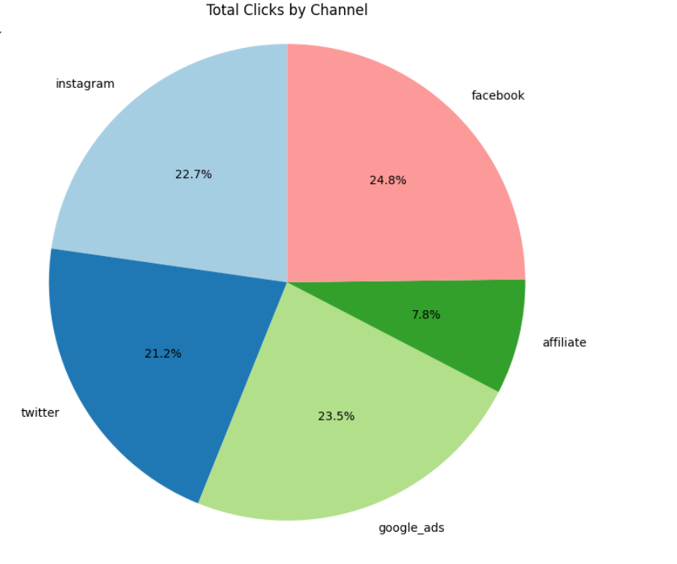
Total clicks
Focus more on google ads as conversion rate is effective
Less focusing on twitter
Static focus should me more on facebook ,insta, google ads

Slide 10
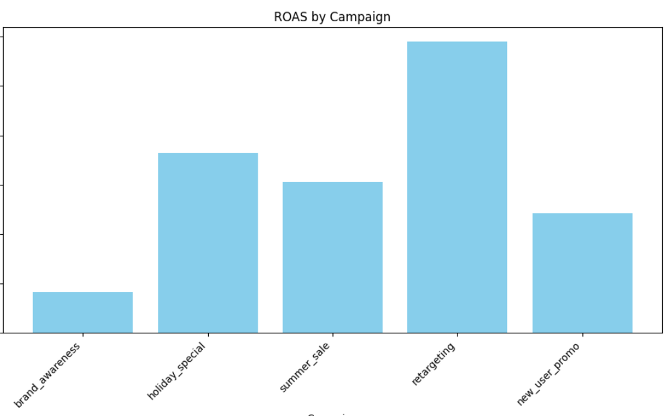
Return on spending across campaign

Slide 11
Insights
Increase Investment in High-Performing Channels
Google Ads has a strong conversion rate—allocate more budget to maximize ROI.
Focus on Facebook, Instagram, and Google Ads for static content as they show better engagement.
Reduce Spend on Low-Performing Channels
Minimize investment in Twitter since it’s not yielding significant results.
Reallocate funds from underperforming channels to those with higher conversion rates.

Slide 12
Strategy recommendation
Double Down on Retargeting: Given its high revenue and low touchpoint requirements, investing more in retargeting can maximize ROI.
Optimize Marketing Channel Spend: Focus more budget on high-performing channels like Google Ads and Instagram while reconsidering low-performing ones.
Improve Conversion for New Users: Since new user promotions require more touchpoints, optimizing onboarding, simplifying purchase flows, or offering better first-time discounts may help.
Target High-Value Users: Identify users contributing the most revenue and offer exclusive deals, loyalty programs, or personalized recommendations.
Refine Reward Strategy: Instead of increasing rewards broadly, use data to provide incentives where they have the most impact.

Slide 13
Summerizing
Revenue vs. Touchpoints Trends
Weak correlation between the number of touchpoints and revenue.
Some high-value users convert after just 1-2 interactions, while others require more touchpoints.
More interactions do not guarantee higher spending, emphasizing the importance of strategic retargeting.
Invest more in Retargeting & Holiday Special campaigns, as they generate the highest revenue per user.
Optimize Google Ads & Instagram strategies, as they yield the highest returns per user.
Improve efficiency in Brand Awareness campaigns, as they have the lowest revenue per user.
Refine multi-touchpoint marketing strategies, ensuring that higher touchpoints actually lead to higher conversions.

Slide 14
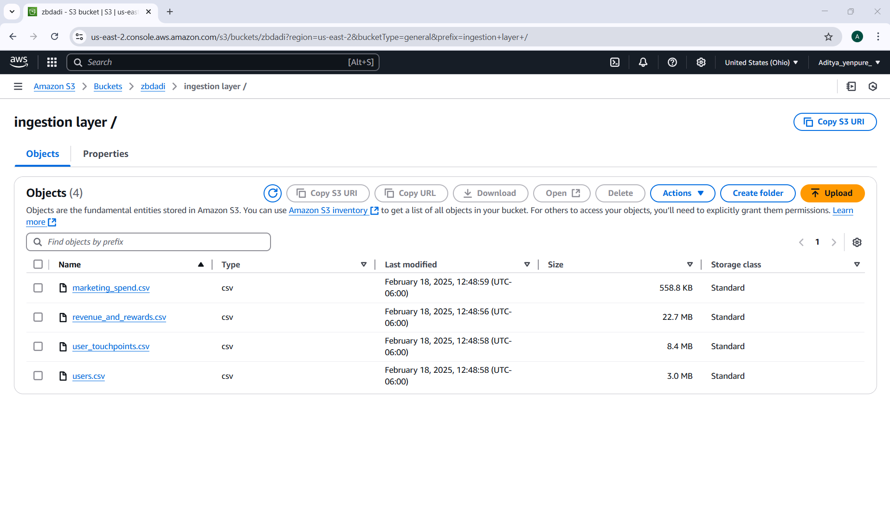
Data loaded in s3 /AWS WEB UI

Slide 15
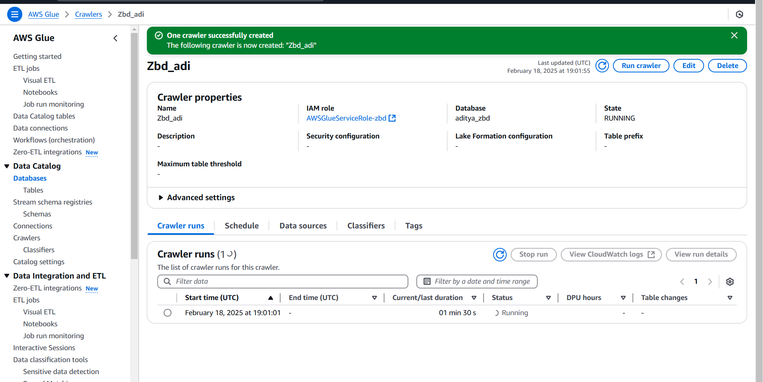
Create glue crawler

Slide 16
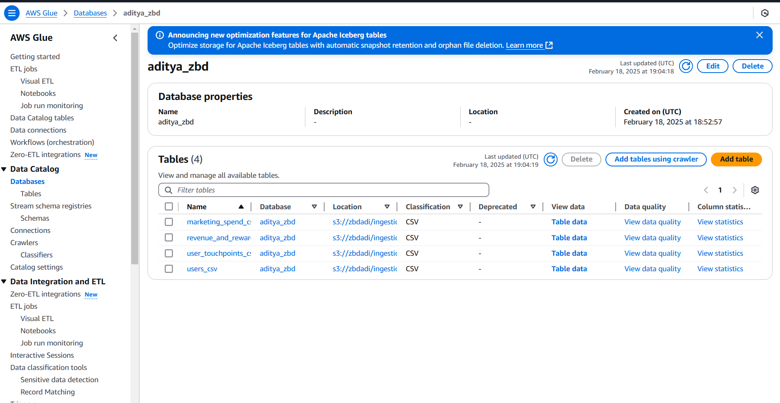
Used glue crawler ingested data from s3

Slide 17
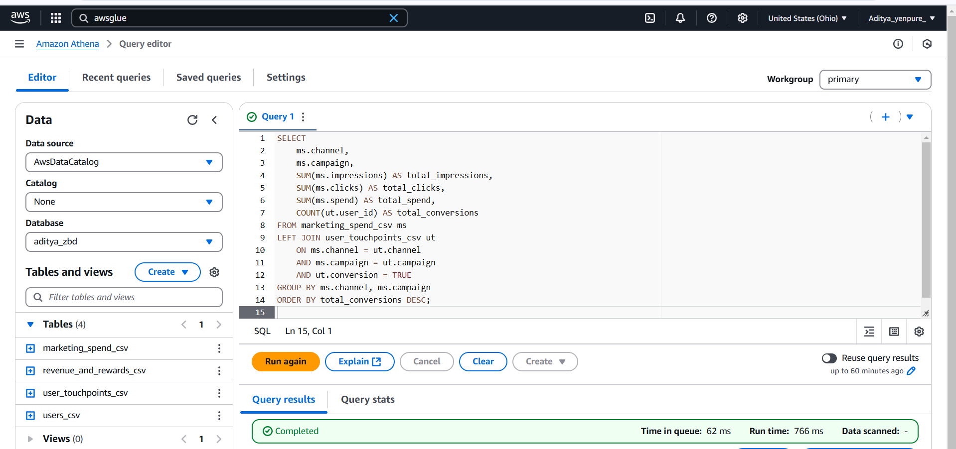
Used Athena to query s3

