Slide 1
Attendance Management System
Presented By:
Aditya Showrov (17042)
Tawfiq Hassan (17017)

Slide 2
Contents
Introduction
Objective of Project
Task of Project
Process of Project
Entity Relationship Diagram
Use Case Diagram
Activity Diagram
Data Flow Diagram
Screenshots
Conclusion

Slide 3
Introduction
Attendance Management System is a software which keeps record of students’ daily attendance.
It is a well-organized software solution for an institute.
It performs all task systematically.
It provides improved and optimized service.

Slide 4
Objective of Project
To provide a user friendly environment where user can be serviced better.
To make functioning of attendance faster.
To eliminate the paper work for attendance in institute.
To calculate accurate attendance status.
To avoid problem such as record file missing.

Slide 5
Task of Project
Admin’s Task
Add teachers’ and student’s information and provide ID to both.
View students’ and teachers’ information.
Update corresponding data.
View students’ attendance information.
Teachers’ Task
Take attendance of students.
View their attendance information.
Students’ Task
View their attendance information.

Slide 6
Process Model of Project
The Waterfall SDLC Model illustrates the software development process in a linear sequential flow & ensures success of the project.
Requirements Gathering & Analysis
System
Design
Implementation & Unit Testing
Integration & System Testing
Maintenance

Slide 7
Entity Relationship Diagram

Slide 8
Use Case Diagram
Register User
Login
Student
Take attendance
Edit own Info
Edit Attendance Info
View Attendance Info
Change own Password
Admin
Teacher
Logout

Slide 9
Activity Diagram
Admin activity diagram
Teachers’ activity diagram
Students’ activity diagram
Admin Login
Teacher Login
Student Login
Authen
tication
Invalid
Authentication
Login Invalid
Authentication
Login Invalid
valid
Login Valid
Login Valid
Register users
Add course Info
Change Password
View Information
View/take/ edit Attendance Information
Change own Password
View Attendance Information
Change own Password
Authen
tication
Register
Invalid
valid
Logout
Logout
Logout

Slide 10
Context Level DFD
request to login, logout
Change password
STUDENT
request to login, logout
Take attendance
Register users
request to login, logout
add users info. update course info, change own password
Attendance
System
Change own password
TEACHER
ADMIN
login, logout confirmation
view teachers, students, admins info, view attendance
login, logout confirmation
view teachers, students, admins info, view attendance
DATABASE
login, logout confirmation
view teachers, students, admins info, view attendance

Slide 11
0 Level DFD
user info
1.0
receive info & register user
confirmation
user info
User DB
2.0
process login request
login req.
user info
confirmation
login req.
confirmation
User
user info
3.0
modify user info, password
Attendance DB
ADMIN
Users’ info, password
password info
4.0
generate atten-dance report
attendance info
ask for attendance report
ask for attendance report
attendance report
attendance report
5.0
process
logout
request
logout req.
confirmation
logout req.
confirmation

Slide 12
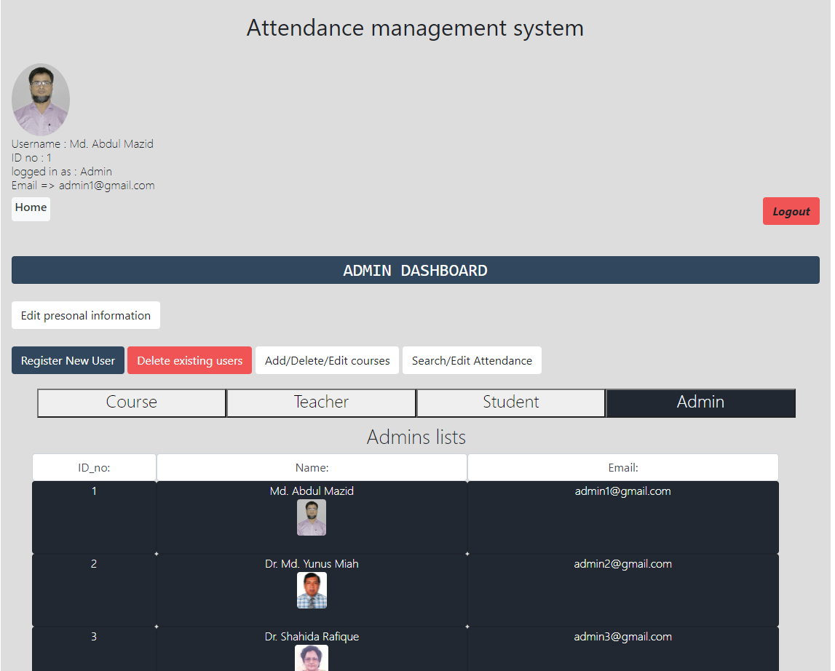
Screenshots
Home Page (Admin)

Slide 13
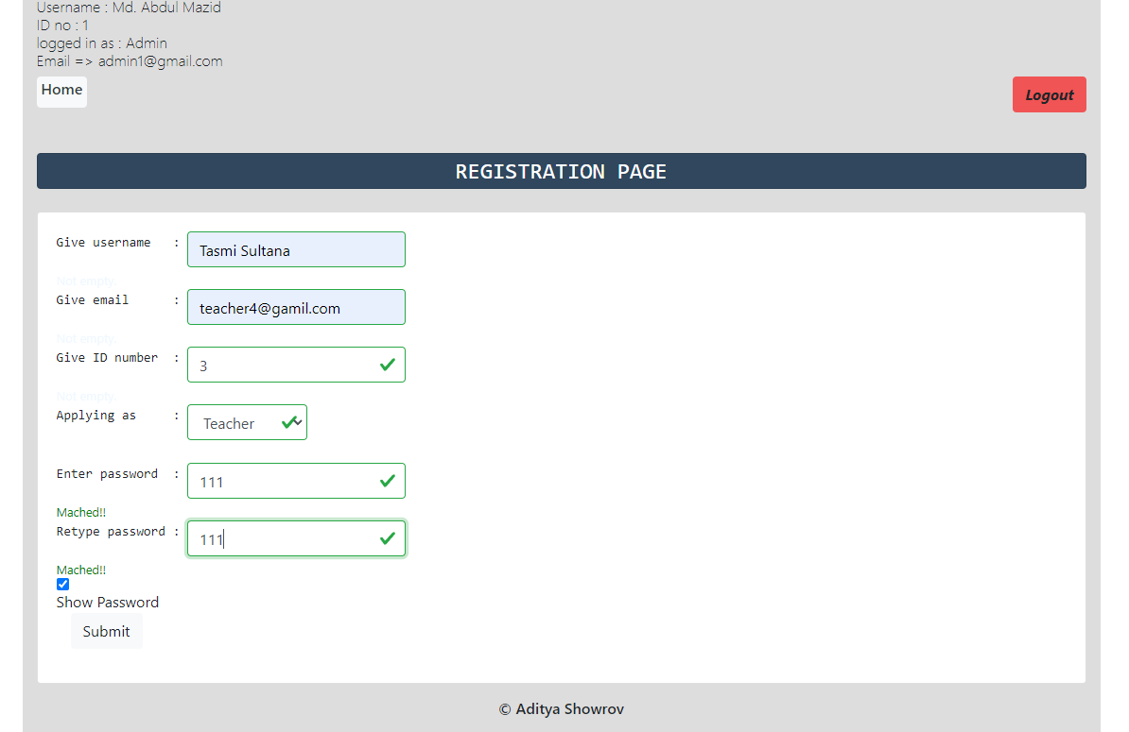
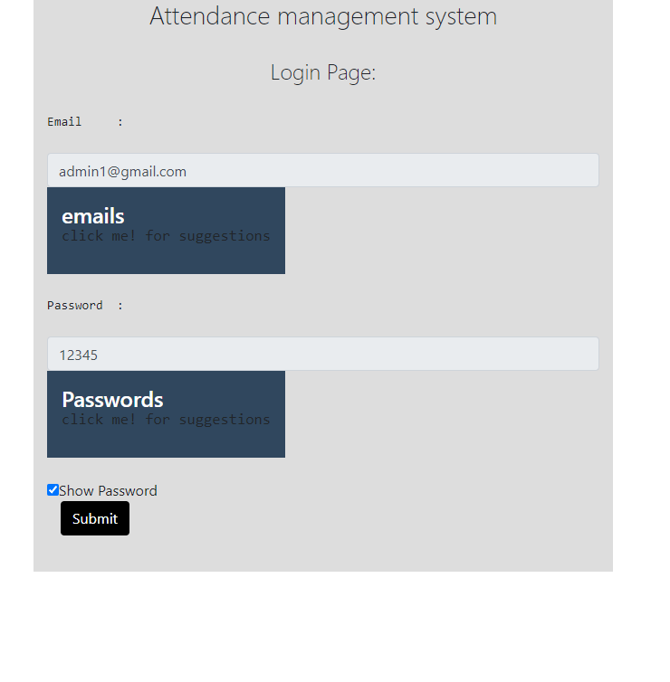
Screenshots
Register Form
Login Form (all users)

Slide 14
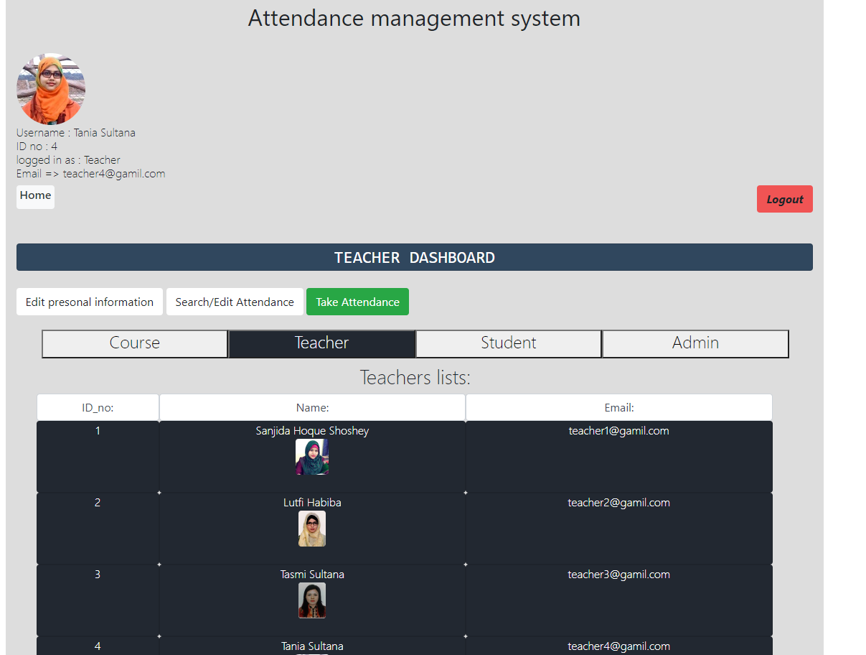
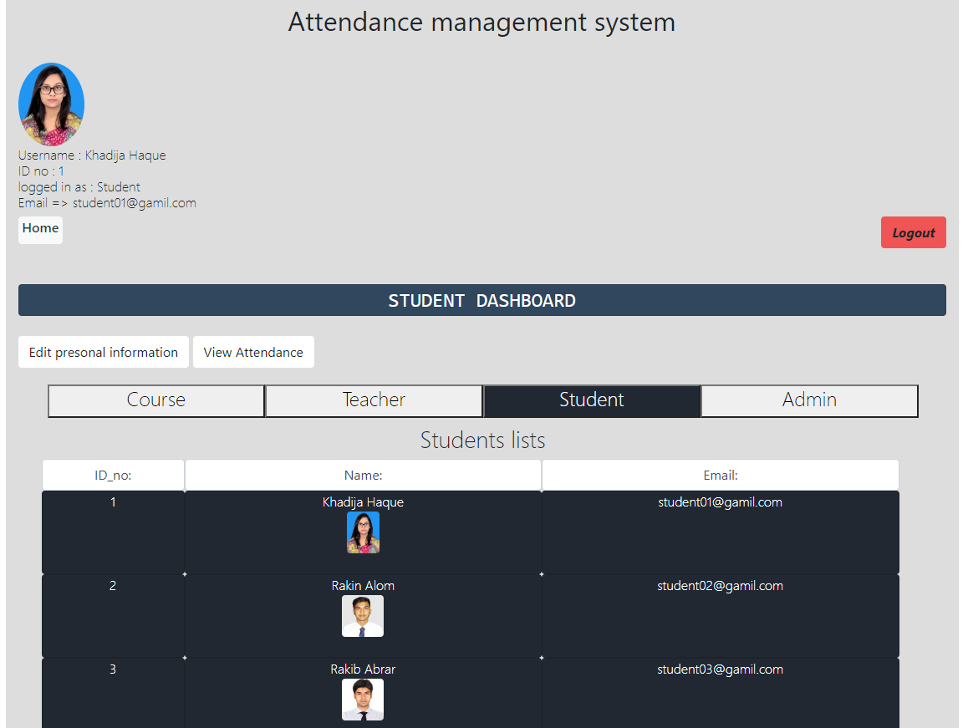
Screenshots
Index Page of Admin , Teacher, student

Slide 15
Screenshots
User’s Information

Slide 16
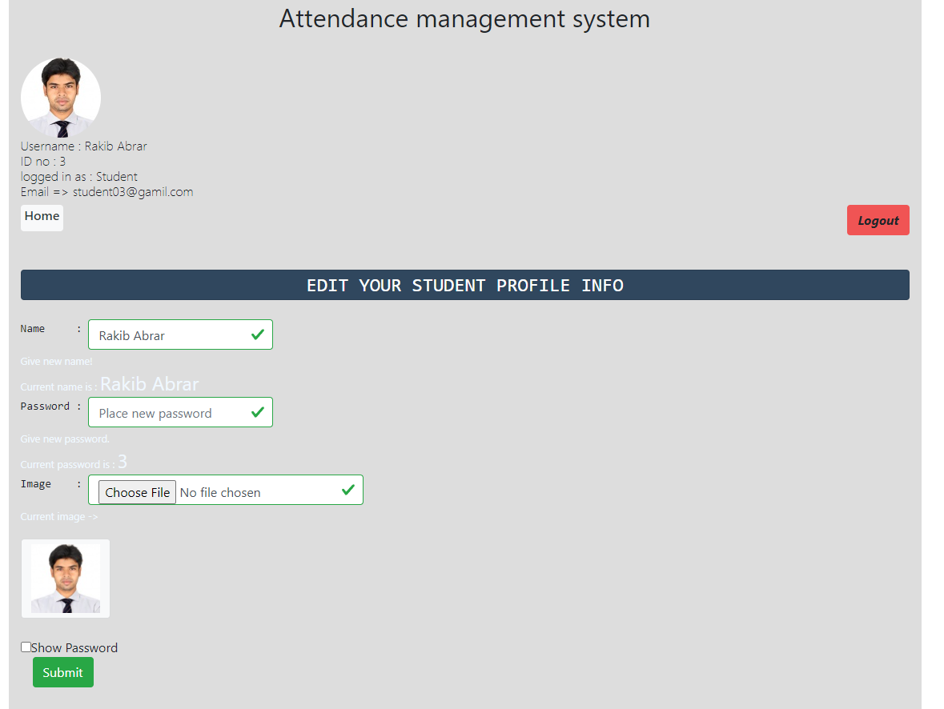
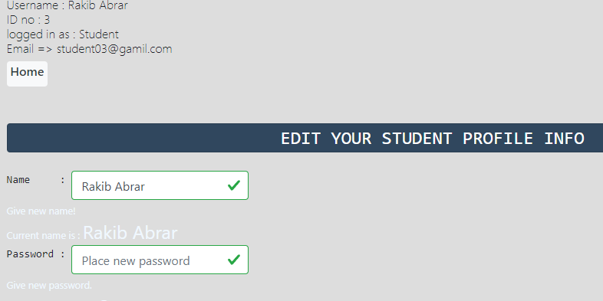
Screenshots
Edit personal information
Change own Password

Slide 17
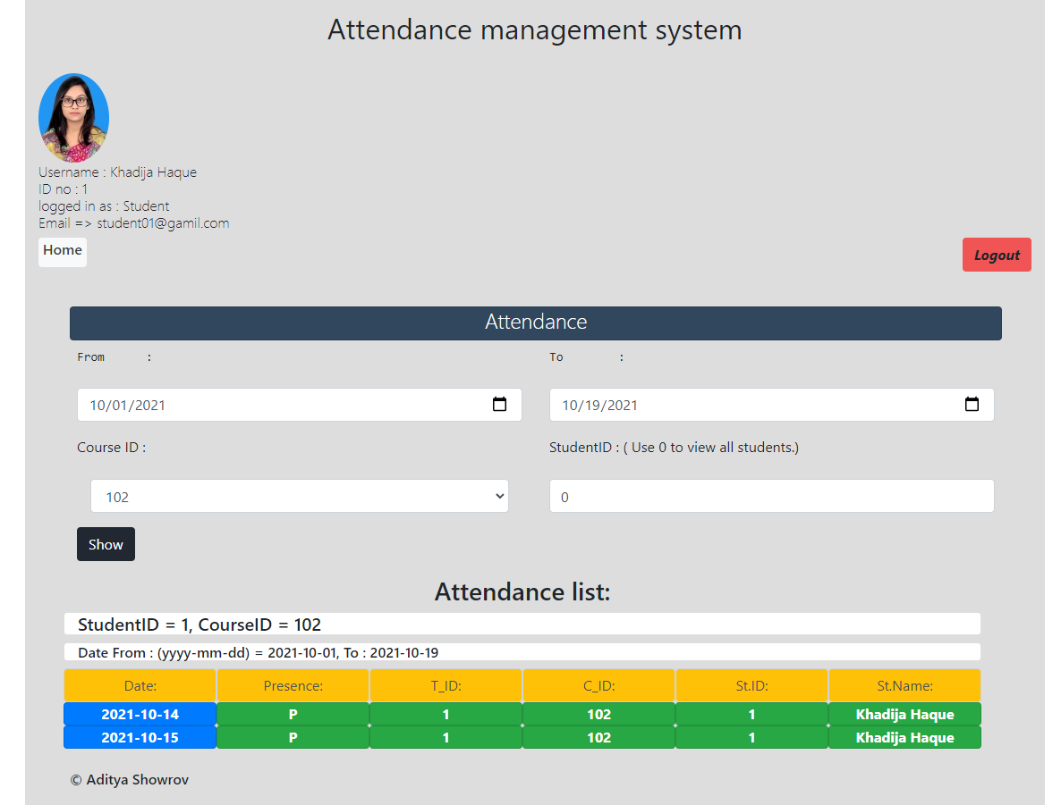
Screenshots
Attendance Record Viewed by All

Slide 18
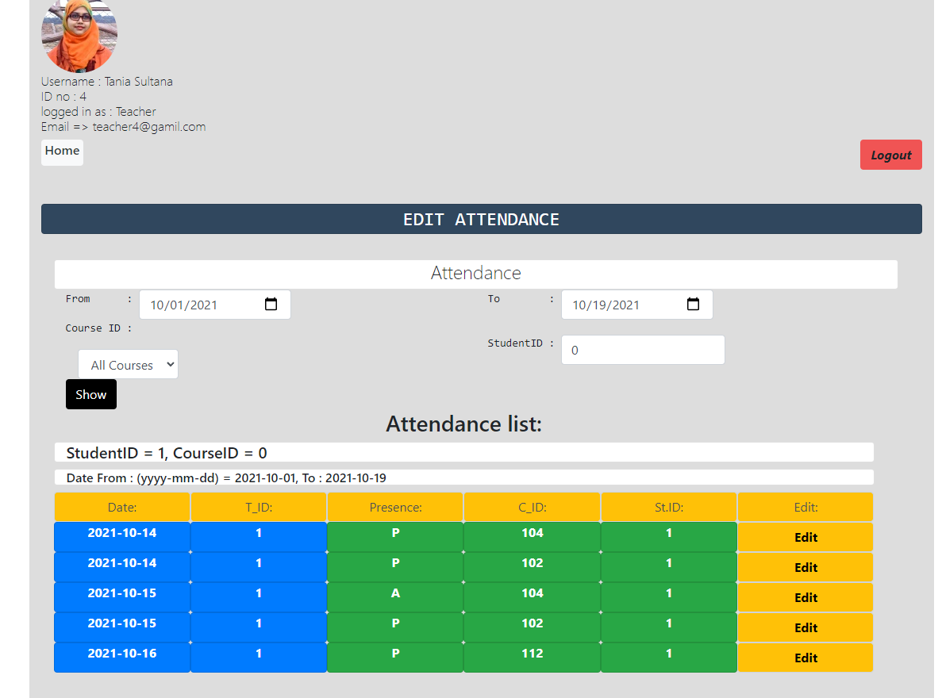
Screenshots
Attendance Record Viewed by Teacher or Admin

Slide 19
Conclusion
The Attendance Management System has been developed as it was intended to solve as requirement specification.
It is able to record attendance and update database with more ease.
It has reached at a steady state by operating at a high level of efficiency.
It can be altered in accordance with the future requirements of the organization.

Slide 20
Thank You

