Slide 1
CAR ACCIDENT SEVERITY PREDICTOR
ADITYA PRAKASH SINGH

Slide 2
INTRODUCTION
As a significant cause of deaths, injuries, and property loss, traffic accident is a major concern for public health and traffic safety. According to statistics from the Ministry of Public Security of China between 2009 and 2011, traffic crashes resulted in an average of 65 123 people dead and 255 540 cases injured annually in China (China Statistical Yearbook of Road Traffic Accidents, 2009–2011). It was reported that the cost of medical care and productivity losses associated with motor vehicle crash injuries was over $99 billion, or nearly $500, for each licensed driver in the United States (Centers for Disease Control and Prevention, 2010). Being one of the major steps of accident management, accident severity prediction can provide crucial information for emergency responders to evaluate the severity level of accidents, estimate the potential impacts, and implement efficient accident management procedures.

Slide 3
DATA ACQUISITION AND CLEANING
The data set for this work contains police-reported traffic accident records for San jose, California
Cleaned data contains approx. 35,000 cases and 8 features.
Duplicate, highly similar or highly correlated features were dropped.

Slide 4
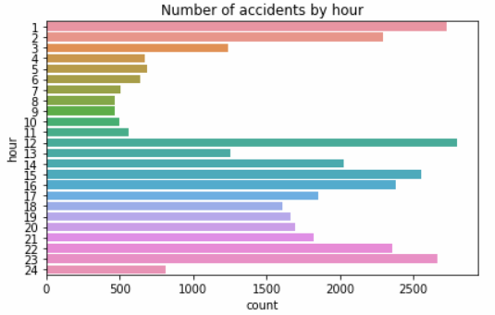
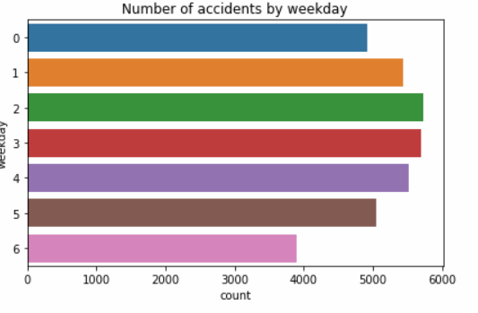
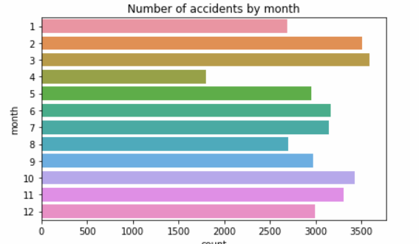
EXPLORATORY DATA ANALYSIS:

Slide 5
CONCLUSION AND FUTURE DIRECTIONS
Built useful models to predict whether and how much a accidents will happen.
Accuracy of the models has room for improvement.
More features will be helpful like-
Car speed
Passenger numbers

